Slide 1
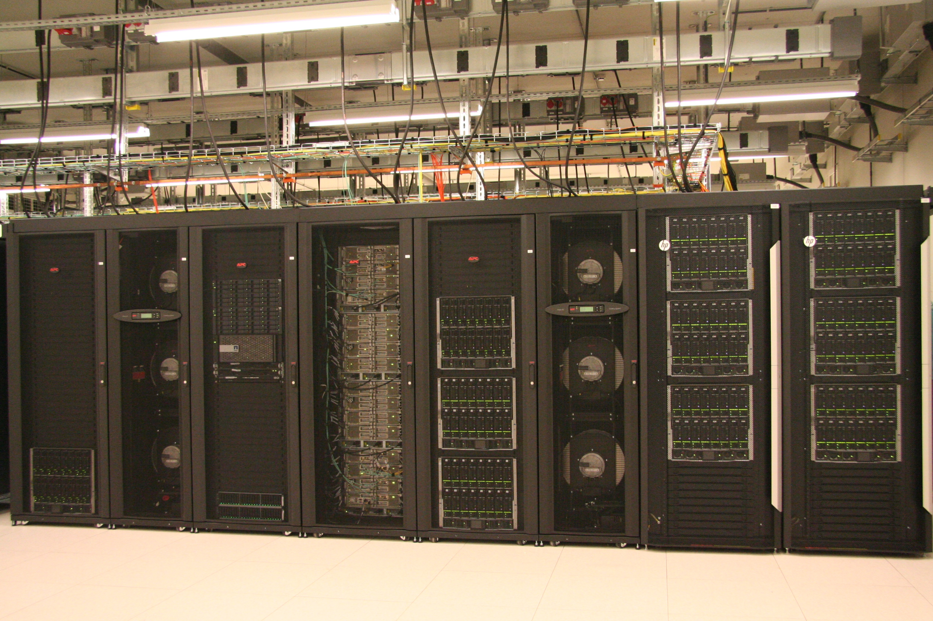
HPC Cluster intro

Slide 2
Today plan
The presentation is based on the officials HPC-Ghent tutorials
http://users.ugent.be/~kehoste/hpcugent-intro-20171110.pdf
and general manual is under following link (subtitute „linux” with „windows” or „mac” to get tutorial fo your OS)
http://hpcugent.github.io/vsc_user_docs/pdf/intro-HPC-linux-gent.pdf
I will specifically use the information from these chapters from the manual manual:
1/ Introduction to HPC
3/ Connecting to the HPC
4/ Running batch jobs
6/ Running jobs with input/output data

Slide 3
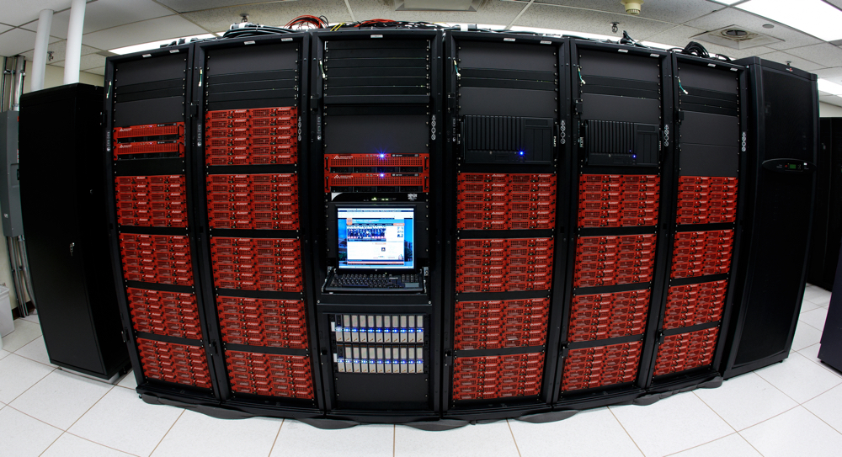
What is High Performance Computing?
A computer cluster consists of a set of loosely or tightly connected computers that work together so that in many respects they can be viewed as a single system.
harness power of multiple interconnected cores/nodes/processing units

Slide 4
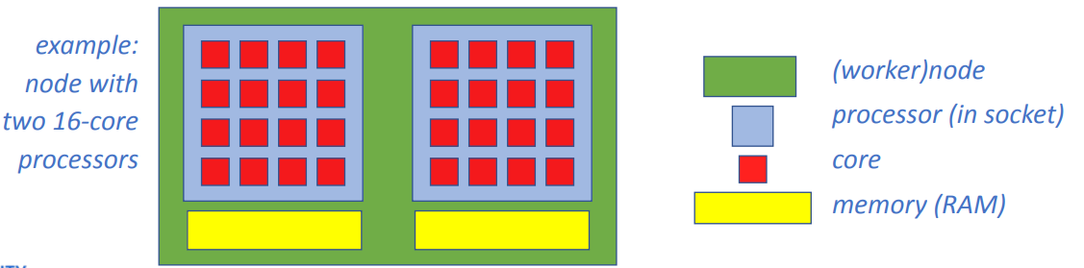
Cores vs processors vs sockets vs nodes
Modern servers, also referred to as (worker) nodes in the context of hpc,
include one or more sockets, each housing a multi-core processor (next to memory, disk(s), network cards, …).
A modern (micro)processor consists of multiple cpus or cores that are u sed to execute computations.

Slide 5
Parallel vs sequential programs
In parallel software, many calculations are carried out simultaneously.They are based on the principle that large problems can often be divided into smaller ones, which are then solved concurrently (“in parallel”).
Sequential (a.k.a. serial) software does not do calculations in parallel, i.e. it only uses one single core of a single worker node. (Sequential) software does not become faster by just throwing cores at it…
You can run multiple instances at the same time on a cluster. e.g., you can easily run a Python script 20 times at once to quickly analyse 20 datasets

Slide 6
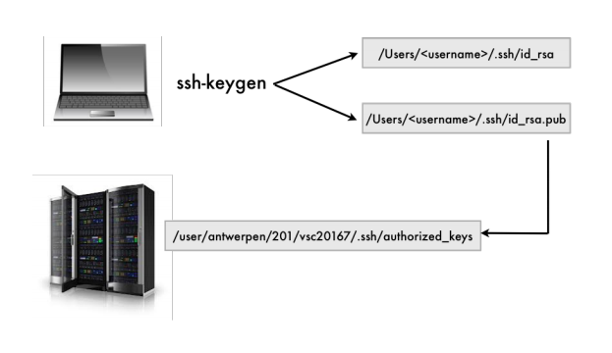
How to login
Use public/private ssh key pairs for user authentication

Slide 7
How to login
But before login you need to create an account!
Follow chapter 2 from the manual to create pair of the public/private keys (http://hpcugent.github.io/vsc_user_docs/pdf/intro-HPC-linux-gent.pdf)
Visit https://account.vscentrum.be/ to register your account
After filling short form you will be asked to upload you public key through the browser
Within one day, you should receive a welcome e-mail with your VSC account details.

Slide 8
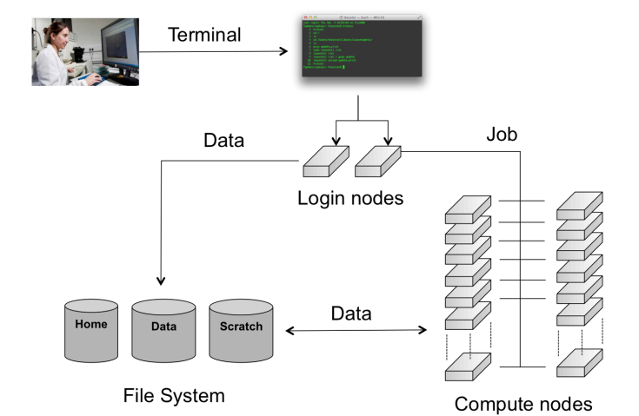
Running batch jobs

Slide 9
Workflow on HPC infrastructure
1. Connect to login nodes
2. Transfer your files
3. (Compile your code and test it)
4. Create a job script
5. Submit your job
6. Be patient
  • Your job gets into the queue
  • Your job gets executed
  • Your job finishes
7. Move your results

Slide 10
HPC worklfow
Users interact with the infrastructure via the login nodes
No direct access to the worker nodes
Except when a job is running on it!
Default time (short job) is 1 hour, it cannot be more than 72hours!

Slide 11
Linux intro
„ls” list the files
„Pwd” show your current directory
cd ‘path’ change directory to ‘path’
cd without parameters move you to your home folder
use cp to copy files
use mv to change name or move files

Slide 12
Basic commands
to login: ssh vsc40000@login.hpc.ugent.be (where vsc40000 have to be your login)
To list specific module(in example matlab): module av 2>&1 | grep -i -e "matlab"
module load MATLAB
module unload MATLAB
to list all active modules: module list

Slide 13
Running batch jobs
In order to have access to the compute nodes of a cluster, you have to use the job system.
The system software that handles your batch jobs consists of two pieces: the queue- and resource manager TORQUE and the scheduler Moab.
Together, TORQUE and Moab provide a suite of commands for submitting jobs, altering some of the properties of waiting jobs (such as reorderingor deleting them), monitoring their progress and killing ones that are having problems or are no longer needed.

Slide 14
Running batch jobs
cp -r /apps/gent/tutorials/Intro-HPC/examples ∼/examples
cd ∼/examples/Running-batch-jobs
./fibo.pl (running program as a script on a login node)
qsub fibo.pbs (running as a job on a computing node)
more fibo.pbs.o123456 (look into printed output of a script)
more fibo.pbs.e123456 (look into errors during execution)

Slide 15
Monitoring and managing your job
Get status: qstat <jobid> or simply qstat
qdel <jobid>
The state S can be any of the following:
Q The job is queued and is waiting to start.
R The job is currently running.
E The job is currently exiting after having run.
C The job is completed after having run.
H The job has a user or system hold on
How long is the queque?
qstat -q
Generate your own e-mail notifications (add the following to your script)
#PBS -m abe
#PBS -M <your e-mail address>

Slide 16
Example of parameters (resources)
  qsub -l some parameters (walltime=2:30:00)
  nodes=1:ppn=1,mem=2gb)
  it could also specified as #PBS-directive
  #!/bin/bash -l
  #PBS -l nodes=1:ppn=1
  #PBS -l mem=2gb
  cd $PBS_O_WORKDIR
  ./fibo.pl

Slide 17
Interactive sessions
Working interactively
hostname -f
qsub -I (will wait for assigment of the node)
hostname -f
exit

Slide 18
Job scheduling
• No guarantees on when job will start, so plan ahead!
Job priority is determined by:
• historical usage
  • aim is to balance usage over users
  • infrequent/frequent users => higher/lower priority
• requested resources (# nodes/cores, walltime, memory, …)
  • large resource request => lower priority
• time waiting in queue
  • queued jobs get higher priority over time
• user limits
• avoid that a single user fills up an entire cluster

Slide 19
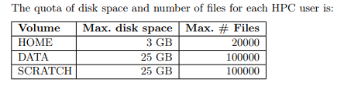
Running jobs with input/output data
cd ∼/examples/Running-jobs-with-input-output-data
qsub file1a.pbs
Pre-defined user directories (substitute to echo $VAR to print your location)
$VSC_HOME /user/gent/xxx/<vsc-account> (Your home directory )
$VSC_DATA /data/gent/xxx/<vsc-account>
$VSC_SCRATCH_NODE
$VSC_SCRATCH

Slide 20
Miscellaneous
Request software installations via hpc@ugent.be
Installing itself software is also possible
Use filezilla (https://filezilla-project.org/) to copy files
Matlab toolboxes → copy them!
We could set up a virtual organisation so w can share data with others in our group, and get more storage quota, http://hpc.ugent.be/userwiki/index.php/User:VSCVos
We could get around the 72h walltime limit for jobs http://hpc.ugent.be/userwiki/index.php/User:Checkpointing
submitting chains of jobs is also possible

Slide 21
Documentation & training
Documentation is available at:
  • https://www.vscentrum.be/en/user-portal
  • (http://hpc.ugent.be/userwiki, being phased out)
  • HPC tutorial: http://hpcugent.github.io/vsc_user_docs/pdf/intro-HPC-linux-gent.pdf
  • Basic Linux: http://hpc.ugent.be/userwiki/index.php/Tips:Introduction_to_Linux

