Slide 1
Work Done
Data Collection
tensorflow and pytorch documentation data
Prototyping
API representation -> Find similar APIs across libraries
Autotesting -> Automatically generate test cases to measure correctness of the generated code
Program Synthesizer -> Enumerate through all combinations of the arguments with the correct type

Slide 2
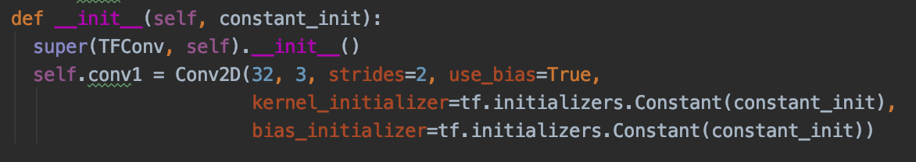
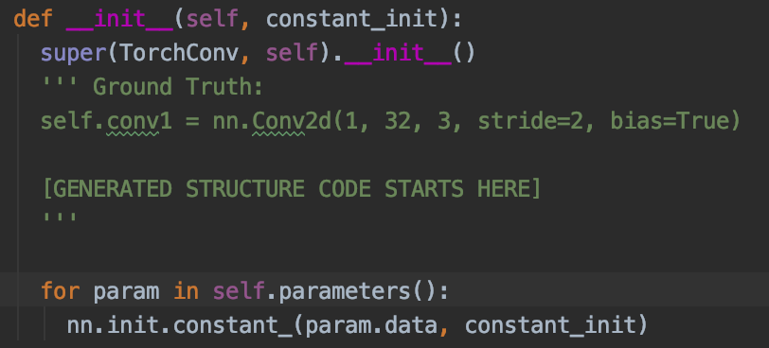
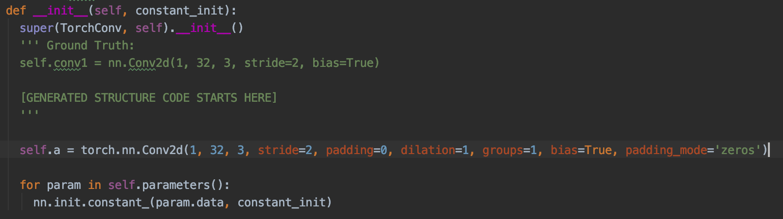
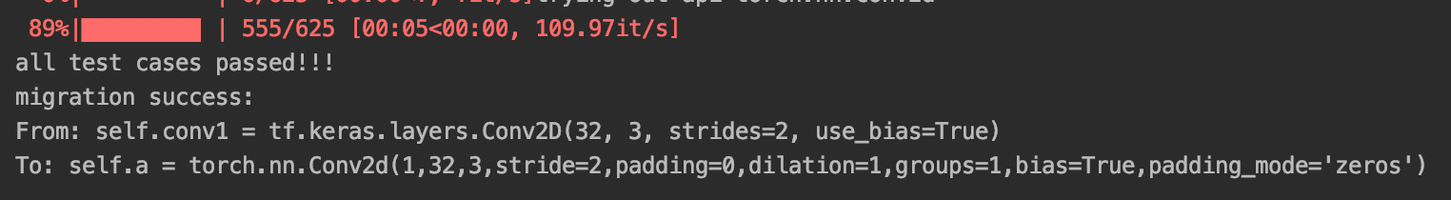
Prototype Result
API call from source library
Sketch of the target
Execution

Slide 3
Prototype Method – API Representation
Two representation method
Count based method – count occurrences and normalize by total number
Embedding based method – weighted averaged on the pretrained embedding of words
Based on two sources
API signature
The natural language description of the API functionality
The method I am using in the prototype:
-Count-based method on API signature

Slide 4
Prototype Method - Autotesting
For each of the migration pair:
Automatically, and randomly generate test cases (I/O) with the API call from the source lib
Automatically test the generated code to measure its correctness

Slide 5
Prototype Method - Synthesis
A enumeration-based synthesizer
With no constraints and heuristics (yet)
Typed.
Takes a pool of variables
e.g. pool = {int: [a, 1, 2, 3], float: [0.1], str: [], others: []}
The pool = vars mentioned in the source API call (e.g. Conv2d(32, 3, strides=2))
+ default value (e.g. stride=2)
+ some ad-hoc values (e.g. 0, 1, 2)
Shallow. Only variables/constants allowed in the argument field, no expression allowed (yet)
Simple. No objects allowed (yet), unless is default or mentioned in the source

Slide 6
The Key Challenges
How to guide the search for the synthesizer
A way to know what to try first (ask Claire and Ruben)
Suppose we have a probability distribution over the candidate argument values for all arguments, is there an algorithm to find the best and next best thing to try?
(note that they may not be all independent, the child node depends on the parent node)
We will skip all other tests when we found a match that passes all tests
Match up the arguments in the source
e.g. source: f(in_c=2, out_c=32), target(input_channel=?, output_channel=?)
Take advantage of the error information
e.g. error information is quite useful, it gives information about which argument you should change (if mis-typed or of wrong shape)

Slide 7
Next Steps
Smaller steps
Add more one-to-one migration test cases
Try to match up the arguments
Find out ways to better organize the search space
See if the error message can be useful
Larger steps
Going from Python to Java
From one-to-one to one-to-many
Even to many-to-many?

