Slide 1
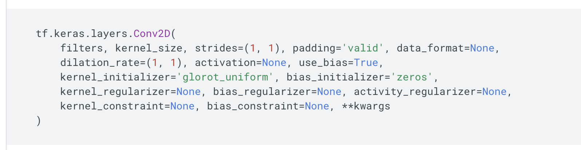
Automatic Test Generation for One-to-One API Migration
For each of the API: Try to fill in the arguments with some preset values (sometimes able to be random) of the specific type
Default values are not changed
Type aliases are not handled (unless it is a tensor)
Then collect the return type and value

Slide 2
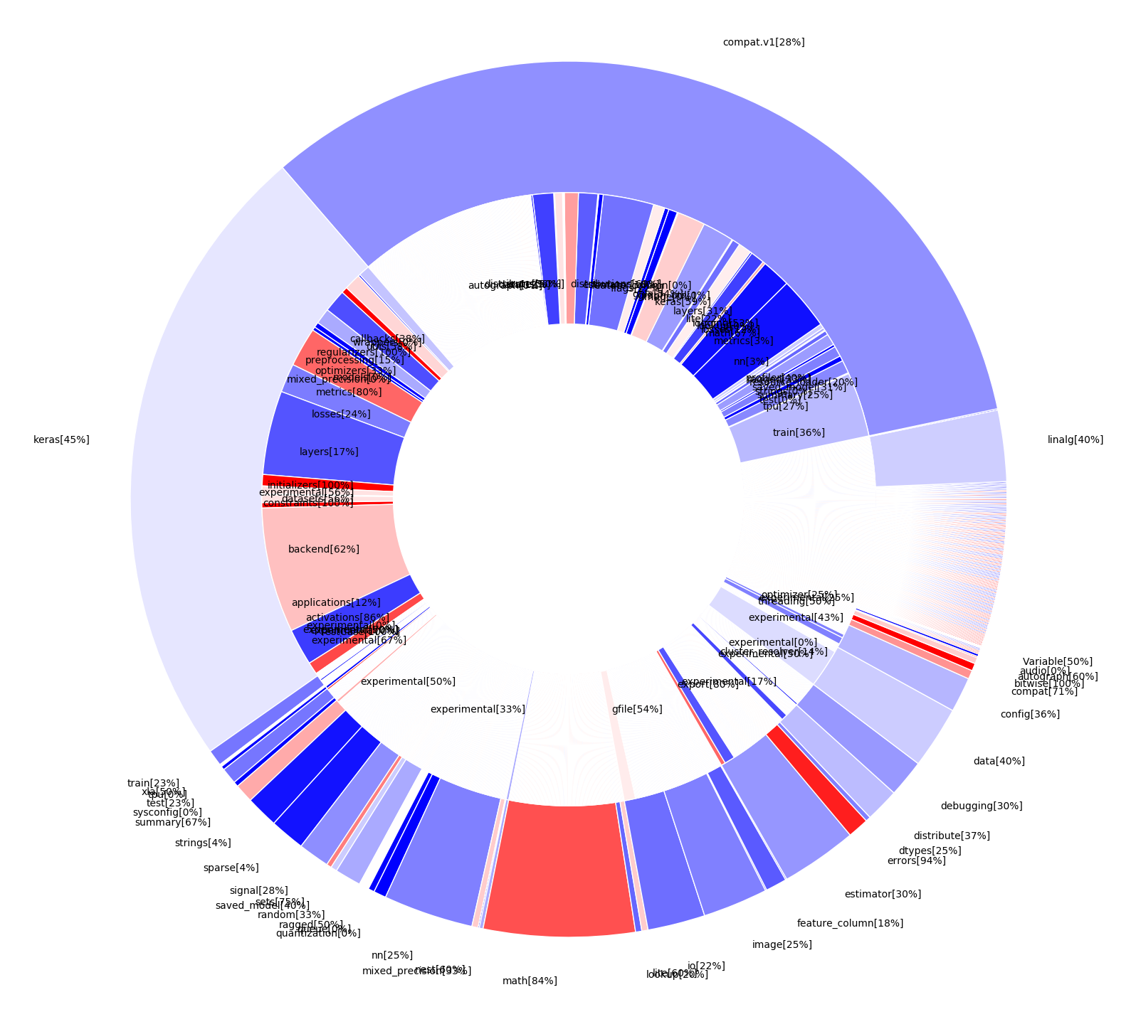
Result on Tensorflow(1)
Overall: 38%
Area denotes # APIs in that package/subpackage
Color denotes success rate: the warmer the better
A few things to notice:
Math/bitwise package is doing good
Class initializer APIs are doing good (default values)
keras.layers is doing bad
compat.v1.nn is doing bad

Slide 3
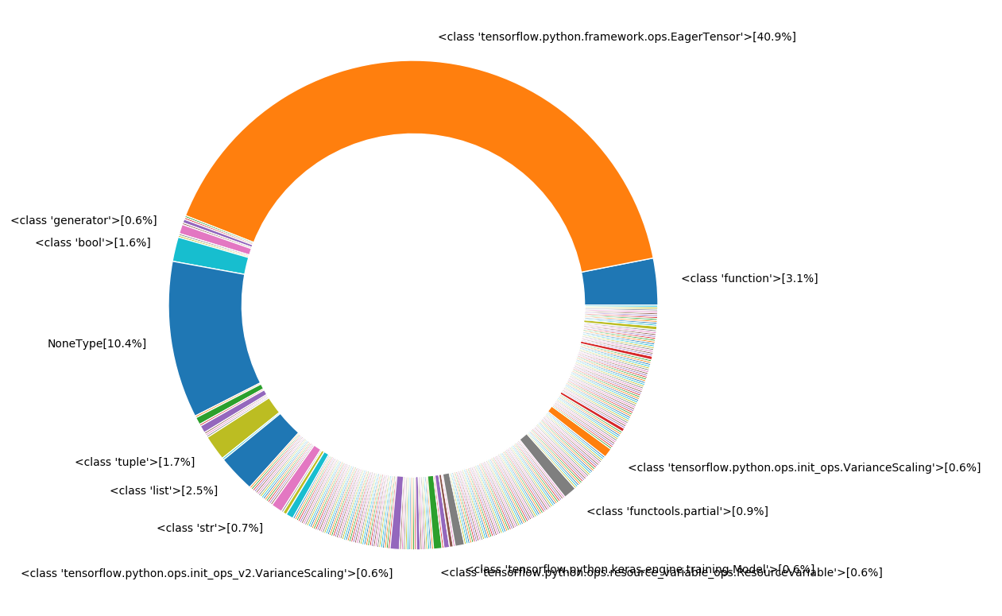
Result on Tensorflow(2)
Area denotes percentage of different types of the return values for the APIs that have successful generated tests
A few things to notice:
Only 10.4% are none types (means a change of state)
40.9% return tensors
about 55% of values we can’t compare because they are not basic types

Slide 4
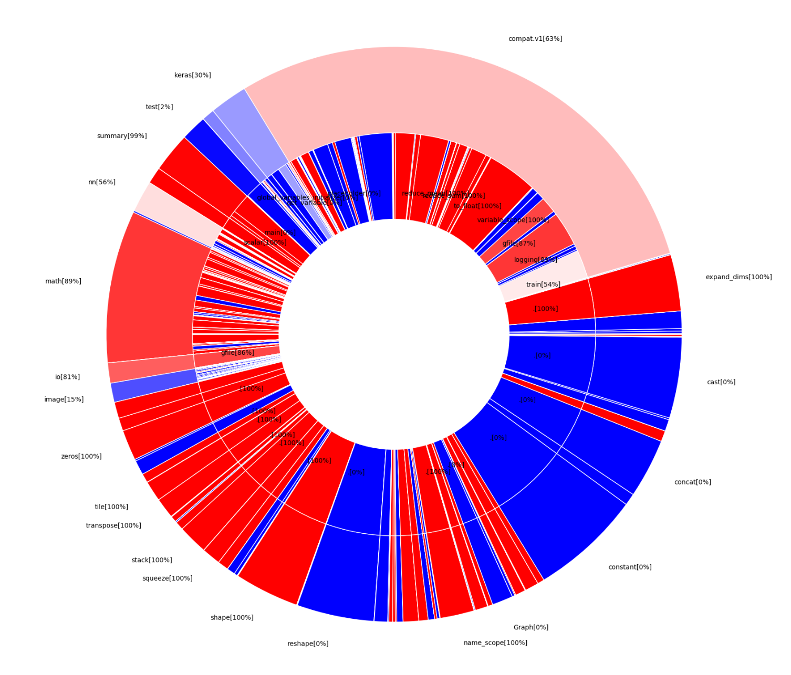
Result on Tensorflow(3)
Overall: 56%
Area denotes # APIs in that package/subpackage
Color denotes success rate: the warmer the better
Frequently Used APIs that can’t cover:
tf.cast(x, dtype) – dtype[tf class]
tf.concat(values, axis) – values[list of tensors]
tf.constant(value) – value[python/numpy list]
tf.reshape(tensor, shape) – shape[must match tensor]
This also gives some idea of one-to-many mapping

