Slide 1
Random numbers

Slide 2
Deterministic, non-deterministic and stochastic
what’s the difference between deterministic, non-deterministic and stochastic?
deterministic processes
Classical (non-quantum) physics is deterministic:
rolling and colliding balls, planets and pendulums
cars, computers, AI driven robots
hard to predict (would be possible):
gravitational N-body problem (N>2)
double pendulum
pollen particles making random walks

Slide 3
Deterministic, non-deterministic and stochastic II
non-deterministic processes
In quantum physics, some behaviour is not deterministic:
measuring the position after measuring the speed, or vica versa
measuring the spin of an electron in the axis x after mesuring it in another axis
radioactive decay
Even knowing all the details of the system does not predict the behavior of the system completely.
Is finance truly non-deterministic?
Chlorophyll uses quantum effects to produce oxigen
maybe the human brain also has quantum effects, therefore it can be non-deterministic, and finance is influenced by human behavior

Slide 4
Deterministic, non-deterministic and stochastic III
Stochastic process

Slide 5
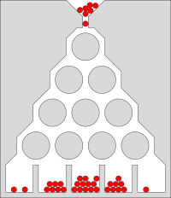
""

Slide 6
a process is stochastic, if one of the properties of the system, for an observer, cannot be determined by the system and its interaction with its environment, and therefore the property is considered as a random variable
deterministic but we don’t have precise enough info (Galton Board)
non-deterministic (electron scattering - model for electrical resistance)
only partially stochastic: we detach the part we can describe in a deterministic manner, and suppose that the leftover is purely stochastic (decoupling)

Slide 7
Applications
classical physical problems:
double pendulum: after long time, we cannot tell the position of the pendulums (chaos)
random walk of pollen particles
PhD topic: collective motion of crystalline defects
financial systems

Slide 8
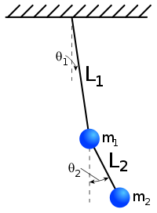
Double pendulum

Slide 9
Properties of the stochastic approach
Type of prediction
one cannot predict exactly what happens with 1 system, but
statistical statements can be still be made.
Type of calculation
analytical predictions are rare (Brownian motion)
discrete, case-base calculations: Monte Carlo simulations

Slide 10
Monte Carlo simulations
We would like to predict the outcome of a stochastic process. We can investigate the outcomes by starting the system
from identical initial settings and developing it in a non-deterministic way
from statistically identical settings and developing it in (a deterministic or) non-deterministic way
How can a computer, that is deterministic, make non-deterministic calculation?
include a non-deterministic hardware that generates true random numbers (digital amplifier, radioactive material)
use strange functions that generates numbers that look like random, pseudo random

Slide 11
pseudo random numbers - history
John von Neumann (computer science, chemistry, physics, mathematics) worked in the Manhattan project:
true random number generators are bad
too slow
cannot be reproduced for debugging
to store them and read back is still slow and consumes a lot of space
let’s invent pseudo random number generation!

Slide 12
middle-square method
(Excel)
very fast, can be easily implemented on binary numbers
some values are prohibited
loops ($a→b→a$) are frequent for smaller $n$
can be improved with Weyl-sequence:
$$a_{i}=s^{i}\%m$$
where $s$ and $m$ are relative-primes (for 32-bit int, $m=2^{32}$, and modulo is just cutting the surplus bits)
$a_{i}$ will be uniformly distributed on $\left[0,m\right)$
similar to the statement that 1, 2, $…$, $n$, $…$ are uniformly distributed on the unit circle
improve middle-square method (apply modulo everywhere):
$$r\left(i\right)=\text{middle bits}\left({\left(r_{i−1}\right)}^{2}+s^{i}\right)$$

Slide 13
LCG class
Linear congruential generator (Excel)
$$r_{i}=\left(a⋅r_{i−1}+b\right)\%m$$
Some set of values are exceptionally good. Periodic in $m=2^{32}$.
Generalizing prngs
The ith random number is generated as
$$r_{i}=f\left(r_{i−1},r_{i−2},…,r_{i−n}\right)$$
The first $n$ numbers are the seeds.
Maximum length of period: ${\left(\text{largest number}\right)}^{n}=2^{32n}$

Slide 14
LFSR, GFSR and TGFSR
Linear feedback shift registers (Excel): random sequence of 0 and 1
Generalised feedback shift registers, not only 0 and 1
group $w=32$ bits into a group of units (words), interpret them as numbers
$$r_{i}=r_{i−n}⊕r_{i−m}$$
wlog $n>m$, the period is $2^{n}$, which is much smaller than the $2^{w⋅n}$
TGFSR: twisted GFSR, twisting one of the parameter:
$$r_{i}=r_{i−n}⊕Ar_{i−m}$$
$A$ is a matrix with size of $w×w=32×32$ consisting 0s and 1s.

Slide 15
Mersenne twister I
A tempered TGFSR.
$$r_{i}=r_{i−n}⊕Ar_{i−m},$$
The random numbers are not the ${\left(r_{i}\right)}_{i∈N}$, but a set of bitwise functions (shifting, masking, modifying) are applied:
$$y:=r_{i}⊕\left(r_{i}>>11\right)$$
$$y:=y⊕\left(\left(y<<7\right)\&b\right)$$
$$y:=r_{i}⊕\left(\left(y<<15\right)\&c\right)$$
$$R_{i}:=y⊕\left(y>>18\right)$$
""

Slide 16
Mersenne twister II
Properties (as of 1997):
32-bit implementation
the internal state consist of 623 numbers: period of $2^{623⋅32}−1$ but $\left(623⋅32\right)/8≈2.5$ KB memory
pass most of the random number tests
moderately fast
if the initial seeds are not random enough, it takes a while to generate good random numbers
similar states remains similar for a long period of time
a sequence of 624 numbers will predict the upcoming numbers (cryptographically unsecure)

Slide 17
Mersenne twister III
the most tested and used prng
limitations are well known and in most cases, not important
implementations can be found in most programming languages
there are variants with
smaller state with a trade off of smaller period
optimization for modern CPUs with SIMD instruction set
optimization for GPU
cryptographical capabilities (patented)

Slide 18
prng tests
Why do we need prngs and what kind of do we need?
computers became faster and cheaper
computer simulation became an elementary tool in research and industry
Monte Carlo simulations became feasible on larger scales
need for better and faster prng is emerging
Test the quality of the generated random numbers.
List of standardized tests instead of visual inspection.

Slide 19
prng tests passed by MT
MT passes the Diehard tests and most from the Big Crush test. ""
Diehard
A set of 12 tests published in 1995. A set of good random numbers are issued on a CD.
Birthday spacings: Choose random points on a large interval. The spacings between the points should be asymptotically exponentially distributed
Overlapping permutations: Analyze sequences of 5 consecutive random numbers. The possible orderings should occur with statistically equal probability. (How many orderings are possible?)

Slide 20
prng tests not passed by MT I
MT fails on 2 similar tests from the Big Crush test set measuring complexity:
select some of the bits of the random numbers (e.g. the 5th and the 11th)
concetanate the same bits from the subsequent random numbers (e.g. 2 bits from every random number)
resulting sequence should be also random, but more precisely, this test checks for its linear complexity
how many bits of information is required to regenerate the sequence (how large the sequence is if we compress it with a zip algorithm?)

Slide 21
prng tests not passed by MT II
Fail I
The number of jumps to reach a bit-length of $n$ (e.g. by $n/2$ random numbers) must be a normal-distribution for large enough $n$.
Fail II
As the bit-length increases, the size of the jumps will increase too. To reach a bit-length of $n$ (e.g. by $n/2$ random numbers), jumps with different sizes will occur. Its distribution must be a geometric distribution with $p=0.5$.

Slide 22
implementations in python and c++
Both languages offer a simple, old way to generate random numbers, and a newer, better way too.

Slide 23
implementation in python - the default way
import random random.seed(1000) random.random() # 0.967... random.random() # 0.305...
If seed is not provided, time is used. Don’t do that!
Drowback: only 1 prng instance can be used.
Only 1 seed value is provided, how about the remaining 623?
The underlying engine is the MT and is OS independent, but can be Python-dependent.

Slide 24
implementation in python - with numpy
import numpy as n inst1 = n.random.Generator(n.random.MT19937(1000)) inst2 = n.random.Generator(n.random.MT19937(1001)) inst1.random() # 0.861..., advances the state inst2.random() # 0.750..., advances the state inst1.random(100) # generates 100 random numbers
The default underlying engine is not MT, but a not so well tested, much faster engine. Given the seed and engine type, the sequence should be the same.

Slide 25
implementation in C++ - the default way
#include <cstdlib> ... srand(1000) // seed std::cout << rand() << "\n" << rand();
No guarantee that different stl implementations give the same sequence. (e.g. MSVC vs GCC)

Slide 26
implementation in C++ - the C++11 way
#include <random> ... std::mt19937 inst1(1000); // prng std::mt19937 inst2(1001); // prng std::cout << inst1() << "\n" << inst2();
No guarantee that different compilers give the same sequence. To ensure that, use the same library, even with different compilers (e.g. boost with MSVC or GCC)
The internal state can be advanced by 1 without generating the random numbers.

Slide 27
A naiive random walk implementation
In case of non-interacting entities (particles):
P = 5 # number of particles T = 1000 # time steps prng_inst = n.random.Generator(n.random.MT19937(1000)) pos = [[0] for i in range(P)] # particles' pos for i in range(1, T): # time evol for j in range(P): if prng_inst.random() > 0.5: # move up pos[j].append(pos[j][-1] + 1) else: # move down pos[j].append(pos[j][-1] - 1)

Slide 28
Improve the naiive random walk implementation
increasing the number of particles produces completely different result
simulations cannot be compared directly
only statistical comparison can be made
simulation cannot be parallelized, because different particles share the same prng instance.
Assign a prng instance to a particle!
If the time evolution depends on the actual state, there is no need to store previous states.

Slide 29
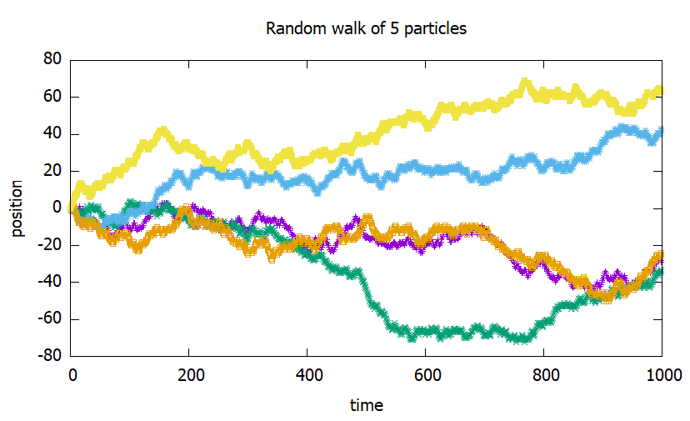
Random walk of 5 particles, random numbers are assigned to each particles at a given time.

Slide 30
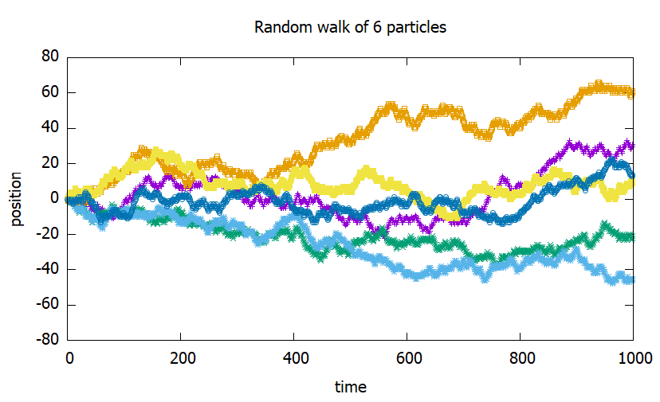
Random walk of 6 particles, random numbers are assigned to each particles at a given time. The paths for the old 5 particles changes.

Slide 31
The improved random walk implementation
for j in range(P): # for every particle pos = [] # particle's pos prng_inst = n.random.Generator(n.random.MT19937(P)) for i in range(1, T): # time evolution if prng_inst.random() > 0.5: # move up pos.append(pos[-1] + 1) else: # move down pos.append(pos[-1] - 1)
This version is better in:
saving memory, because only 1 particle’s position is stored in the memory at a time
adding further particles does not affect the previously investigated particles
can be parallelized easily, because particles are computationally independent too

Slide 32
The problem of close seed values
Is it a good practice to seed the different simulations from ajdacents seed values? E.g. particle 1, 2, 3 from seed values 1, 2 and 3?
close seed values can produce correlated values (how correlated?), but still better than using
time
user input
write a faulty seed-generating engine that produces the same random numbers
maybe the seed is to pre-seed a pre-prng to generate proper seed values
implementation-specific
seed sequence solves this problem

