Slide 1
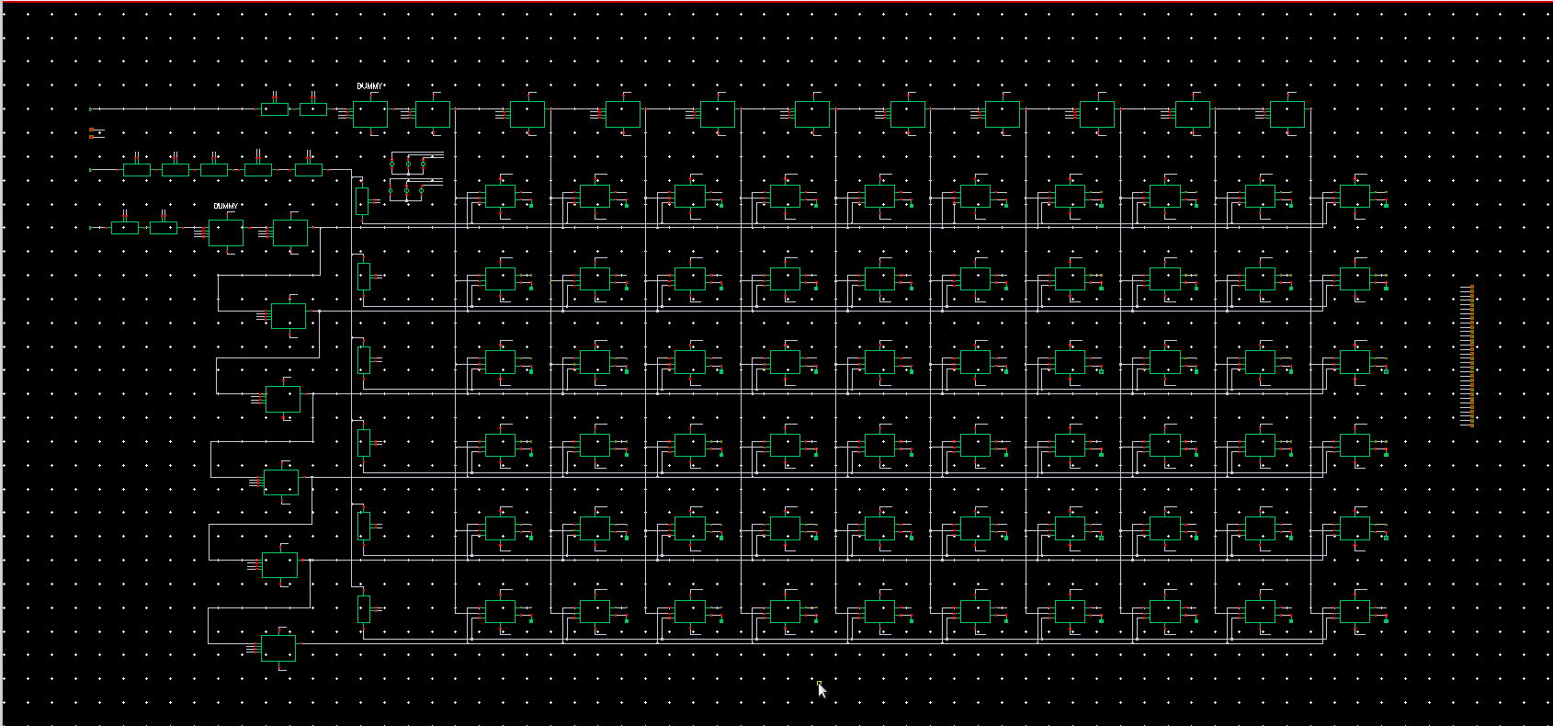
A 2-D Vernier Time-to-Digital Converter
15 ps resolution, 5-bit thermometer output, TSMC 180 nm BCD
EE4615 Digital IC Design II | Group 22
Daniel Tyukov (5714699) | Joris Hoogeweegen (5619963)
Delft University of Technology | 10 June 2026

Slide 2
The brief: quantize a time interval to 5 bits
Daniel
▪ Task: convert the delay between a START and a STOP edge into a 5-bit thermometer code Q₁..Q₃₁
▪ Hard requirements: resolution better than 20 ps, full 32-code range, and validated robustness in all five process corners
▪ Rules of the game: TSMC 180 nm BCD at 1.8 V, every gate hand-built (no standard cells), schematic plus Spectre only
▪ Optimize the trade-off: linearity (DNL, INL), energy per conversion, area as total transistor width ΣW, and FoM = energy per step
▪ Our choice: a two-dimensional Vernier TDC (Vercesi et al., JSSC 2010), the structure that decouples resolution from range
5 bit
thermometer output
< 20 ps
required resolution
5 / 5
corners must pass
0
standard cells allowed
2

Slide 3
Why Vernier, and why a 2-D grid
Joris
▪ Vernier principle: START runs through slow stages τ₁, STOP chases through fast stages τ₂
– the LSB is the difference t₀ = τ₁ − τ₂, far below a single gate delay
▪ 1-D catch: range = N·t₀, so 32 codes need 32 stages in each line; cells and latency grow linearly
▪ 2-D idea: compare START tap i against STOP tap j; every pair measures Δt(i,j) = i·τ₁ − j·τ₂
– a grid of N+N stages yields ~N²/2 distinct codes: range without long lines
▪ Payoff for our 5-bit target: 31 codes from only 10 + 6 delay stages, one SR-latch arbiter per code
For 32 codes | 1-D Vernier | 2-D (ours)
Delay stages | 32 + 32 | 10 + 6
Arbiters | 32 | 31 + 29 dummy
Full-scale latency | ~3.3 ns | ~0.9 ns
LSB | τ₁ − τ₂ | τ₁ − τ₂
Same resolution, a quarter of the delay cells
3

Slide 4
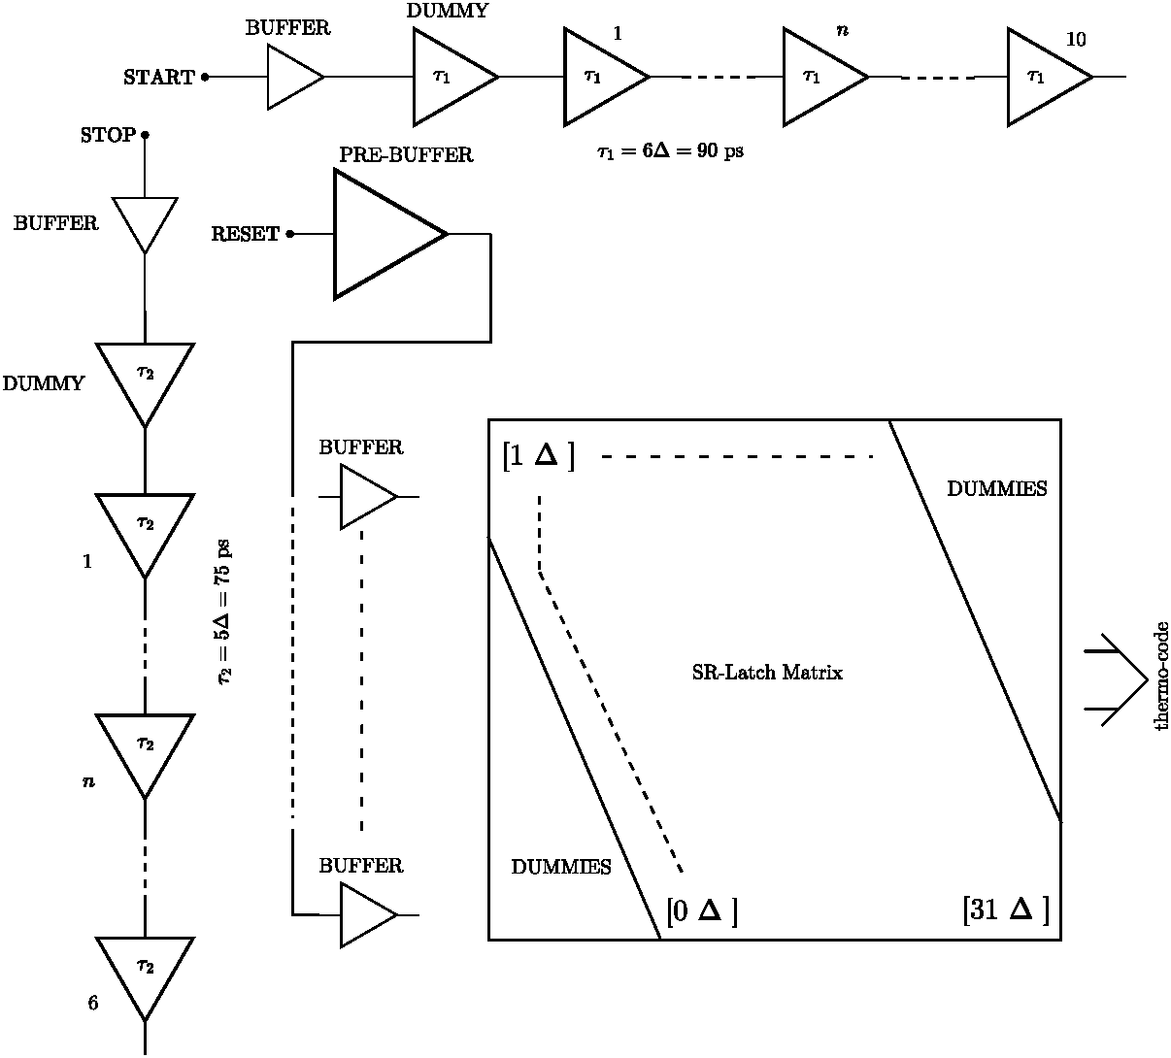
Architecture: a 10 × 6 grid locked at k = 6
Daniel
▪ Operating point: τ₁ = 6·t₀ = 90 ps (10 stages), τ₂ = 5·t₀ = 75 ps (6 stages), so t₀ = 15 ps with 5 ps of spec margin
▪ Bijective routing: each thermometer level m maps to exactly one grid cell, so no OR-tree and no skew from combining logic
– yₘ = ((m−1) mod 6) + 1, xₘ = (m + 5·yₘ) / 6
▪ Matched loading: 31 active SR latches plus 29 dummies pad the array to 10 × 10, every tap drives identical fan-out
▪ I/O: buffer trees distribute START, STOP and the 40 ps RESET; the code is read straight off the latch outputs
Two delay lines, SR-latch matrix, dummy padding
4

Slide 5
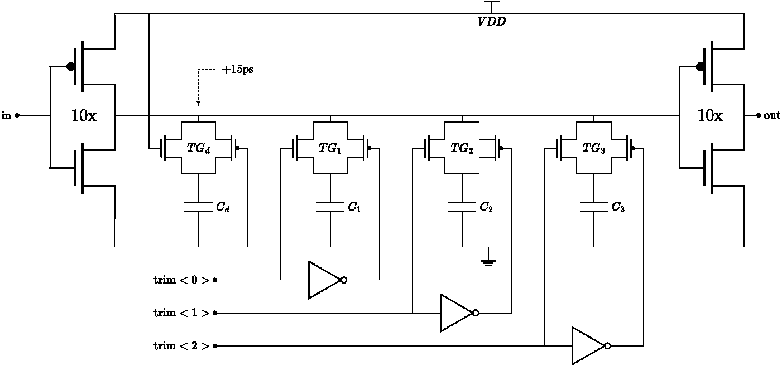
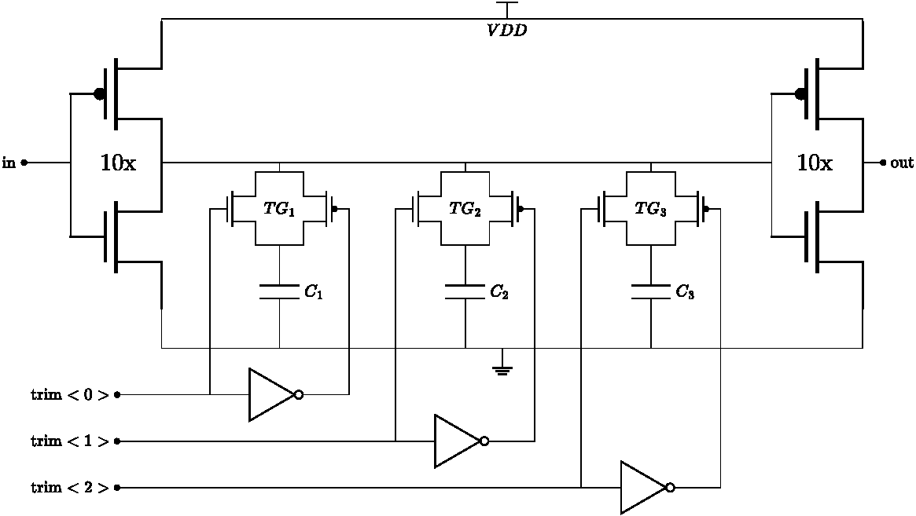
Delay stage: FO = 1 inverter pair with MOSCAP trim
Joris
▪ Breaking the FO = 4 habit: classical sizing pinned the stage floor at 97 ps; an FO = 1 pair opened a 74 to 147 ps tuning window
▪ Twin cells: both lines use identical active devices; the 6:5 delay ratio comes from loading, so τ₁ and τ₂ track across PVT
▪ Calibration built in: a fixed MOSCAP sets the nominal delay, three transmission-gate switched banks re-center t₀ per corner (authority ≈ 0 to 48 ps)
delay_tau1 (START, 90 ps): trim<0:2> banks behind transmission gates
delay_tau2 (STOP, 75 ps)
5

Slide 6
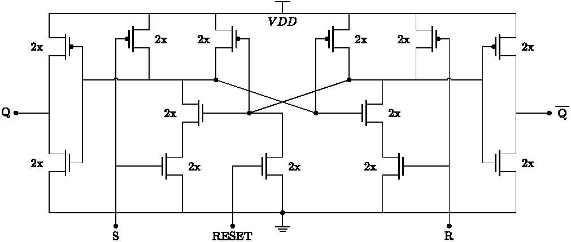
Arbiter: cross-coupled NAND SR latch, 13 transistors
Daniel
▪ Topology: two 2-input NANDs (all devices 440 nm / 180 nm), an async-reset NMOS, and buffered Q / Q̅ outputs
▪ Race logic: both NAND outputs idle high; the first rising input wins, so the latch directly records which edge arrived first
▪ Why it works: equal N and P widths balance the S and R paths, keeping the arbitration offset at the femtosecond level
▪ Why not a D flip-flop: 60 instances make cell economy count; the SR latch is smaller, symmetric, and resets in one transistor
vernier2d/srlatch: S and R race, RESET clears the grid in 40 ps
6

Slide 7
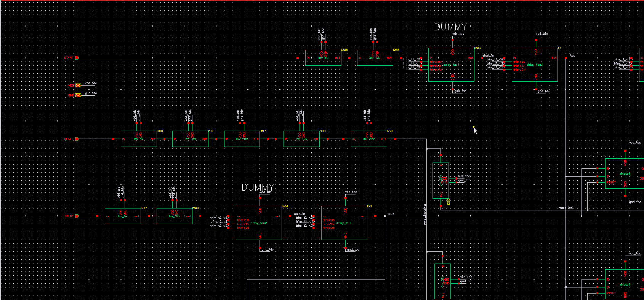
The pivot: size against the real load, not the ideal one
Joris
▪ The trap: a grid tap drives a full row or column of latches plus the next delay stage, about a 20× equivalent load
▪ We measured it: a 1-D row built from the same cells with raw tap loading predicted t₀ = 16.6 ps, but measured 28.6 ps
– sizing against an idealized load gives a fictitious LSB
▪ The fix: characterize every stage under the replica 20× load, and equalize all taps with dummy latches
▪ Consequence: the original k = 4 point (60 / 45 ps) was unreachable; the design re-locked at k = 6 (90 / 75 ps)
▪ Lesson: in a Vernier grid, loading is part of the architecture, not a layout afterthought
Grid detail: DUMMY latches pad every tap to fan-out 10
7

Slide 8
Built in Cadence, verified with the course testbench
Daniel
▪ The core: 11 + 7 delay stages, 60 SR latches, 1120 devices, ΣW = 1306 µm, all cells hand-built in vernier2d
▪ Honest energy numbers: the DUT sits on its own supply behind a series ammeter; stimulus buffers run from a separate rail
▪ Automated sweeps: OCEAN steps Δt through all 32 codes per corner and extracts LSB, DNL, INL, energy and pass / fail
vernier2d/tdc_core: τ₁ line (top), τ₂ line (left), 10 × 10 padded latch matrix
8

Slide 9
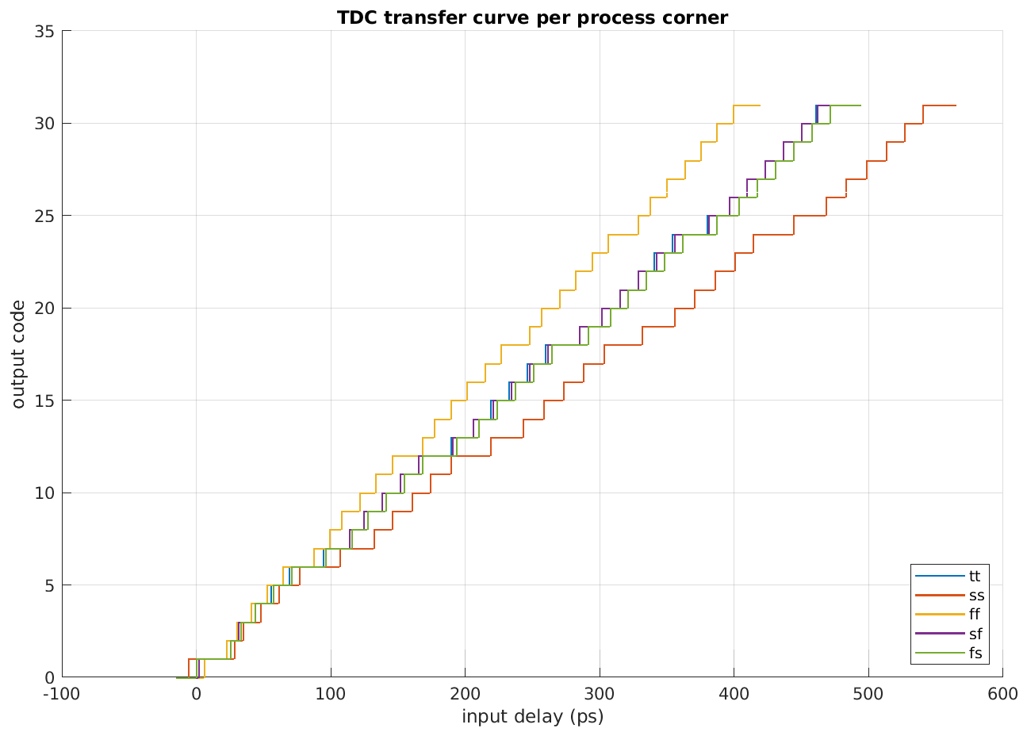
Transfer: a clean 5-bit staircase in every corner
Joris
Corner | LSB (ps) | Spec < 20 ps
TT | 15.35 | PASS
SS | 18.20 | PASS
FF | 13.10 | PASS
SF | 15.35 | PASS
FS | 15.70 | PASS
▪ One fixed trim code, no per-corner tweaking
▪ All 31 steps present in all five corners
▪ Offset stays a static, calibratable shift
Measured TDC transfer, all corners, 27 °C, 1.8 V
9

Slide 10
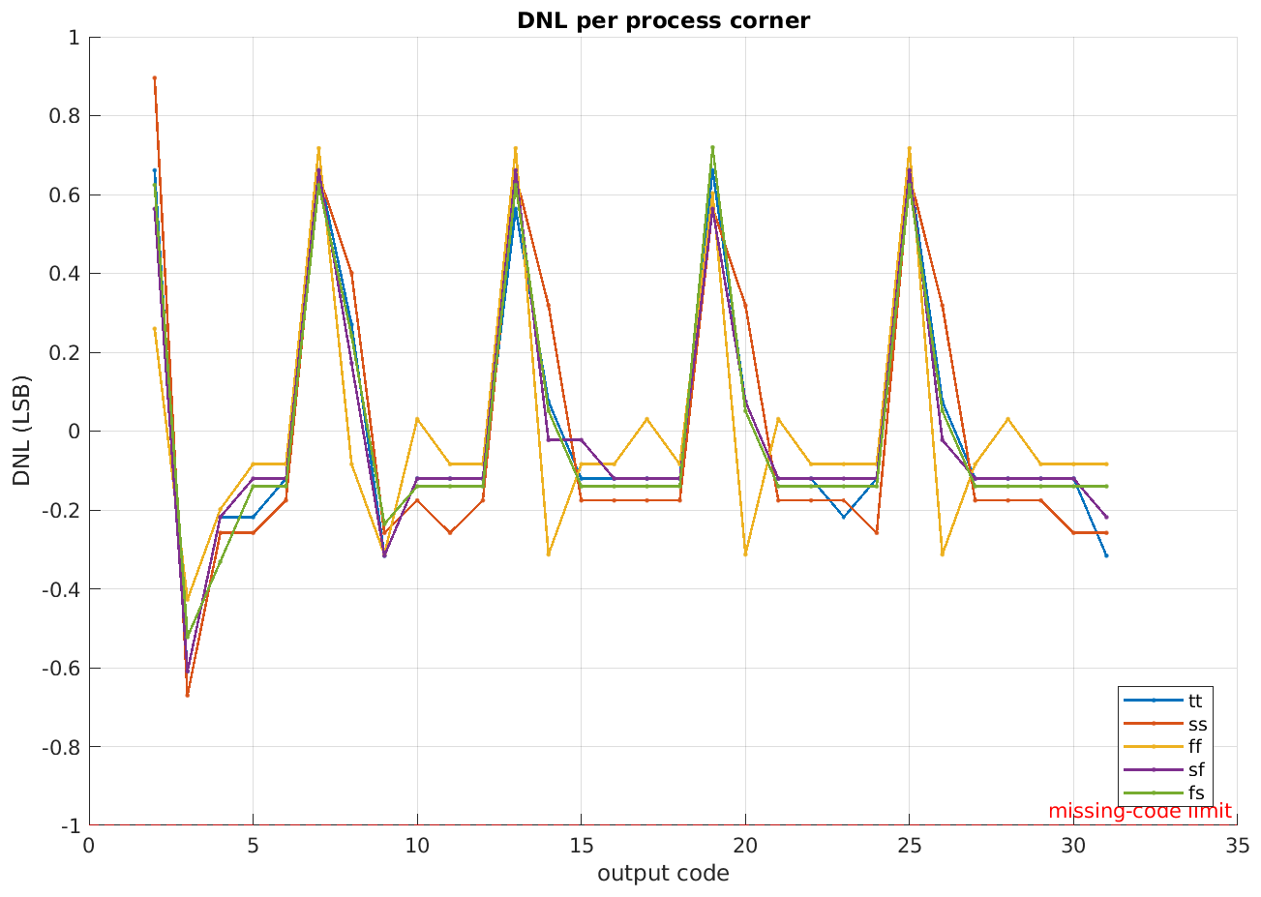
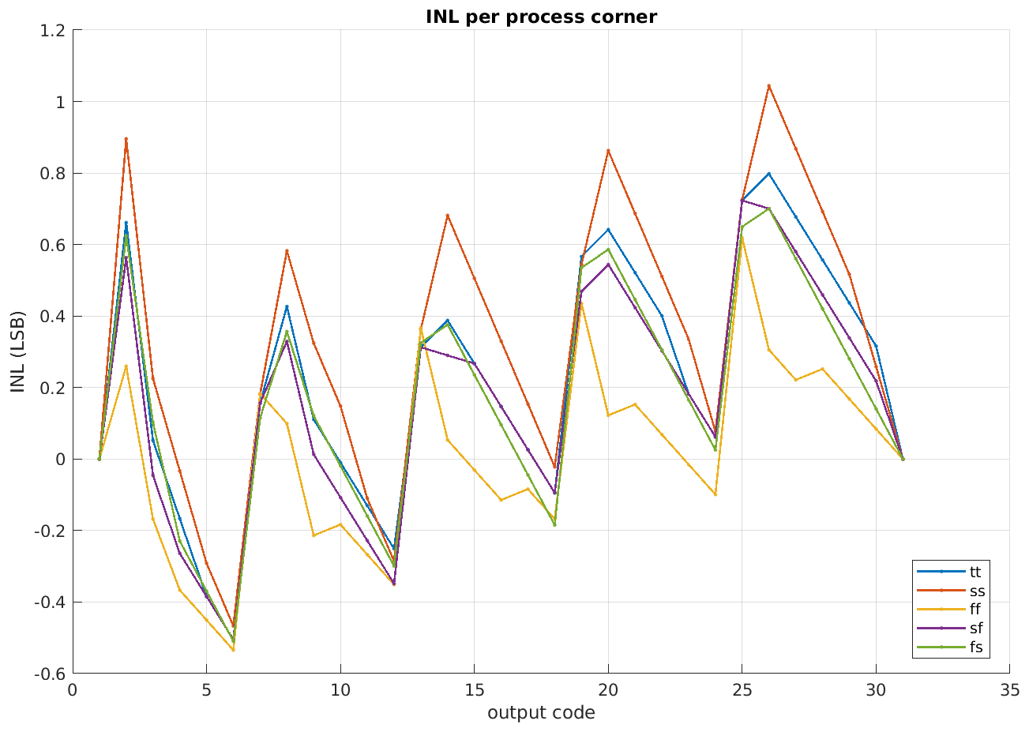
Linearity: no missing codes anywhere
Daniel
DNL per corner (LSB)
INL per corner (LSB)
▪ Worst DNL 0.90 LSB (SS), far from the −1 LSB missing-code limit; worst INL 1.04 LSB, all other corners below 0.8
▪ The every-6-codes DNL signature is the row-to-column residual of the grid, the expected 2-D Vernier fingerprint
10

Slide 11
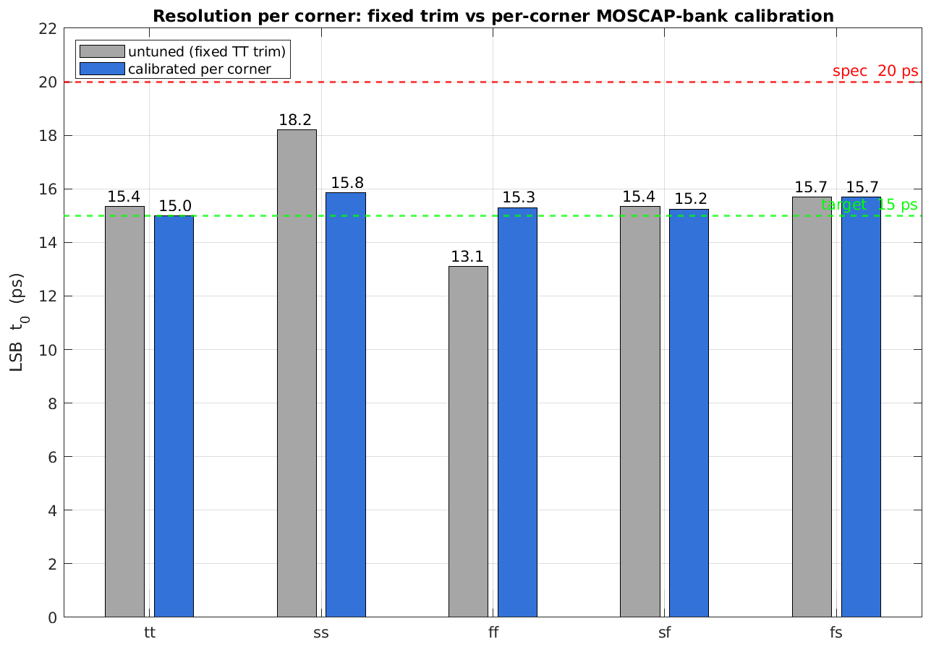
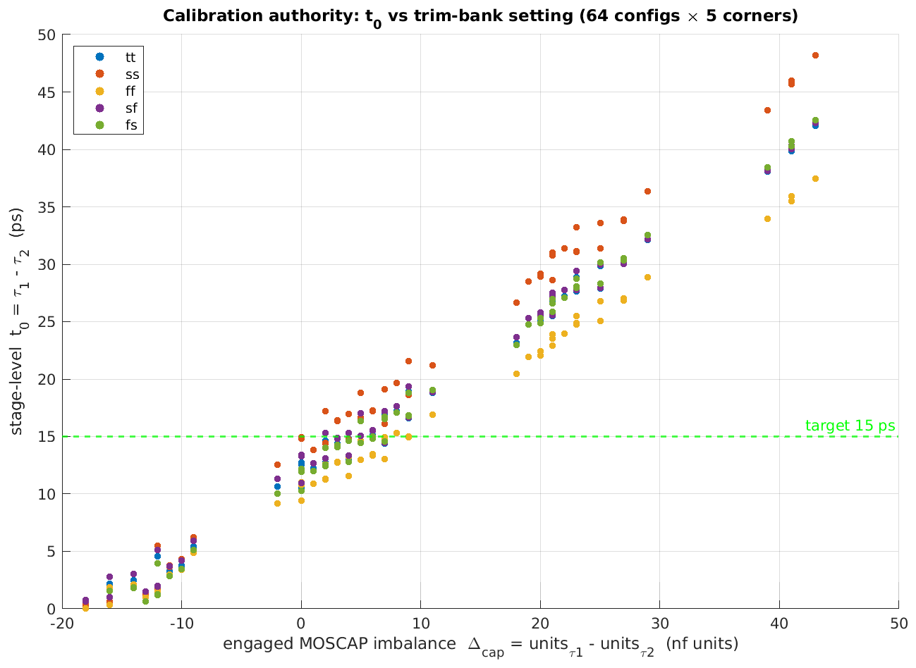
Per-corner MOSCAP calibration: 6× tighter LSB
Joris
LSB per corner, untuned vs calibrated
Trim-bank authority: t₀ vs configuration
▪ Three trim banks per stage act as static configuration bits, set once per corner
▪ LSB corner spread shrinks from 5.10 ps to 0.85 ps; every corner re-centers to 15.0 – 15.9 ps, worst INL drops to 0.74 LSB
11

Slide 12
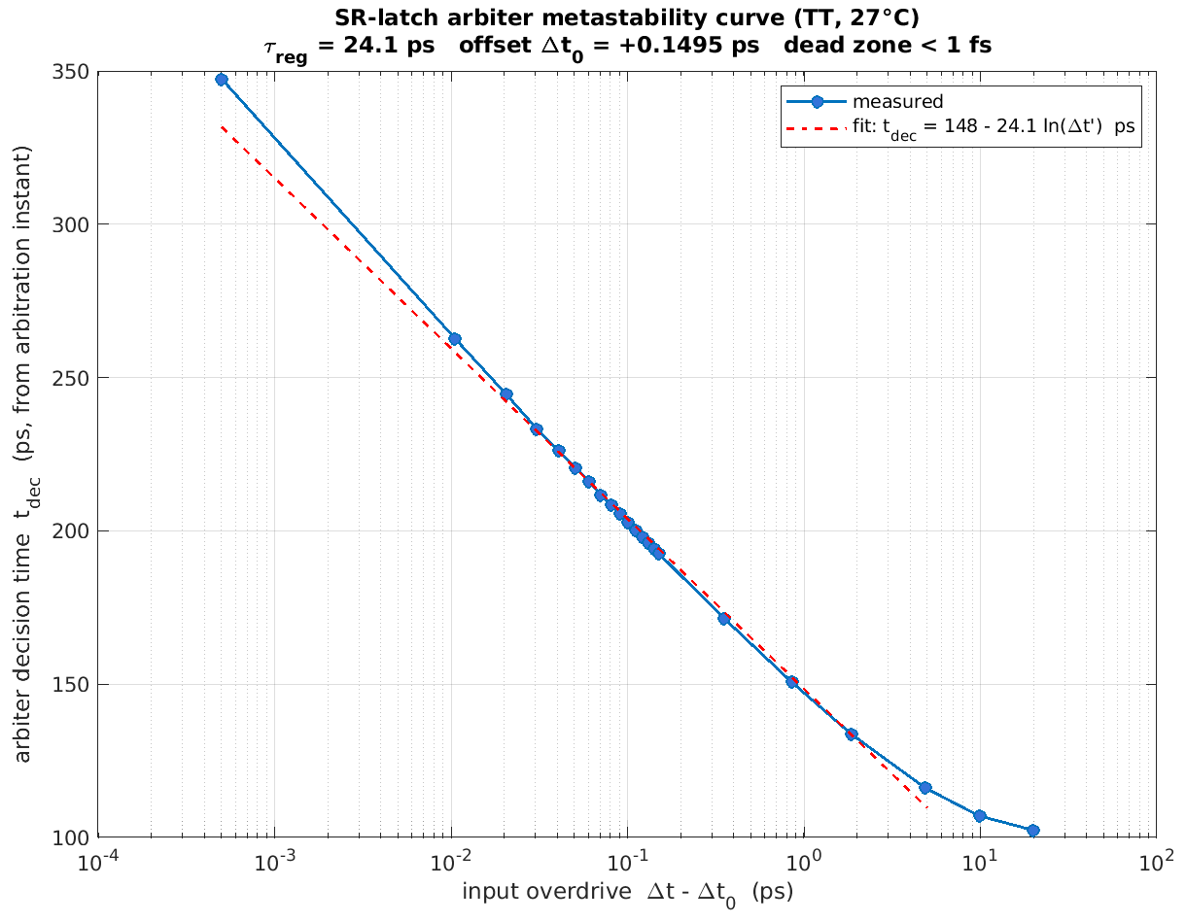
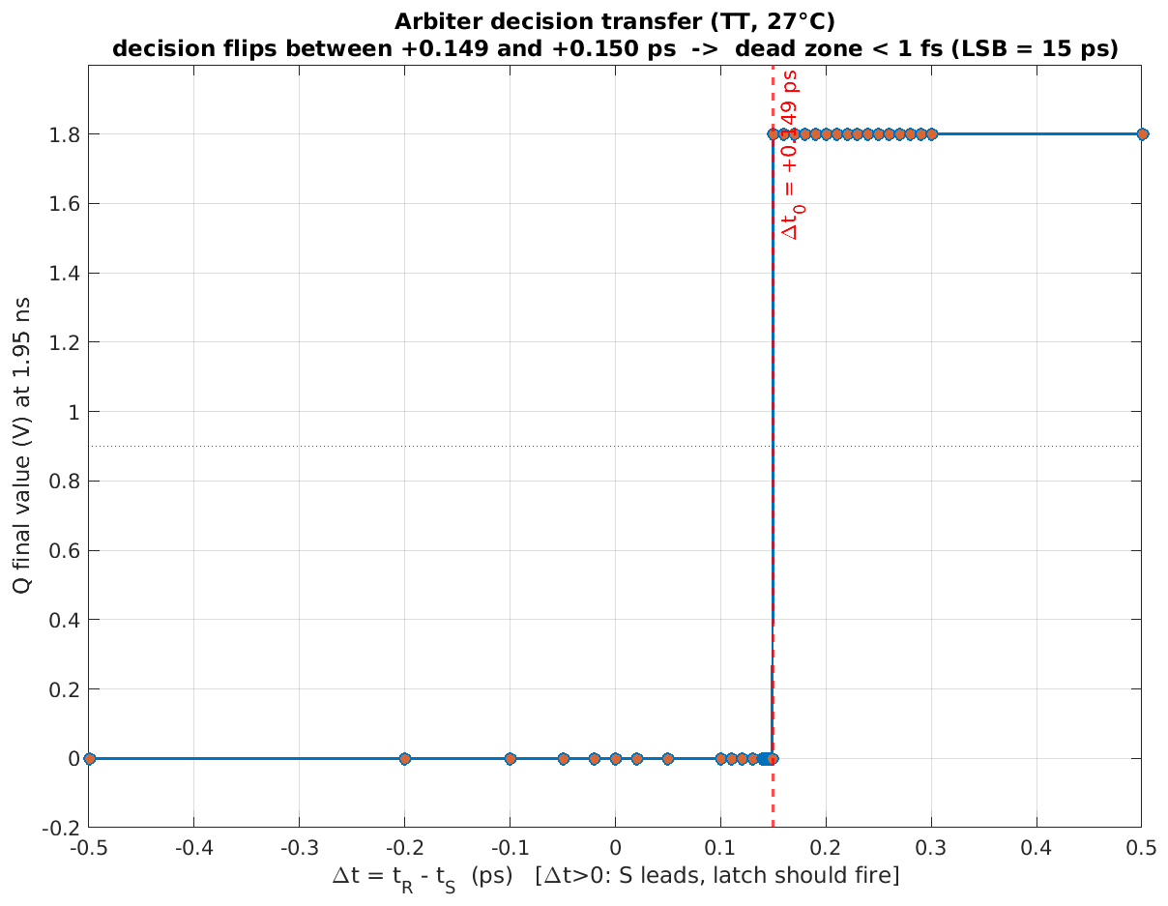
How small a Δt can the arbiter resolve?
Joris
Decision time vs overdrive: τ = 24.1 ps regeneration
Arbiter transfer: dead zone below 1 fs
▪ Arbitration offset +0.15 ps (1 % of one LSB); decision ambiguity below 1 fs, four orders under the 15 ps LSB
▪ Worst observed decision time 348 ps at 0.5 fs overdrive: metastability does not limit this design, the LSB does
12

Slide 13
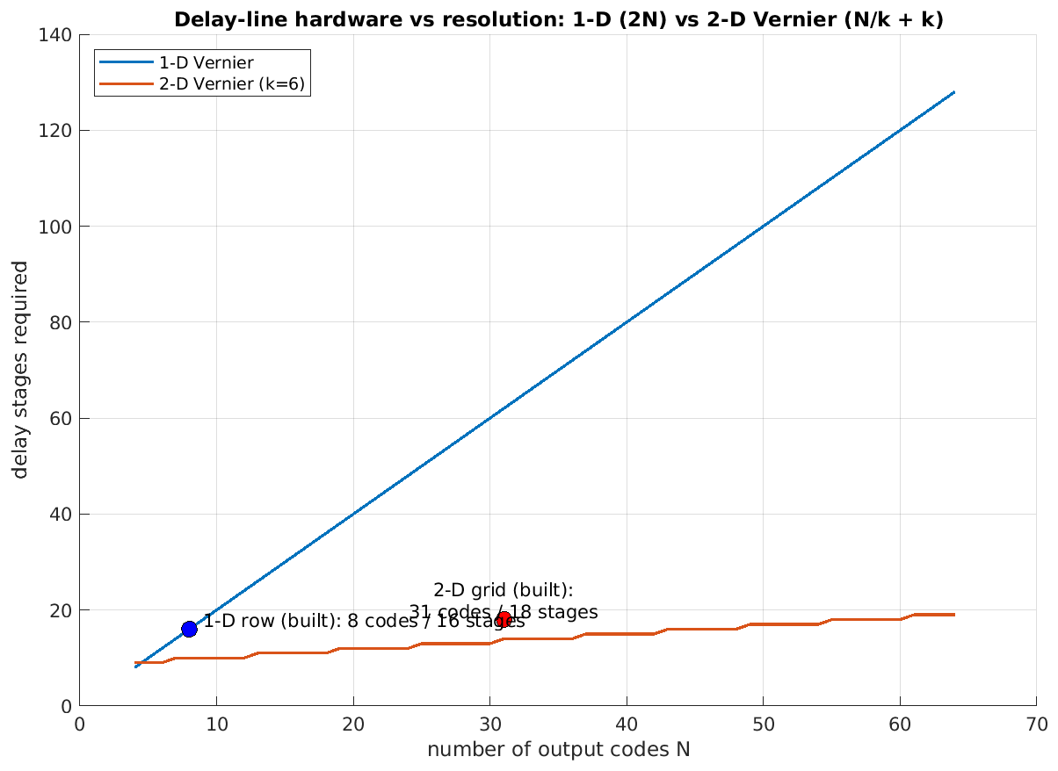
Measured: 2-D beats 1-D built from the same cells
Daniel
Same cells, measured | 1-D row | 2-D core
LSB (ps) | 28.57 | 15.35
DNL max (LSB) | 0.89 | 0.66
ΣW per code (µm) | 81.4 | 42.1
Energy per code (pJ) | 0.327 | 0.376
Latency, 31 codes | 3.3 ns | 0.9 ns
▪ Raw tap loading costs the 1-D row almost 2× in resolution
▪ Scaling to 31 codes: 1-D needs 3.4× the stages and 1.9× the area
Cost scaling with code count, 1-D vs 2-D
13

Slide 14
Scorecard: every requirement met, with margin
Joris
Requirement | Target | Achieved | Verdict
Output bits | 5 | 5 (thermometer Q₁..Q₃₁) | PASS
Resolution (LSB) | < 20 ps | 15.0 – 15.9 ps calibrated | PASS
Corner robustness | TT, SS, FF, SF, FS | 5 / 5 corners pass | PASS
DNL | > −1 LSB (no missing codes) | worst 0.89 LSB | PASS
INL | report | worst 0.74 LSB (calibrated) | PASS
Energy per conversion | minimize | 10.7 – 13.0 pJ | ✓
FoM (energy per step) | minimize | 0.48 – 0.53 pJ / step | ✓
Area ΣW | minimize | 1305.6 µm (1120 devices) | ✓
ENOB | report | 4.40 – 4.62 bit | ✓
All numbers from Spectre corner sweeps at 27 °C, 1.8 V, course TB_TDC harness
14

Slide 15
Conclusions and outlook
Daniel
What we showed
The design in six numbers
15 ps resolution t₀, spec asks < 20 ps
0.85 ps LSB corner spread after calibration
11.7 pJ energy per conversion (TT)
0.49 pJ / step figure of merit (TT)
1306 µm total transistor width ΣW
< 1 fs arbiter dead zone
▪ A 15 ps, 5-bit 2-D Vernier TDC in 180 nm that meets every course spec in all five corners
▪ Two ideas carried the design: size under the real grid load, and equalize fan-out with dummies
▪ Calibration is cheap: three MOSCAP banks per stage buy a 6× tighter LSB spread
Future work
▪ DLL-based background calibration to replace static trim codes
▪ Voltage-to-time front end: reuse the TDC as an ADC quantizer
▪ Layout and extracted re-simulation
All design, simulation and analysis were carried out jointly by both team members.
15

Slide 16
Thank you. Questions?
Group 22: Daniel Tyukov, Joris Hoogeweegen
2-D Vernier TDC, EE4615 Digital IC Design II

