Slide 1
Time-Domain Systems and THz Material Characterization
EE4730 Oral Exam | Time-Domain Topic | Daniel Tyukov | July 2026
Notes:
Good morning, I'm Daniel Tyukov. I picked the time-domain topic: how a photoconductive spectrometer works, and how we used one to identify six unknown dielectric slabs.

Slide 2
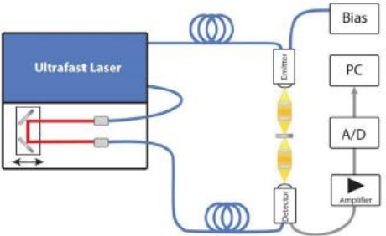
Why measure in the time domain
• The THz band (0.3 to 3 THz) sits above transistor f_{max} (records around 0.75 THz) and below optical sources. Generating and detecting power is the hard part.
• Two generation paradigms from the lectures: multiply a microwave oscillator up in frequency, or switch a DC bias with a femtosecond laser in a photoconductor.
• The photoconductive route gives a single picosecond pulse whose spectrum covers the entire band at once.
• Measure the field E(t), take an FFT, and one scan characterizes a material from 0.15 to 3 THz. That is what this lab does.
 | Heterodyne | Photoconductive
Source | LO chain, xN | fs laser + DC bias
Signal | CW tone | ps pulse
Bandwidth | ~30 GHz | up to ~2 THz
Use here | VNA labs | this lab
Lecture 2: the two ways to make THz signals
TDS spectrometer chain (lab manual)
Notes:
The terahertz band is awkward: it sits above what transistors reach and below what optical sources cover. I can multiply a microwave oscillator up for a clean tone, but that only covers about 30 gigahertz, or I can switch a DC bias with a femtosecond laser for a single-picosecond pulse that spans the whole band. One scan, one FFT, and I get a material's response from about a tenth of a terahertz up to three.

Slide 3
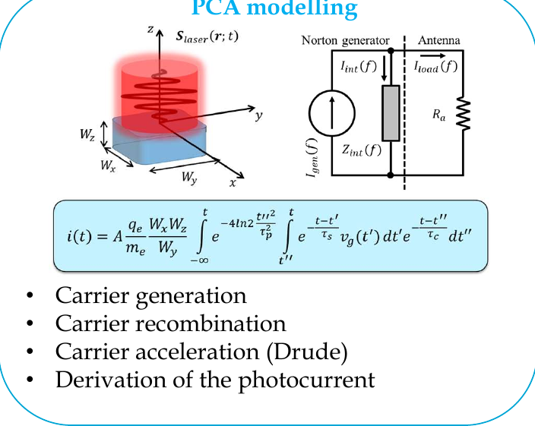
The photoconductive antenna
• An LT-GaAs gap between two electrodes. The 1.59 eV band gap matches the 780 nm pump laser.
• The femtosecond pulse creates carriers, the DC bias accelerates them, and recombination cuts the current off after about 1 ps. That current burst radiates the THz pulse.
• The lecture photocurrent model has exactly three ingredients: carrier generation (Gaussian laser pulse), Drude acceleration, and exponential recombination with τ_{c}.
• The receiver is the same device without bias. The incident THz field accelerates the carriers, so the gated current is proportional to the field at the moment of illumination.
• At high optical power the radiated field screens the bias and the photocurrent saturates. That is why high-power sources use arrays of matched PCAs.
PCA model and Norton equivalent (Lecture 2)
Notes:
The device behind all this is the photoconductive antenna, a gap of low-temperature-grown gallium arsenide between two electrodes. Its band gap is 1.59 electron-volts, which is why the pump laser sits at 780 nanometres. The laser pulse creates carriers, the bias accelerates them, and recombination kills the current almost immediately after, and that short burst is what radiates the pulse: generation, acceleration, recombination.
The receiver is the same device without a bias, so the incoming field does the accelerating, and the current I read out follows the field at the instant the laser fires. At high power the radiated field screens the bias and the current saturates, which is why scaling up uses arrays instead of a bigger laser spot.

Slide 4
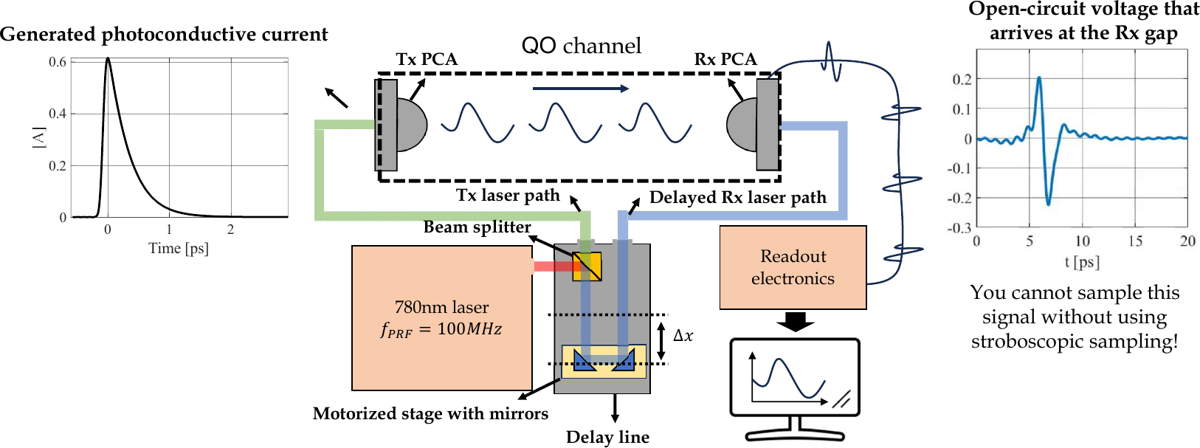
Stroboscopic sampling
• No ADC samples a THz waveform directly; electronics stop at a few gigasamples per second.
• The laser fires an identical pulse every 10 ns (100 MHz repetition). The receiver gap conducts only during the picosecond it is illuminated, so each repetition samples the field at one delay.
• A motorized mirror sweeps the delay (1 mm of travel adds 6.67 ps of round trip). The readout measures a DC average current i_{rec}(Δt) proportional to the field at the gate instant; sweeping Δt reconstructs E(t).
Full TDS chain: one laser, a beam splitter, and a delay line (Lecture 2)
Notes:
Nothing samples a terahertz waveform directly, since ordinary electronics fall far short of the speeds involved. The trick: the laser fires an identical pulse every ten nanoseconds, and the receiver only conducts for the instant it's lit. Each repetition hands me one sample of the field at one delay, set by a motorized mirror, where every millimetre of travel works out to about six and a half picoseconds.
The readout itself is just a plain DC measurement, tracking the field at that one instant, so sweeping the mirror reconstructs the whole waveform point by point.

Slide 5
Noise: what the lecture predicts
• Average transmit power 1 mW at 100 MHz repetition: 10 pJ per pulse, roughly 20 W of peak power.
• With link efficiency near 1/10, the receiver current burst is about 0.14 A for half a picosecond.
• The duty cycle dilutes it: i_{ave} = i_{peak} · τ_{rec}/T_{rep} ≈ 7 µA of DC current at the amplifier input.
• The readout amplifier noise is about 70 pA, so a single sweep already delivers a signal-to-noise ratio near 100 dB.
• Averaging N sweeps beats down white noise only:
SNR_{N} = SNR₁ + 10·log₁₀N
Prediction for the lab
N = 50 → +17.0 dB
N = 100 → +20.0 dB
N = 1000 → +30.0 dB
Assignment 1 tests exactly this.
Notes:
Before the measurements, here's the reasoning behind the prediction. Working through the laser's power, its repetition rate, and the losses along the path, the receiver's signal comes out with something like a hundred decibels of headroom above the amplifier's noise floor, in a single sweep. From there, averaging should improve things by ten times the log of how many sweeps I combine: about seventeen decibels after fifty, thirty after a thousand. That's the prediction the next slide tests.

Slide 6
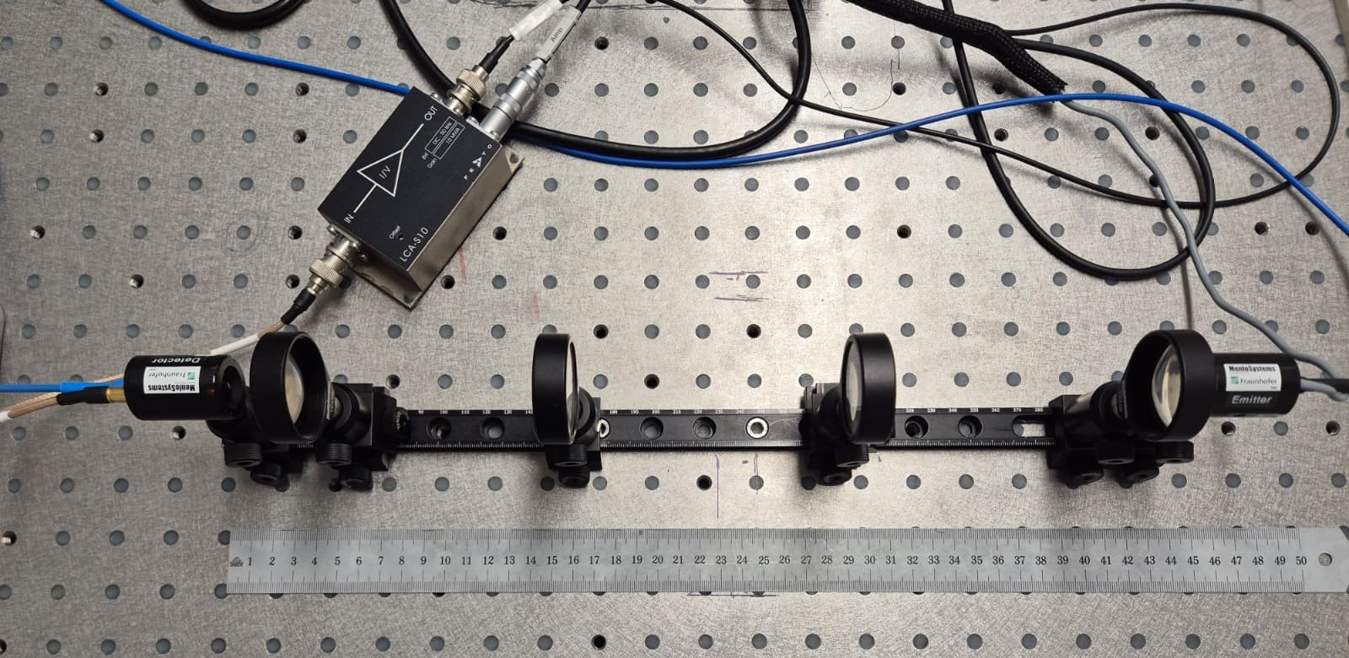
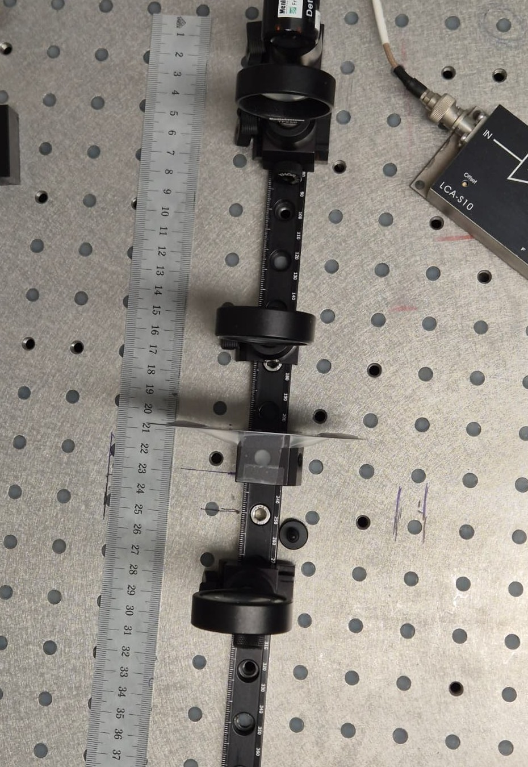
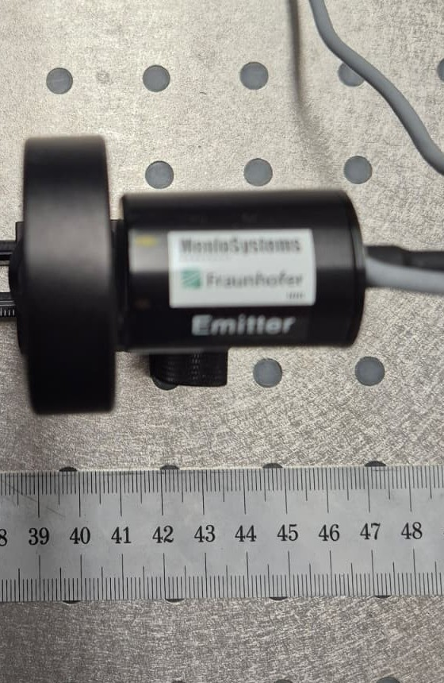
The lab bench
Emitter (right), four TPX50 lenses, detector and LCA-S10 amplifier (left)
Slab at the pinhole focus
Emitter PCA on its carrier
• Both PCAs are fibre-coupled to the Menlo unit. Lenses 1 and 4 collimate at the antennas, lenses 2 and 3 form an intermediate focus where the samples go (carriers at 35 / 70 / 190 / 245 / 305 / 400 / 435 mm).
• Alignment by maximizing detector current lens by lens; the aligned pulse peaks at 2.89 a.u.
• Every scan: 100 ps delay window, 33.3 fs steps, Tukey window (α = 0.1) in ScanControl.
Notes:
Emitter on the right, detector on the left, both fibre-coupled to the Menlo unit. Four lenses shape the beam: an outer pair collimates it at the antennas, an inner pair focuses it at the pinhole, where the samples go later. I aligned everything watching the detector current lens by lens, and the pulse peaked at 2.89 once it was lined up. Every scan since covers the same hundred-picosecond window, in thirty-three-femtosecond steps.

Slide 7
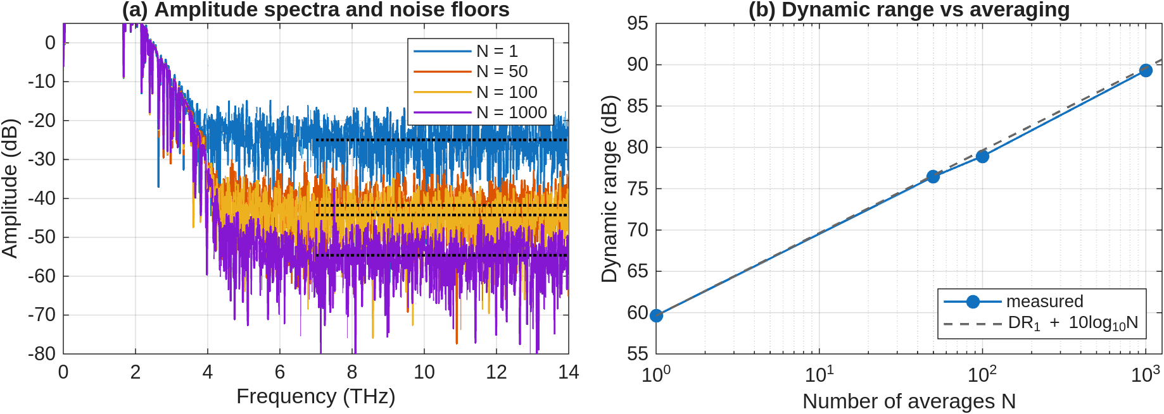
Averaging, measured against the prediction
• Dynamic range grows from 59.6 dB (N = 1) to 89.3 dB (N = 1000): gains of 16.9 / 19.3 / 29.7 dB against the predicted 17 / 20 / 30 dB. The white-noise law holds within 0.7 dB.
• The time trace saturates: past N = 100 the pre-pulse floor stays near 4·10⁻⁴ of the peak because a coherent baseline structure repeats in every sweep. Averaging only buys bandwidth where the noise is white.
Notes:
The prediction holds up well. Dynamic range climbs from about sixty decibels unaveraged to around ninety at a thousand sweeps, and the three measured gains, close to seventeen, nineteen, and thirty decibels, land right on the ten-log-N prediction.
Past about a hundred averages, though, the floor just before the main pulse stops improving, because a coherent baseline structure repeats in every sweep. Averaging only removes noise that's random; it can't touch something identical every time. What it actually buys me is bandwidth, since the spectrum keeps rising above the noise floor the longer I average.

Slide 8
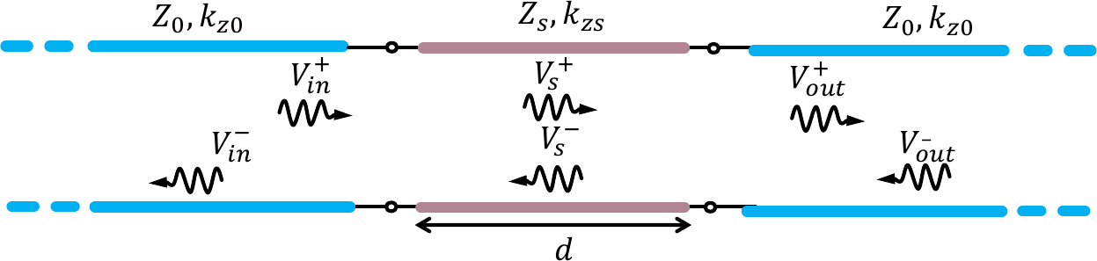
Extracting permittivity and loss
• Differential measurement: a reference scan without the sample, a sample scan with it, and their ratio H(f) = E_{sam}(f) / E_{ref}(f). The N = 100 trace is the reference.
• Delay gives the permittivity: the slab replaces a thickness d of air, so the pulse arrives Δτ = (n−1)·d/c₀ later and ε_{r} = n².
• Loss comes from the spectrum: model the slab as a transmission-line section between air lines, then fit tan δ(f) until the modelled magnitude matches the measurement.
• The model contains the Fabry-Perot etalon of the slab faces. If the internal echo lands outside the 100 ps window (slabs 1 and 3), only the first transit is kept.
Air / slab / air transmission-line model from the processing notes
Notes:
Now for the material work. Every slab measurement is differential: one scan without the sample, one with it, and I work from their ratio. The delay gives me permittivity directly, since the slab just stands in for a known thickness of air.
Loss takes more effort: I model the slab as a transmission-line section between two air lines, and adjust the loss term at each frequency until the model matches the measured transfer function, echoes from the slab faces included. For the two thickest slabs, where that echo falls outside the scan window, I keep only the first pass through the material.

Slide 9
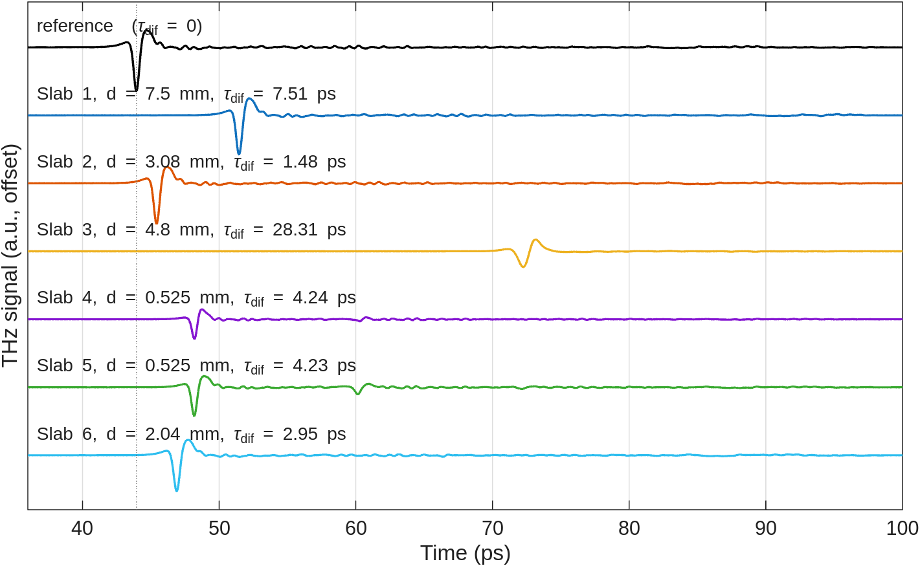
Six slabs identified
Slab | d (mm) | ε_{r} | tan δ (1 THz) | Material
1 | 7.5 | 1.69 | 0.0010 | porous PTFE *
2 | 3.08 | 1.31 | 0.0026 | Gore-Tex
3 | 4.8 | 7.66 | 0.0131 | Ceramic
4 | 0.525 | 11.72 | 0.0138 | Silicon
5 | 0.525 | 11.66 | 0.0028 | Silicon
6 | 2.04 | 2.05 | 0.0082 | Teflon
• Five of six match the manual's reference table within 3.1%.
• Slab 3 arrives 28 ps late and heavily attenuated; the silicon wafers show their etalon echo 12 ps after the main pulse.
• * Slab 1 (ε_{r} = 1.69) sits between Gore-Tex and Teflon: consistent with porous PTFE of intermediate density.
Reference and slab pulses; the delay carries ε_{r}
Notes:
Here are all six, with delays from about a picosecond and a half up to twenty-eight. Matching the extracted permittivities against the manual's table points to two silicon wafers, a ceramic, Teflon, and Gore-Tex, most within a few percent of the reference value.
Slab one is the odd one out, sitting between Gore-Tex and Teflon with very low loss; my read is a porous PTFE of intermediate density that the table doesn't list separately.

Slide 10
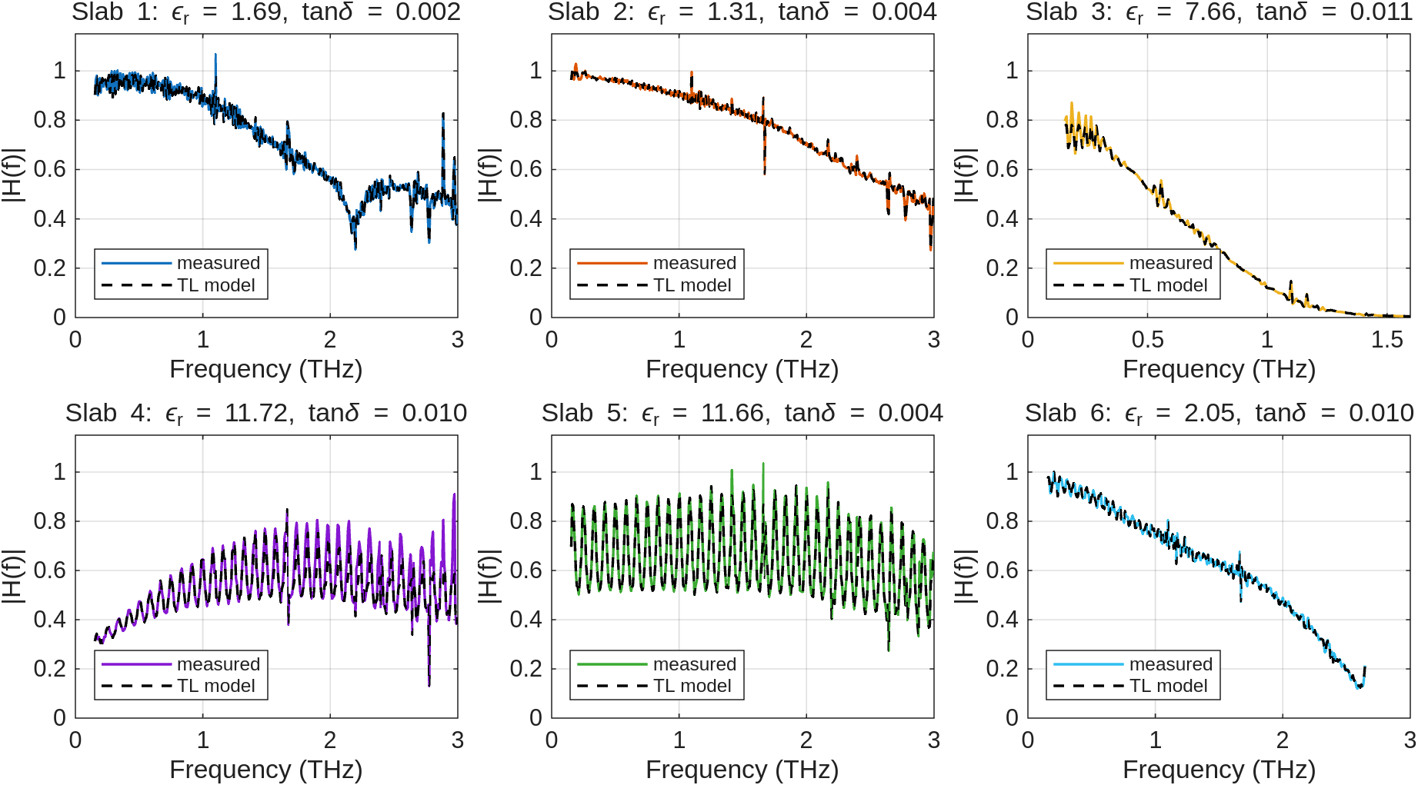
Transfer function fits
• The fit reproduces level and etalon ripple; on silicon the ripple period c₀/(2nd) ≈ 83 GHz pins the optical thickness.
Notes:
These are the fits behind those numbers. The thing to look at is the ripple riding on the silicon wafers, the etalon between the two faces, repeating roughly every 83 gigahertz. The model reproduces both that spacing and its depth, which alone pins down the slab's optical thickness independently of the delay.

Slide 11
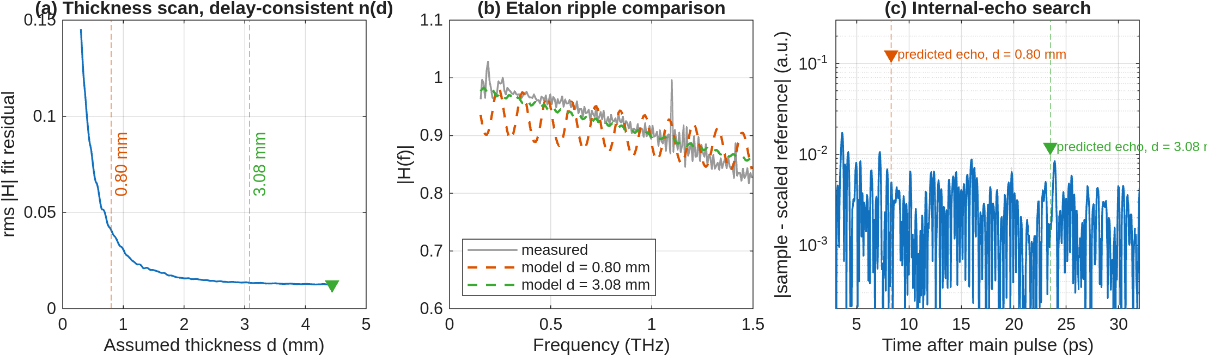
The slab 2 thickness conflict
• The data file says 0.8 mm, the label on the holder says 3.08 mm. The delay alone cannot decide: both give a plausible material (ε_{r} = 2.44, HDPE-like, versus 1.31, Gore-Tex-like).
• Three independent tests reject 0.8 mm: the fit residual is three times worse, the required ±10% ripple at 120 GHz is absent, and the predicted internal echo at +8.3 ps (0.13 a.u.) does not exist in the residual.
• Conclusion: d = 3.08 mm and the slab is Gore-Tex. The file name recorded a different sample or a typo.
Notes:
Worth walking through, since it shows what this measurement can do. The data file for slab two lists 0.8 millimetres; the sample itself is labelled 3.08. The delay alone can't settle it, since either thickness just implies a different plausible material.
Three checks all point the same way: the fit is noticeably worse under the thinner reading, the ripple that thinner slab would produce isn't in the measurement, and the internal echo it predicts, about 8.3 picoseconds after the main pulse, is nowhere in the time trace either. So the sample really is 3.08 millimetres of Gore-Tex, and it was the file name that was wrong.

Slide 12
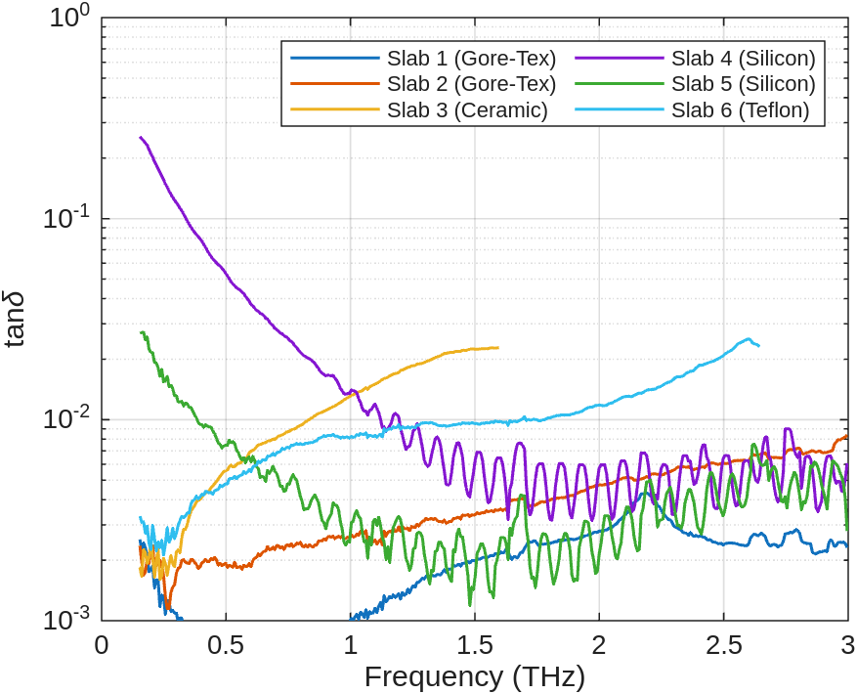
Silicon wafers: same index, different loss
• Both wafers give n ≈ 3.42, within 0.3% of the literature value for high-resistivity silicon. The etalon ripple period confirms the permittivity independently.
• Their loss differs by an order of magnitude. Conduction loss follows tan δ = σ/(ω·ε₀·ε_{r}), so constant conductivity appears as a 1/f slope. That is the measured behaviour below 1.5 THz.
• Converting the median conductivity of wafer 5 to resistivity gives 37 Ω·cm. The wafer is labelled 33 Ω·cm from a four-point-probe measurement: an independent end-to-end check of the loss extraction.
• Wafer 4 comes out at 9 Ω·cm, the more doped and lossier twin.
Extracted tan δ(f): silicon falls as 1/f, polymers rise
Notes:
The two wafers make a nice controlled experiment: they share essentially the same refractive index, close to 3.42, right in line with the literature value, but their loss is completely different.
Conduction loss scales as one over frequency, exactly the slope I see below about one and a half terahertz. Converting that to resistivity, one wafer comes out around 37 ohm-centimetres, close to the 33 printed on its label from an independent four-point-probe measurement. The other wafer is far more heavily doped, down around 9.

Slide 13
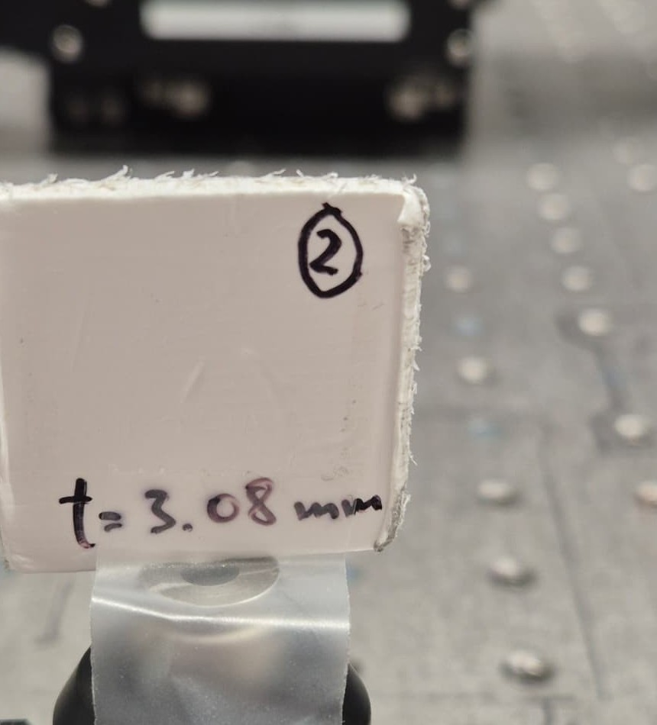
What this lab showed
• Stroboscopic sampling works as taught: a DC photocurrent measurement reconstructs the THz field with 33 fs steps.
• The averaging law holds: 29.7 dB measured against 30 dB predicted at N = 1000. What it cannot remove is coherent structure, and the time-domain floor shows exactly that.
• One delay reading plus a transmission-line fit identified five of six materials within 3.1% of the reference permittivities.
• The same physics settles a metadata conflict (slab 2) and reproduces a wafer's labelled resistivity within 12%.
Slab 2, marked t = 3.08 mm
Notes:
Four things, to wrap up. Stroboscopic sampling turns a plain DC current measurement into femtosecond-scale resolution. Averaging follows that ten-log-N climb until coherent structure takes over. A delay measurement paired with a transmission-line fit identifies materials to within a few percent, and that same fit was sharp enough to catch a labelling error and reproduce a resistivity from a completely different instrument.

Slide 14
Thank you
Time-Domain topic | Daniel Tyukov | EE4730 oral exam
Notes:
Thank you. Happy to take questions.

