Slide 1
Design Techniques for Wideband Single-Bit Continuous-Time Delta-Sigma Modulators with FIR Feedback DACs
Shettigar & Pavan, IEEE JSSC, vol. 47 no. 12, 2012
Daniel Tyukov, 5714699 - ET4278

Slide 2
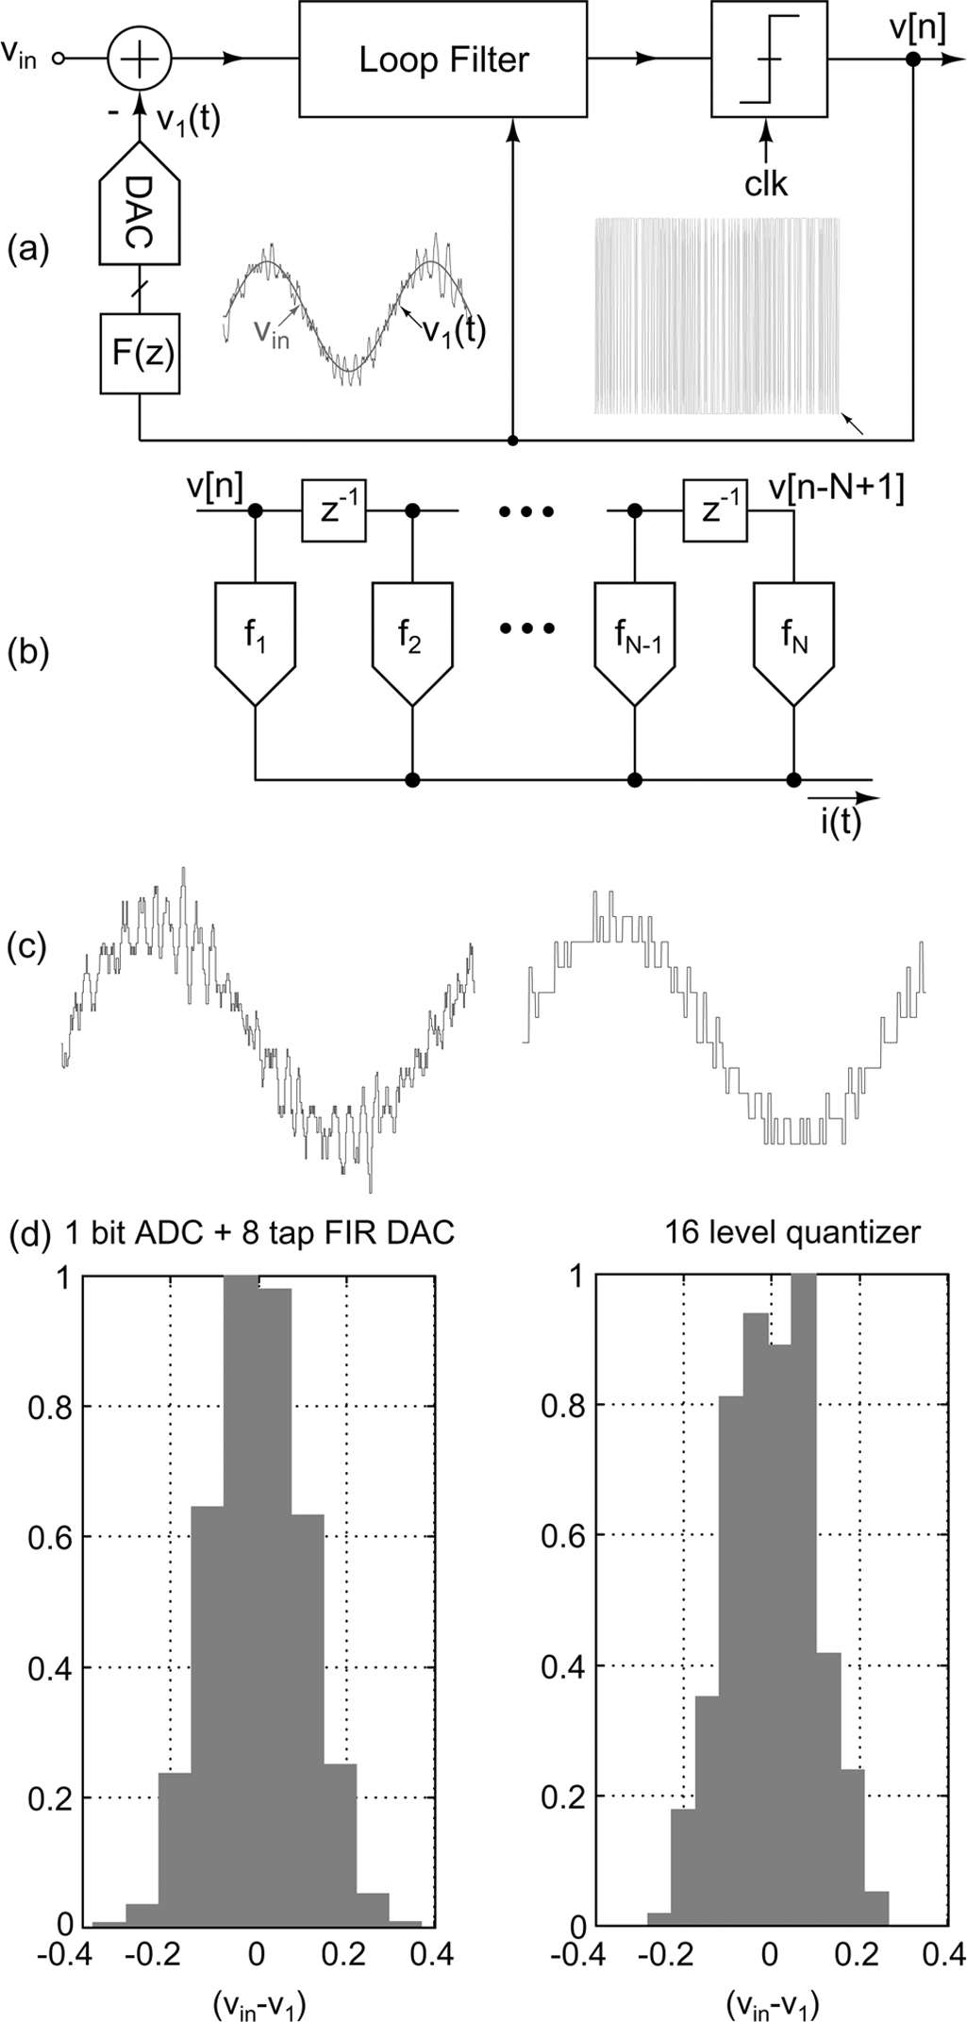
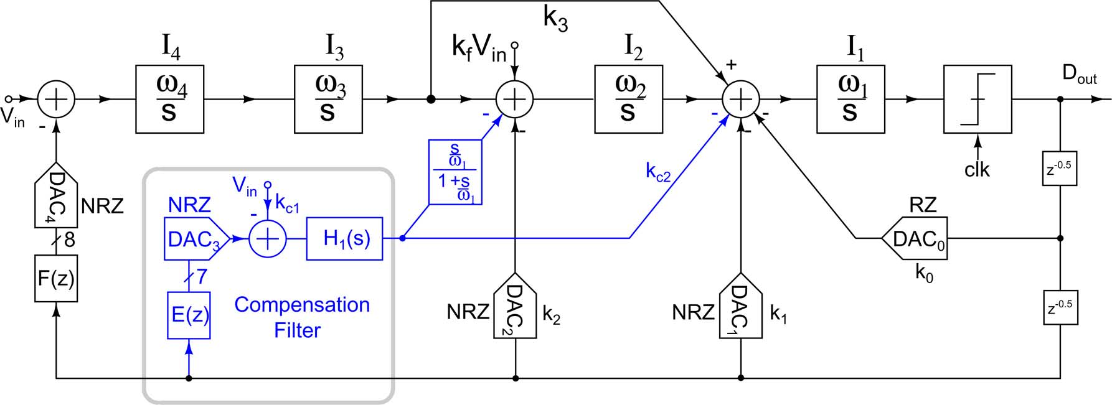
Q1. Introduction
Q1. Identify the issues addressed by the assigned paper and identify the main techniques used to address these issues. (5 points)
Issues addressed by the paper
  Single-bit NRZ feedback: full-scale steps every cycle -> high clock-jitter sensitivity
  Comparator metastability adds data-dependent jitter -> in-band SNR collapses
  Full-scale single-bit feedback demands a very linear loop filter
  Multi-bit avoids these but costs quantizer power/area + DAC mismatch -> DEM/calibration
  An FIR feedback DAC adds group delay (excess loop delay) that destabilises the loop
Main techniques
  1-bit ADC + 8-tap semi-digital FIR feedback DAC (multi-bit-like waveform, 2-level linear, no DEM)
  First FIR tap = 0 (explicit 1-cycle delay) to dodge metastability
  Analog FIR-delay compensation: E(z) FIR DAC + bandpass H1(s) restores the target NTF
  RZ DAC0 for ELD compensation (no summer around the quantizer)
  Modified CIFB + input feed-forward, active-RC integrators, assisted opamp
Conclusion: FIR feedback gives a 1-bit loop the jitter/linearity of a multi-bit loop; the price is loop delay, solved by an analog compensation path.

Slide 3
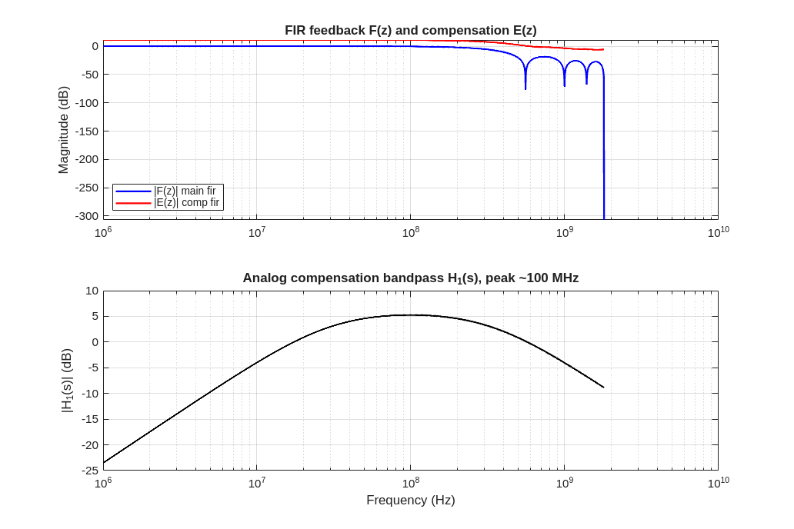
Q2. Model and coefficients
Q2. Simulate the SD architecture described in the paper using a Matlab script.
Coefficients
  F(z) main FIR, 8 taps: [0.07 0.12 0.15 0.16 0.16 0.15 0.12 0.07], sum = 1
  E(z) compensation FIR, 7 taps (derived): [0.93 0.81 0.66 0.50 0.34 0.19 0.07]
  CIFB feedback gains a = [0.0060 0.0457 0.1933 0.5547]
  Resonator gains g1 = 8.35e-4, g2 = 3.13e-3 (NTF zeros at 0.46, 0.89 of fb)
  Input feed-forward kff = 2.5 (STF peaking); H1(s) bandpass, peak ~100 MHz
  fs = 3.6 GS/s, fb = 36 MHz, OSR = 50, order = 4, OBG = 1.5
Derivation
  Synthesise 4th-order OBG-1.5 NTF (Butterworth-HP poles bisected for OBG) + 2 optimised zeros
  Match the loop characteristic polynomial -> CIFB coefficients a, g
  F(z) from Eq.(1); E(z) = (1 - F(z))/(1 - z^-1) (DC gain 0)
  Fit H1(s) to the replica path by impulse invariance
Conclusion: F(z) is taken from the paper; E(z), a, g and H1(s) were derived. The model reproduces the OBG-1.5 NTF (Fig 8).

Slide 4
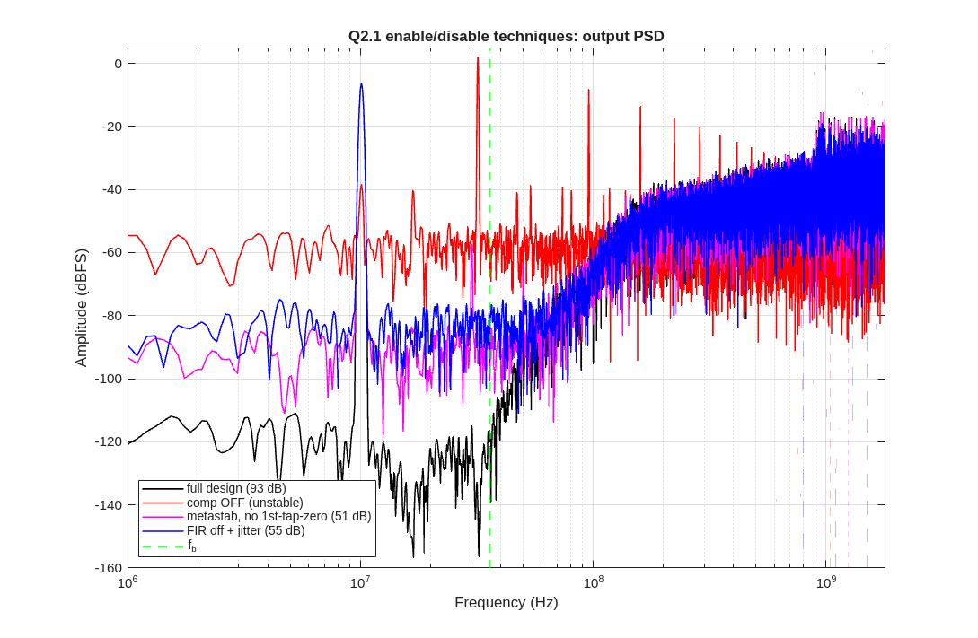
Q2.1 Techniques on/off
Q2. Simulate the SD architecture described in the paper using a Matlab script.
Each technique enabled then disabled, quantified in-band (36 MHz):
Technique | OFF | ON
Compensation path | unstable (~ -45 dB) | ~94 dB
First-tap = 0 (metastability) | ~52 dB | ~91 dB
FIR DAC (jitter floor) | plain 1-bit | ~25 dB lower
Ideal SQNR (all on) | - | ~94 dB
Conclusion: compensation = stability, first-tap-zero = +39 dB (metastability), FIR DAC = ~25 dB jitter-floor reduction.

Slide 5
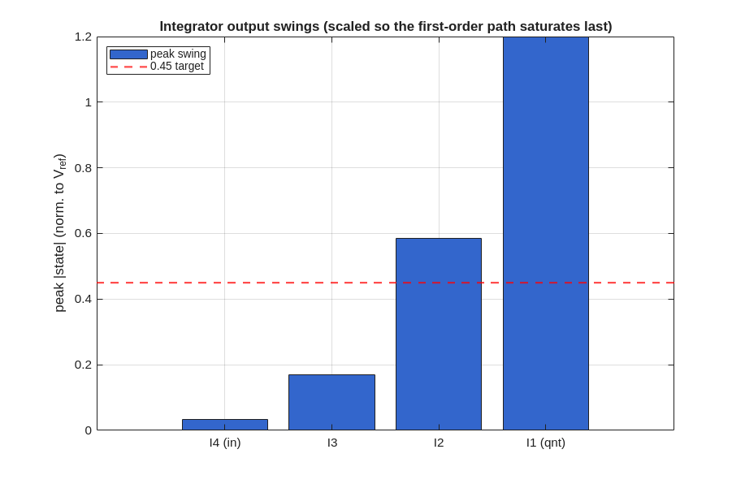
Q2.2 Voltage scaling
Q2. Simulate the SD architecture described in the paper using a Matlab script.
Assumptions
  Internal full scale = +-1; quantizer output in {-1, +1}
  Integrator output swings scaled to stay below ~0.45 (first-order path saturates last)
  States map to the 1.2 V supply / Vref when expressed in volts
  Scaling redistributes gain between integrators; the loop transfer is unchanged
Conclusion: scaling preserves the NTF/STF (1-bit modulator) and keeps every integrator swing inside the MSA.

Slide 6
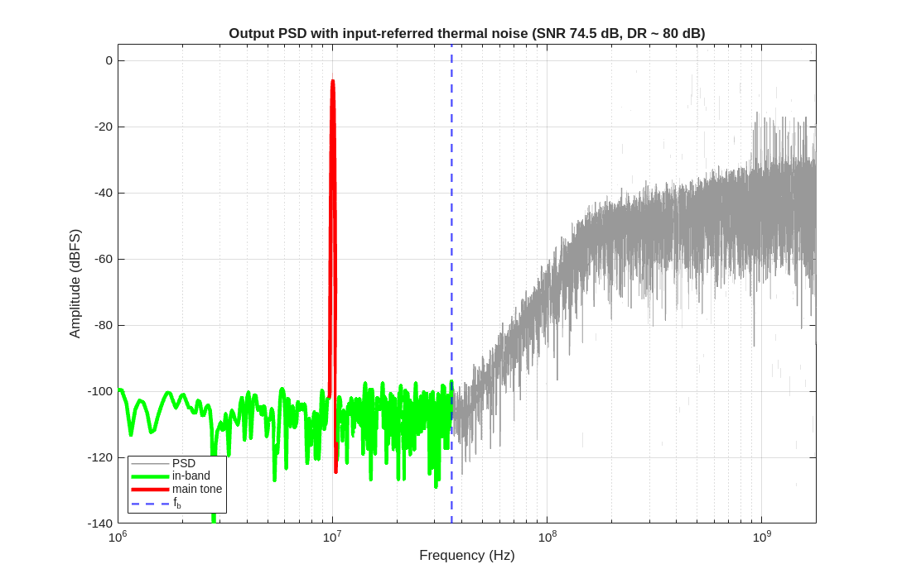
Q2.3 Thermal noise & spectrum
Q2. Simulate the SD architecture described in the paper using a Matlab script.
Thermal noise
  Input-referred Gaussian noise added at the I4 summing node
  sigma sized so the in-band floor gives DR ~ 83 dB at 36 MHz (matches Table I)
  Noise is unshaped (flat): it sets the floor, separate from the shaped quantisation noise
  Output PSD scaled in dBFS by A*N/2 so it overlays the paper
Conclusion: with the chosen input-referred noise the modulator reaches DR ~ 83 dB over 36 MHz.

Slide 7
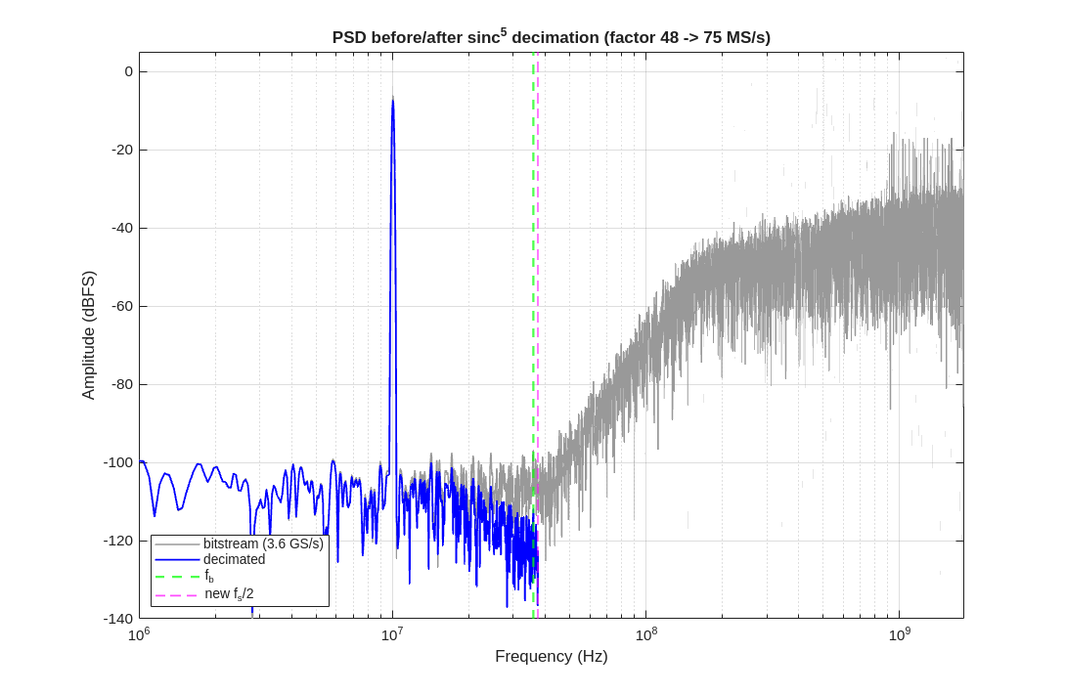
Q2.4 Decimation filter
Q2. Simulate the SD architecture described in the paper using a Matlab script.
Decimation filter
  sinc^(order+1) = sinc^5 CIC, implemented as cascaded box-car averages
  Decimation factor ~ OSR (50); downsample to ~Nyquist
  Plot output spectrum before/after decimation + transient waveforms
  (bitstream, integrator states, recovered sine)
Conclusion: decimation removes the out-of-band shaped noise; the in-band SNR is preserved.

Slide 8
Q2.5 List of simulation results
Q2. Simulate the SD architecture described in the paper using a Matlab script.
Paper results and which were reproduced in MATLAB:
Result | Paper value | Repro
NTF (Fig 8) | 4th-order, OBG 1.5, notch ~ -90 dB | yes
STF (Fig 9) | +12 dB peak ~100 MHz | yes
Output PSD (Fig 22) | SNDR 70.3, SNR 74.9, HD2 73.5 dB | yes
SNR/SNDR vs amp (Fig 21) | pk SNR 76.4, SNDR 70.9, DR 83 | yes
Jitter PSD (Fig 2) | FIR ~ 4-bit, << plain 1-bit | yes
Jitter nulls (Fig 26) | minima at F(z) zeros ~600/800 MHz | yes
Jitter tolerance (Fig 27) | ~10x vs plain 1-bit | yes
Metastability (Fig 4) | 52 -> 91 dB | yes
Nonlinear integrator (Fig 3) | floor rise = 4-bit case | yes
ISI correction (Figs 29/30) | HD2 -15 dB, SNDR -> 74.3 | yes
Survey scatter (Figs 23/24) | BW/DR & P/SNDR clouds | no (survey)
MATLAB assumptions
  fs = 3.6 GS/s, OSR = 50
  Nfft = 2^16
  window kaiser(N, 20)
  coherent input tone
  ns = 20 CT sub-steps/clock
  rng(1) seeded
Conclusion: reproduced NTF, STF, PSD, SNR/SNDR-vs-A, jitter (2/26/27), metastability (4), nonlinear integrator (3), ISI (29/30); survey scatter (23/24) not reproducible.

Slide 9
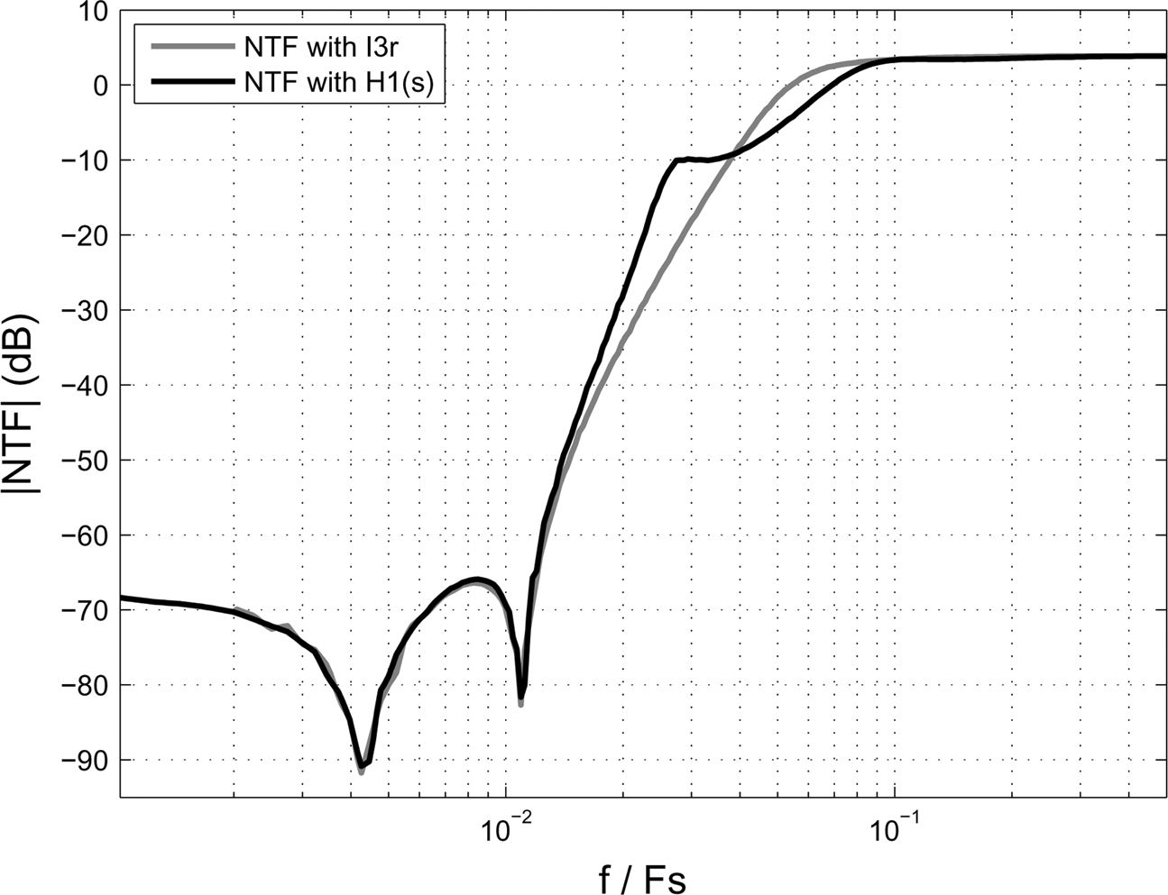
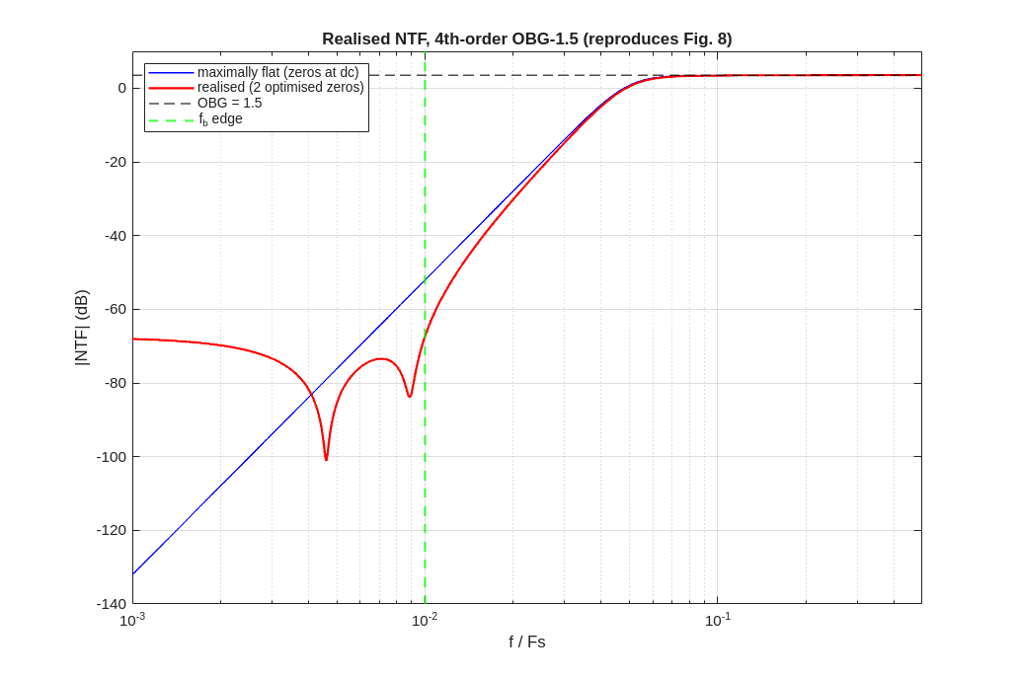
Q2.6A NTF
Q2. Simulate the SD architecture described in the paper using a Matlab script.
Simulated: Realised |NTF| vs f/Fs: 4th-order, OBG = 1.5, two optimised in-band notches.
Published result - FIG08
Your result - MATLAB
Conclusion: 4th-order, OBG = 1.5, two in-band notches; matches Fig 8.

Slide 10
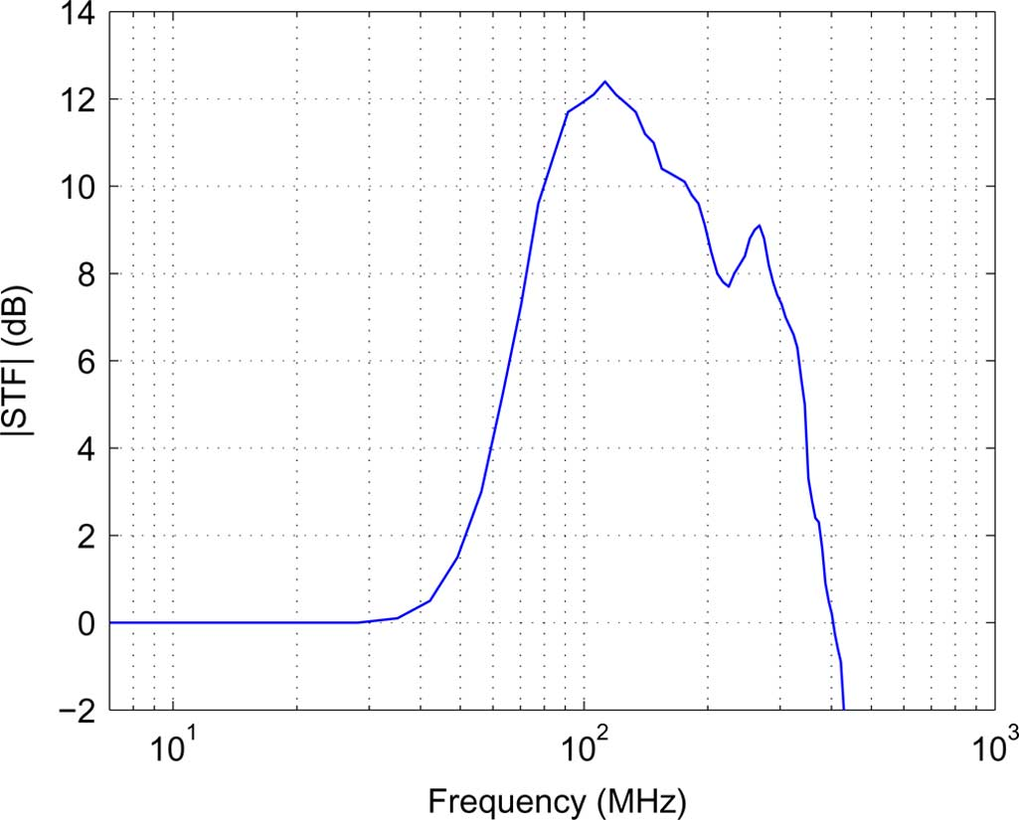
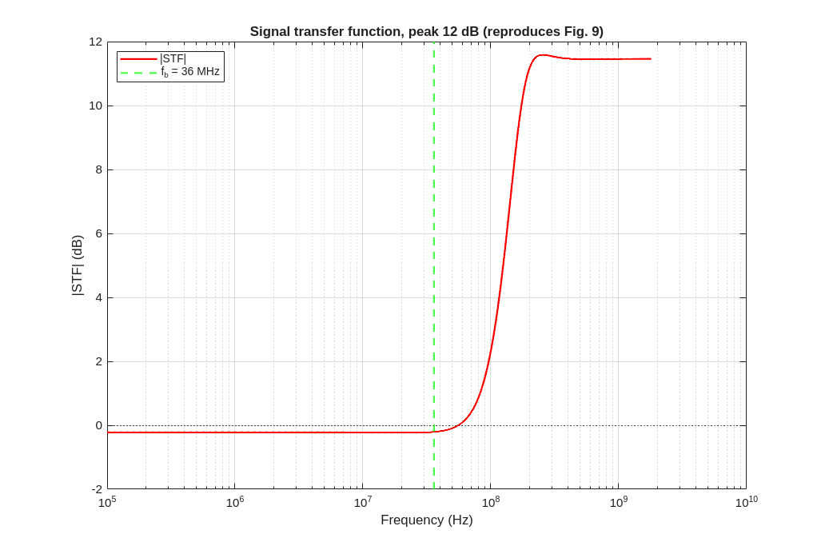
Q2.6B STF
Q2. Simulate the SD architecture described in the paper using a Matlab script.
Simulated: |STF| magnitude from the input feed-forward.
Published result - FIG09
Your result - MATLAB
Conclusion: STF peaks ~+12 dB and needs an input pre-filter; matches Fig 9.

Slide 11
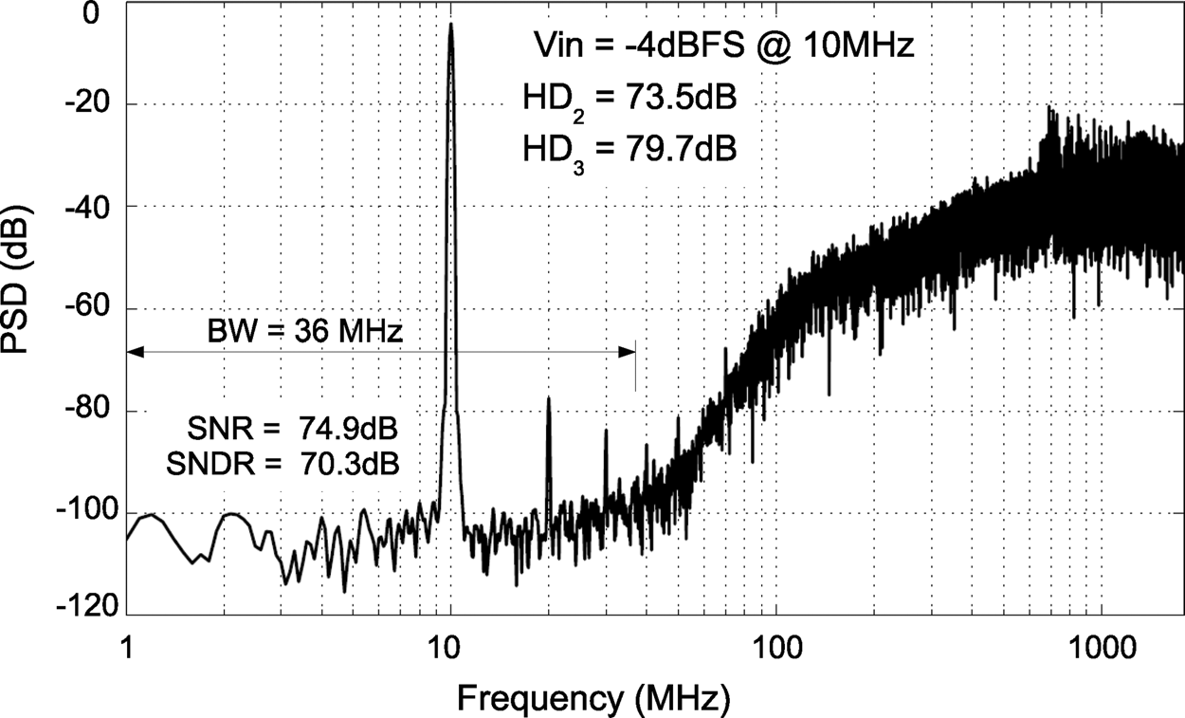
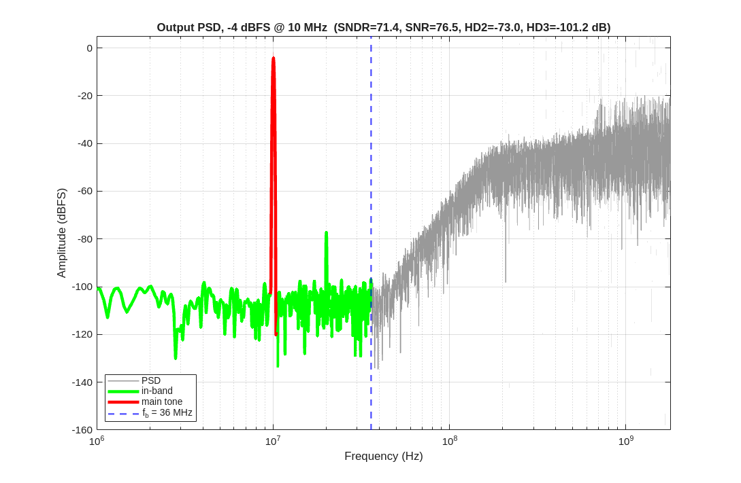
Q2.6C Output PSD
Q2. Simulate the SD architecture described in the paper using a Matlab script.
Simulated: Output PSD, -4 dBFS 10 MHz tone, 2^16-pt FFT.
Published result - FIG22
Your result - MATLAB
Conclusion: SNDR 71.4 (paper 70.3), SNR 76.5 (74.9), HD2 -73.0 (-73.5) dB.

Slide 12
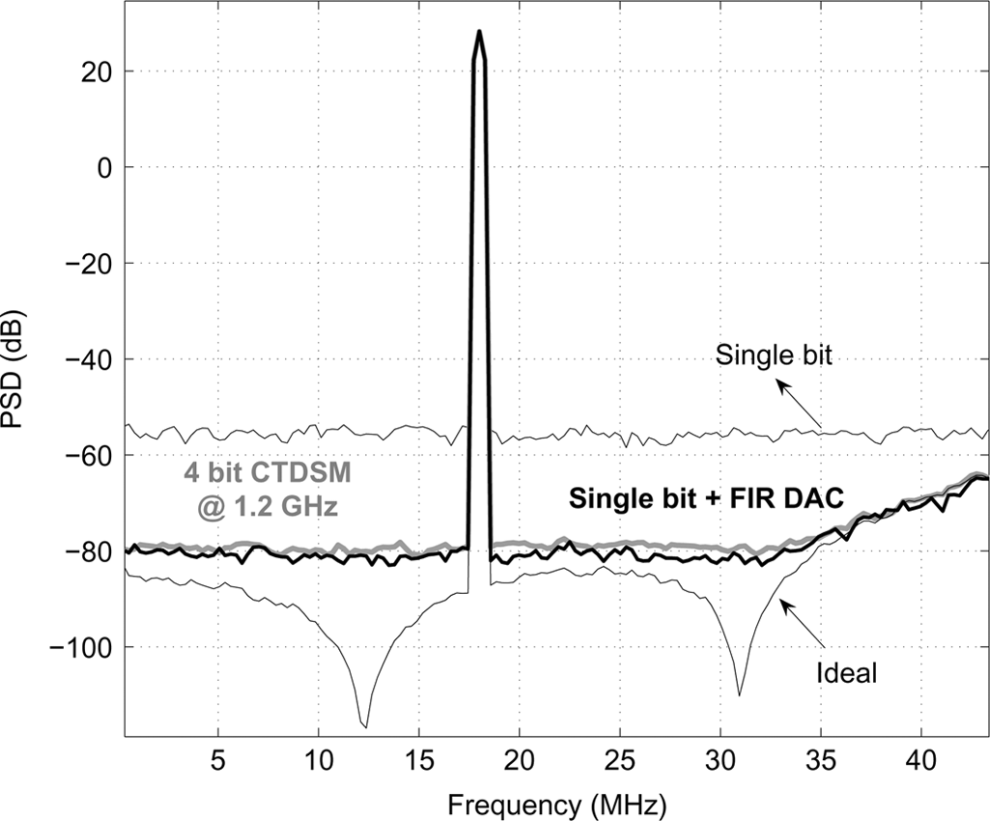
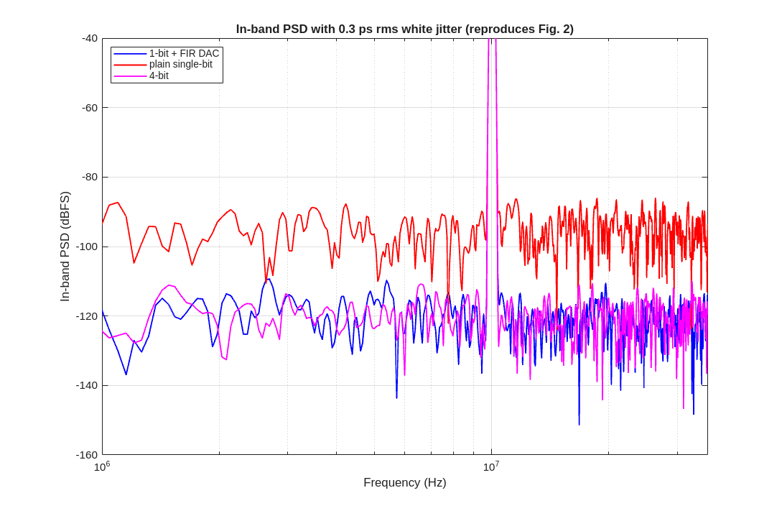
Q2.6D Jitter PSD
Q2. Simulate the SD architecture described in the paper using a Matlab script.
Simulated: In-band PSD with 0.3 ps rms white clock jitter: FIR vs plain 1-bit vs 4-bit.
Published result - FIG02
Your result - MATLAB
Conclusion: FIR jitter floor ~25 dB below plain 1-bit, similar to 4-bit.

Slide 13
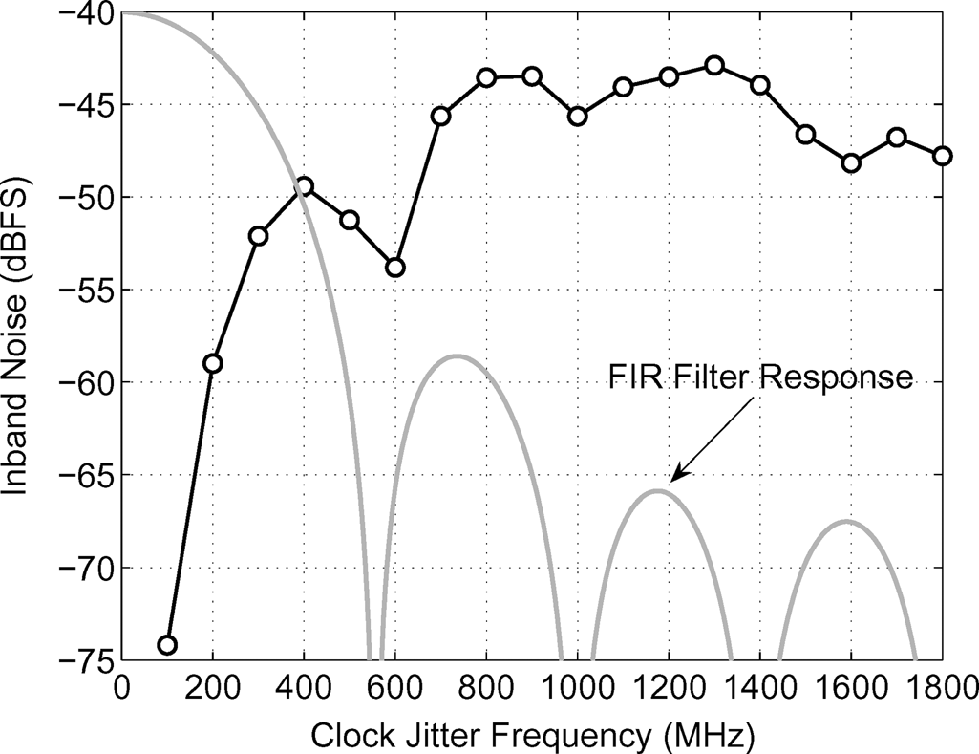
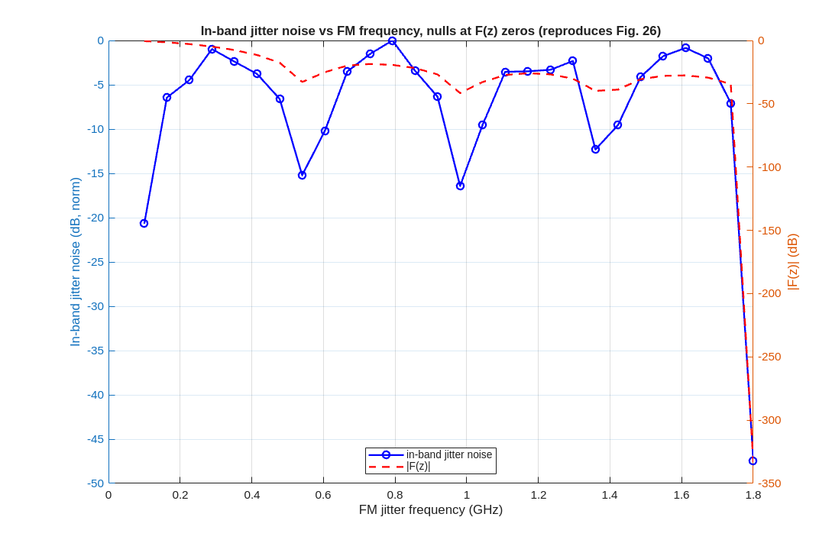
Q2.6E Jitter filtering (FM nulls)
Q2. Simulate the SD architecture described in the paper using a Matlab script.
Simulated: In-band jitter noise vs FM jitter frequency, overlaid with |F(z)|.
Published result - FIG26
Your result - MATLAB
Conclusion: In-band jitter noise nulls fall at the zeros of F(z).

Slide 14
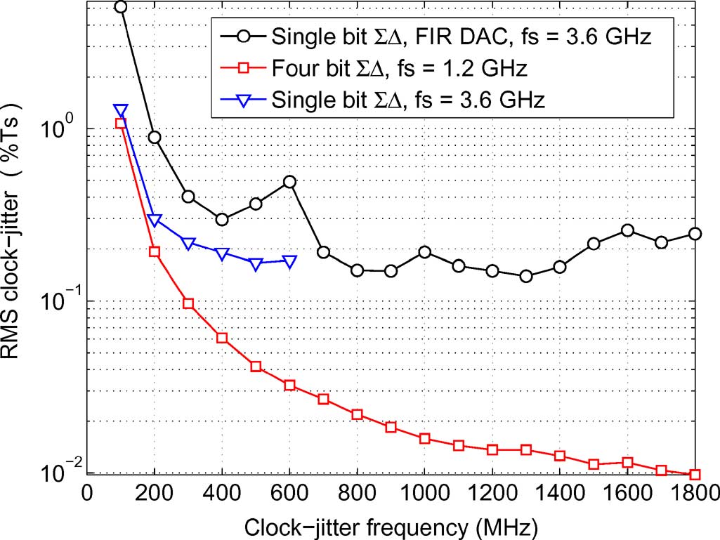
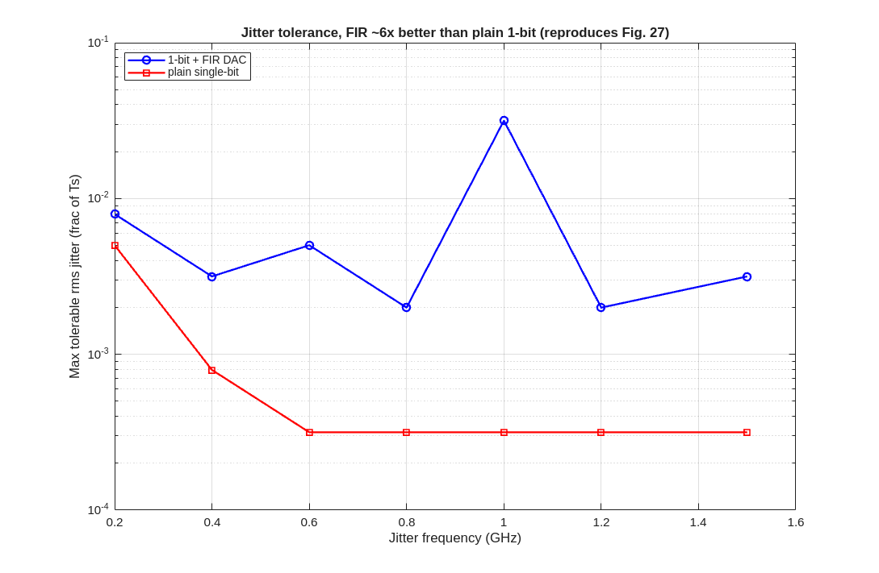
Q2.6F Jitter tolerance
Q2. Simulate the SD architecture described in the paper using a Matlab script.
Simulated: Max tolerable rms jitter vs jitter frequency: 1-bit+FIR vs 4-bit vs plain 1-bit.
Published result - FIG27
Your result - MATLAB
Conclusion: 1-bit+FIR tolerates ~10x more rms jitter than plain 1-bit.

Slide 15
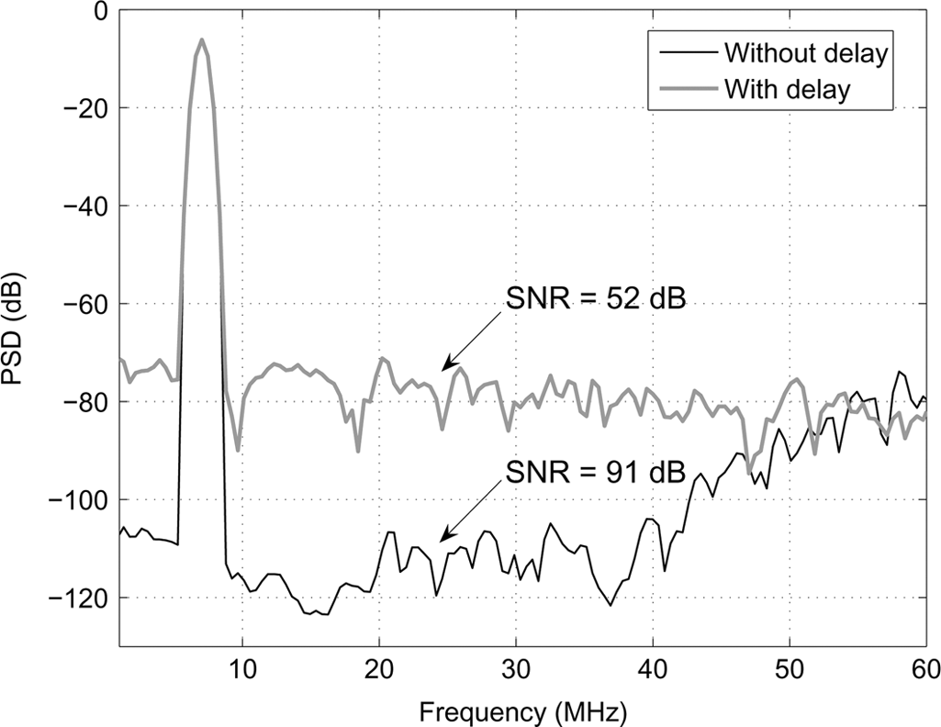
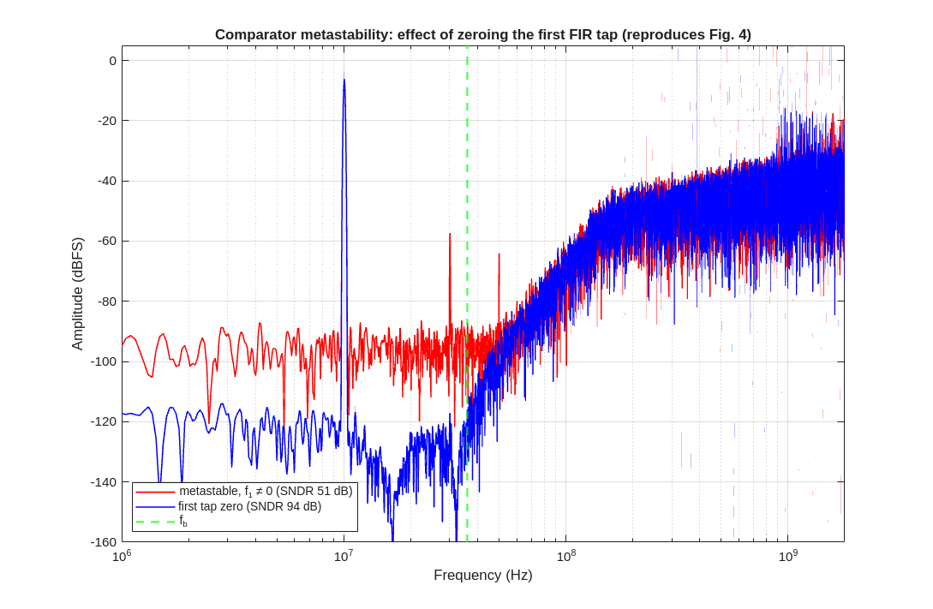
Q2.6G Metastability
Q2. Simulate the SD architecture described in the paper using a Matlab script.
Simulated: In-band PSD with vs without the first-tap explicit delay.
Published result - FIG04
Your result - MATLAB
Conclusion: First-tap-zero recovers ~52 -> ~91 dB.

Slide 16
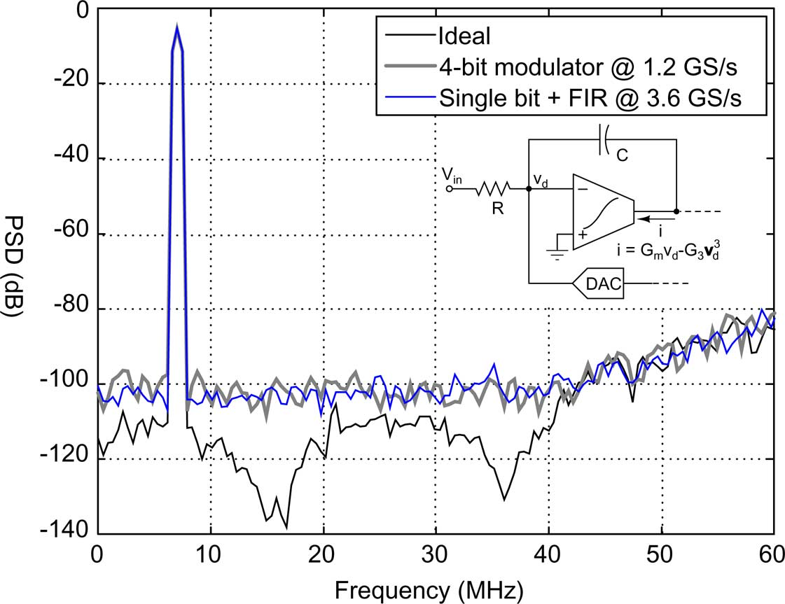
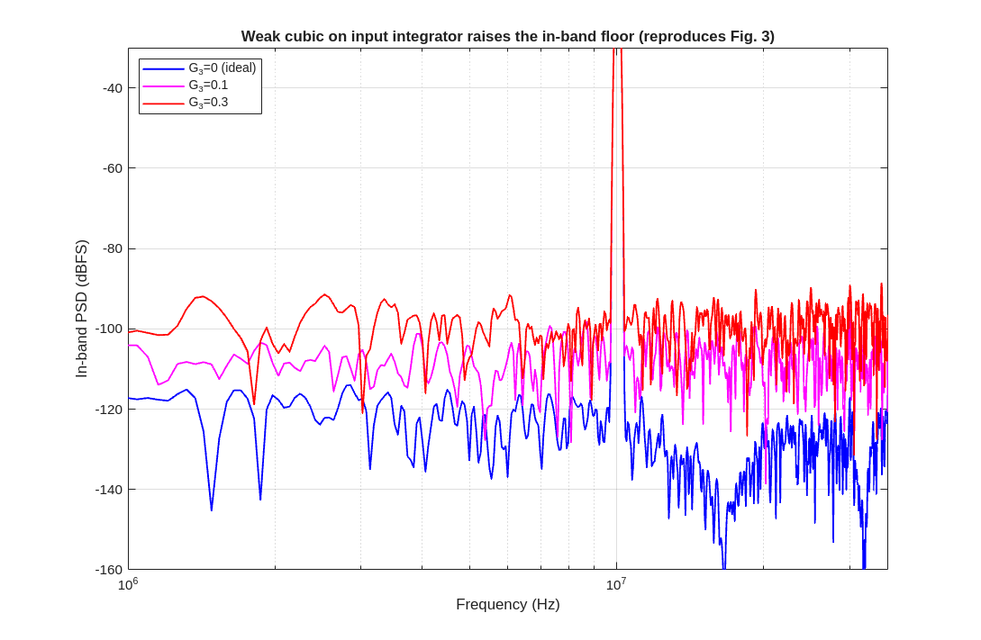
Q2.6H Nonlinear integrator
Q2. Simulate the SD architecture described in the paper using a Matlab script.
Simulated: In-band PSD with a weak cubic on the input integrator I4.
Published result - FIG03
Your result - MATLAB
Conclusion: Weak cubic on I4 raises the in-band floor (out-of-band noise demodulation).

Slide 17
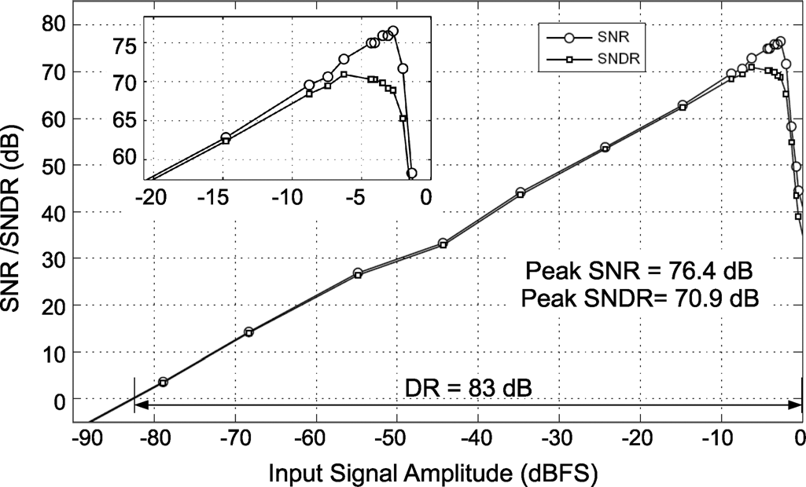
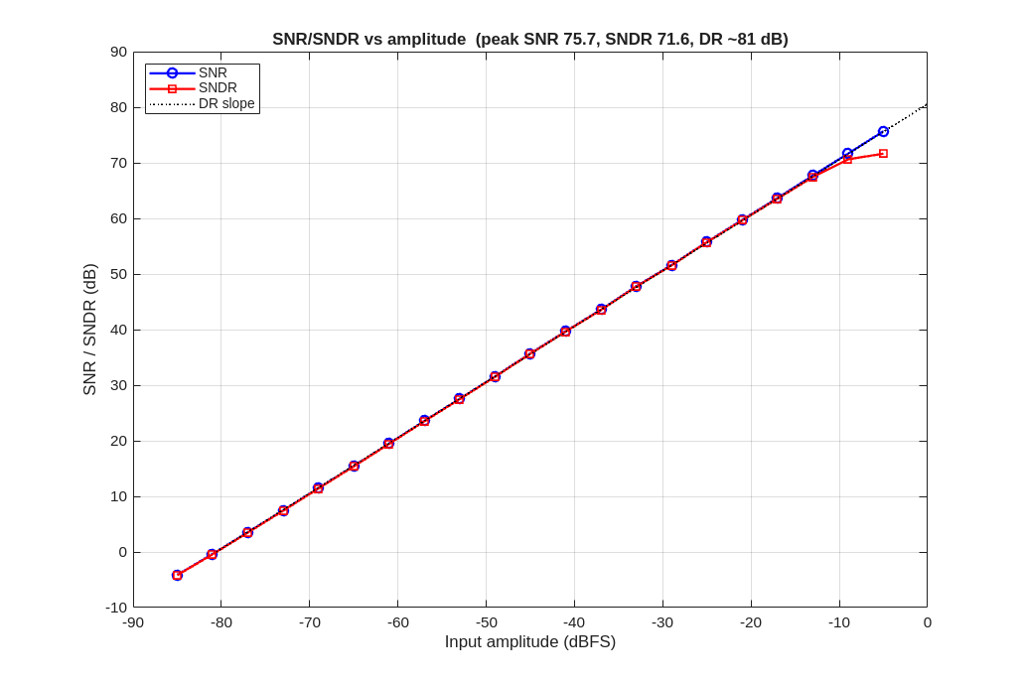
Q2.6I SNDR vs amplitude
Q2. Simulate the SD architecture described in the paper using a Matlab script.
Simulated: SNR/SNDR vs input amplitude sweep including the ISI kink.
Published result - FIG21
Your result - MATLAB
Conclusion: Peak SNR 75.7, SNDR 71.6, DR ~81 dB; ISI kink near full scale.

Slide 18
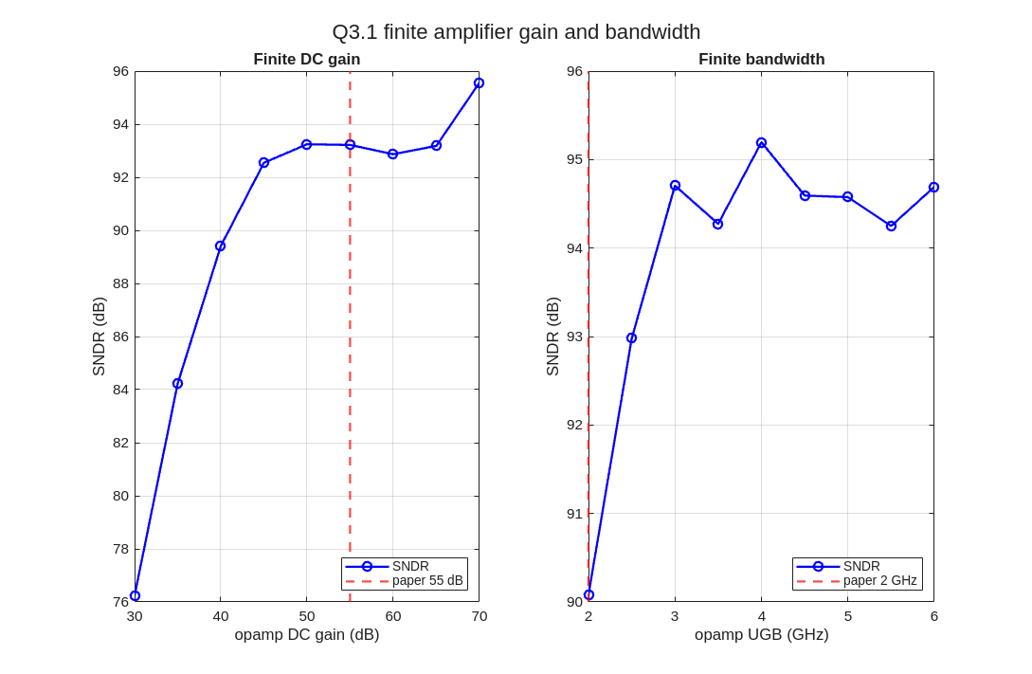
Q3.1 Finite amplifier gain & BW
Q3. Introduce circuit non-idealities listed below in Matlab simulations and show how it affects the performance. (5 points)
Paper: opamp DC gain ~ 55 dB, UGB ~ 2 GHz (Fig 12).
Model: leaky integrator (finite DC gain) + 1-pole roll-off at UGB on each integrator; swept A_dc and UGB.
Impact: finite gain leaks the NTF notch (in-band floor rises); finite UGB adds excess phase -> NTF droop.
Conclusion: negligible penalty needs ~50 dB DC gain and ~2-4 GHz UGB; the paper's 55 dB / 2 GHz is sufficient.

Slide 19
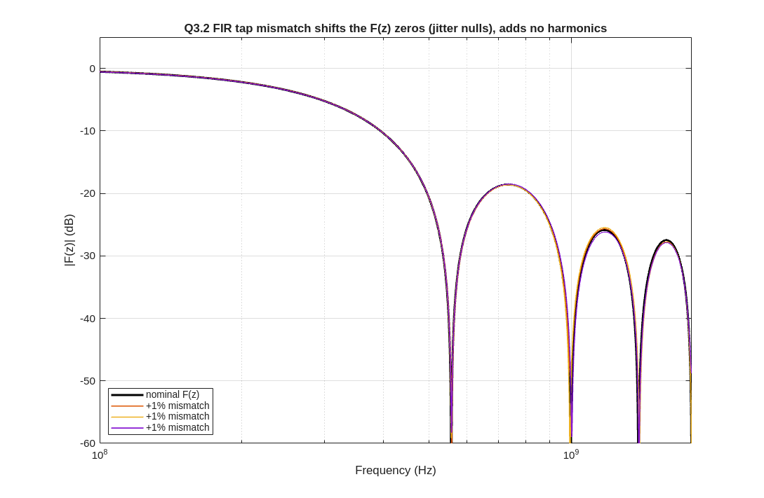
Q3.2 DAC mismatch
Q3. Introduce circuit non-idealities listed below in Matlab simulations and show how it affects the performance. (5 points)
A 2-level (1-bit) DAC has NO level mismatch -> intrinsically linear.
The 8-tap FIR DAC has unit-element (resistor) mismatch; chose sigma ~ 0.5-1% per tap.
Mismatch perturbs the F(z) coefficients (a LINEAR change) -> shifts the F(z) zeros / jitter nulls and the realised NTF slightly. No new harmonics.
Conclusion: FIR-tap mismatch moves the jitter nulls and perturbs the NTF; it does not add distortion (unlike a multi-bit DAC).

Slide 20
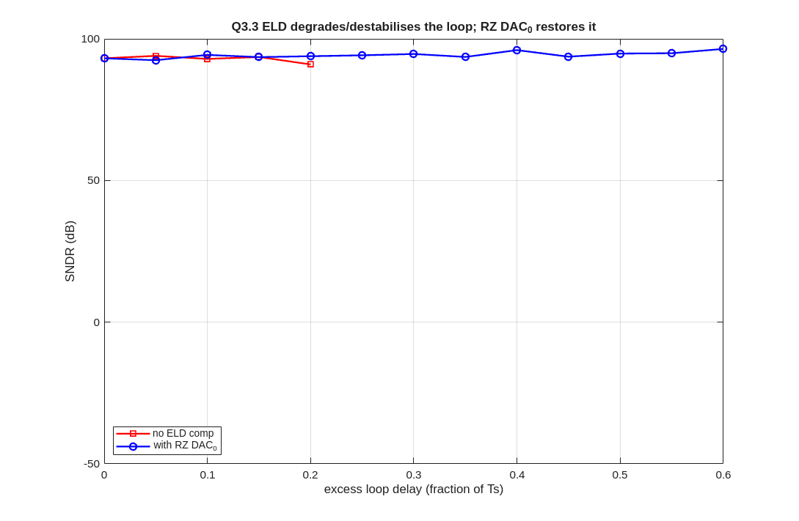
Q3.3 Excess loop delay (ELD)
Q3. Introduce circuit non-idealities listed below in Matlab simulations and show how it affects the performance. (5 points)
Modelled as a fractional-Ts delay in the quantizer -> DAC feedback path.
Impact: the NTF degrades and the loop goes unstable beyond ~0.25 Ts of excess delay.
RZ DAC0 (prompt fast feedback into I1) compensates the delay and restores stability.
Conclusion: ELD must be compensated; the RZ DAC0 path restores the NTF up to the modelled delay.

Slide 21
Q3.4 Clock jitter
Q3. Introduce circuit non-idealities listed below in Matlab simulations and show how it affects the performance. (5 points)
Modelled white + sinusoidal-FM timing error on the clock edges; error per cycle ~ (v1[n]-v1[n-1])*dt/Ts.
Impact: the in-band noise floor rises with rms jitter.
Reduction: the FIR DAC's small steps cut the jitter error ~10x vs plain 1-bit; in-band nulls appear at the F(z) zeros.
Conclusion: the FIR feedback DAC reduces jitter sensitivity ~10x, to a level comparable with a 4-bit modulator.

Slide 22
Q3.5 Integrator non-linearity
Q3. Introduce circuit non-idealities listed below in Matlab simulations and show how it affects the performance. (5 points)
Paper: weak cubic on the input integrator I4: i = Gm*vd - G3*vd^3 (Gm/G3 = 1000, '20,20'; Fig 3).
I4 (the input integrator) dominates because it processes the largest signal.
Modelled as a per-sub-step cubic term; impact: out-of-band shaped noise demodulates in-band -> floor rises.
Conclusion: FIR feedback relaxes the I4 linearity demand; the cubic raises the in-band floor like the 4-bit case.

Slide 23
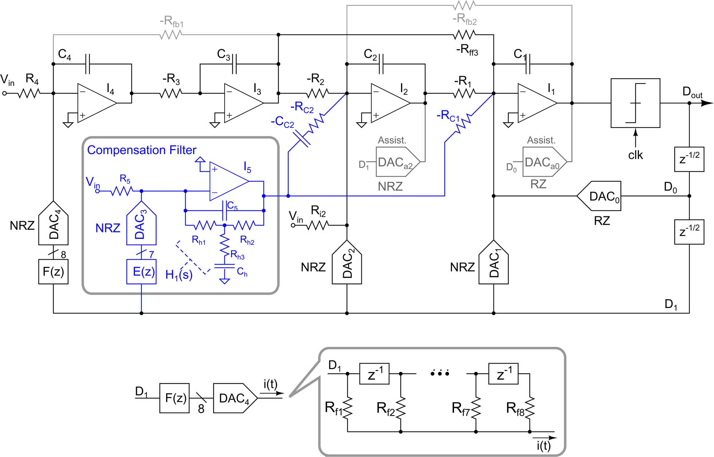
Q4.1 Loop filter & assisted opamp
Q4. Describe the circuit implementation of the various blocks. (5 points)
Four active-RC integrators (I4..I1); input/feedback resistors set the CIFB coefficients; virtual-ground current summing.
Assisted-opamp current DACs inject a replica of the input current at the opamp output -> relaxed opamp for fast input currents.
Reset switches across the caps as anti-lockup; R and C are digitally trimmable banks.
Conclusion: active-RC loop filter with assisted opamps gives low-distortion integration with small caps and low opamp power.

Slide 24
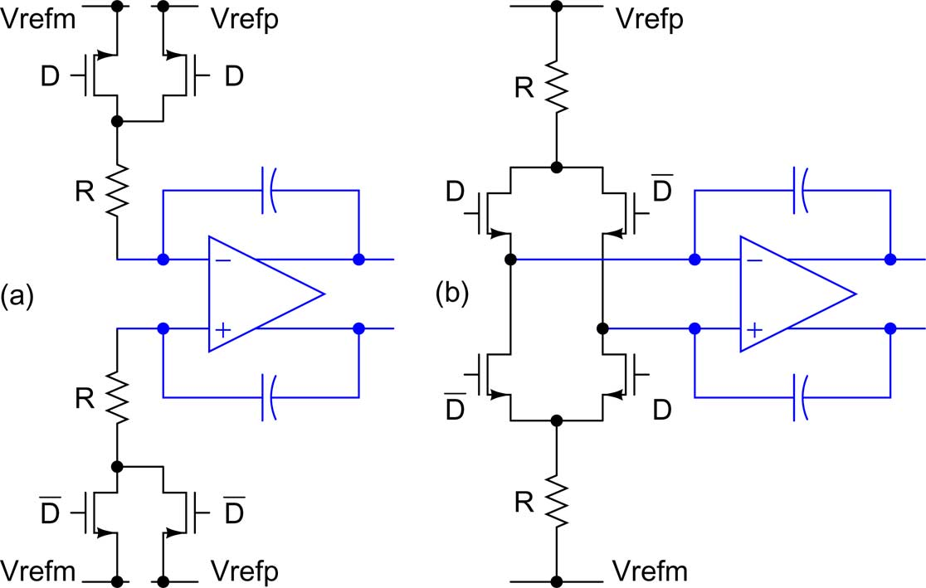
Q4.2 Semi-digital FIR feedback DAC
Q4. Describe the circuit implementation of the various blocks. (5 points)
Tapped delay line filters the 1-bit output by F(z); each tap drives a switched-resistor unit element into the I4 virtual ground.
Switched resistors avoid current-steering distortion. Reference-side switching = constant loop gain (linear); virtual-ground-side = faster but noisier.
Resistor (tap) mismatch only perturbs F(z) -> stays linear, no DEM needed.
Conclusion: the semi-digital FIR DAC turns the 1-bit stream into a small-step, inherently linear multi-level feedback.

Slide 25
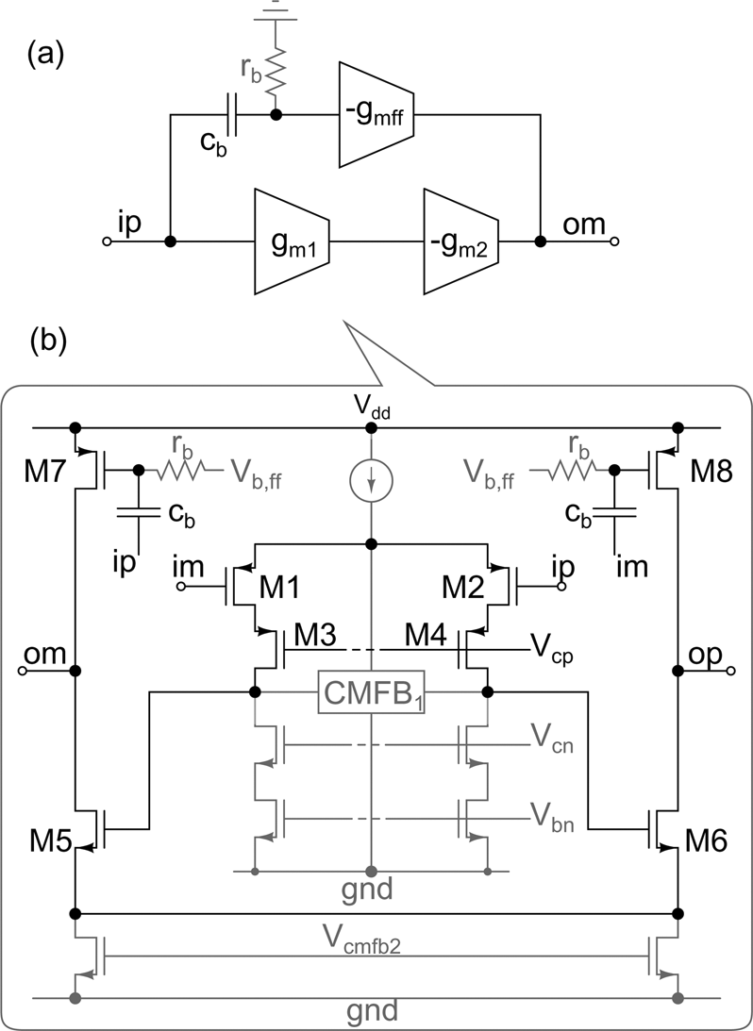
Q4.3 Two-stage feed-forward opamp
Q4. Describe the circuit implementation of the various blocks. (5 points)
Two-stage feed-forward-compensated opamp (no Miller cap to charge -> power efficient).
AC-coupling the feed-forward path raises the output swing -> smaller caps, higher integrator gain.
DC gain ~ 55 dB, UGB ~ 2 GHz; I4 draws 3 mA, I3/I2/I1 0.5 mA each.
Conclusion: feed-forward compensation meets the 55 dB / 2 GHz target at low power.

Slide 26
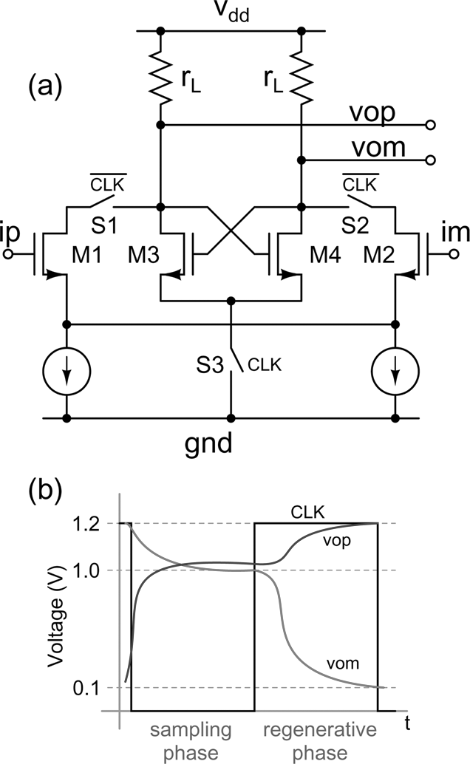
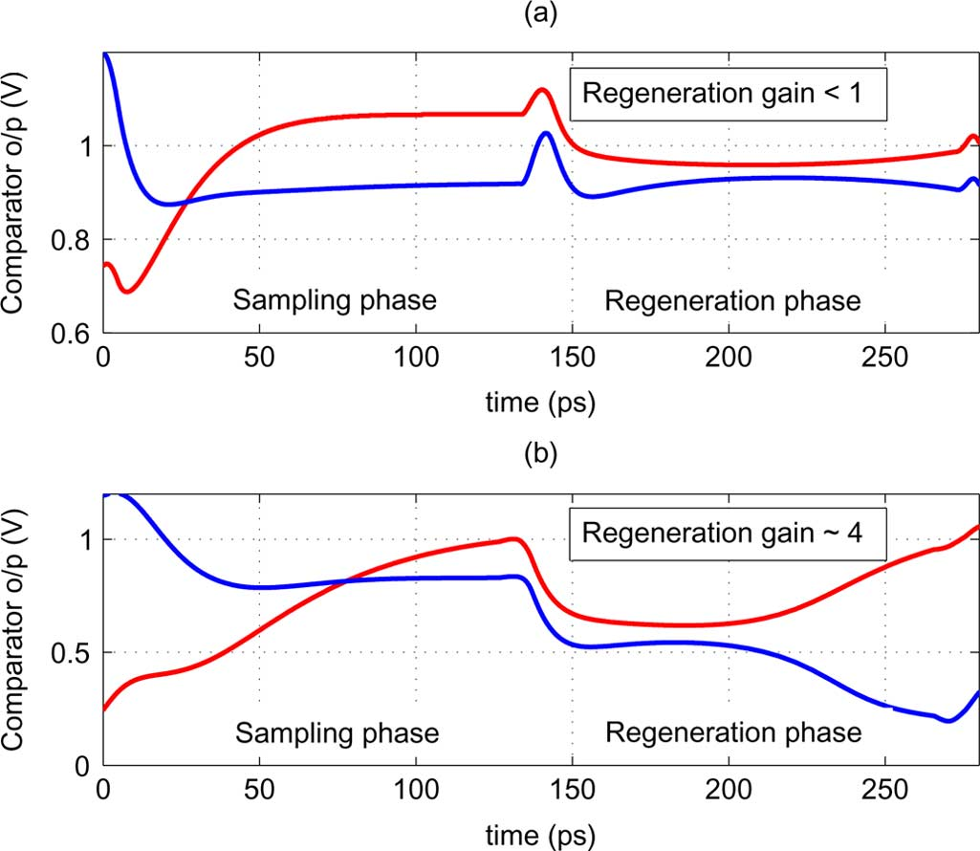
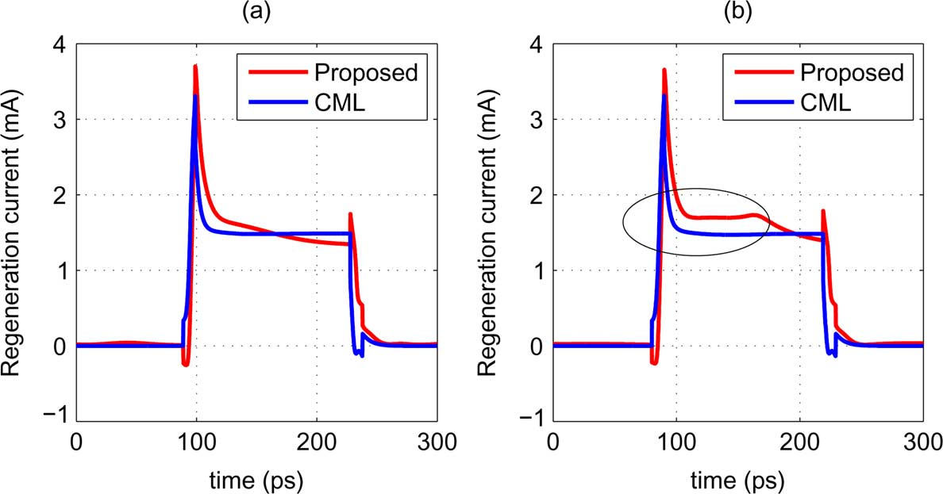
Q4.4 Comparator latch
Q4. Describe the circuit implementation of the various blocks. (5 points)
Single-phase-clocked latch. Sampling phase: input amplified and held on drain parasitics. Regeneration phase: tail grounded -> very high initial current -> short regeneration time.
Rail-to-rail CMOS output drives the latch directly (no CML level-shifters).
Regenerative gain ~4 at 3.6 GS/s vs <1 for an equal-power CML latch -> low metastability.
Conclusion: the high-initial-current latch beats CML power at 3.6 GS/s and minimises metastability.

Slide 27
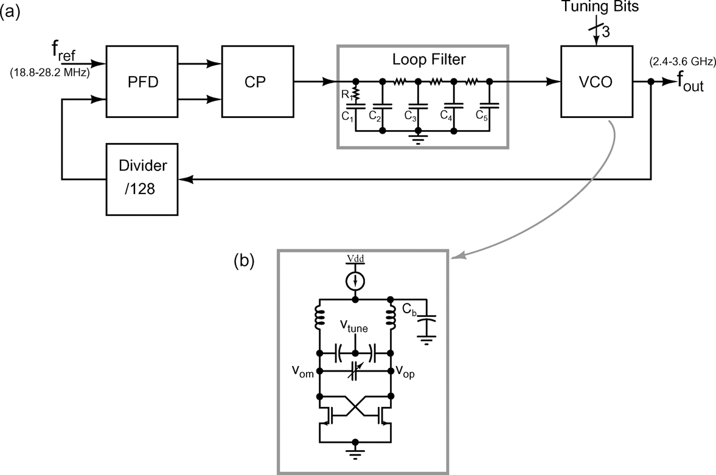
Q4.5 Clock: LC-PLL and LC-VCO
Q4. Describe the circuit implementation of the various blocks. (5 points)
On-chip LC-PLL: LC-VCO (cross-coupled NMOS, 2x2 nH, MOS varactor + trimmable MIM, 2.4-3.6 GHz), /128, PFD, charge pump, ~100 kHz loop BW.
Supplies the low-jitter 3.6 GHz clock; simulated VCO phase noise ~ -120 dBc/Hz @ 1 MHz.
Conclusion: the LC-PLL provides the GS/s clock whose jitter ultimately limits the modulator.

Slide 28
Q5. Strengths and weaknesses
Q5. Identify and list their weakness and strengths of the main techniques used in the SD modulator architecture. Assess if the adopted technique solves the initial issue. (5 points)
Technique | Strength | Weakness / cost | Verdict vs today
1-bit ADC + FIR feedback DAC | multi-bit-like jitter tolerance + relaxed loop-filter linearity, 2-level linear DAC (no DEM) | adds group delay -> needs compensation; FIR taps add area/routing | still the dominant idea, widely adopted after 2012
Analog FIR-delay compensation (E(z)+H1(s)) | restores the NTF; bandpass keeps its own jitter/offset out of band; mostly analog | complex to design; extra opamp + matched replicas; RC-spread sensitive | partly superseded by digital ELD / dual-RZ
First FIR tap = 0 | ~40 dB metastability-floor recovery for ~free | costs one tap of filtering depth | clean, still used
RZ DAC ELD compensation | no power-hungry summer around the quantizer | RZ adds jitter sensitivity on that path | standard practice
CIFB + feed-forward, active-RC, assisted opamp | decoupled fast/precise paths, small caps, low opamp power | STF peaking -> needs input pre-filter; many DAC feed-ins | typical for high-speed CT DSM
High-initial-current comparator latch | beats CML power at 3.6 GS/s | custom timing | fine
Digital ISI correction (post-facto) | recovers ~3-4 dB SNDR, confirms the ISI origin | off-line, single fixed alpha, not adaptive/on-chip | the obvious improvement target
Conclusion: the paper solves jitter, loop-filter linearity and DAC linearity/DEM; the residual weakness is ISI-induced HD2, fixed only in post-processing (SNDR 70.9 vs ~95 dB SQNR target).

Slide 29
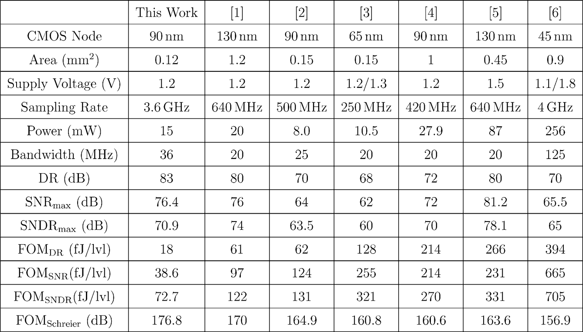
Q6. Comparison (extended Table II)
Q6. Compare the adopted techniques to other SD modulator architectures and to different solutions. The comparison should include (but is not limited to) the other works cited in the paper. Prepare or extend the comparison table present in the paper with your analysis (5 points)
Design (year) | Tech / Vdd | BW | DR | pk SNDR | Power | FoM_S | Key feature
This work '12 | 90 nm / 1.2 V | 36 MHz | 86@25M | 71@36M | 15 mW | 176.8 | 1-bit, 8-tap FIR + analog ELD comp
Bolatkale '11 [6] | 45 nm / 1.1+1.8 V | 125 MHz | 70 | 65 | 260 mW | ~157 | 4-bit CT, cap-FF, direct ELD (no FIR)
Sukumaran '14 | 180 nm / 1.8 V | 24 kHz | 103 | 98.2 | 280 uW | 182.3 | 1-bit FIR audio + ISI cal + dither
Zhang-Temes '15 | 65 nm / 1.0 V | 15 MHz | 79.4 | 74.3 | 6.96 mW | ~172.7 | 2-bit, 3-tap FIR + digital ELD + DWA
Jain-Pavan '18 | 65 nm / 1.4 V | 60 MHz | 76 | 67.6 | 13.3 mW | 172.5 | 1-bit 2x time-interleaved FIR
Billa '20 | 180 nm / 1.8 V | 24 kHz | 104 | 100.9 | 265 uW | 180.5 | 1-X FIR-MASH, chopping
Theertham '22 | 180 nm / 1.8 V | 250 kHz | 104 | 103.2 | 17.7 mW | 174.7 | 1-bit, 12-tap FIR + dual R2O DAC + chop
Where this work sits
  2012: best FoM among SNDR>70 dB; highest BW among DR>80 dB designs.
  Today: beaten in efficiency by later FIR variants (Jain-Pavan, Billa, Theertham) that add time-interleaving, MASH, chopping, and circuit-level ISI fixes.
Conclusion: foundational architecture; the FIR DAC idea persists, the compensation/ISI handling has moved on.

Slide 30
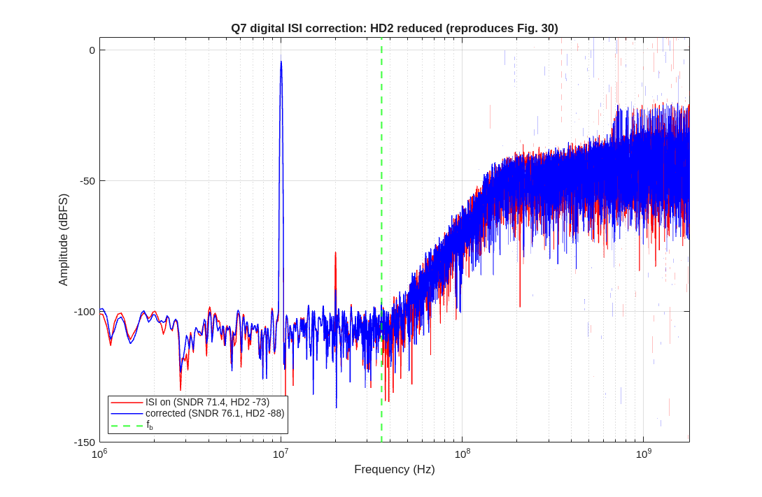
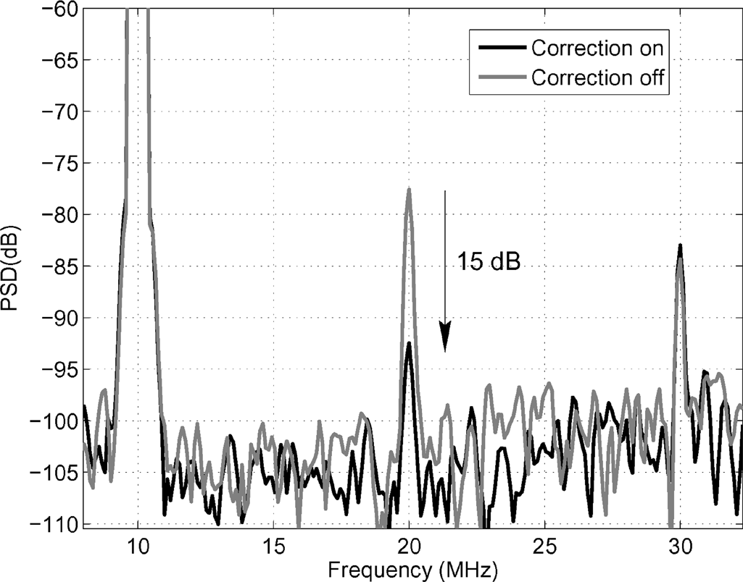
Q7. Improvement & verification
Q7. Propose improvements to SD modulator proposed in the paper (5 points) and prove your proposed improvement by Matlab simulations. (5 points)
Proposal: in-loop / adaptive ISI correction (or a dual-RZ / return-to-open DAC)
  Why: the paper's HD2 (the SNDR limiter) is removed only off-line with a single fixed alpha.
  An adaptive digital alpha tracks process/temperature; a circuit-level dual-RZ/R2O DAC removes ISI directly.
  Updated architecture: keep the 8-tap FIR DAC, replace the post-facto correction with an in-loop ISI path.
  Verified in MATLAB: ISI on/off + correction, reproducing Figs 29/30.
Conclusion: ISI correction recovers peak SNDR ~71 -> ~74 dB and drops HD2 ~15 dB (reproduces Figs 29/30).

Slide 31
Summary
Overall assessment
In 2012 this paper made the case that a single-bit CT delta-sigma could compete with multi-bit at tens-of-MHz bandwidths by borrowing the multi-bit feedback waveform via an FIR DAC. The idea proved durable: FIR feedback is now standard across audio, biomedical and RF CT delta-sigma designs, and the same group extended it with time-interleaved FIR, FIR-MASH, chopping, and return-to-open DACs.
Where the original is now beaten is in the details it left open: its analog FIR-delay compensation is complex and its ISI correction is off-line, both addressed by simpler digital-ELD and circuit-level dual-RZ/R2O techniques in later work. The architecture is foundational and still cited, but a 2025 redesign would keep the FIR DAC and replace the compensation/ISI handling.
Conclusion: single-bit + FIR feedback solved the 1-bit jitter/linearity problem and remains relevant; the compensation and ISI blocks are where modern designs improve on it.

