Slide 1
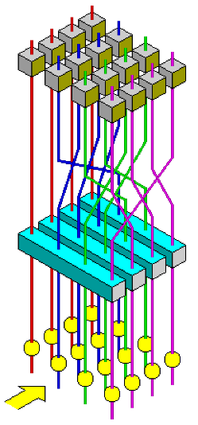

Title slide + image
Processor Design Project
Group 24

Slide 2

Introduction
Data security is critical across embedded systems, IoT, and communications infrastructure
Encryption is the primary mechanism
AES is the global standard
The primary goal of this project:
implement AES acceleration on a RISC-V core efficiently in hardware

Slide 3

Where is AES used?
HTTPS/TLS
Wi-Fi (WPA2/WPA3)
File encryption
Cloud storage
VPNs
USB drives & SSDs
Smart cards & passports
IoT devices

Slide 4
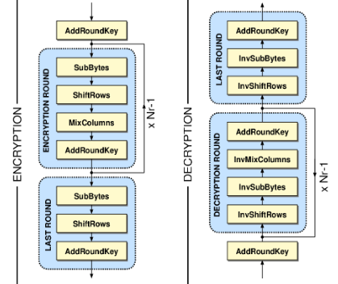
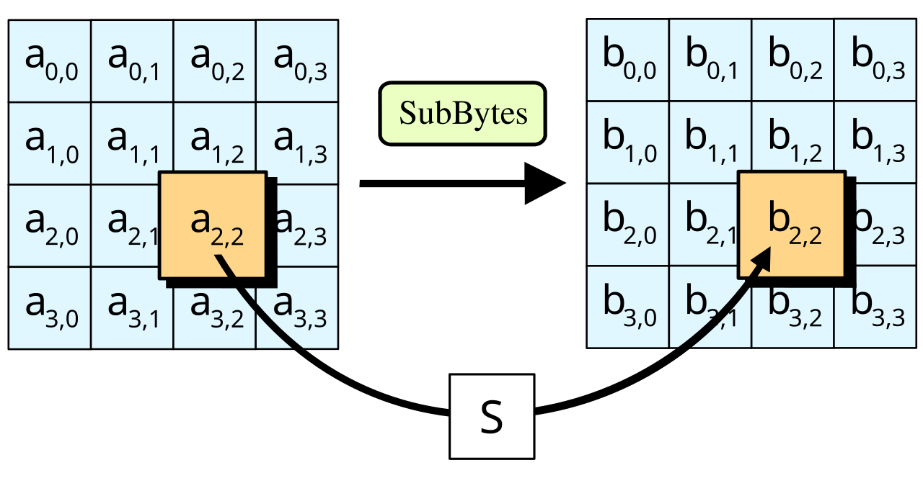
Advanced Encryption Standard (AES)
What is AES?
Symmetric block cipher — same key for encryption and decryption
Operates on a 4×4 matrix of bytes called the state (= 128 bits)
Key is expanded into 11 round keys via the key schedule

Slide 5
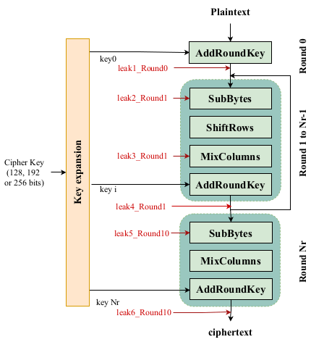
Advanced Encryption Standard (AES)
How does AES work?
Initial Round Plain text XOR'd with round key 0
Middle Rounds × 9
SubBytes — Byte substitution via S-box (confusion)
ShiftRows — Cyclic row shifts to spread data across columns
MixColumns — Column mixing over GF(2⁸) (diffusion)
AddRoundKey — XOR with current round key
Final Round (Round 10) Same as middle rounds but no MixColumns

Slide 6
Baseline software implementation
Pure C AES-128 on the unmodified RISCY core: standard loads, stores, XORs and shifts.
Table-based S-box and gf_mult MixColumns, all from data memory; no hardware acceleration.
Resource | Count
Cycle Count | 61184
LUTs | 4644
Registers | 2163
Muxes | 284
61,184 cycles per block, almost all spent in MixColumns (next slide). This is the bottleneck the hardware targets.

Slide 7
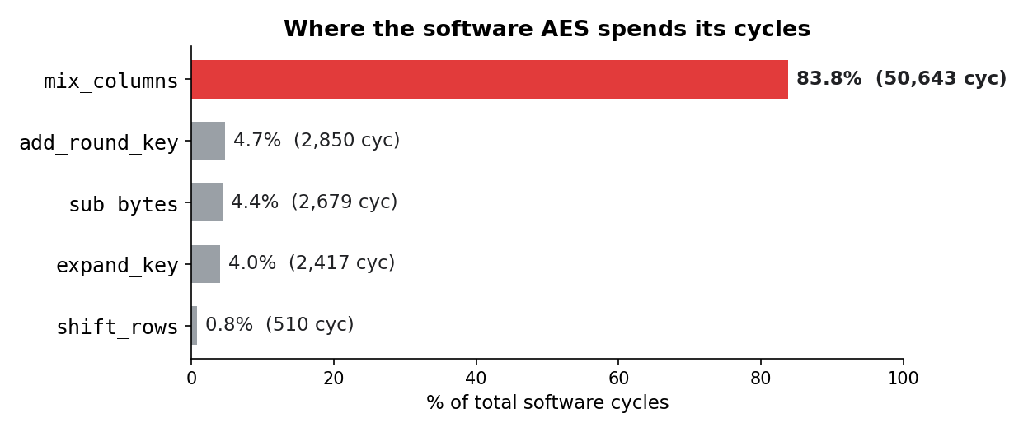
Baseline Bottlenecks
MixColumns (the gf_mult inner loop) is 83.8% of all cycles, so it is the single thing worth accelerating in hardware.

Slide 8
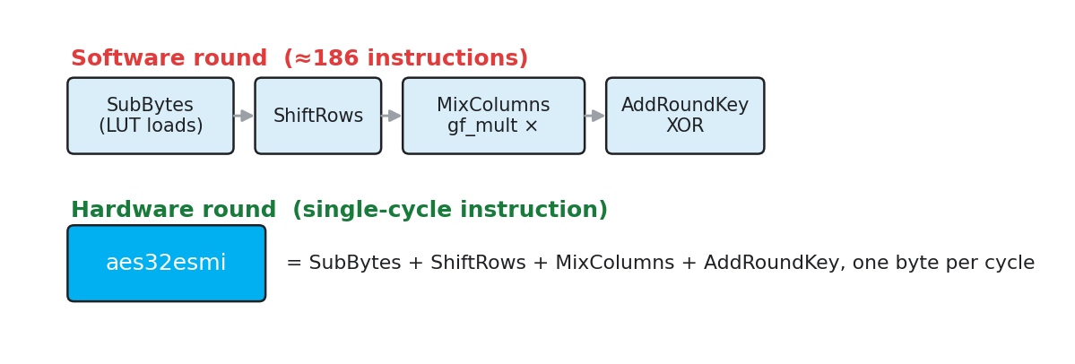
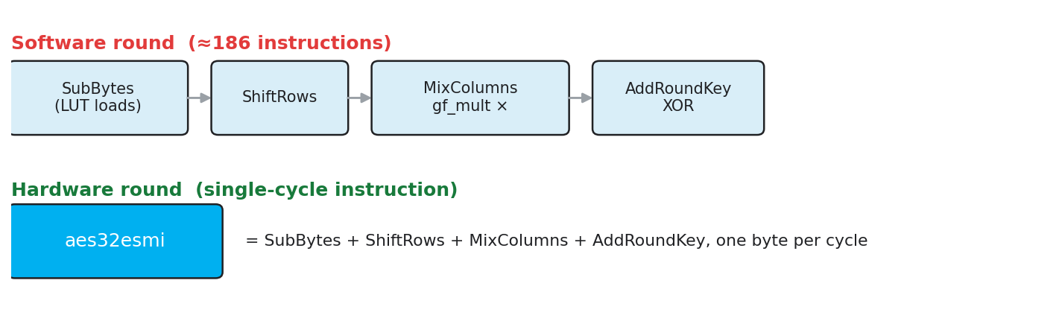
How does hardware help?
The 186-instruction software mix_columns collapses to a few aes32esmi calls (no gf_mult).
Runs entirely on registers: no BRAM loads for the S-box or MixColumns.
aes32esmi = SubBytes + ShiftRows + MixColumns + AddRoundKey, in one cycle.

Slide 9
Performance after implementation of AES hardware support
aes32esmi does SubBytes + ShiftRows + MixColumns + AddRoundKey in a single cycle, removing the mix_columns bottleneck that was 83.8% of software runtime.
Version | Cycles | vs software baseline
Software AES (baseline) | 61,184 | 1.0×
+ aes32esmi / aes32esi hardware | 6,260 | 9.8x faster
The looped hardware version (6,260) is the starting point for the later optimisations: custom loop-unroll pass → 4,800, parallel DOM S-box → 4,104 (covered on the compiler and RTL slides).

Slide 10
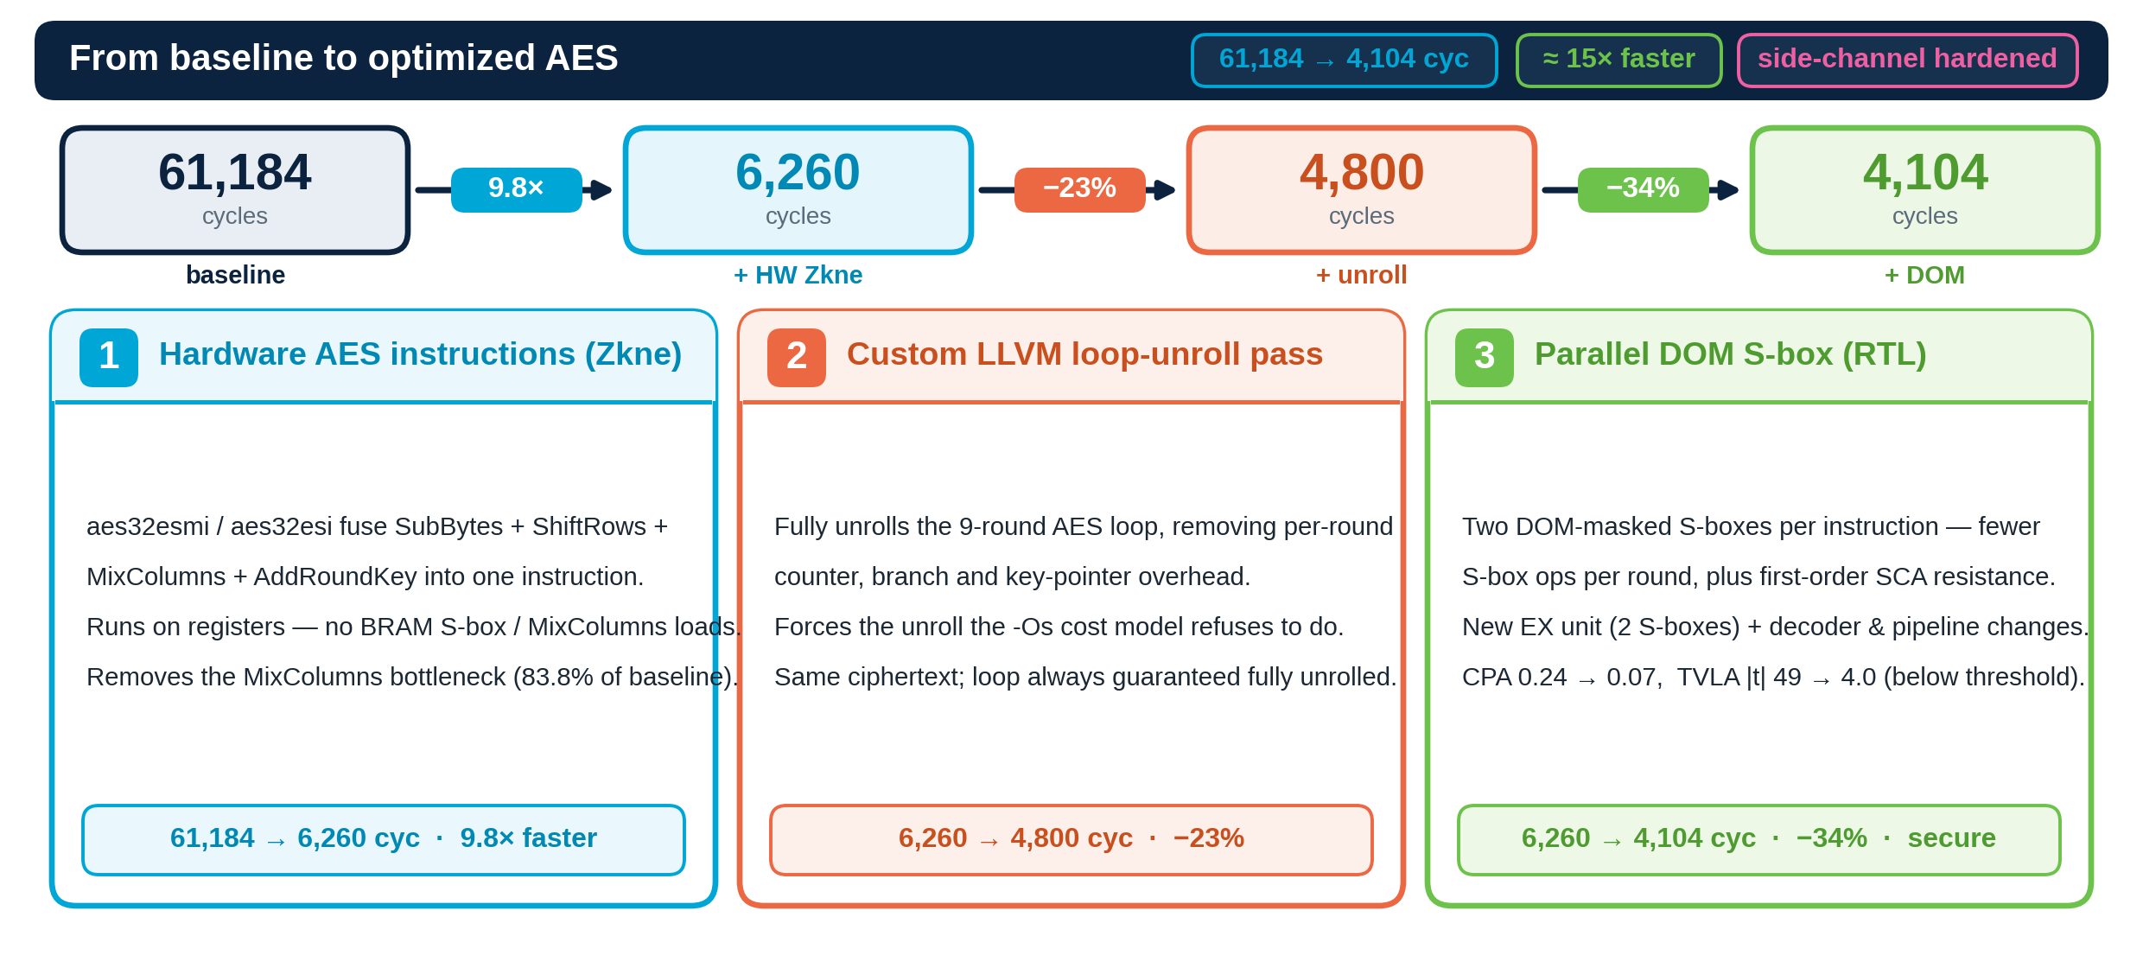
Optimization Overview

Slide 11
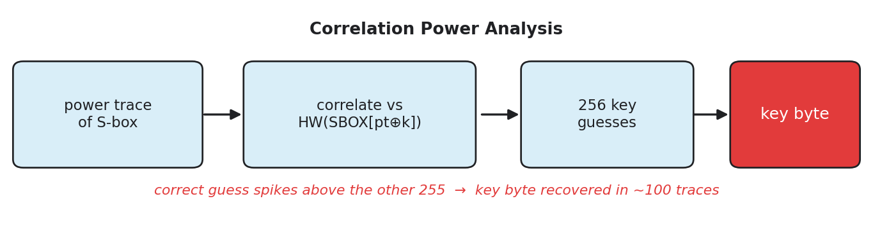
Vulnerabilities to side channel attacks
The Zkne S-box and MixColumns switch a data-dependent number of bits, so power leaks the byte being processed.
Correlation Power Analysis turns that leakage into the key: about 100 traces on our unprotected core.
Countermeasure: Domain-Oriented Masking (DOM). Secrets are split into two random shares, recombined only inside registered gates, so no wire (or glitch) tracks the real value.
Follows the TU Delft secure-Zkne paper of Kassimi, Aljuffri, Hamdioui and Taouil (2026).

Slide 12
Compiler Optimizations: Custom LoopUnroll Pass
What was done?
Wrote our own LLVM compiler pass to fully unroll the 9-round AES loop
Calls LLVM's unroll routine directly instead of using a built-in flag
Flattens all 9 rounds into straight line code
Detects the loop by spotting the AES instructions inside it, so it survives inlining

Slide 13
Compiler Optimizations: Custom LoopUnroll Pass
Why we did it?
The looped version wastes cycles on loop overhead every round (counter, branch, condition check, key pointer reload).
Built in unrolling is cost model driven and often refuses to unroll, especially when optimizing for size.
Wanted full control to force unrolling on exactly the target loop.
Goal was to build the optimization myself, not just flip a compiler switch.

Slide 14
Compiler Optimizations: Custom LoopUnroll Pass
Results
Brought the software from 6,260 to 4,800 cycles, about 23 percent faster
Same correct ciphertext, guarantees the loop is always fully unrolled
Build | Unroll Method | Cycles | Vs. Baseline
GCC -Os (looped) | none | 6260 | -
GCC -Os + #pragma unroll | Source pragma | 6067 | -3%
GCC -O2 + -funroll-loops | Build-in flag | 5509 | -12%
Clang –Os + Custom pass | AESUnroll | 4800 | -23%

Slide 15
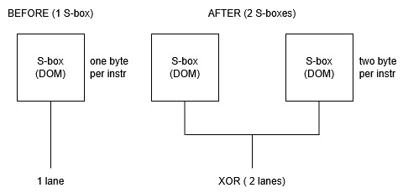
RTL Optimization: Parallel DOM S-box
What was done?
Added a custom instruction that runs two DOM protected AES S-boxes in parallel
Each instruction now processes two-byte lanes of a column instead of one
Built a new execution unit in the core (two S-boxes side by side) plus decoder and pipeline changes
Software XORs the two halves together to finish each column
Kept the original single S-box path intact as a fallback

Slide 16
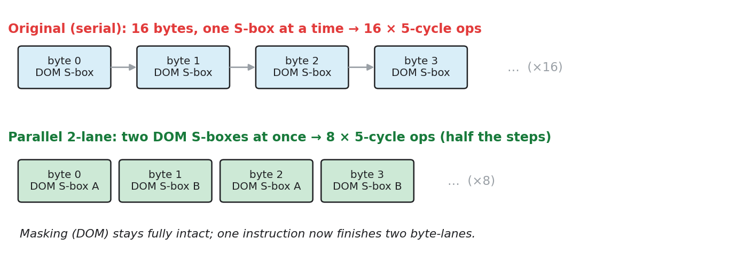
RTL Optimization: Parallel DOM S-box
Why we did it?
The DOM S-box is the real bottleneck: every byte pays a fixed 5 cycle latency and stalls the whole pipeline
The original design did the S-box one byte at a time, so the 16 bytes per round were fully serial
Running two S-boxes at once halves the number of instructions per round
The masking (side channel protection) had to stay fully intact

Slide 17
RTL Optimization: Parallel DOM S-box
Results
Stage | Cycles | Vs. Original
Original | 6260 | baseline
Custom Unroll Pass | 4800 | 23% faster
Parallel DOM S-box | 4104 | 34% faster
Resource | Count
Cycle Count | 4121
LUTs | 11987
Registers | 10412
Muxes | 289
DSP | 5

Slide 18
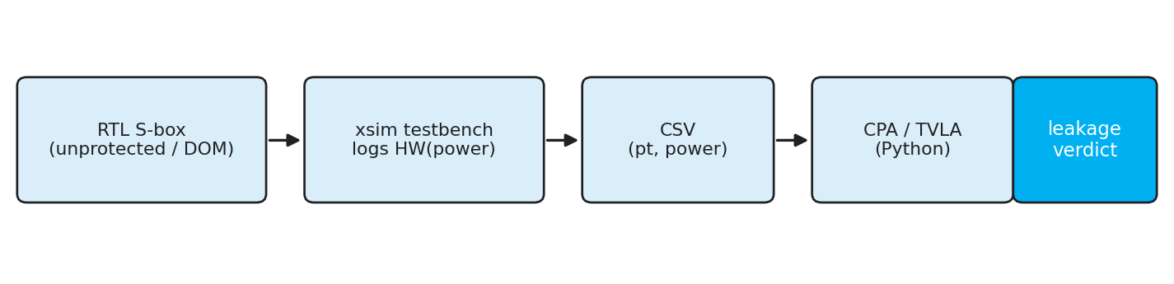
Validation Framework: Simulation-Based Power Analysis
How we proved the masking works, in simulation and on hardware
Power proxy = Hamming weight of the captured S-box result, logged per trace by a SystemVerilog testbench in Vivado xsim. The same rig drives the unprotected and the DOM S-box, so the before/after is clean.
CPA: correlate power with HW(SBOX[pt XOR guess]) over all 256 guesses, 20 000 traces.
TVLA: Welch fixed-vs-random t-test, 40 000 traces; |t| > 4.5 means first-order leakage.
Simulation isolates the data-dependent switching with no analog noise, alongside Rishi's CW305 hardware validation.

Slide 19
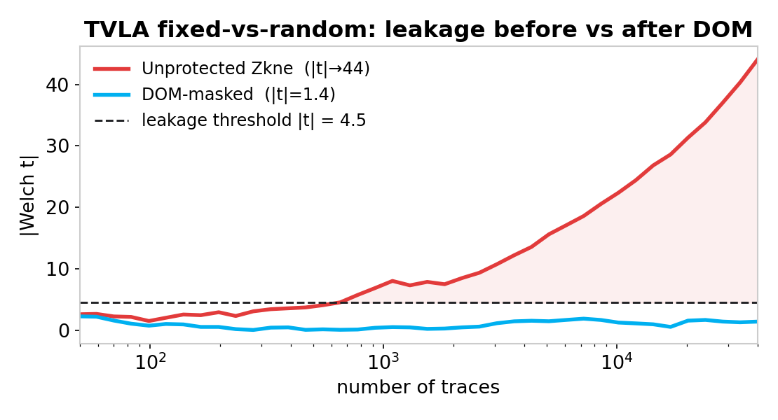
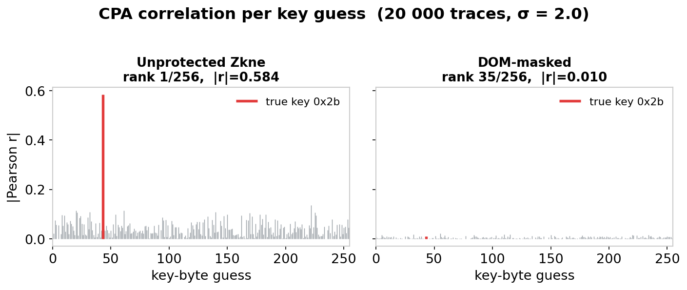
Validation Results: DOM Defeats the Attack
Same rig, same noise (σ = 2.0). The only change is the S-box, and the leakage disappears.
Metric | Unprotected | DOM-masked
CPA true-key rank | 1 / 256 | 35 / 256
CPA top |r| | 0.58 | 0.022
TVLA max |t| | 44.0 | 1.4
Crosses |t| = 4.5? | Yes (9.8x) | No (0.3x)

Slide 20
Hardware Validation: CW305 Setup
From simulation to silicon - Validation on CW305 Artix-7 FPGA with CV32E40P RISC-V soft core
Hardware setup
CW 305 Artix-7 100T with CV32E40P RISC-V soft-core
ChipWhisperer-Lite scope, 50 MHz clock, ADC at 200 MHz
Gain:30 dB
Three bitstreams tested: AES_100t (reference), Baseline RI5CY, DOM-protected RI5CY
Attack Method
CPA: sbox_output leakage model and last_round_state_diff leakage model
Window: samples 0-80 (round 1 S-Box)
TVLA: Welch t-test, fixed vs random PT
Threshold: |t| > 4.5

Slide 21
Hardware Validation Results: DOM defeats the attack
Real silicon confirms simulation – leakage disappears with DOM masking
Metric | AES_100t | Baseline RI5CY | DOM Protected RISCY
CPA bytes recovered | 16/16 | 0/16 (Need more traces) | 0/16 (Protected)
CPA max correlation | 0.236 (strong) | 0.21, PGE dropping | 0.07 (noise floor)
TVLA max |t| | 49.27 (10.9x threshold) | 4.69 (marginal, 1 sample) | 3.98 (below threshold)
Leakage detected | Yes | Marginal (1 sample) | No
Key Findings:
CPA successfully breaks unprotected hardware AES with correlation = 0.236
DOM masking bring correlation to 0.07 and TVLA t-value below the leakage threshold, confirming first-order SC resistance on real hardware.

Slide 22
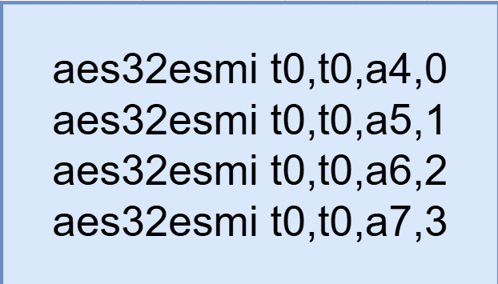
Future Work
The observation:
Same operation four times
This results in:
Additional execution overhead
Repeated instruction fetch and decode.
Increased instruction count. .
Independent, highly regular pattern.
Places a limit on the throughput
4 instructions required for a single round. A consequence of the bit width of the registers

Slide 23

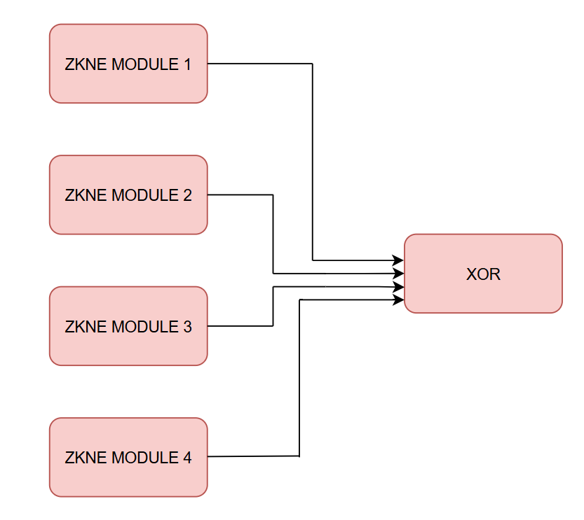
The Super Instruction
The Idea:
i) Introduce a super instruction
ii) Replicate AES32/Zkne datapath four times
iii) Execute in parallel within a single instruction.
iv) Combine the results internally
and write back the final 32-bit result.
Proposed Block Diagram

Slide 24
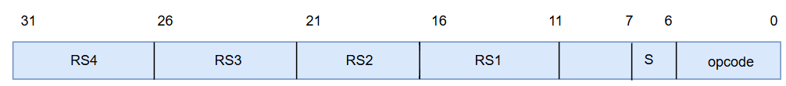
The Super Instruction
Architectural Changes
i) New opcodes and instruction formats
ii) Modifications to the Register File (or) Decode Logic
iii) Replicate the Zkne hardware
iv) Software Support for the Instruction
Proposed Instruction Format

Slide 25
The Super Instruction
Limitations
Opcode space pollution
Custom-0 opcodes consume scarce encoding space and may clash with future standard extensions.
Register-file pressure
Reading four source registers needs extra read ports or a 2-cycle read, complicating the pipeline.
Higher hardware utilisation
Replicating the Zkne datapath four times costs significant extra LUTs and flip-flops.
Narrow workload applicability
The fused op only accelerates AES; that area sits idle for any other workload.

Slide 26

Quote
THANK YOU !!

