Slide 1
Notice List Project CS 347: Data Management
Daniel Dao
Carlos Trejo
Evan Carr

Slide 2
Github: https://github.com/danielvdao/cs347_project.git Apex: https://apex.oracle.com/pls/apex/f?p=91920:68:112711312500905::NO:::

Slide 3
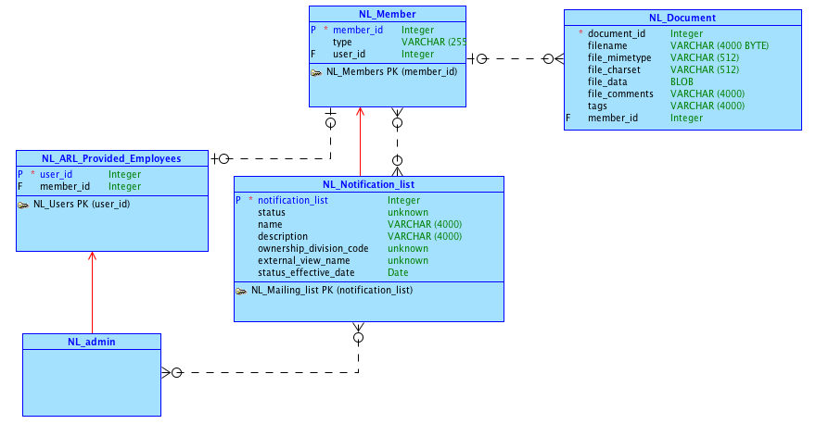
Logical Model

Slide 4
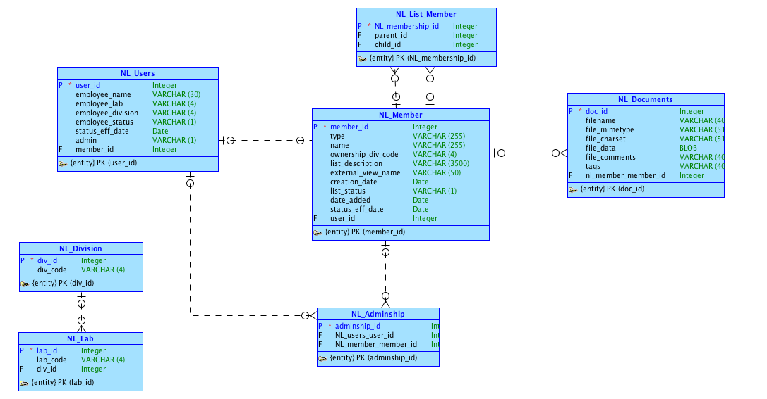
Conceptual Model

Slide 5
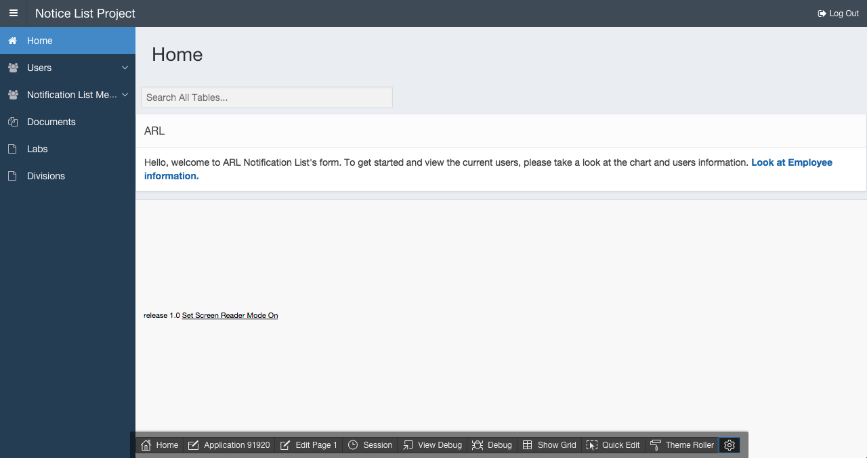
Our Application

Slide 6
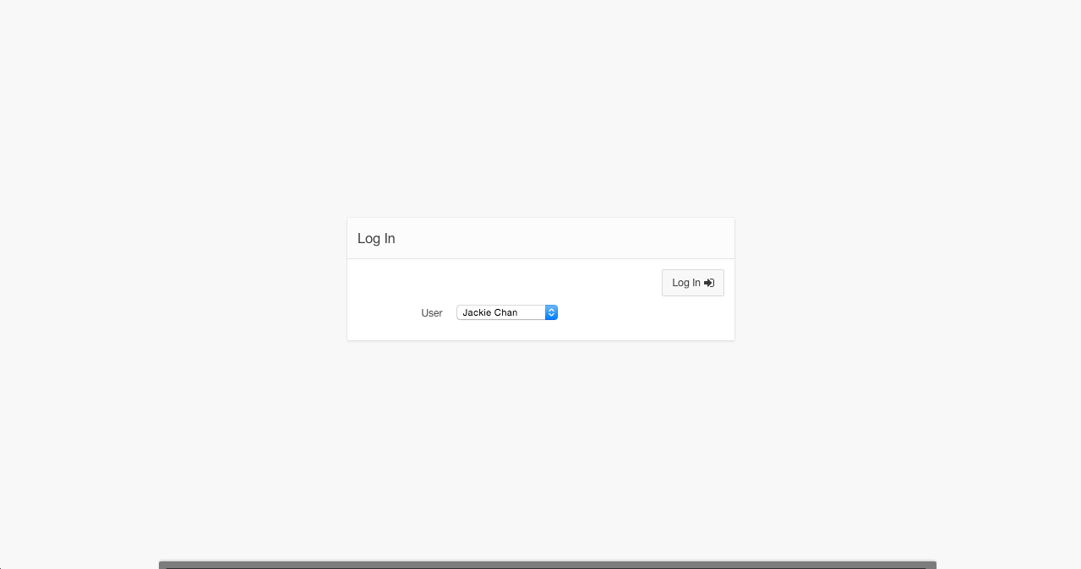
Login

Slide 7
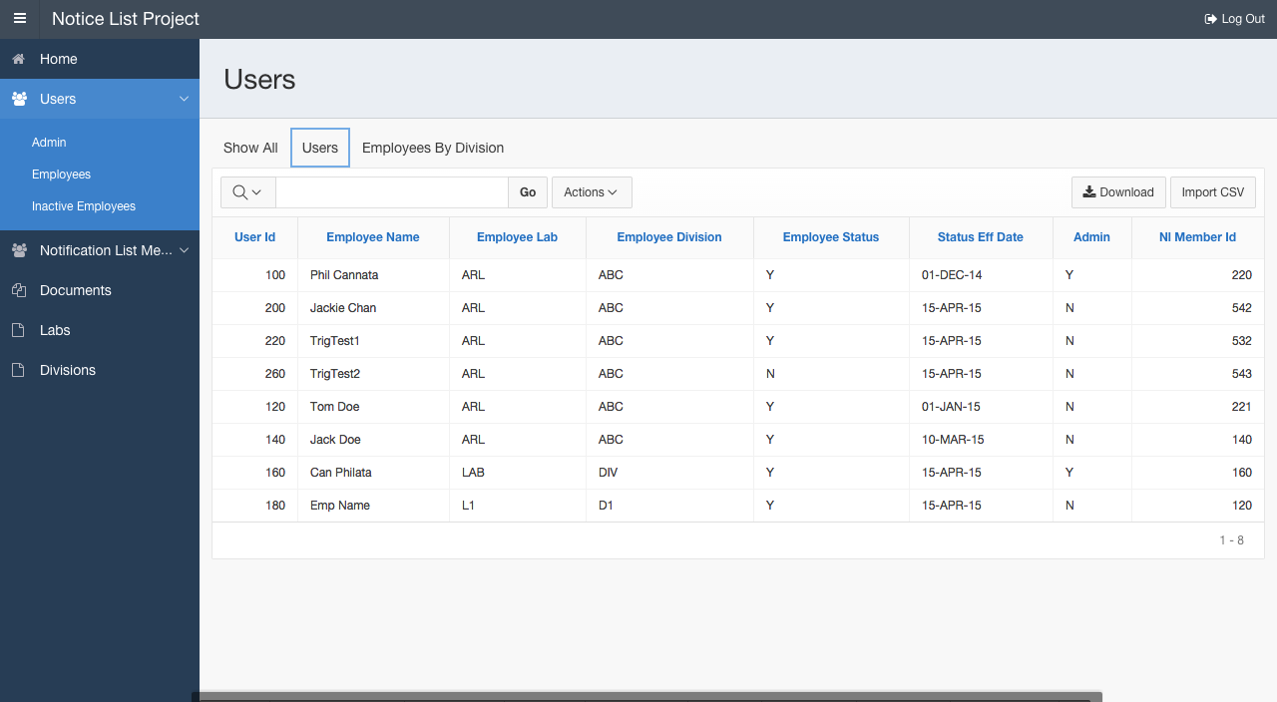
Users Page

Slide 8
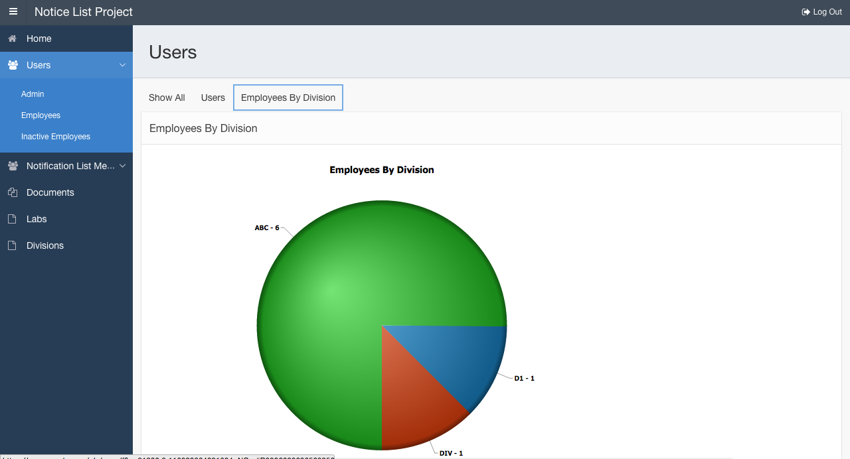
Region Tabs with Chart

Slide 9
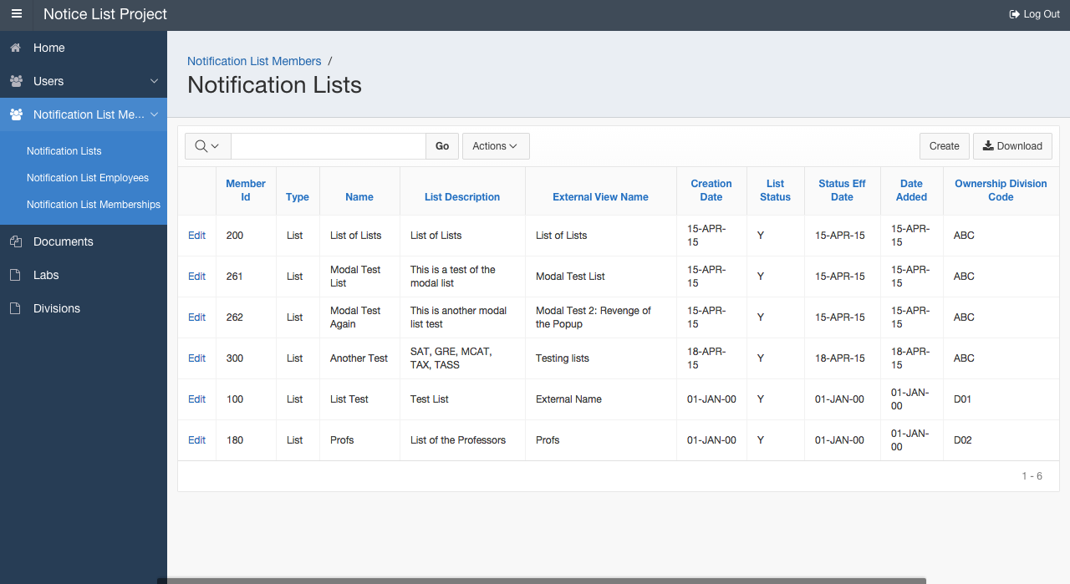
Notification Lists

Slide 10
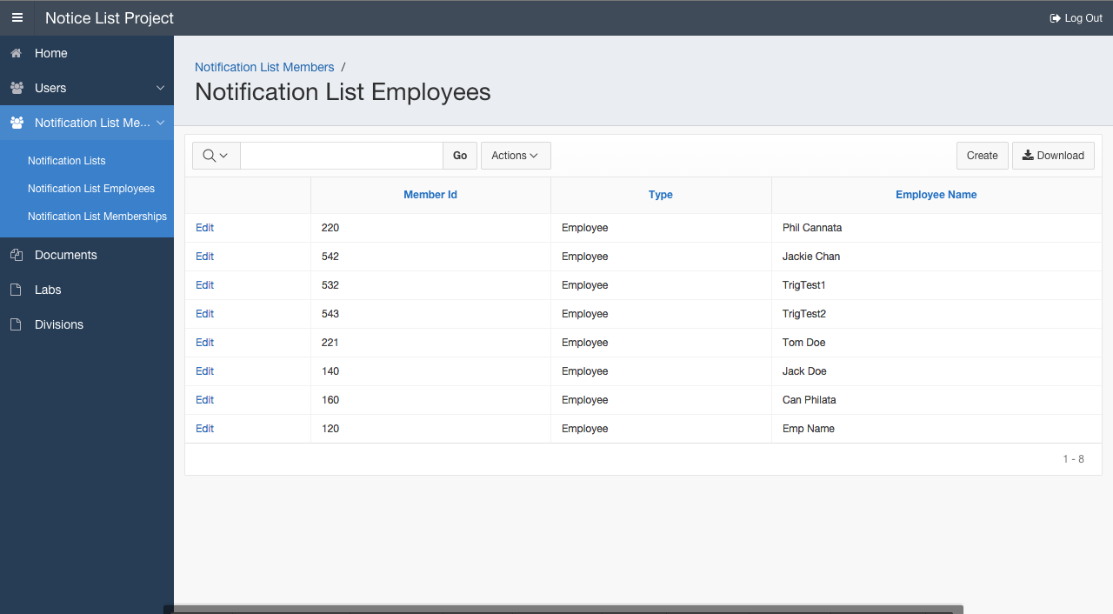
Notification List Employees

Slide 11
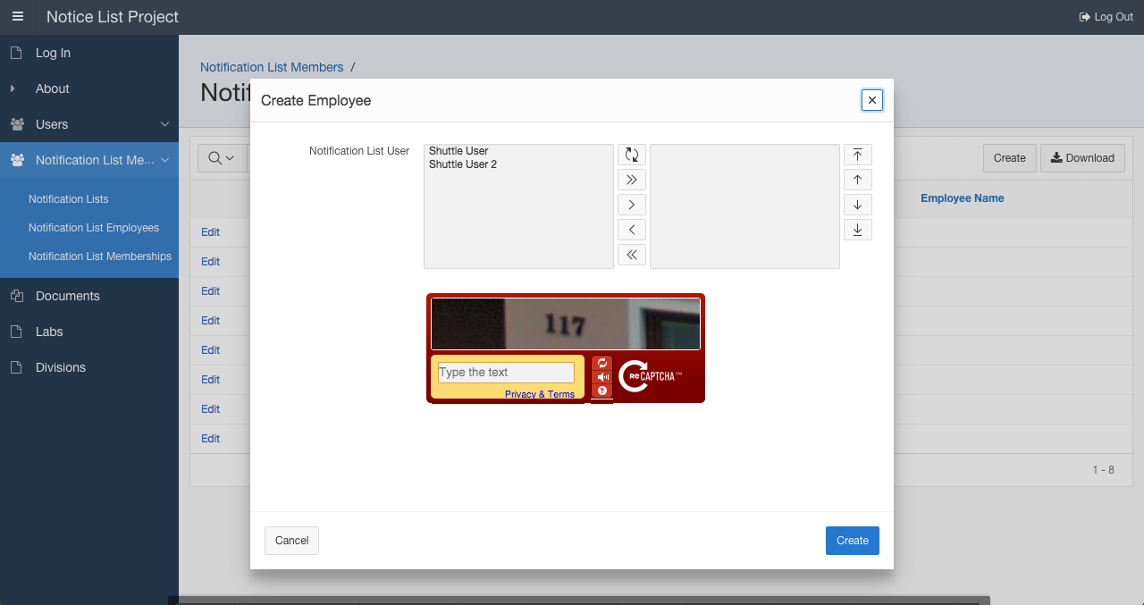
Shuttle List and reCaptcha

Slide 12
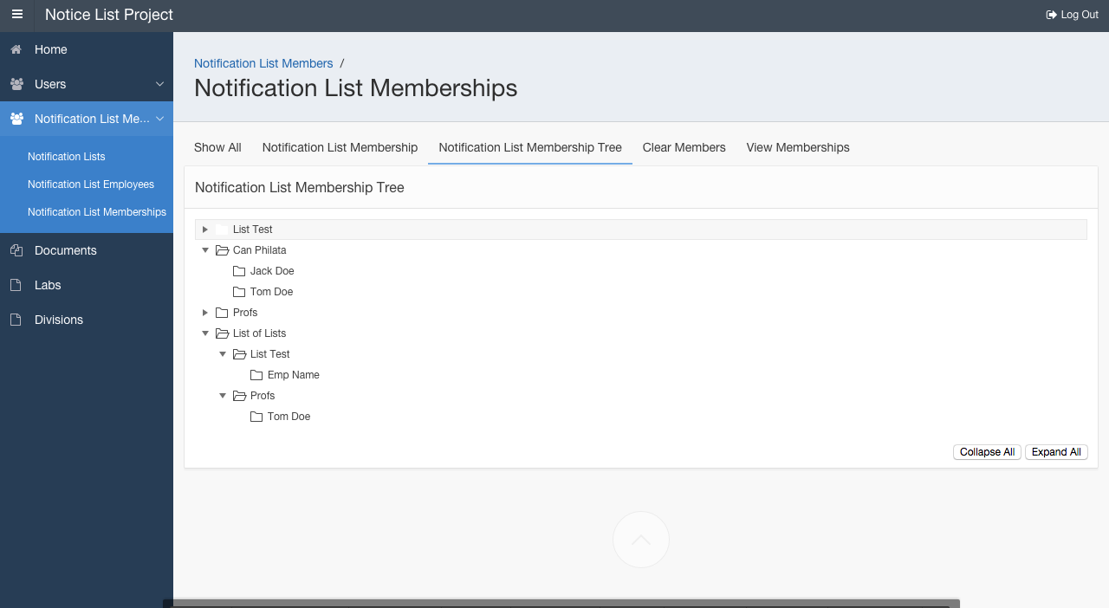
Membership Trees

Slide 13
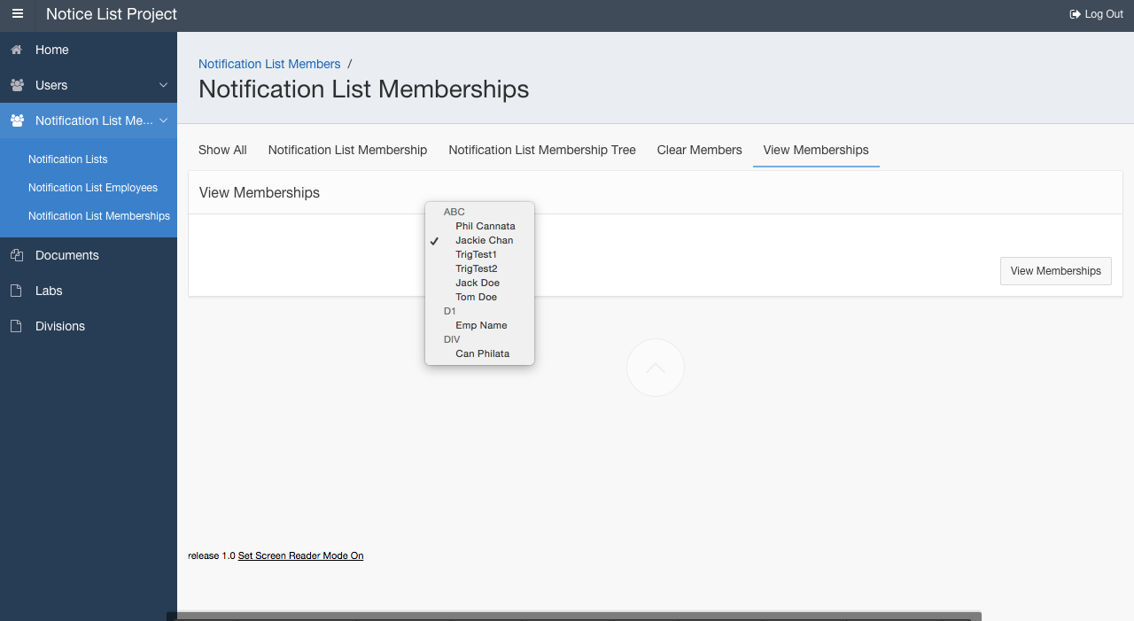
Group Select List

Slide 14
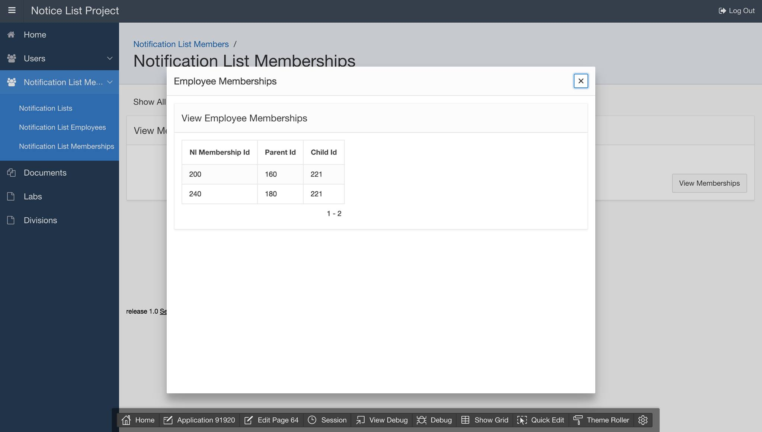
View Membership

Slide 15
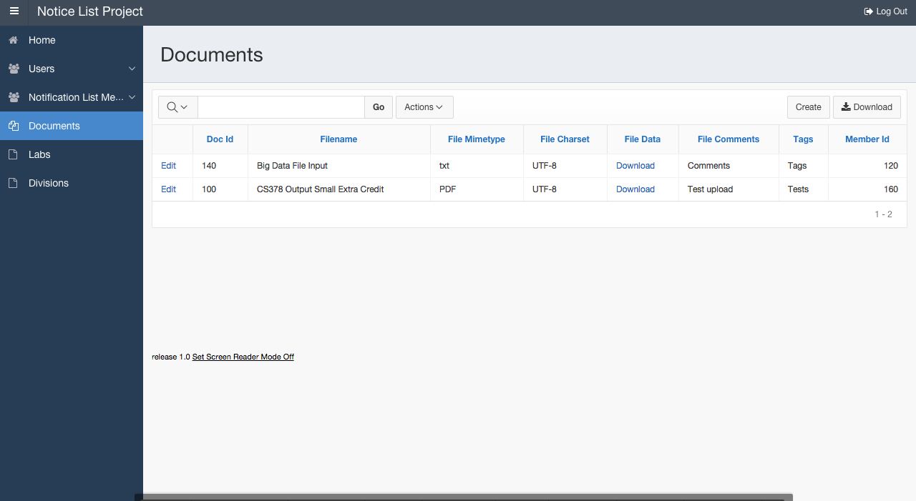
Documents

Slide 16
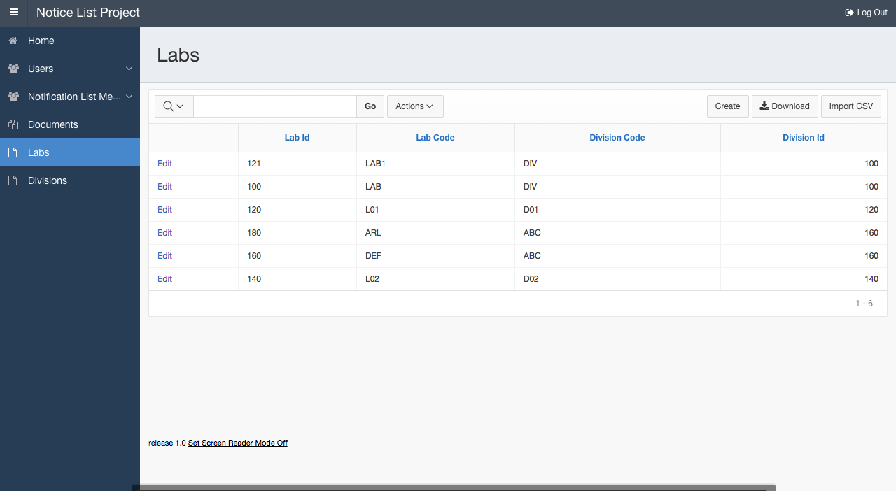
Labs

Slide 17
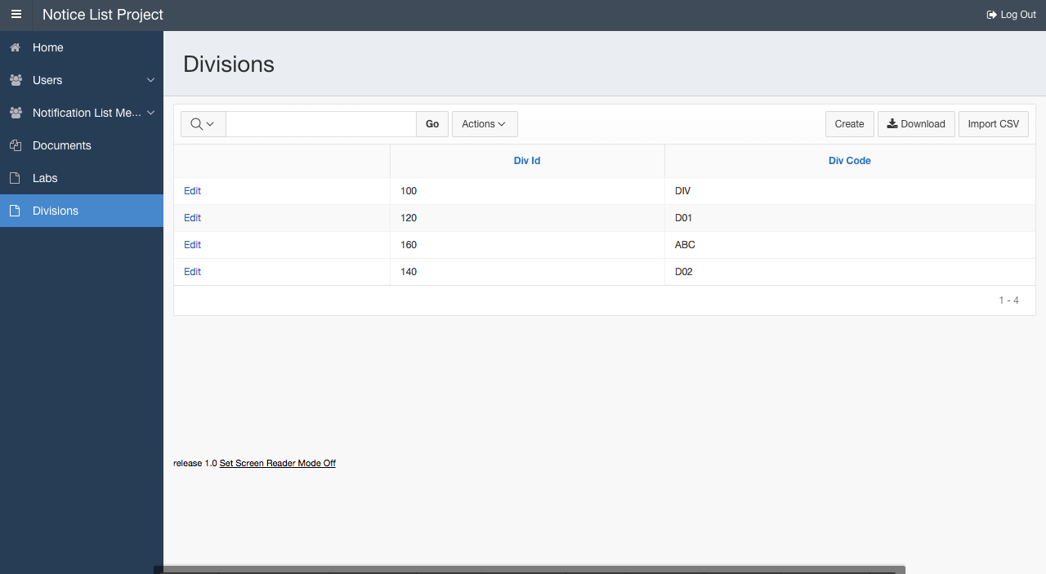
Divisions

