Slide 1

How to Write Contract Tests in .NET With Pact
Daniel Ward
Slides and repo at daninacan.com

Slide 2


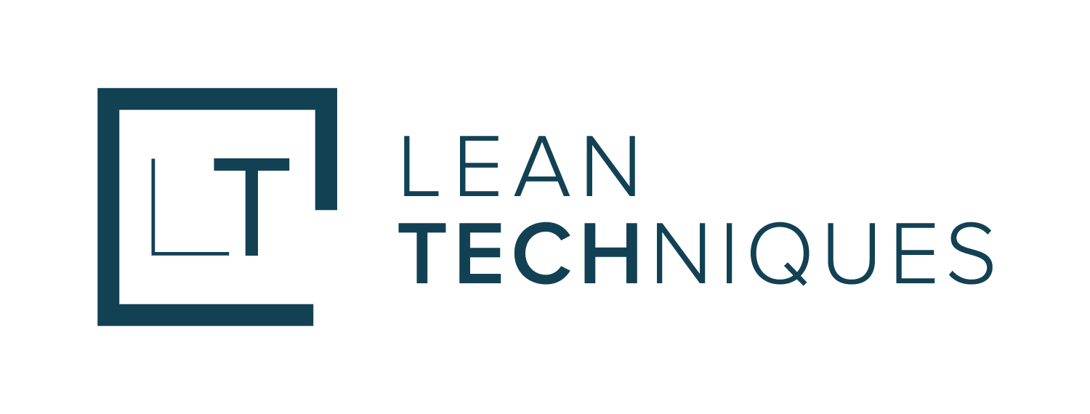




Me
Software developer, consultant
Co-organizer San Antonio/Austin .NET User Group
Microsoft MVP .NET
🌐 daninacan.com
@danielwarddev
daniel-ward-dev
Slides and repo at daninacan.com

Slide 3
Overview
What is contract testing?
Why use it over current testing methods?
Microservices implications
How to contract test
Coding demo with Pact

Slide 4

What is Contract Testing?
Integration tests that produce a contract (JSON file) describing the expectations of an API

Slide 5
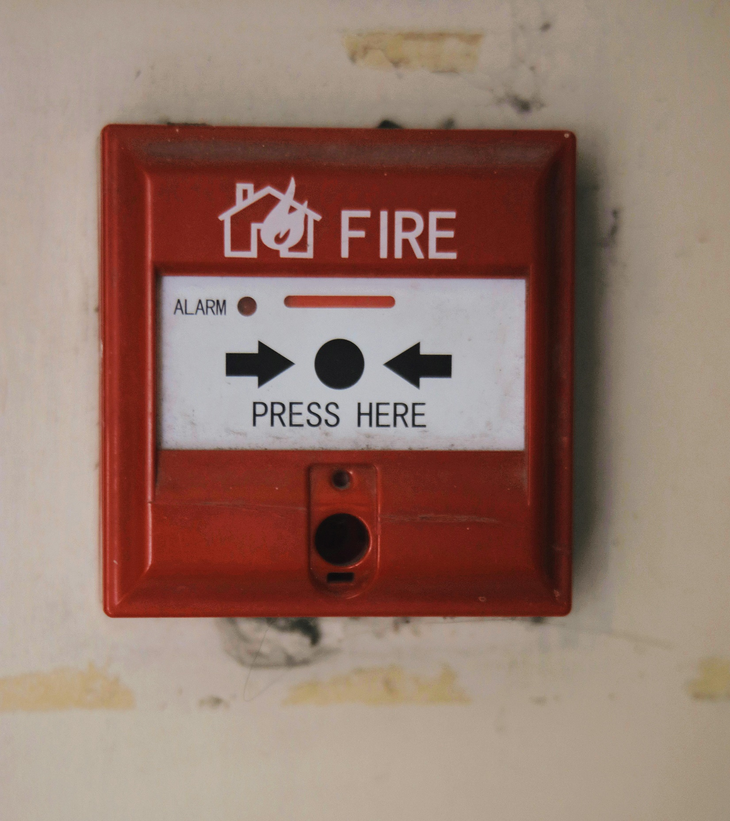
Why Contract Testing?
Do you set your house on fire to test your smoke alarm?
Facilitates discussion between teams

Slide 6
Microservices
My app
Slides and repo at daninacan.com

Slide 7
Now we need more tests!
e2e
Mostly here
Integration
Unit
Slides and repo at daninacan.com

Slide 8
Integration/e2e tests
⏳
Slow to write, slow to run
💲
Slow to diagnose
🥖
Brittle (how many times have you used [Skip]?)
My app
API
Slides and repo at daninacan.com

Slide 9
Contract Testing
Martin Fowler
Microservices communicate through each others’ interfaces
  REST
  gRPC
  Queues, pub/sub, events
Test with the interfaces instead of the real services

Slide 10
Contract Testing
My app
API
Slides and repo at daninacan.com

Slide 11
Contract Testing
Mock web server
My app
API
Slides and repo at daninacan.com

Slide 12
Producing a Contract
GET /product/1
If a product with id 1 exists
Return 200 with this body: {…}
etc.
My app
Contract
API
Integration tests produce
Contract tests ensure it adheres to
Slides and repo at daninacan.com

Slide 13
Consumer-Driven Contracts
Consumer
Contract
Produces
API
Consumer
Contract
Informs business rules
Produces
Consumer
Contract
Produces
Slides and repo at daninacan.com

Slide 14
Why Consumer-Driven Contracts?
✅Suitable for internal APIs with known consumers
❌NOT suitable for public APIs with thousands/millions of consumers
Facilitates team communication
Customer-driven
Slides and repo at daninacan.com

Slide 15

Why not OpenAPI?
Tell you all valid requests and responses, but not which ones map to which

Slide 16
Pact
Library for writing contract tests
Javascript, Java, .NET, Go, Python, Swift, Scala, PHP, Ruby, Rust, C++
Backend written in Rust
Slides and repo at daninacan.com

Slide 17

Coding demo
Notes:
https://learn.microsoft.com/en-us/aspnet/core/fundamentals/middleware/?view=aspnetcore-8.0

Slide 18
Recap
What is contract testing?
Why use it over current testing methods?
Microservices in modern organizations
More services requires more tests, more team communication
How to contract test, what problems it solves
Coding demo
Slides and repo at daninacan.com

Slide 19

Further Reading
https://martinfowler.com/articles/practical-test-pyramid.html#ContractTests
https://testing.googleblog.com/2015/04/just-say-no-to-more-end-to-end-tests.html
https://pactflow.io/what-are-the-benefits-of-contract-testing/

Slide 20
Thank you!
Slides and repo at daninacan.com

