Slide 1
Breaking the Prime Directive
Using C# for IaC to Put .NET on AWS
Daniel Ward

Slide 2
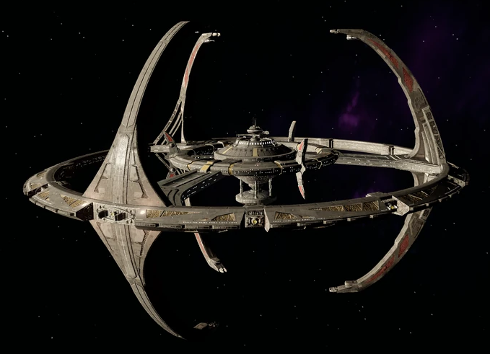
The Prime Directive
No identification of self or mission.
No interference with the social, cultural, or technological development of said planet.
No reference to space, other worlds, or advanced civilizations.

Slide 3
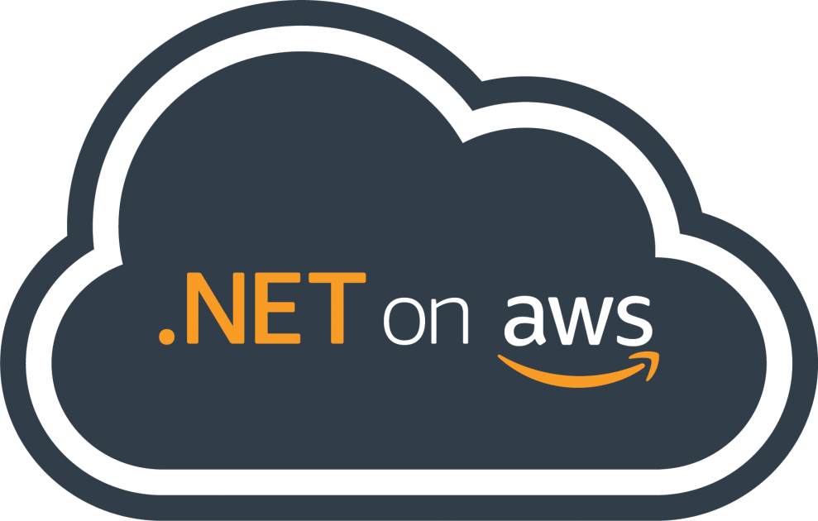


The Prime Directive v2
🤝
🤝

Slide 4
Overview
Why .NET on AWS?
Tooling
.NET on AWS Community
Native AOT
AWS Cloud Development Kit (CDK)
Coding demo
Won’t cover
  Creating an AWS account and IAM user
  Installing command line tools

Slide 5



Me
Software consultant leantechniques.com
Co-organizer of the San Antonio/Austin .NET User Group
🌐 daninacan.com
@danielwarddev
daniel-ward-dev

Slide 6
Why .NET on AWS?
⭐.NET and AWS is what you know!
AWS supports Windows environments
AWS supports .NET AoT on Lambda
.NET tooling for AWS

Slide 7
.NET on AWS tooling
Lambda runtimes
IDE/CLI Lambda templates and tools - https://docs.aws.amazon.com/lambda/latest/dg/csharp-package-cli.html
.NET Lambda annotations - https://docs.aws.amazon.com/sdk-for-net/v3/developer-guide/aws-lambda-annotations.html

Slide 8
.NET on AWS community/Resources
https://aws.amazon.com/developer/language/net/net-community/
.NET on AWS Show – https://community.aws/@codetraveler
.NET on AWS twitter account - @dotnetonAWS
AWS + .NET Foundation – https://aws.amazon.com/blogs/opensource/aws-joins-the-net-foundation/
Serverless Land – https://serverlessland.com/lambda/dotnet
AWS blog posts

Slide 9
Native AOT (.NET 7+)
Just-in-time (JIT) process:
  Compiles your written code to common intermediate language (CIL)
  Your CIL is shipped and is compiled to native code at execution time with a JIT compiler
  Native code is ran
Native AOT:
  Compiles your written code to CIL
  A native AOT compiler compiles the CIL to native code at publishing time by targeting a specific environment (Linux x64, Windows x64, etc.)

Slide 10
Native AOT on AWS
Up to 86% improvement in Lambda cold start times
https://aws.amazon.com/blogs/compute/introducing-the-net-8-runtime-for-aws-lambda/
https://docs.aws.amazon.com/lambda/latest/dg/dotnet-native-aot.html
https://blog.martincostello.com/native-aot-make-dotnet-lambda-go-brr/

Slide 11
AWS Cloud Development Kit (CDK)
https://docs.aws.amazon.com/cdk/v2/guide/cli.html
Use a programming language to create CloudFormation (IaC)
  C#, Java, Javascript/Typescript, Python, Go
Benefits of IaC while also getting the benefits of a programming language
  Familiarity
  Intellisense
  Type safety

Slide 12
CDK Constructs
Represents one or more CFN resources
Sensible defaults
Common pattern
Best practices
L1 (aka CFN resources) – Example: CfnBucket
L2 (aka curated constructs). Example: Bucket
L3 (aka patterns). Example: ApplicationLoadBalancedFargateService

Slide 13
Requirements
.NET SDK
Docker
An AWS account
An IAM user
AWS CLI
AWS CDK
Node.js (I recommend that you install nvm first and use that to install Node)

Slide 14

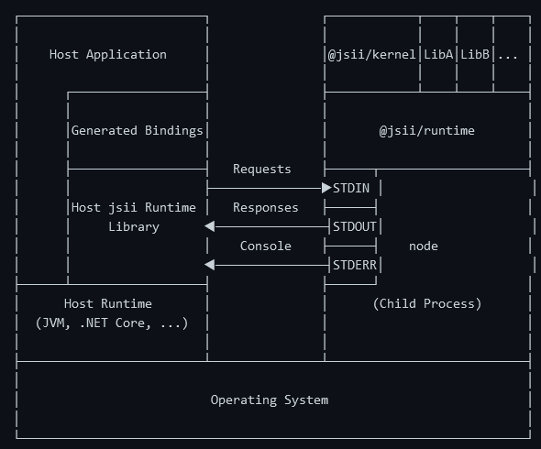
Wait! Why do I need Node?
CDK is made with jsii
jsii exposes a Typescript API and generates code in the specified language to model that same API
The generated code still calls down to Javascript code through a sidekick node process, which responds back with the result
https://aws.github.io/jsii/overview/runtime-architecture/

Slide 15

Coding
Demo

Slide 16

Cattle, Not Pets
Bill Baker, 2011/2012. Scale-up vs scale-out
https://cloudscaling.com/blog/cloud-computing/the-history-of-pets-vs-cattle/
Pets
Irreplaceable and cute
Individual names
Manually managed
Cattle
Replaceable and fine
Numbered
Automated management

Slide 17
Recap
Why .NET on AWS?
Tooling
.NET on AWS Community
Native AOT
AWS Cloud Development Kit (CDK)
Cattle vs pets
Using the CDK
C# Lambda
Lambda annotations for DI
DynamoDB
API Gateway

Slide 18
Thank you
🌐 daninacan.com
@danielwarddev
daniel-ward-dev

