Slide 1
OPENING
Geo-located NLP Feedback System for Public Transport
A 10-minute recorded technical presentation
Yifan Shi
Junzhen Wang
Hanwen Yang
Lead NLP Engineer Model training, classification, sentiment evaluation
Geospatial Data Analyst Data cleaning, QGIS layers, clustering
Full-stack & Dashboard Developer Backend API, UI, map integration
NLP + GIS
420
4
5 tabs
integrated prototype
demo feedback records
DBSCAN clusters
interactive dashboard
Speaker: Hanwen | Target time: 0:45
1

Slide 2
MOTIVATION
WHY IT MATTERS
The problem is not a lack of feedback; it is a lack of usable feedback
Passenger comments describe delays, crowding, cleanliness, accessibility, and safety.
Most comments are unstructured text, so manual review does not scale.
Transport planning also needs location: where do these issues happen?
Worthwhile
It turns public feedback into evidence that can support service evaluation.
Hard
The project has to connect text meaning, station matching, GIS layers, and spatial statistics.
Successful
The final prototype links NLP outputs to maps, heatmaps, clusters, and district summaries.
Speaker: Hanwen | Target time: 1:00
2

Slide 3
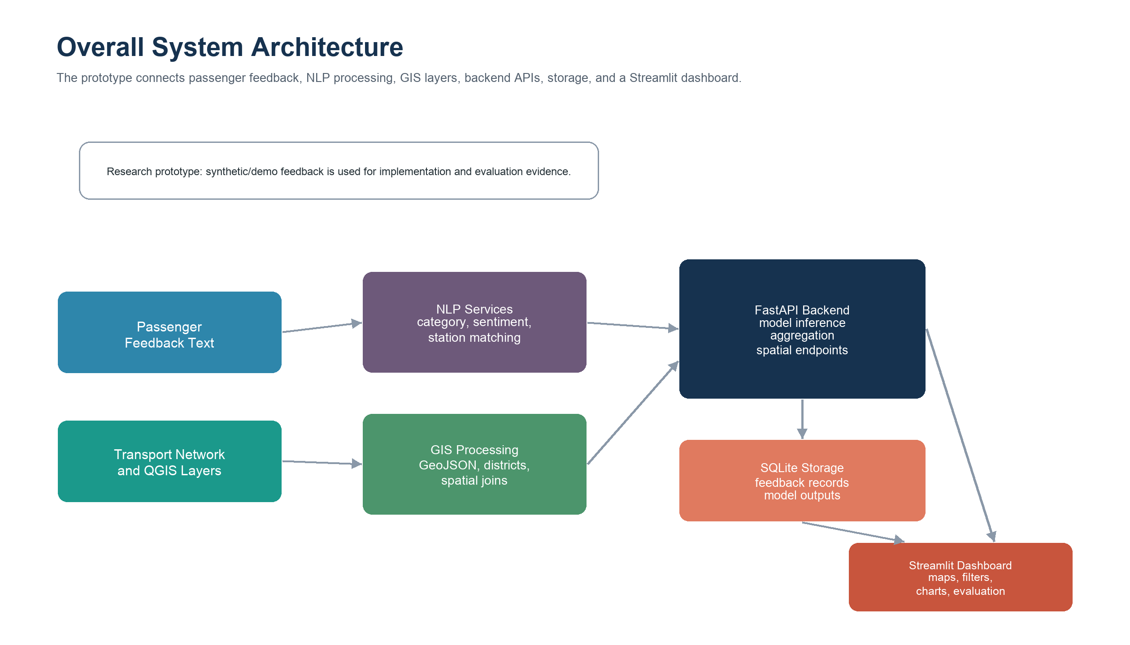
SYSTEM OVERVIEW
SYSTEM VIEW
Our solution connects feedback text to geographic insight
Speaker: Hanwen | Target time: 1:00
3

Slide 4
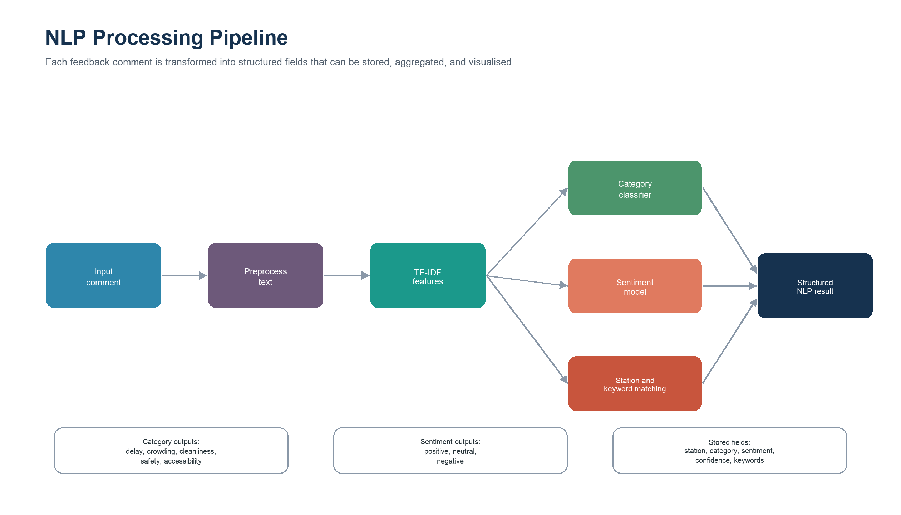
NLP CONTRIBUTION
YIFAN - NLP
Yifan's role: convert passenger comments into structured NLP outputs
Speaker: Yifan | Target time: 1:10
4

Slide 5
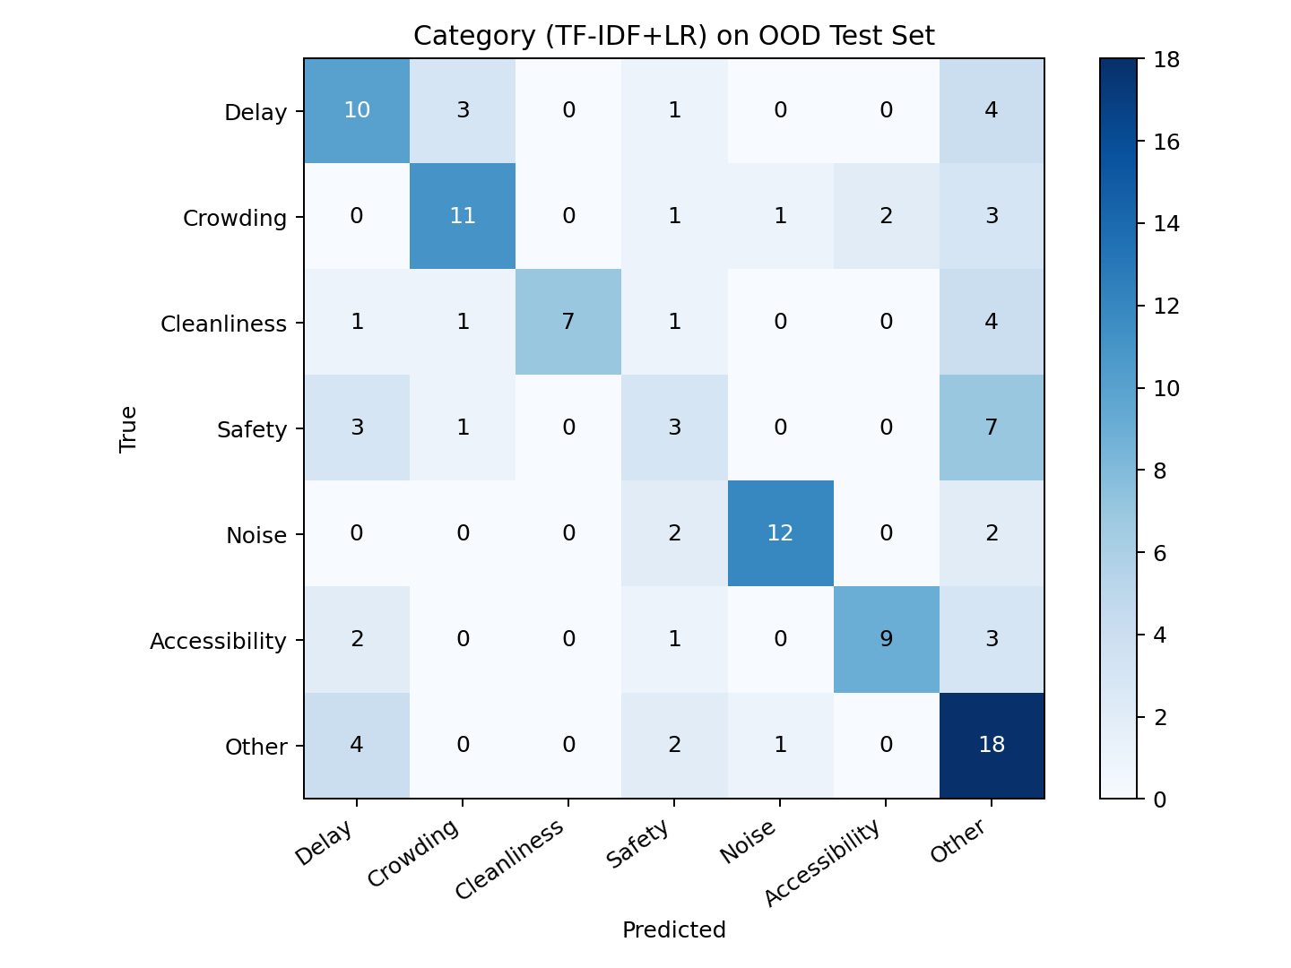
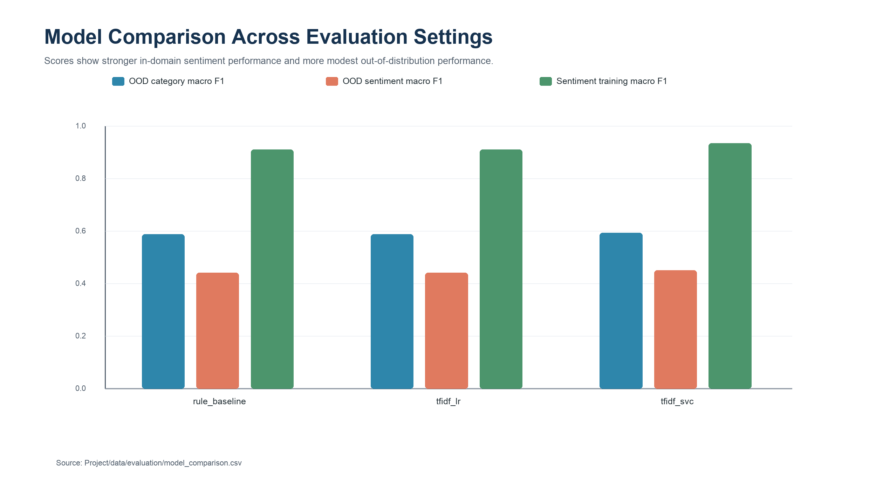
NLP EVALUATION
YIFAN - EVALUATION
The model works as a baseline, but OOD testing shows the limitation clearly
Best OOD category macro-F1: 0.5929; best OOD sentiment macro-F1: 0.4513. The system is suitable as a prototype baseline, not an operational classifier.
Speaker: Yifan | Target time: 1:00
5

Slide 6
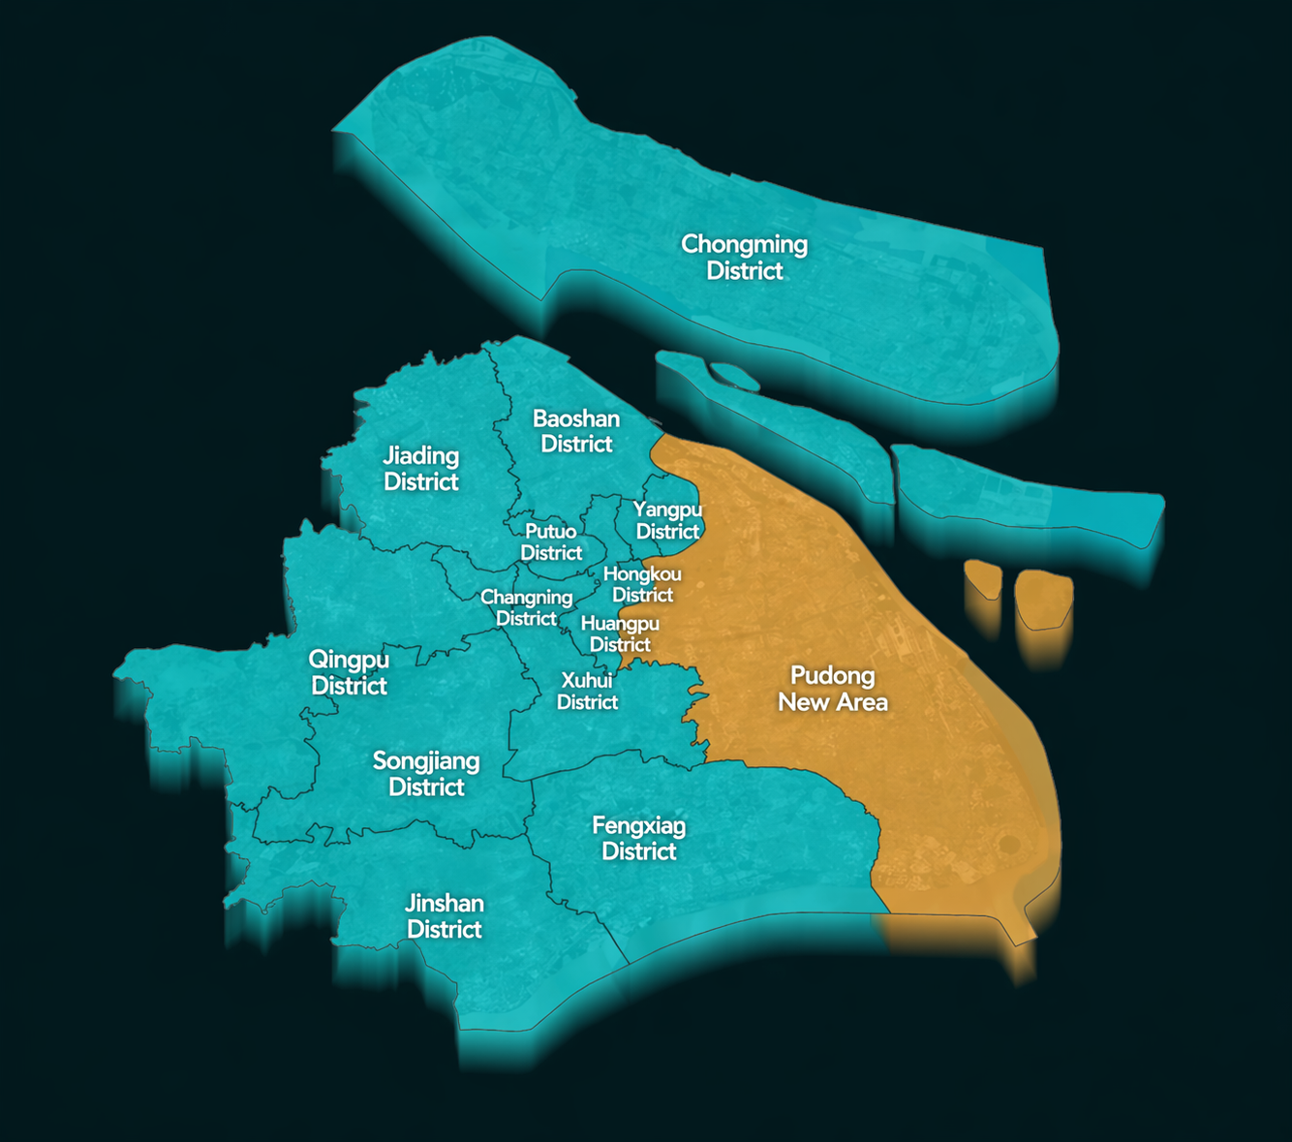
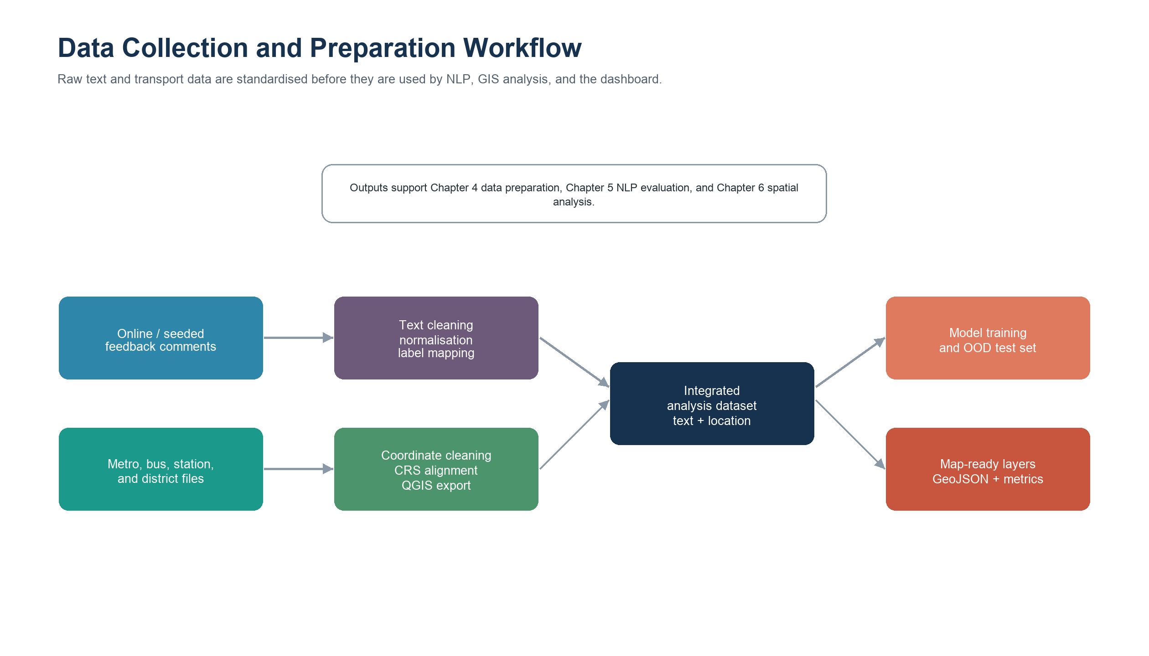
GIS AND DATA PREPARATION
JUNZHEN - GIS DATA
Junzhen's role: prepare the transport geography that makes feedback mappable
QGIS layers include district boundaries, subway lines, subway stops, and bus stops; backend services convert them into map-ready GeoJSON.
Speaker: Junzhen | Target time: 1:10
6

Slide 7
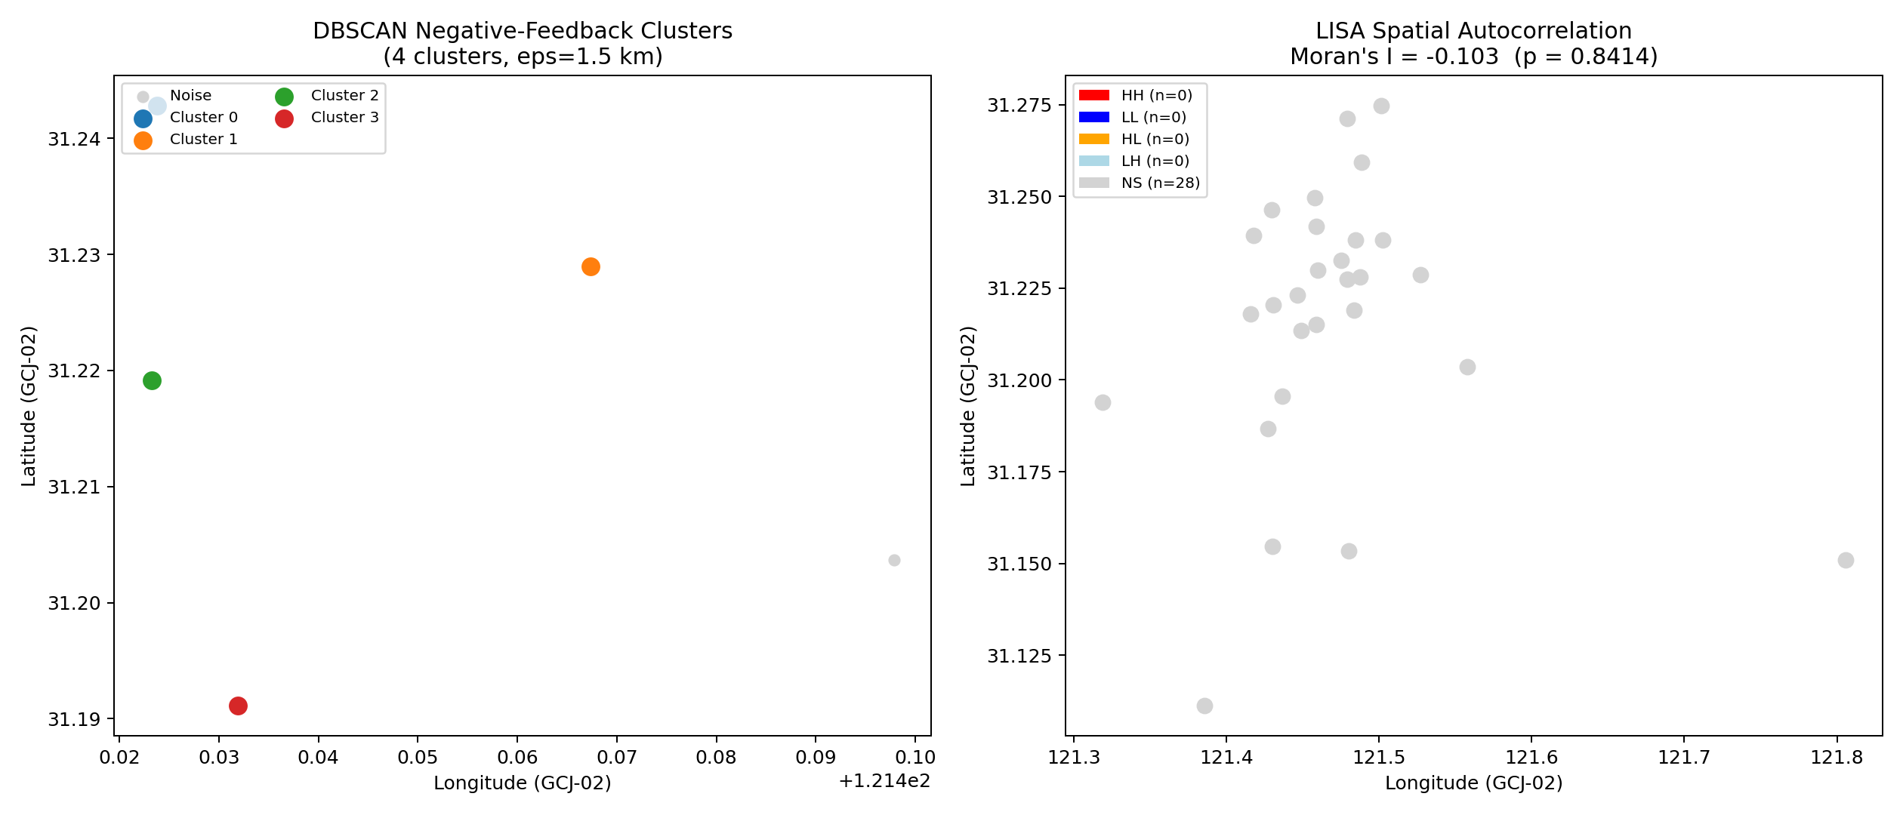
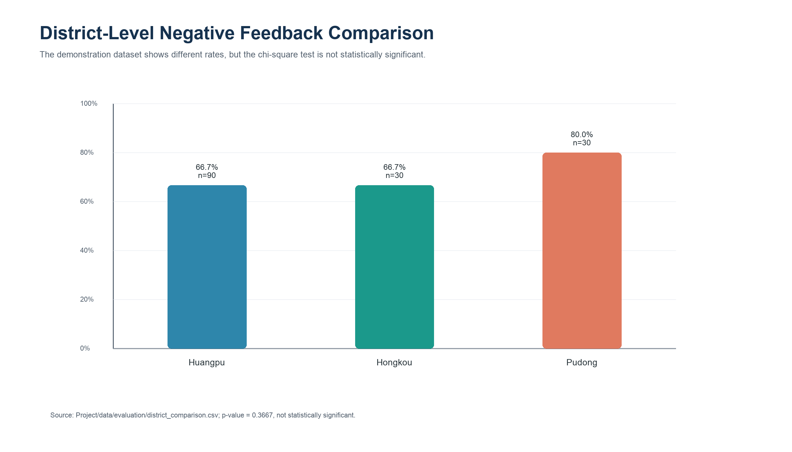
SPATIAL FINDINGS
JUNZHEN - SPATIAL ANALYSIS
Spatial analysis validates the feedback-to-map pipeline
Because the dataset is synthetic/demo data, results are interpreted as method validation rather than real Shanghai service evidence.
4
-0.103
0.8414
DBSCAN clusters
Moran's I
Moran p-value
Speaker: Junzhen | Target time: 1:10
7

Slide 8
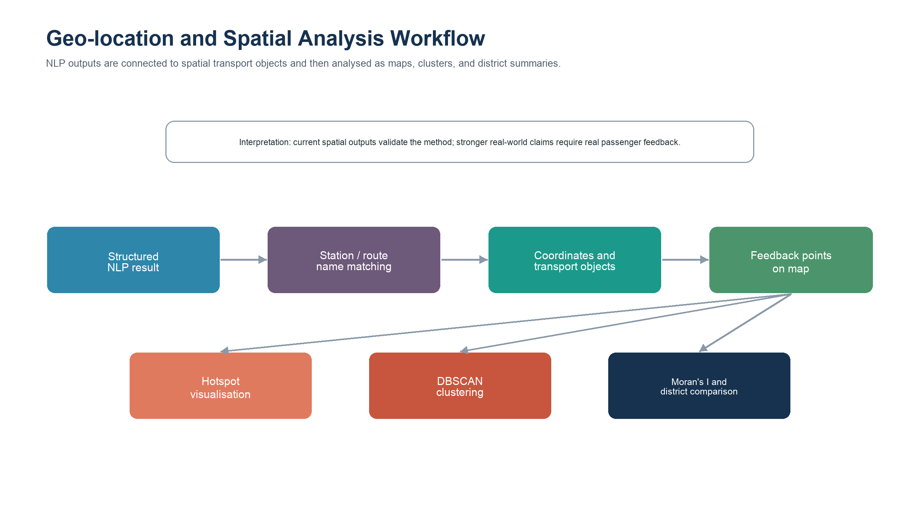
SYSTEM IMPLEMENTATION
HANWEN - IMPLEMENTATION
Hanwen's role: integrate the model, GIS services, database, and dashboard
FastAPI backend receives feedback and returns NLP analysis.
SQLite stores text, station, category, sentiment, confidence, and keywords.
GIS endpoints serve district boundaries, bus stops, subway stops, and subway lines.
Streamlit dashboard presents maps, filters, charts, hotspots, spatial insights, and evaluation evidence.
Speaker: Hanwen | Target time: 1:15
8

Slide 9
HOW TO PRESENT THE PROTOTYPE
RECORDED DEMO FLOW
The recorded demo should show the complete integration path
1. Submit feedback
2. Read NLP output
3. Refresh analysis
Example: a passenger complains that People's Square station is seriously delayed.
Show station, issue category, sentiment, confidence score, and matched keywords.
Explain how saved records update aggregation, heatmaps, and district results.
What the audience should understand
What not to overclaim
The project is not only a classifier and not only a map. Its value is the connection between both.
The current dataset is synthetic/demo data, so spatial results demonstrate capability rather than real transport conclusions.
Transition line: Yifan's NLP outputs become Junzhen's spatial inputs, and Hanwen's backend/dashboard makes the whole workflow usable.
Speaker: All / Hanwen lead | Target time: 0:55
9

Slide 10
TAKEAWAYS
CLOSING
Conclusion: the project proves an integrated NLP-GIS workflow
Main achievement
Main limitation
Future work
A working research prototype links unstructured feedback to structured NLP outputs and map-based analysis.
Synthetic/demo data limits real-world claims; OOD NLP performance is modest.
Use real feedback streams, stronger models, larger GIS coverage, and deployment-ready engineering.
Together, our three roles formed one pipeline: NLP explains what passengers say, GIS explains where issues occur, and the dashboard makes the results explorable.
Thank you
Speaker: Hanwen / All | Target time: 0:45
10

