Slide 1
Algorithm Term Project
第五組
游騰杰 王宇晨

Slide 2
Design method: Greedy Algorithm
Construct a conflict table
Compare two car direction in same time with conflict table
If there has a pair can pass, then pass
If not, pass one of the queueing car

Slide 3
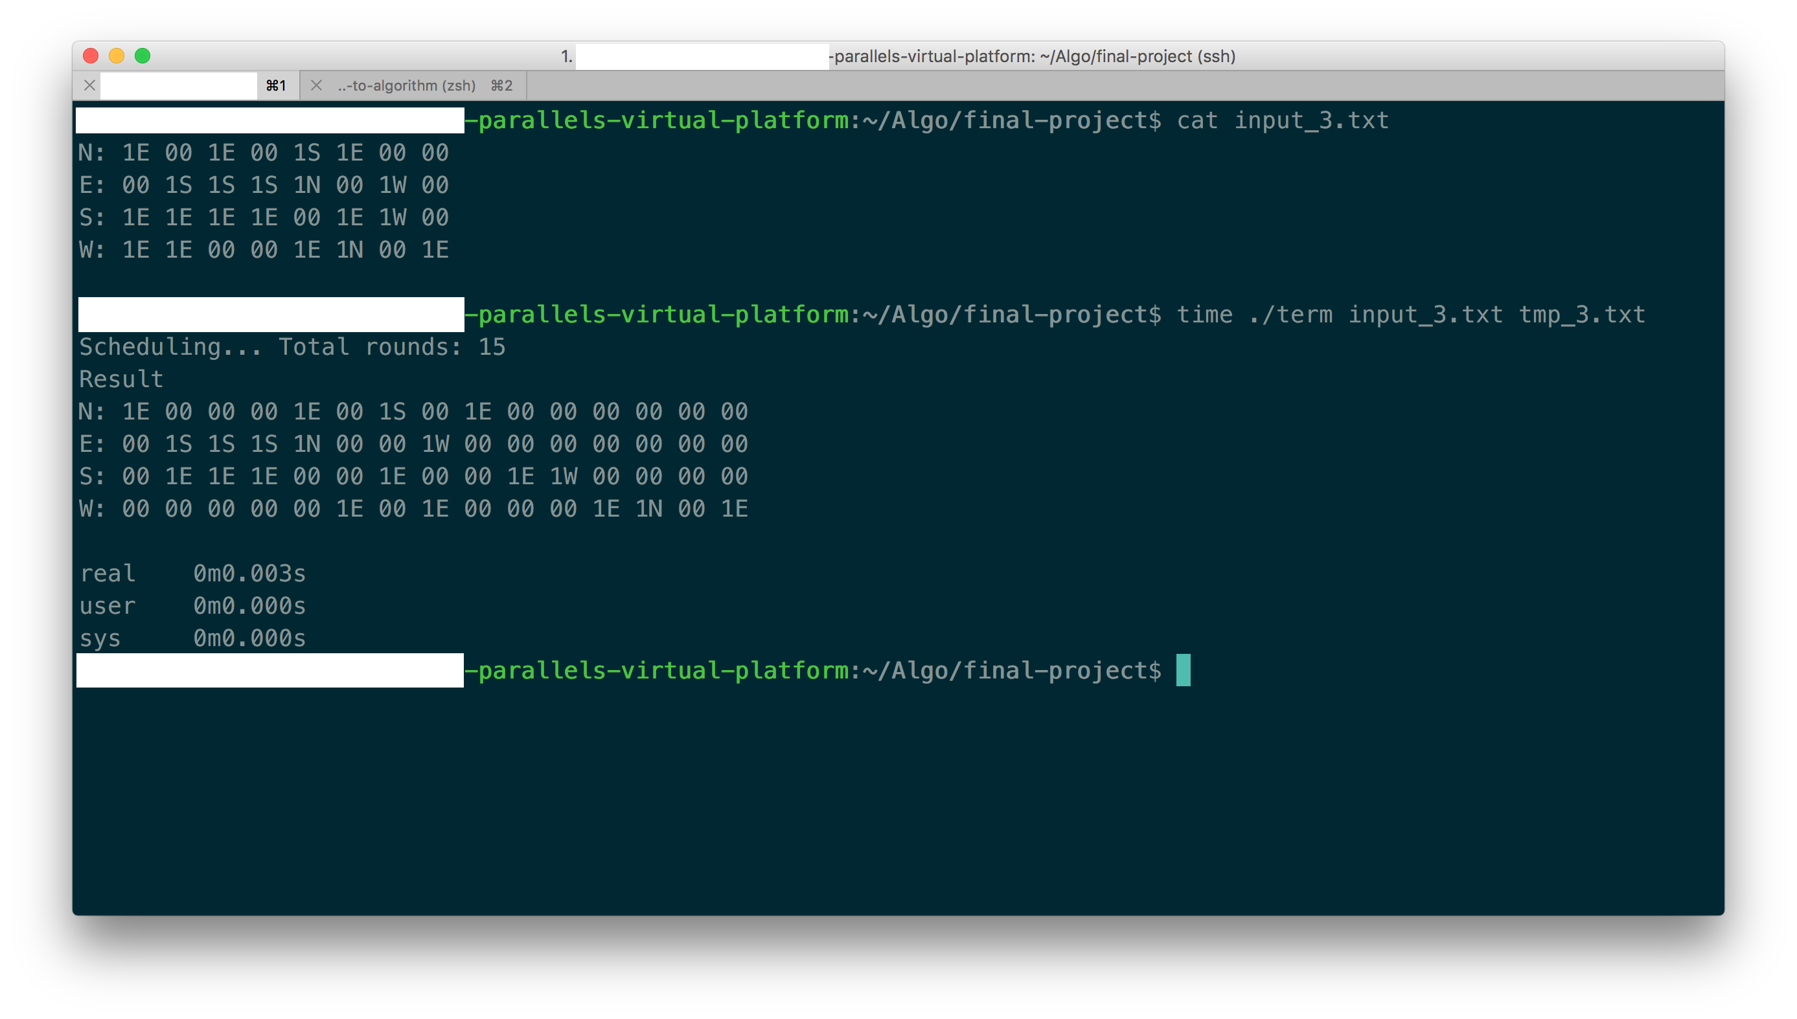

Slide 4
Average rounds
Case 1 : 0.666667
Case 2 : 4.52632
Case 3 : 2.7
Case 4 : 4.0625
Case 5 : 3.8

