Slide 1
Web front-ends with re-frame
https://github.com/danielytics/reframe-talk

Slide 2
What is re-frame?
re-frame is a pattern for writing SPAs in ClojureScript, using Reagent.
Kinda like Redux
Also kinda like Elm
It gives you..
  an event loop
  subscriptions (a reactive view of your data)
  a model to keep your logic as pure as possible
  happiness

Slide 3
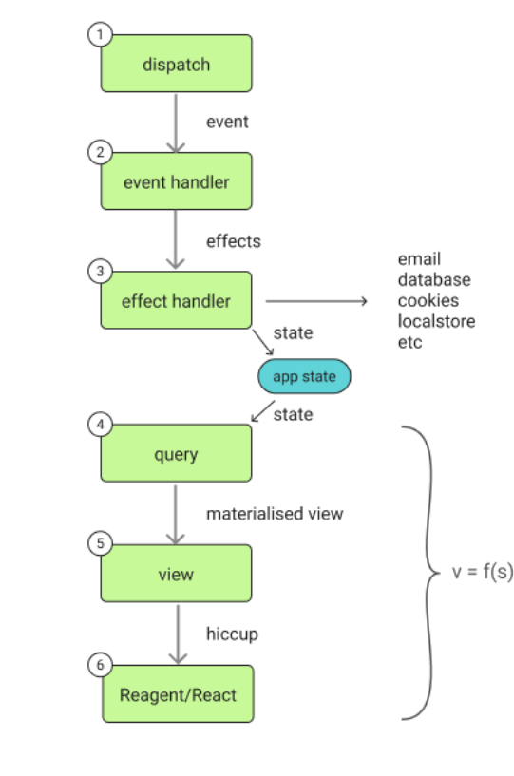
Application Composition
Pure-functional event handlers (3)
Reagent “views” (4)
Pure-functional “queries” to your
data (4)

Slide 4
Application Composition
User triggers browser event
Browser event callback dispatches
re-frame event
Event handler generates collection
of “effects” to apply
Data changes trigger queries to
update
Query updates trigger rendering

Slide 5
Interacting with the world
Event handlers are pure...
They tell what should be done (“effects”)
Effect handler actually does it (impure)
Event handlers can also request impure data...
“coeffects” get this data for them (eg, current time)
event + coffects → effects

Slide 6
Subscriptions
Kinda like database queries
Describe what application state you want
A layer of indirection between your actual data
What not where/how
Are reactive, if their results change, your view
will re-render
Allow for optimisations

Slide 7
Lets see some code!
This slide is intentionally left blank

Slide 8
Any questions?
http://github.com/danielytics/reframe-talk

