Slide 1



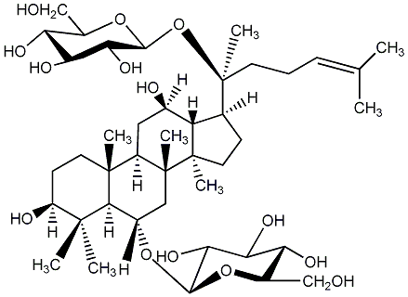






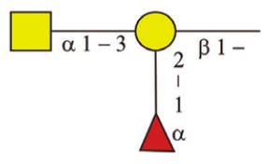

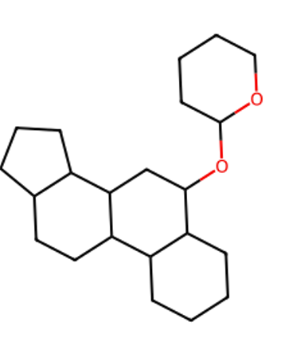

Steroid Glycosides/Natural Herb Extraction
Opensource DATABASE
Natural Products
Natural Products
Glycomics
Lipidomics
Bioactivity
Property
NAME: Ginsenoside Rg1
MW: 801.0 g/mol Log P: 5.7
IC50: 111 mM
SMILES:CC(C)=CC…
AI Training
Glycan Sequence Database
(with Glycosidic linkage )
Data Splitting
*
*
DATA MINING
Gold Glycan Rush
Same Scaffold with Different Sugar
Best Sugar Sequence for similar function
Chemical little change from same organism
*
*
AI-assisted Screening
* Methyl group
A-Glycan Database
(Framework/Functional group)

Slide 2
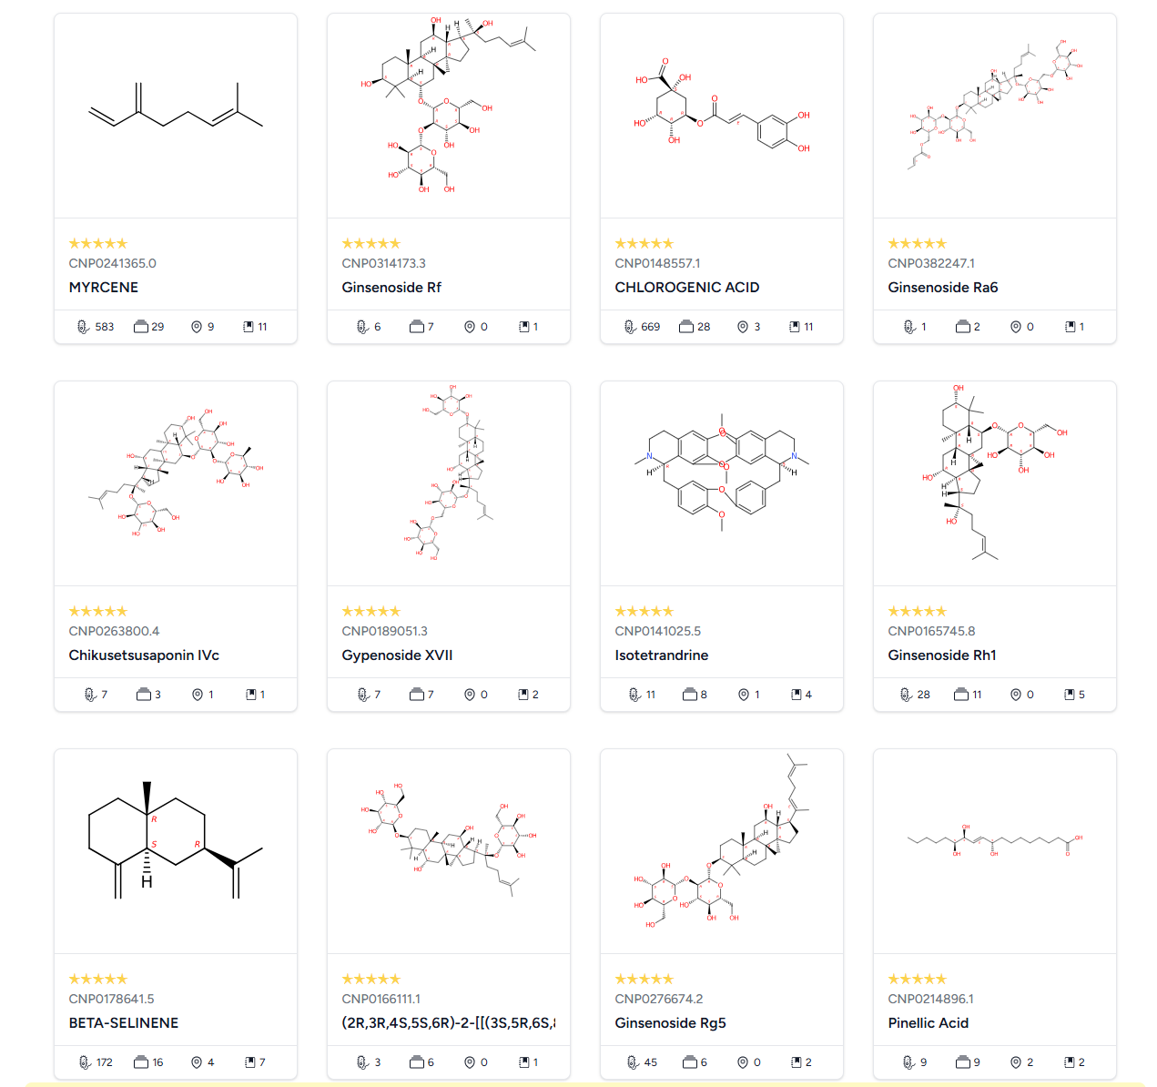
Ginsenoside
Steroid Glycosides
Natural Product
Tr

Slide 3
KNApSAcK Metabolite Information - GINSENOSIDE
Compound: GINSENOSIDE F1 (CHEMBL584011) - ChEMBL

