Slide 1
EVI-based Pixel-level Crop Classification
Yifan Zhang 8/12/2020

Slide 2
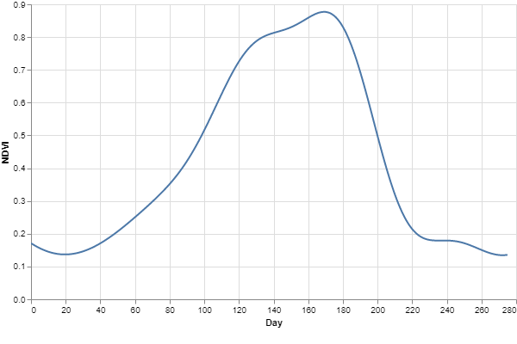


Crop Classification---Question
Question to answer:
Can we make a promising crop discrimination based on the full season EVI information?
Which crop it is?
Multi class classification problem with time series data

Slide 3
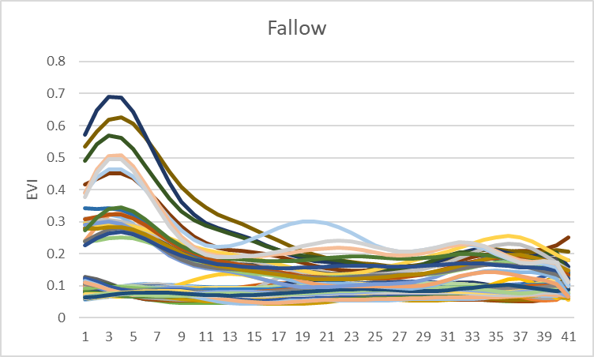
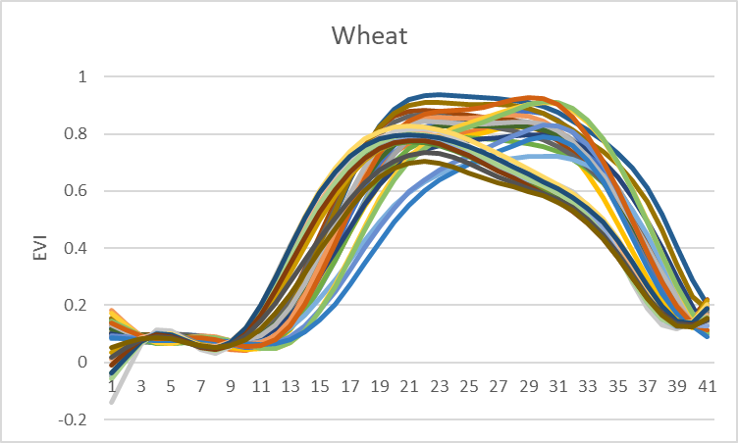
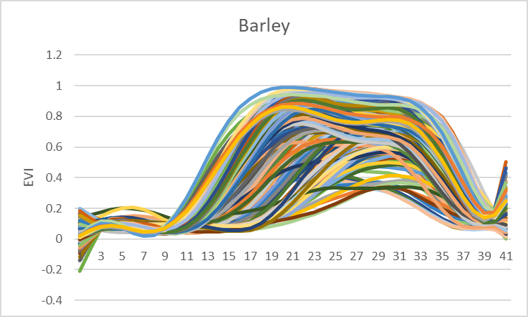
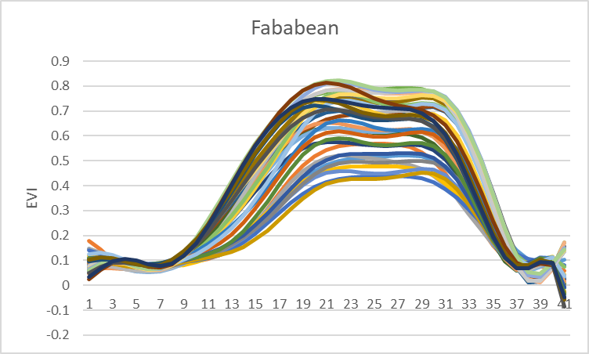
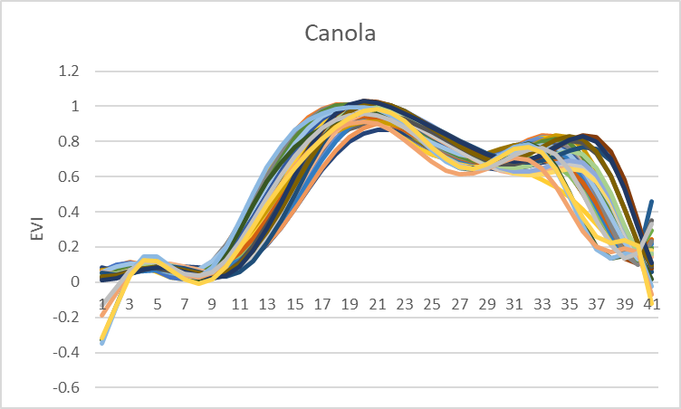
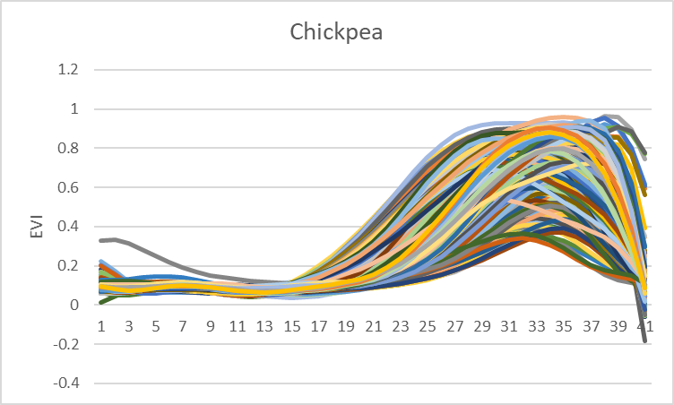
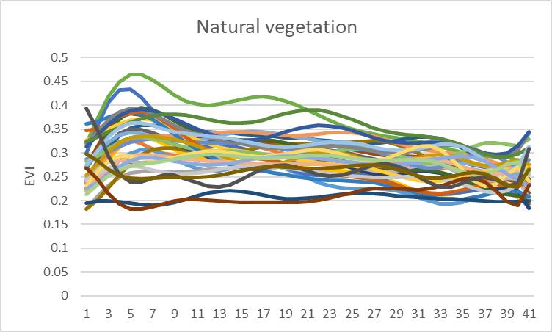
Crop EVI profiles
EVI for each pw and df fields

Slide 4
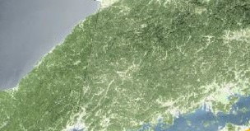

Generate EVI Curve
Satellite images cover save crop area
Take images through time
Each satellite Image has thousands of pixels
Each pixel is 10mX10m
We can get EVI value from each Pixel
With many satellite images, we get a EVI time series
Each pixel is 10mX10m, it represents a type of crop
classification crop == classification pixel

Slide 5

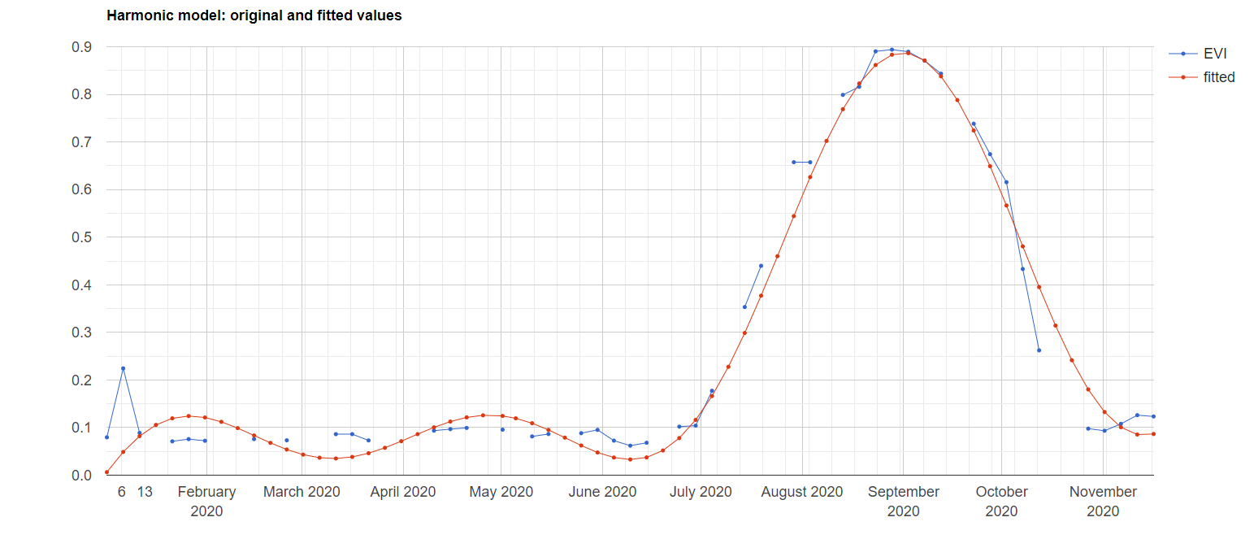
Data Preprocessing:Harmonic model and curve fitting

Slide 6
Crop Classification---Experimental Design
VIC 2019 Crop Data, Start from 1 April, end at 31 December
Train
Test
Validation
70%
30%
Training – random points randomly generated within the datafaming and paddockwatch polygons;
Validation dataset – an independent sampling points within the datafarming and paddockwatch polygons

Slide 7
Classification methods
RF – 4harmonics: Random forest using harmonic coefficients (4 harmonics, 8 coefficients)
RF – fittedEVI: Random forest using harmonic analysis fitted every 5 day EVI
DL – ANN: DL method using a feedforward neural network
Trained with a relative small dataset (~ 20000 points)
Trained with a relative large dataset (~ 60000 points)
DL – RNN: DL method using a recurrent neural

Slide 8
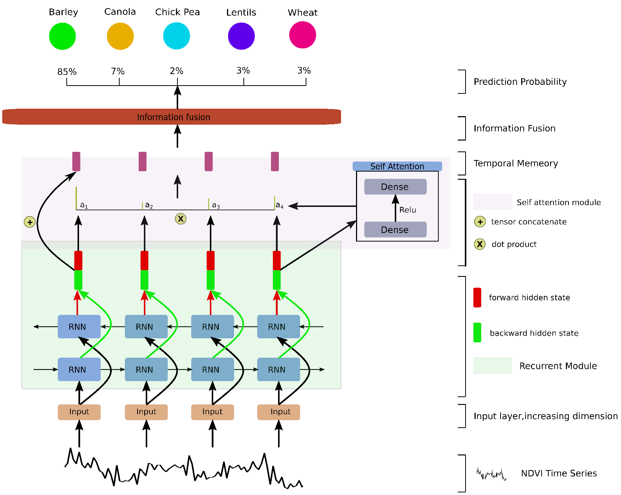
RNN (LSTM+SelfAttention)

Slide 9
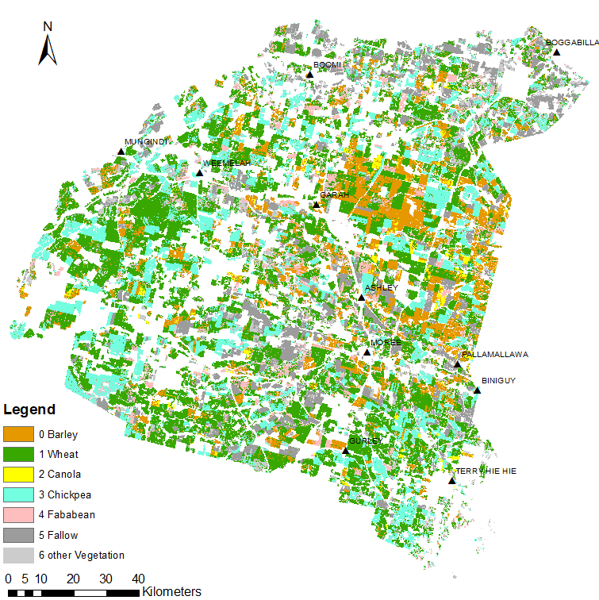
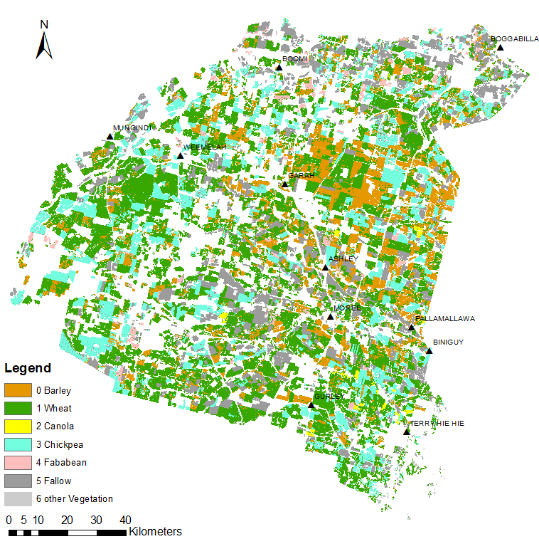
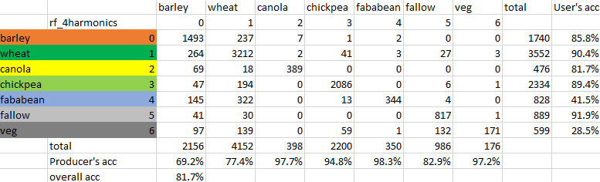
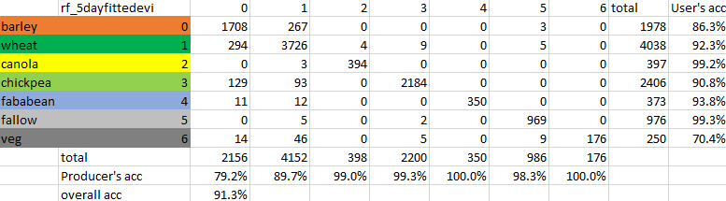
RF – 4 harmonics
RF – fitted 5day EVI

Slide 10
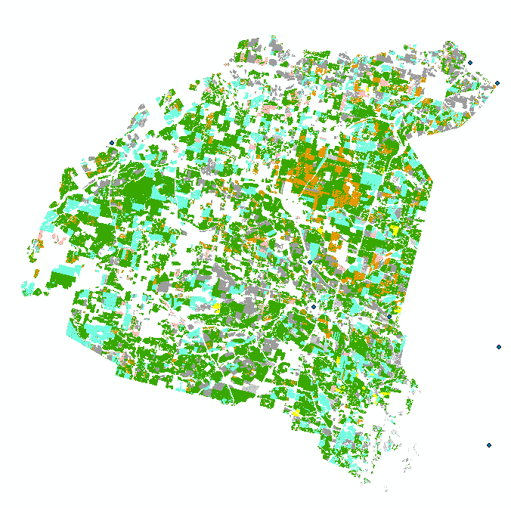
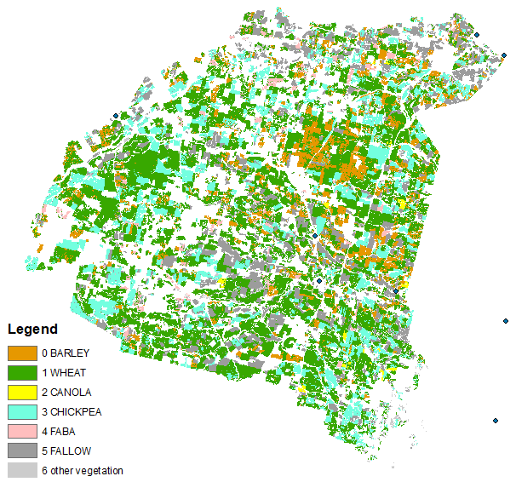
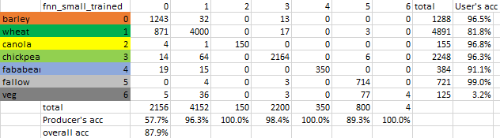
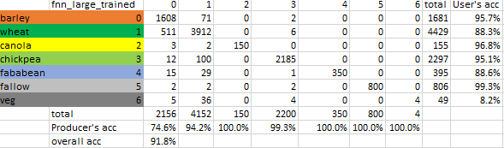
ANN – trained on 20000+
ANN – trained on 60000+

Slide 11
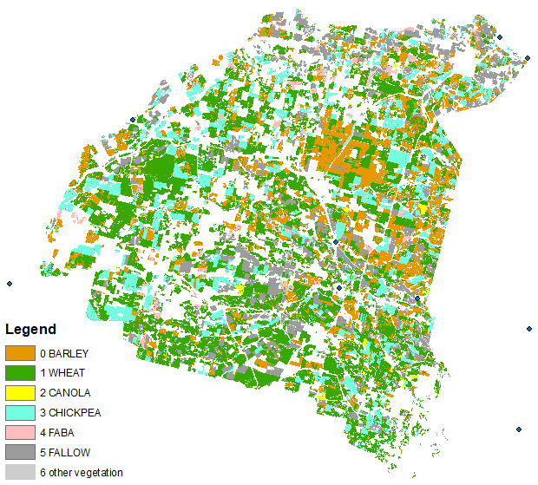
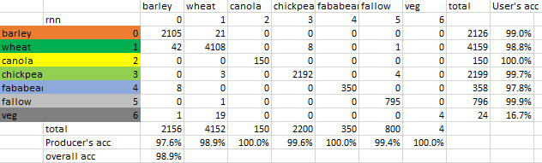

Slide 12
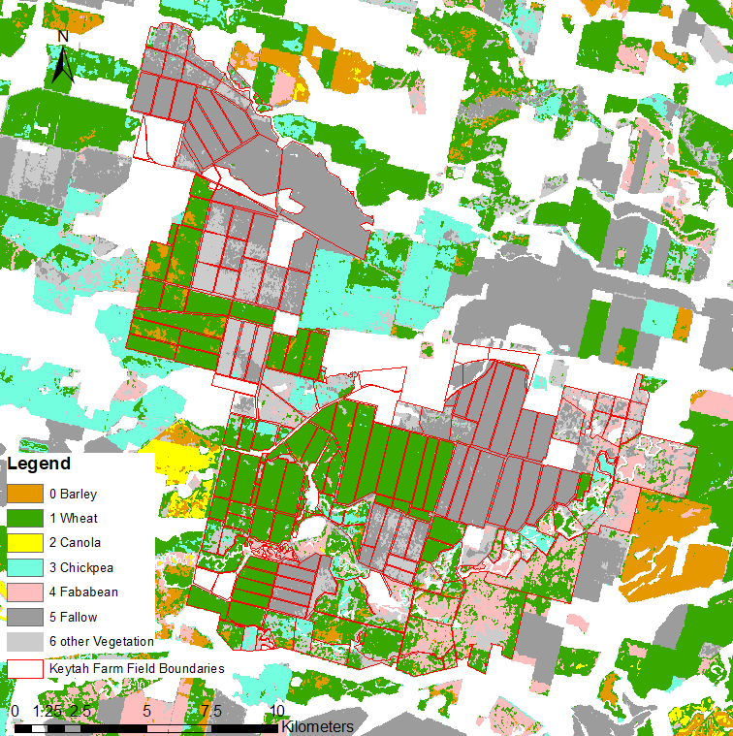
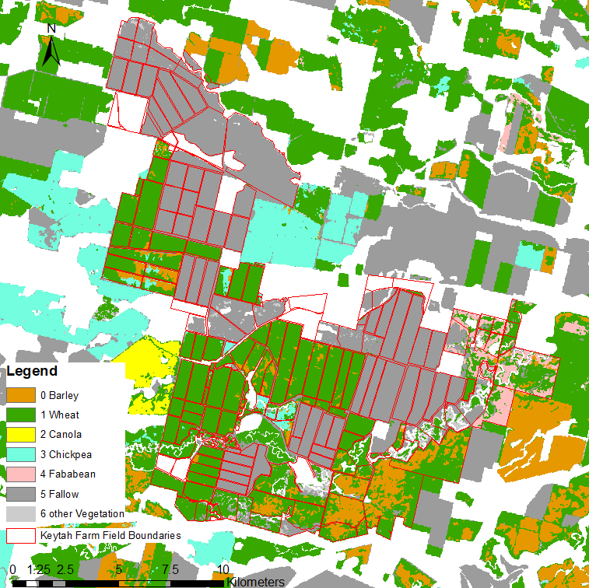
RF – 4 harmonics
RF – fitted 5day EVI

Slide 13
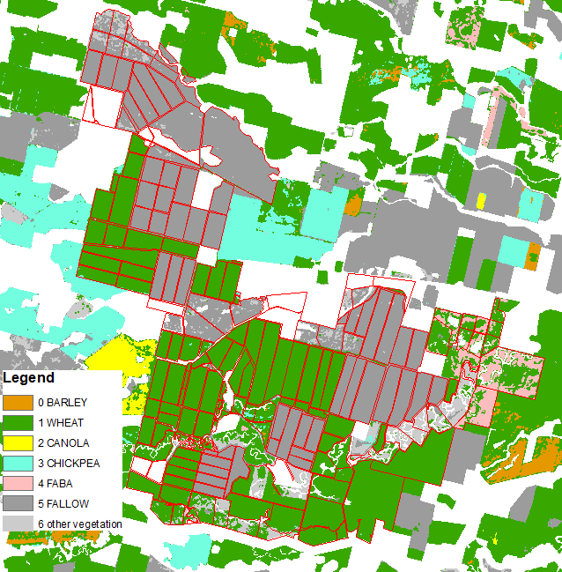
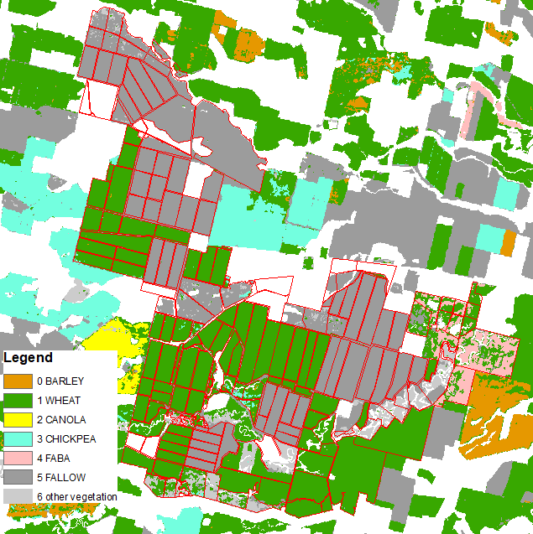
ANN – trained on 20000+
ANN – trained on 60000+

Slide 14
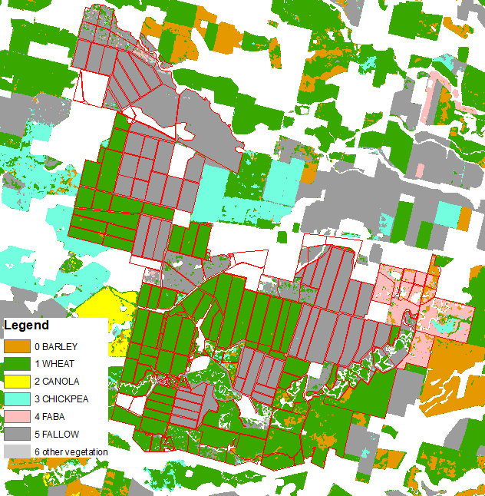
RNN – trained on 60000+

Slide 15
Problem about the results
The islands and salt and pepper effects
A proper image processing algorithm?
Or other improvements on the model?

Slide 16
Related Resources
The Moree rnn results are uploading to the RDM directory below.
https://cloud.rdm.uq.edu.au/index.php/s/WBtExSjEsRg5Bgr
password: CROPPHEN
Contact:
Yifan Zhang, Yifan.zhang@uq.edu.au

Slide 17
Thanks

