Slide 1
Generative Adversarial Networks
Siyu

Slide 2
Today’s Content
Theory of
GANs
TensorFlow Implementation

Slide 3
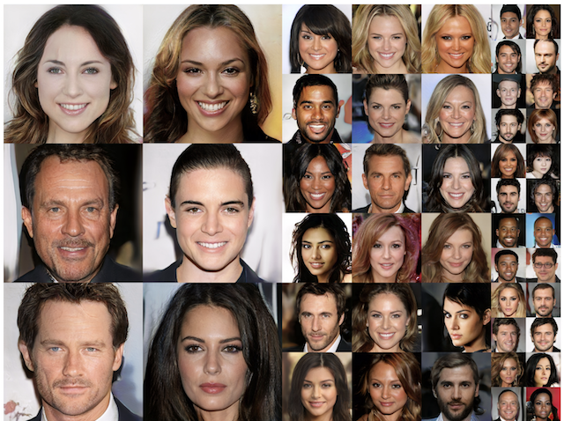
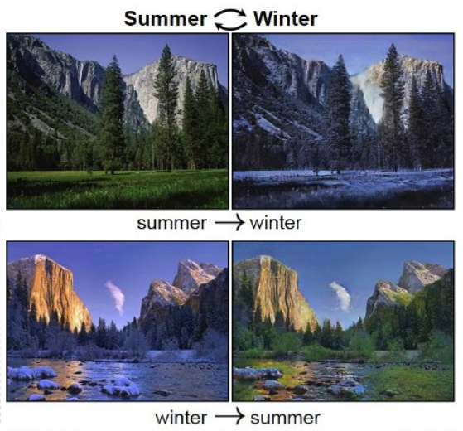
What Do GANs Do?
Image Synthesis
Image Translation
Traditional discriminative models are not good enough!

Slide 4
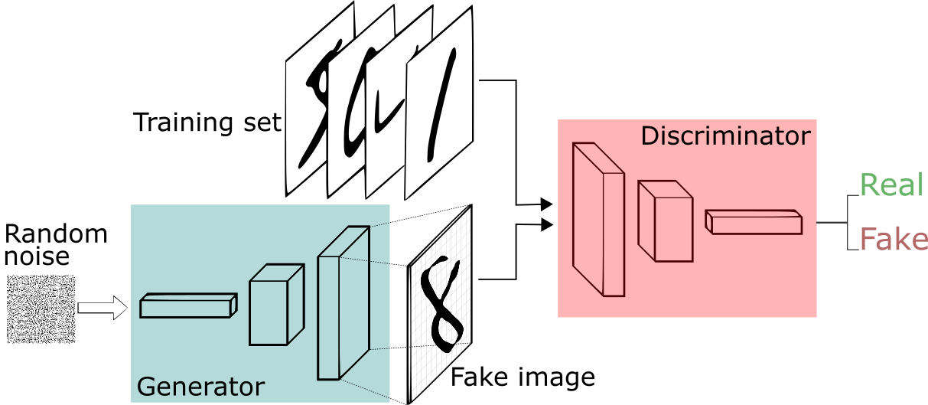
Generating Data
Generating data had been historically difficult and was thought to be impossible in many cases.
How do we define realness?
Naïve loss functions like MSE cannot quantify realness.
“Realness”
Loss

Slide 5
Generative Adversarial Networks (GANs)
A framework for generating data, can be supervised or unsupervised.
Involved at least two models: a generator and a discriminator.
Neural nets can be trained to classify things, they can be trained to assess realness as well

Slide 6
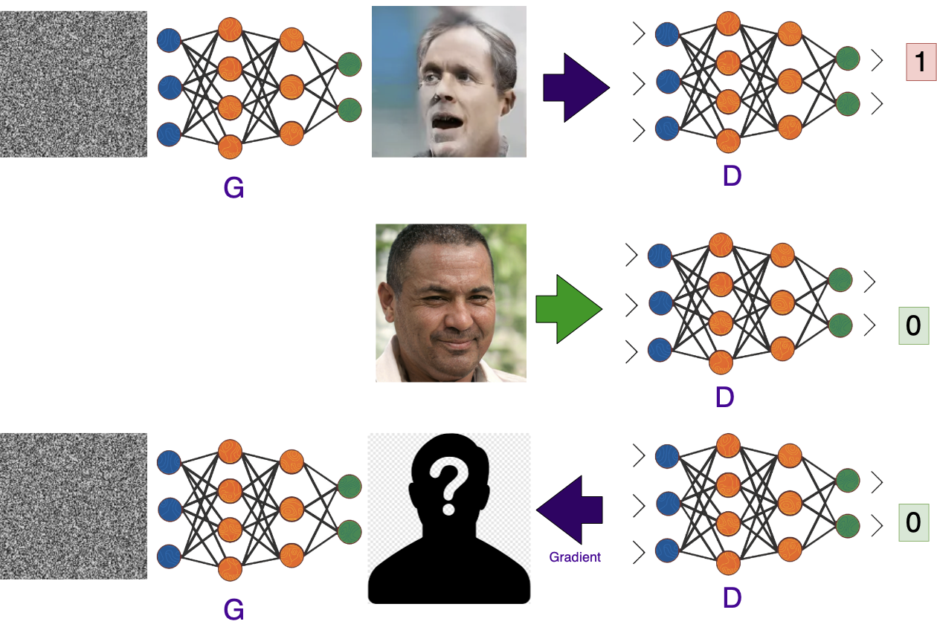
Generative Adversarial Networks – Training Step
Step 1 – Training the Discriminator on a fake sample
Step 2 – Training the Discriminator on a real sample
Step 3 – Optimise the Generator to make the Discriminator predict “real”

Slide 7
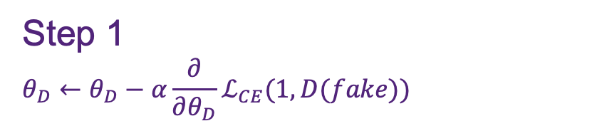
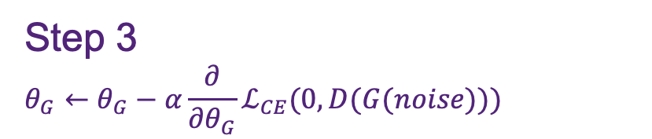
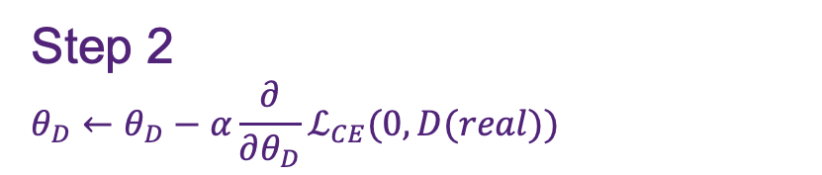
Generative Adversarial Networks – Training Step
Step 1
$$θ_{D}←θ_{D}−α\frac{∂}{∂θ_{D}}ℒ_{CE}(1, D(fake))$$
Step 2
$$θ_{D}←θ_{D}−α\frac{∂}{∂θ_{D}}ℒ_{CE}(0, D(real))$$
Step 3
$$θ_{G}←θ_{G}−α\frac{∂}{∂θ_{G}}ℒ_{CE}(0, D(G(noise)))$$
The models are trained alternatively until equilibrium

Slide 8
Training Using Model.fit()
Step 1
$$θ_{D}←θ_{D}−α\frac{∂}{∂θ_{D}}ℒ_{CE}(1, D(fake))$$
d.train_on_batch(fake, [1, 1, 1 …])
Step 2
$$θ_{D}←θ_{D}−α\frac{∂}{∂θ_{D}}ℒ_{CE}(0, D(real))$$
d.train_on_batch(real, [0, 0, 0 …]))
Step 3
$$θ_{G}←θ_{G}−α\frac{∂}{∂θ_{G}}ℒ_{CE}(0, D(G(noise)))$$
gd.train_on_batch(noise, [0, 0, 0 …]))
The models are trained alternatively until equilibrium

Slide 9
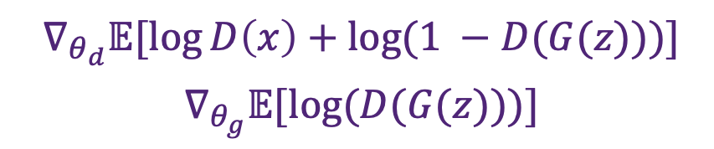
Training Using Model.fit()
Step 1
$$θ_{D}←θ_{D}−α\frac{∂}{∂θ_{D}}ℒ_{CE}(1, D(fake))$$
d.train_on_batch(fake, 1)
Step 2
$$θ_{D}←θ_{D}−α\frac{∂}{∂θ_{D}}ℒ_{CE}(0, D(real))$$
d.train_on_batch(real, 0)
Step 3
$$θ_{G}←θ_{G}−α\frac{∂}{∂θ_{G}}ℒ_{CE}(0, D(G(noise)))$$
g_and_d.train_on_batch(noise, 0)
The models are trained alternatively until equilibrium

Slide 10

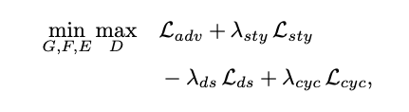



Generative Adversarial Networks – Implementation
We had to convert the real loss function to a supervised learning problem
GAN losses can be very complex. For example, the StarGAN v2 loss:
Cross Entropy Losses for model.fit(x, y)

Slide 11
Generative Adversarial Networks – Implementation
We had to convert the real loss function to a supervised learning problem
GAN losses can be very complex. For example, the StarGAN v2 loss:
Cross Entropy Losses for model.fit(x, y)
model.fit(x, y)?

Slide 12
Generative Adversarial Networks – Implementation
model.fit is good for supervised learning
model.fit is a convenience API, it does not reflect the nature of deep learning
It is hard to define the input (x) and target (y) for complex loss functions
model.fit(x, y)?

Slide 13
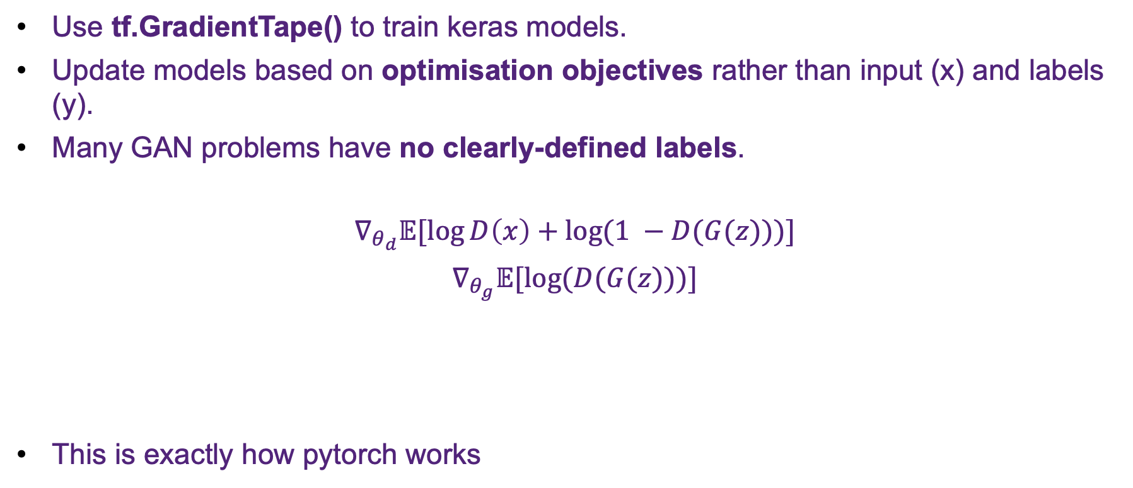
Gradient Tape
Use tf.GradientTape() to train keras models.
Update models based on optimisation objectives rather than input (x) and labels (y).
Many GAN problems have no clearly-defined labels.
$$∇_{θ_{d}}𝔼[\log{D\left(x\right)+log(1 −D(G(z)))}]$$
$$∇_{θ_{g}}𝔼[log(D(G(z)))]$$
This is exactly how pytorch works
Example GAN loss function

Slide 14
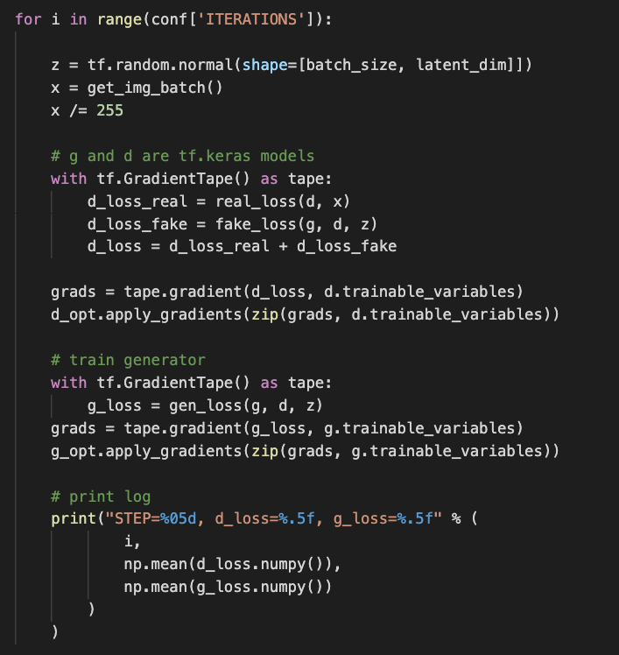


GAN Example Using GradientTape
Real Loss

Slide 15
GAN Example Using GradientTape
Fake Loss

Slide 16
GAN Example Using GradientTape
Gradient w.r.t Discriminator

Slide 17

GAN Example Using GradientTape
$θ_{d}⟵$ $θ_{d}−{α∇}_{θ_{d}}(x, z, G, D)$
Update the weights of D

Slide 18
GAN Example Using GradientTape
Generator Loss

Slide 19
GAN Example Using GradientTape
Gradient w.r.t Generator

Slide 20

GAN Example Using GradientTape
$θ_{g}⟵$ $θ_{g}−{α∇}_{θ_{g}}(z, G, D)$
Update the weights of G

Slide 21
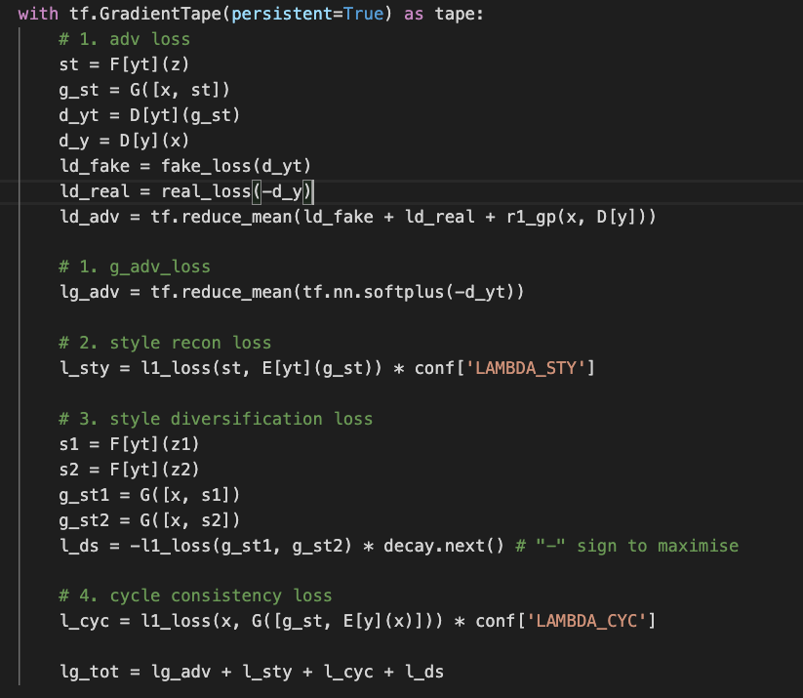
StarGANv2 Example Using GradientTape
Losses are implemented as they are defined in the paper

Slide 22

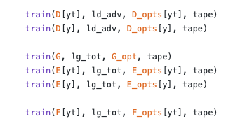
StarGANv2 Example Using GradientTape
Updated all the models using the same loss function

