Slide 1
AI Competitions!
ITEE Summer of AI
Dr. Shekhar “Shakes” Chandra

Slide 2
What are the Competitions
Real world research problems needing your help!
Leading UQ researchers present their projects and data for you to crunch!
Real research data that you can build AI solutions for!
Great opportunity to flex your AI muscles!
Guidance to be provided for projects and participants by the event organisers
Best performing model is sought for the objective set by the project team
Winner per project will be announced by each project team
Overall winner to receive a prize!
#summer-of-ai

Slide 3
How do I take part?
Choose one or more projects from the ones presented today
Note their objective(s) and performance metric(s)
Download the data
Do some reading/survey of the research/code/models, especially those suggested
Setup a private GitHub repository to store you code
Start building your model(s)!
Commit regularly
Document your findings
#summer-of-ai

Slide 4
Rules
Setup a private GitHub repository to store you code
You may use a public repository if the project team approves
This is to track and prove the originality of your work
You may use pre-built solutions and open code/models, but be sure to cite/acknowledge them
Start building your model(s)!
The performance of the model will be compared using the metric(s) decided by the project teams on a per project basis
Project teams may use your code in the future for their research
Overall winner will be voted on by all the project teams and event organisers
The decision of the teams and organisers will be final
#summer-of-ai

Slide 5
Projects Available
#summer-of-ai

Slide 6
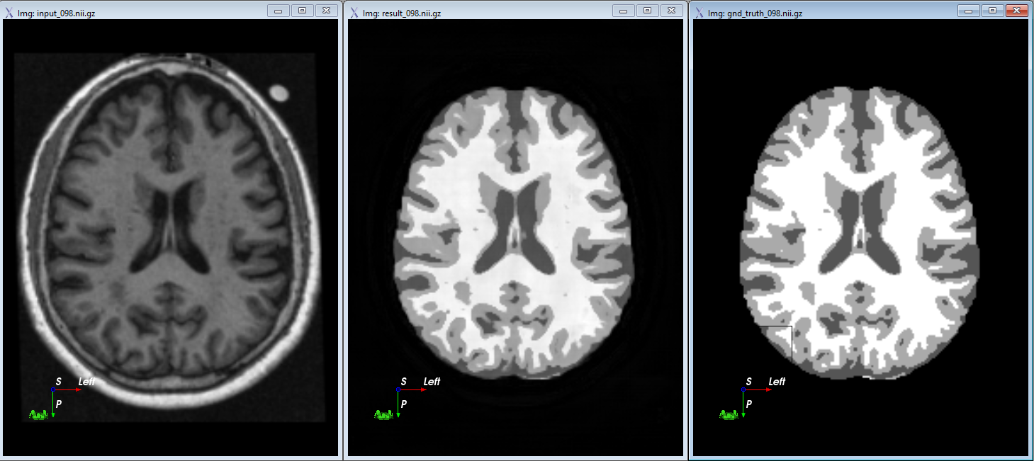
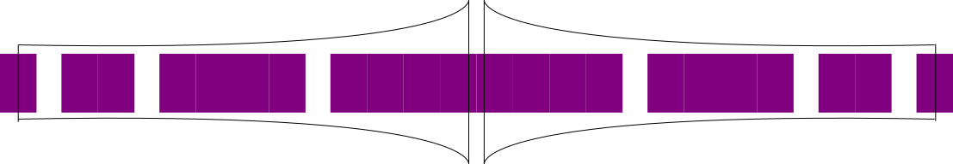
Objective: A UNet without any downsampling
Given a simple medical imaging dataset such as the OASIS dataset
Compute the 3D patch-based semantic segmentation
The network should have minimal or no downsampling achieving receptive fields analoguous to the UNet
Hint: Use dilated convolutions in stead of downsampling and max pooling
The labels should be one-hot encoded to produce a categorical output
The best performing model WRT to Dice similarity coefficient (DSC) will be the winner
Schematic representation of the UNet model without any dowsampling. It should be possible to replace all downsampling and pooling with dilated convolutions. Thus, it should be 100 times smaller than the standard UNet model with similar performance!

Slide 7
Suggested Steps
First build a UNet to do whole image 2D segmentation with one-hot encoded labels for semantic segmentation
Then extend this to do patch-based 2D segmentation with the UNet
Ensure minimal artefacts within your results of your patch-based approach
Compare both whole-image and patch-based models and their performance with the DSC, if similar performance, then go to the next step
Extend the 2D patch-based method to 3D patch-based method
Compute the DSC of all labels. All DSC should be > 0.9 DSC for each label

Slide 8
Conclusion
We have a variety of projects for you to explore
A chance to build real world AI solutions and practice as you learn!
A chance to explore the literature and AI codes
We are here to help you build the solutions if need it
A chance to join the project team(s) when its all done!
Chance to win a prize!
#summer-of-ai

Slide 9


Thank you
Dr Shekhar “Shakes” Chandra | Senior Lecturer
School of Information Technology and Electrical Engineering
shekhar.chandra@uq.edu.au
+61 7 3365 8359
@shakes76
shekhar-s-chandra

