Slide 1
GPU Resources
ITEE Summer of AI
Dr. Shekhar “Shakes” Chandra

Slide 2
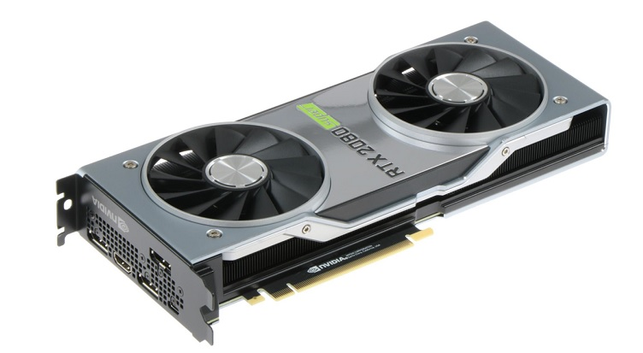
Graphics Processing Units
Heterogenous Computing
Cheap
Readily available
Optimized for Linear Algebra etc.
Open Source Software
High level interfaces available
Graphical Processing Units (GPUs) – 10 TeraFLOPS
~ $1000 – $10000 AUD
#summer-of-ai

Slide 3
High Performance Computing (HPC)
Server-side GPUs on computing clusters
UQ RCC Wiener Cluster – Largest in Southern Hemisphere
Limited to HDR students and researchers
Requires activation and sign up with QBI admins
http://www2.rcc.uq.edu.au/hpc/guides/index.html?secure/Wiener_userguide.html (UQ LAN only)
16 V100 (16 GB VRAM) and 16 V100s (32 GB VRAM)
Uses SLURM
ITEE Goliath HPC - https://student.eait.uq.edu.au/infrastructure/compute/
Features 12 GPUs including 4 P100s (16 GB VRAM)
Uses SLURM
#summer-of-ai

Slide 4
GPU Compute Lab
Found in 78-336
Accessible to EAIT students and staff
42 RTX 2080 (8 GB VRAM) Workstations
Available on site and via Remote Desktop
Used in teaching periods, but available over Summer
User added manually if not in a course
#summer-of-ai

Slide 5
Google Colaboratory
CPU and GPU Notebook style interface
Based on Jupyter notebooks
Limited login period (~ 3hrs)
Shareable
Always available
#summer-of-ai

Slide 6
Google Cloud / AWS / Azure
Various cloud services also offer GPU time
UQ gets default access via agreements – for example all staff and students get $100 USD on Azure services
UQ has access to AWS Learning in the past.
UQ’s partnership with the AWS Educate Program – Sign up using your UQ email
You can request Google Cloud Faculty access through their education contacts
#summer-of-ai

Slide 7


Thank you
Dr Shekhar “Shakes” Chandra | Senior Lecturer
School of Information Technology and Electrical Engineering
shekhar.chandra@uq.edu.au
+61 7 3365 8359
@shakes76
shekhar-s-chandra

