Slide 1
Deep Learning with Tensorflow
Programming Tool
Wei Dai
PHD Candidate
School of Information Technology and Electrical Engineering

Slide 2

Programming Language
Possible choices:
Python, Julia, R, Java, matlab
Most popular choice:
Python
free and open source
Huge amount of libraries for different problems
Friendly implementation for varying programming skill level
Easy for debugging
Requirements:
Need some python programming skill

Slide 3
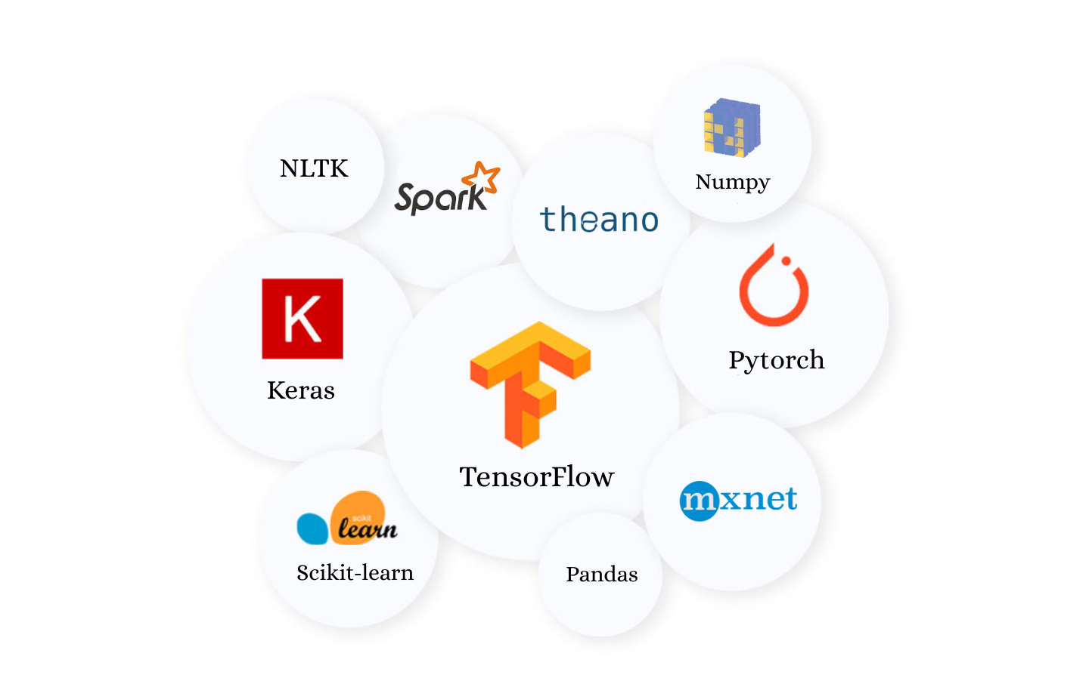
Deep Learning Libraries:
Tensorflow
Suit for both beginners and professionals
Static computation graph
PyTorch
Good for developing and training different models
Suit for intermediate
Dynamic computation graph
Keras
A higher level API for Tensorflow
Very friendly for newcomers
Others:
Theano, MXNet
Notes:
These are libaraies in python, like other libraries such as numpy
Static graph:
defines the sequence of computation that one wants to do, with placeholder for the data.
After that for training / running the model you feed in the data.
Static computation graph is great for performance and ability to run on different devices (cpu / gpu / tpu), but is a major pain to debug.
Dynamic computation graph:
computations are done line by line as the code is interpreted. Just like how code works
easier to debug the code, and also offers other benefits

Slide 4
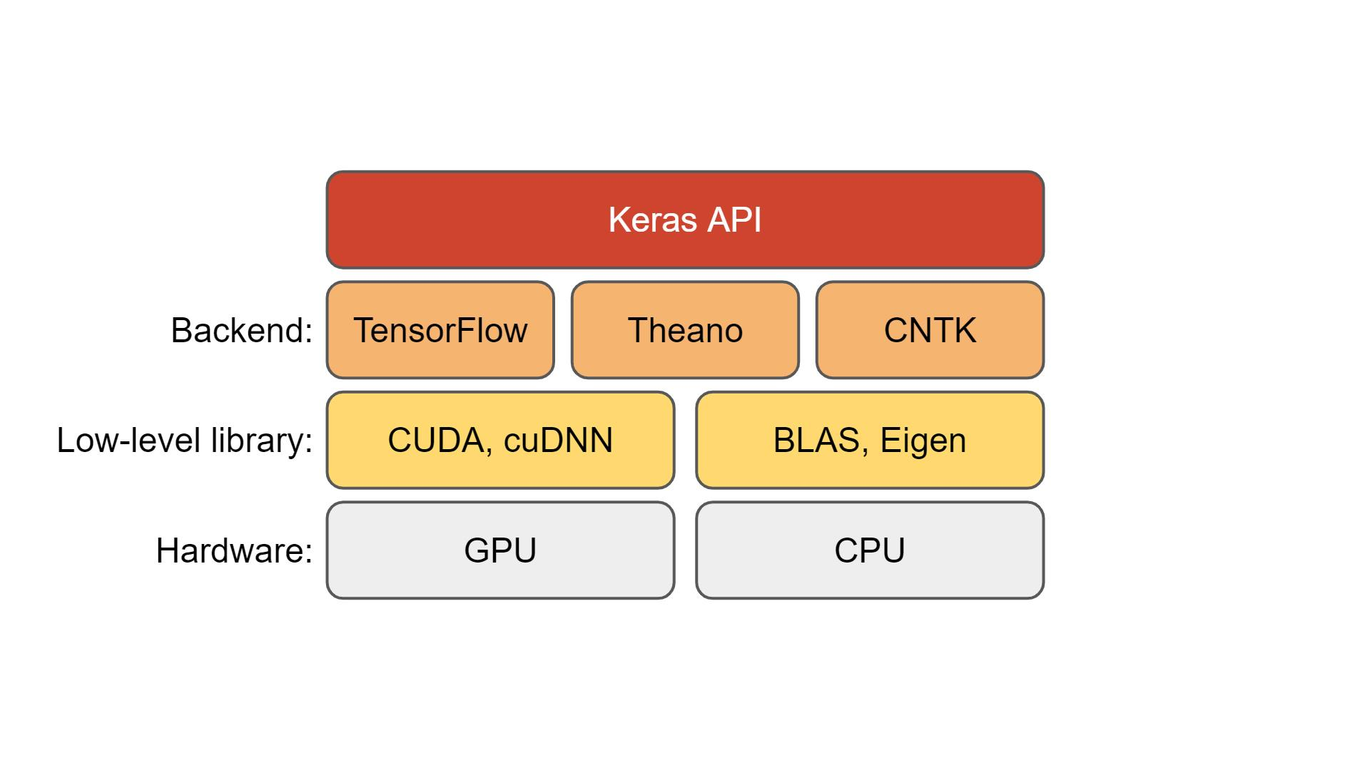
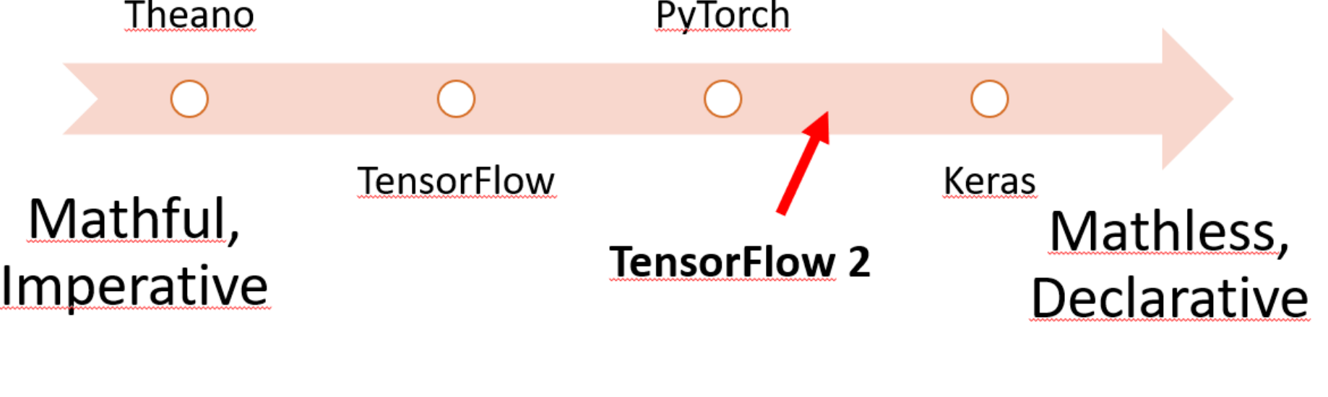
Tensorflow 1 vs Tensorflow 2:
Tensorflow 1:
Define the static graph using tf.Graph
no computation
Execute graphs using tf.Session
allocate resources and hold variables’ value
API is hard to start with, like a new language
Hard to debug
Tensorflow 2:
Higher level API Keras integrated in the main TF2 API
Easy method: Build model and execute using tf.keras
Hard method: Build mode using custom subclassing and execute using tf.GradientTape
Eager mode: Achieve dynamic computation based on static graph

Slide 5
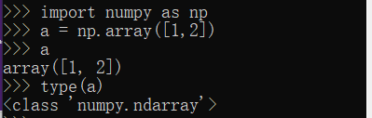
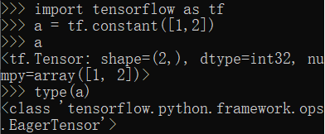
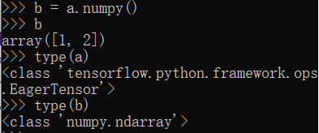
The basic unit of Tensorflow: Tensor VS Numpy
Tensor
A multi-dimensional arrays with uniform data type
Similar to numpy like type: np.ndarray
Immutable like python number or strings
No update. Need to create a new one
To create a immutable tensor: Use tf.constant()
To create a mutable tensor: Use tf.Variable()
Difference:
Tensorflow operations with tensor can be done within GPU.
Numpy array is normally done in CPU
Array or Matrix operations involves extensive parallel comptuion which is much faster in GPU
Operations
Most numpy operations has counterpart in tensorflow
Module: tf.math | TensorFlow Core v2.3.0
Free conversion between tensor and np.array

Slide 6
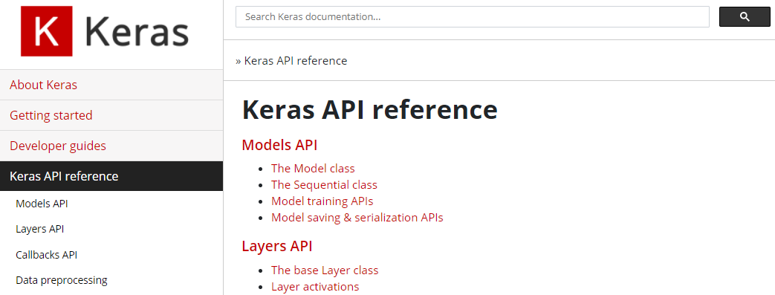
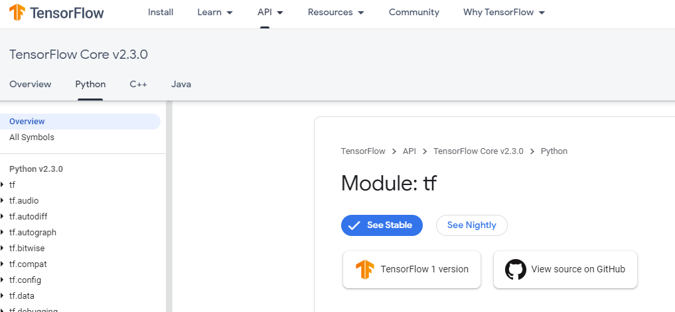
How to use tensorflow?
How to get start?
Keras:
Getting started (keras.io)
Tensorflow
Tutorials | TensorFlow Core
Use the API documentation!
Keras:
Keras API reference
Tensorflow:
Module: tf | TensorFlow Core v2.3.0
Same API functions, but more details for Keras API in Keras webpage

Slide 7
Network Training process
https://theffork.com/activation-functions-in-neural-networks/
Stage 1: Data preparation
Data Loading
Data Pre-processing
Stage 2: Training Stage
Building the model
Compile the model
Train the model
Model Prediction
Model Evaluation
Stage 3: Testing Stage
Performance Evaluation
Stage 4: Evaluation
#deep-learning-uq

Slide 8
Data Preparation:
Data loading:
Load pre-built data library:
tf.keras.datasets
Module: tf.keras.datasets | TensorFlow Core v2.3.0
Tensorflow_datasets library
TensorFlow Datasets
Manual method:
Use tf.data.Dataset to load, pre-process the image
tf.data.Dataset | TensorFlow Core v2.3.0

Slide 9

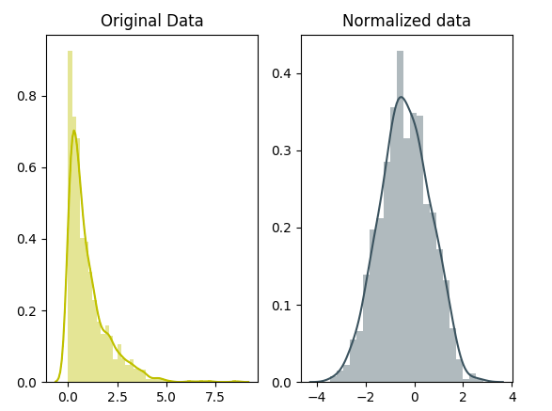
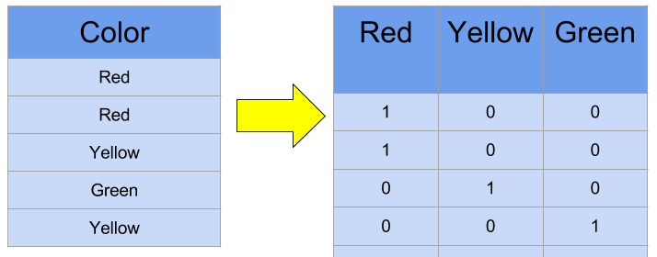
Data Preparation:
Why do we need pre-processing?
messy and from different sources
Standardize and clean up
Reduce complexity and increase performance
Techniques:
Reduce complexity
Convert to grey scale
Standardize images
Clip
Crop
Normalization
Change data structure for specific task
One-hot encoding

Slide 10
Network Training process
https://theffork.com/activation-functions-in-neural-networks/
Stage 1: Data preparation
Data Loading
Data Pre-processing
Stage 2: Training Stage
Building the model
Compile the model
Train the model
Model Prediction
Model Evaluation
Stage 3: Testing Stage
Performance Evaluation
Stage 4: Evaluation
#deep-learning-uq

Slide 11
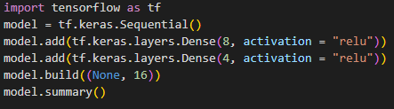
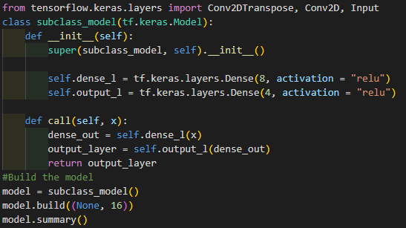
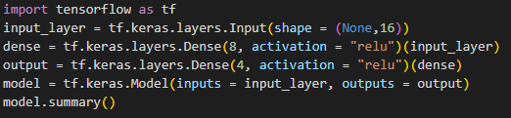
Training stage: Build the model
Head
Body 1
Body 2
Tail
Building method:
Sequential Method (easy):
…….
Model Subclassing(hard):
Functional API (medium):

Slide 12
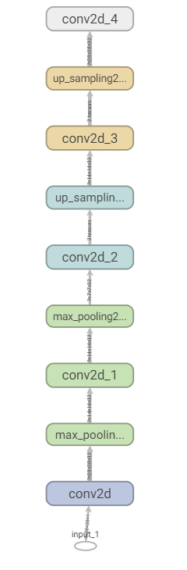
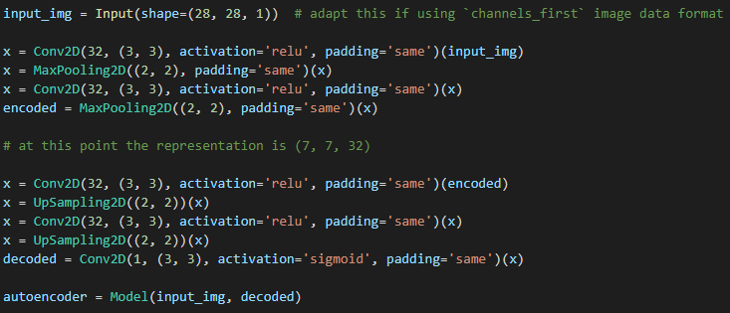
Network Graph:

Slide 13
Network Training process
https://theffork.com/activation-functions-in-neural-networks/
Stage 1: Data preparation
Data Loading
Data Pre-processing
Stage 2: Training Stage
Building the model
Compile the model
Train the model
Model Evaluation
Model Prediction
Stage 3: Testing Stage
Performance Evaluation
Stage 4: Evaluation
#deep-learning-uq

Slide 14
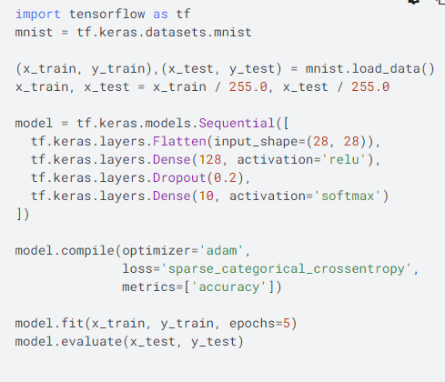
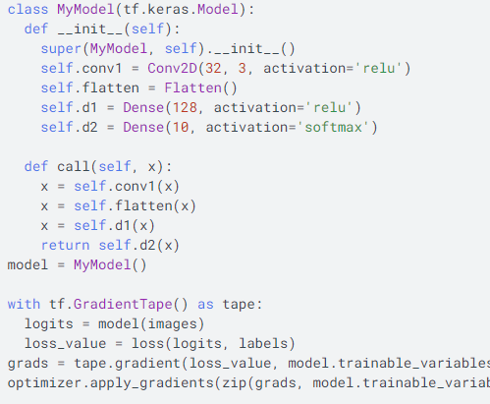
Training Stage:

Slide 15
Evaluation Stage: Performance Evaluation
Common Evaluation process:
Check the output results visually
Such as plt.imshow() for images
Check the training plot
Use tensorboard
tensorboard --logdir=“tensorboard_path”
Perform evaluation using metric
Use model.predict(test_data) to get prediction
Calculate the “accuracy” between predicted label image and ground truth label image
Metrics:
DSC
Surface distance
MSE

