Slide 1

React Demo

Slide 2
What Is React?
An open-source library for building user interfaces
Multilanguage and Multiplatform Support (JavaScript, Java, Xcode)
Reference implementation is browser-side JavaScript
Allows you to write HTML components directly in code
React components have an immutable state manager
Used and Maintained by Facebook

Slide 3
A Brief History of Server-Side JavaScript
node.js
Server-side JavaScript is born! More concurrent connections than you shake a stick at. Fast prototyping. You should probably be using it.
npm
What good is new runtime environment with a dependency manager/repository? Npm is released with node.js, allowing developers to do what they do best: import and be lazy
Sad, jealous, and frustrated front-end developers
Frontend devs have been frustrated for many years because of differences between browsers
Frontend devs get sad and jealous because backend JS developers can easily import npm code and they can’t
Webpack Bundler
A tool for bundling and transpiling node.js code into a build file, allegedly fixing the problem of sad, jealous, and frustrated front-end developers. Turns out we’re just malcontents

Slide 4
JSX
JSX is a syntax that lets you write custom HTML components, called React Components, directly in JS, with HTML syntax.
This is made possible by webpack module that transpiles JSX to javascript.
React Components are defined as either pure functions or classes that extend a Component base-class.

Slide 5
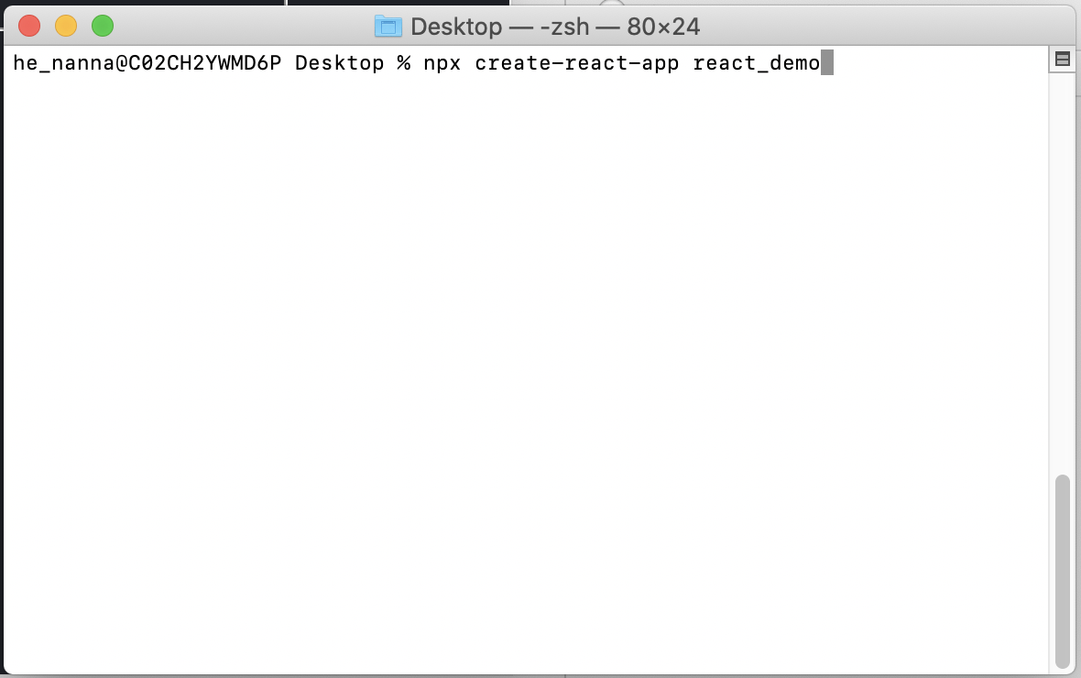
Create React App

Slide 6
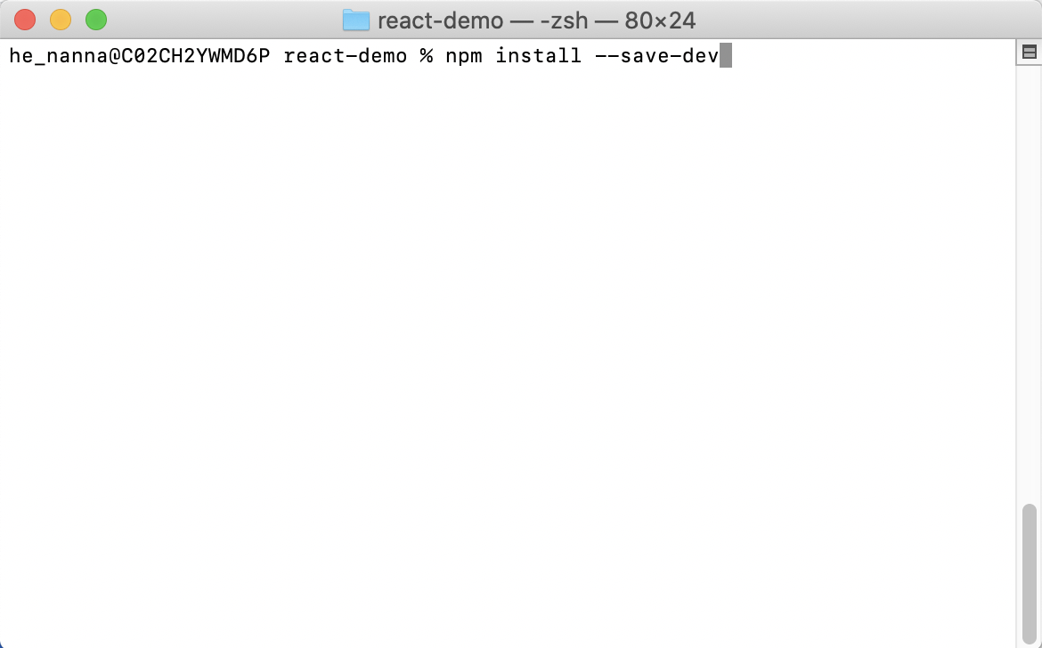
Create App Demo
https://github.com/nickanna42/react_demo

Slide 7
Questions?
https://github.com/nickanna42/react_demo

