Slide 1

Mekdela Amba Universty
College of Computing and Informatics
Internship Report Presentation
Company: Ewenet Communication PLC
Project Title: CombolojoSPORT – Venue Booking System
Role: Frontend Developer
Prepared By: Daniel Zigabe
Abel Shewangzaw
Department: computer Science
Presentation Date: [Date]

Slide 2

Company Background
History
• Founded in 2012 in Addis Ababa, Ethiopia
• Started by three young innovators
• Initial capital: 20,000 Birr
• By 2015: capital grew to 2,000,000 Birr
Current Operations
Ewenet Communication PLC provides services in:
Branding
Software development
Video production
Interior design
Core Values
• Creativity
• Teamwork
• Innovation
• Contribution to Ethiopia’s digital transformation

Slide 3
Internship Environment
Software development team
Web application development
Frontend development
Mobile application development

Slide 4
Internship Experience
Internship Duration:
2 Months
Position
Internship Student – Frontend Developer
Main Experience
Participated in a real software development project
Studied project requirements
Learned the existing development process
Designed and developed frontend interfaces
Worked with Nuxt.js
Participated in Flutter mobile application development
Tested and debugged the application
Worked under supervision and guidance

Slide 5
we Role and Responsibilities
we Role
Frontend Developer
Responsibilities
Analyze frontend requirements
Design user interfaces
Develop responsive web pages
Build reusable components
Implement navigation
Integrate frontend with backend APIs
Test and debug interfaces
Improve user experience
Participate in Flutter mobile application development

Slide 6
Project Overview
Project Title
Combolojo Sports Venue Booking Platform
What is CombolojoSPORT?
CombolojoSPORT is a sports platform designed to help users:
Discover sports venues
Search for venues
View venue information
Access sports activities
Book sports venues through the mobile application

Slide 7
Platforms
Web Platform
Public Website
Admin Dashboard
Partner Dashboard
Mobile Platform
Flutter Mobile Application
Venue Booking

Slide 8
Project Objectives
General Objective
To develop a digital combolojo sports venue platform that allows users to discover, explore, and book sports venues conveniently.
Specific Objectives
Make sports venues easier to discover
Provide venue information in one platform
Allow users to search and filter venues
Support venue partners
Provide an administration system
Develop a responsive web interface
Provide mobile-based venue booking

Slide 9
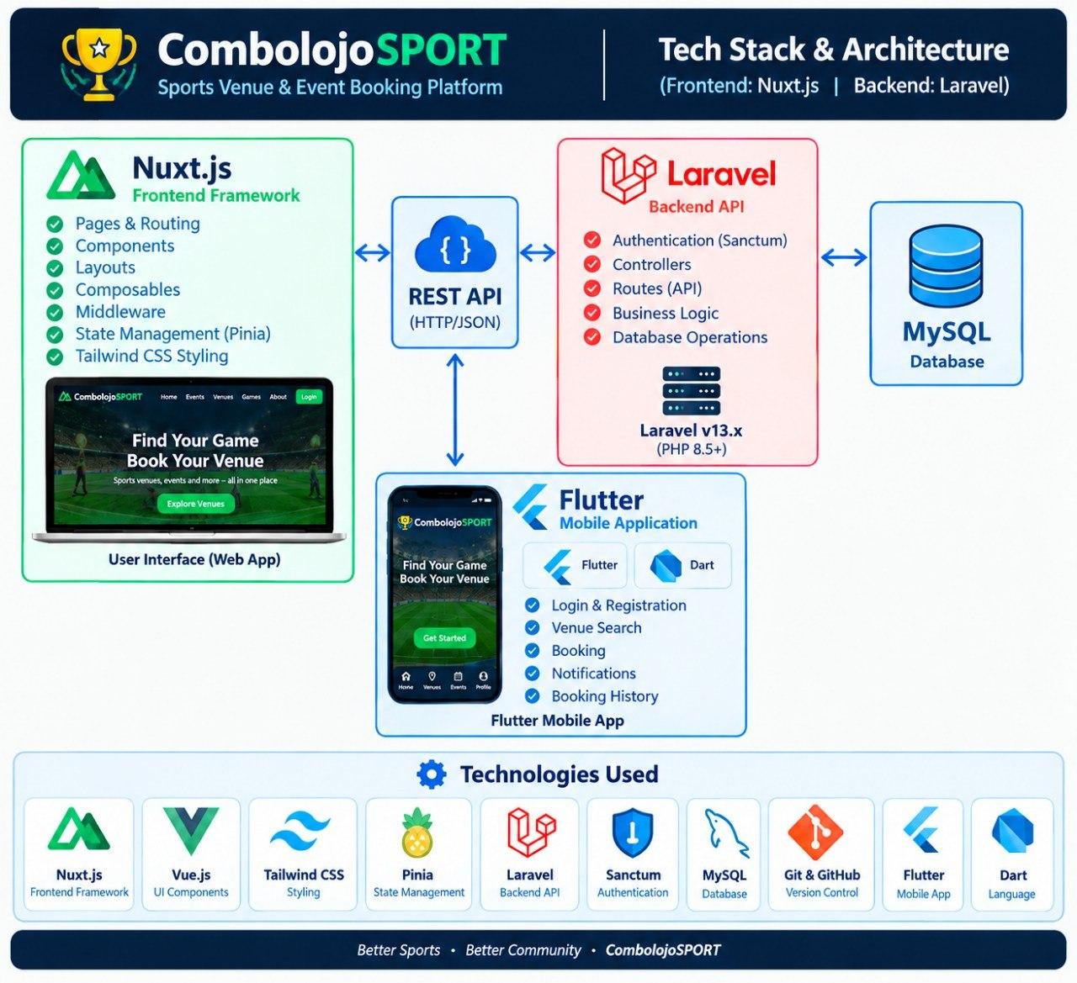
Technologies Used

Slide 10
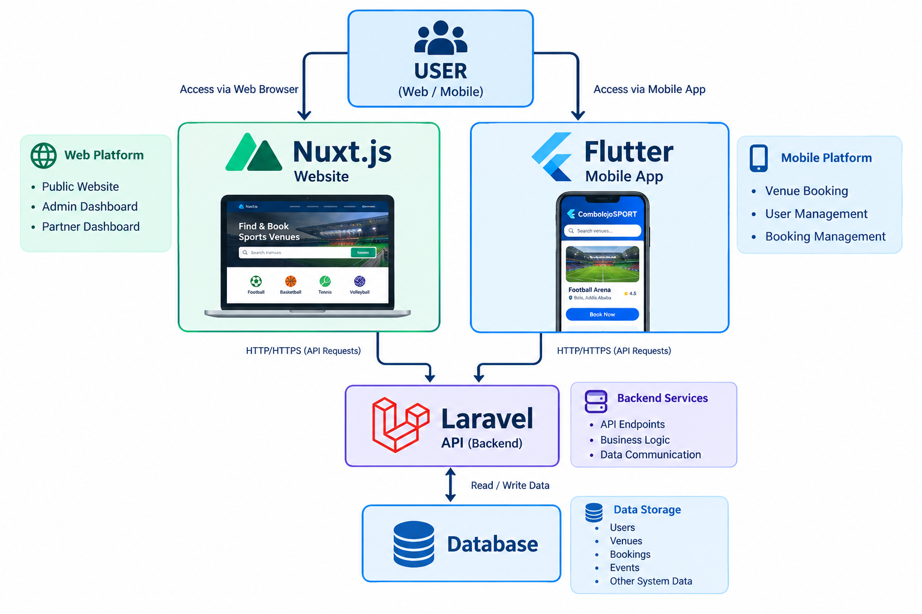
System Architecture

Slide 11
System Components
Nuxt.js
→ Public Website
→ Admin Dashboard
→ Partner Dashboard
Flutter
→ Mobile Application
→ Booking
Laravel
→ API
→ Business Logic
→ Data Communication
Database
→ Users
→ Venues
→ Bookings
→ Other system data

Slide 12
Website
Development
Public Website
Main Pages
Home
About
Venues
Blogs
Just Play
Contact
Download App
Frontend Work
Responsive layouts
Navigation
Search interface
Venue cards
Venue details
Buttons and forms
API integration

Slide 13
Dashboard Development
Admin Dashboard
Dashboard overview
Users
Partners
Venues
Bookings
Reports
Settings

Slide 14
Partner Dashboard
Dashboard
My Venue
Manage Slots
Bookings
Payouts & Wallet
Profile
Settings

Slide 15
Mobile Application
Flutter Mobile Application
The mobile application provides the actual booking experience.
Main Concept

Slide 16
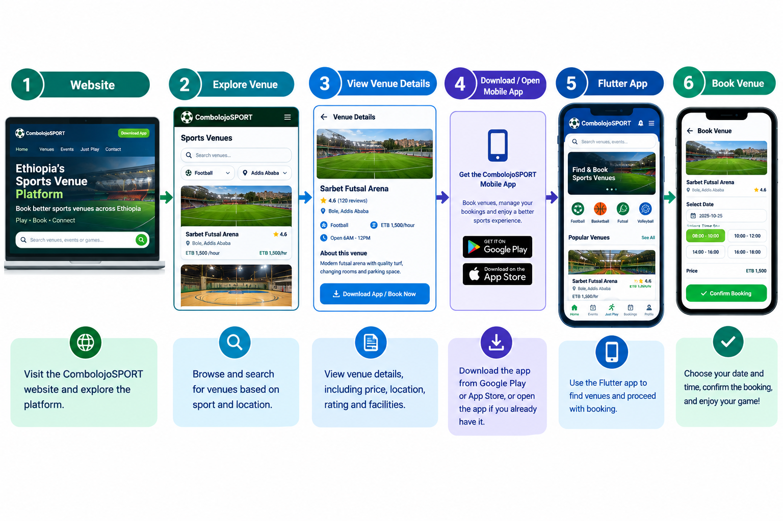
Main Concept

Slide 17
Why Mobile Booking?
Convenient for users
Designed for mobile interaction
Supports the actual booking workflow
Separates public web discovery from mobile booking

Slide 18
11. Major Features
User Features
Venue search
Venue filtering
Venue details
Sports categories
Just Play
Mobile app access

Slide 19
Management Features
User management
Venue management
Partner management
Booking management
Slot management
Reports

Slide 20
Part-Two
Mobile
Venue discovery
Booking
Booking management

Slide 21
. Challenges and Solutions
Challenge | Solution
Understanding the existing project | Studied the project structure and requirements
Learning Nuxt.js | Practiced Nuxt components and routing
Responsive UI | Used Tailwind CSS responsive utilities
API integration | Studied API endpoints and response data
Frontend debugging | Used browser developer tools
Mobile development | Practiced Flutter widgets and navigation
Maintaining UI consistency | Used reusable components and common design patterns

Slide 22
13. Skills Gained
Technical Skills
Nuxt.js
Vue.js
Tailwind CSS
Responsive Web Development
API Integration
Flutter
Laravel API understanding
Debugging
Git and GitHub

Slide 23
Professional Skills
Teamwork
Communication
Problem Solving
Time Management
Requirement Understanding
Professional Responsibility
Continuous Learning

Slide 24
Project Results
Achievements
Developed responsive web interfaces
Implemented public website pages
Developed venue exploration interfaces
Developed admin and partner dashboard interfaces
Integrated frontend with backend APIs
Participated in Flutter mobile development
Implemented the concept of mobile-based booking

Slide 25
Future Improvements
Possible Future Enhancements
Advanced venue search
Improved booking management
More mobile application features
AI chatbot for user assistance
Advanced analytics
Better recommendation features
Performance optimization
Additional sports and venues

Slide 26
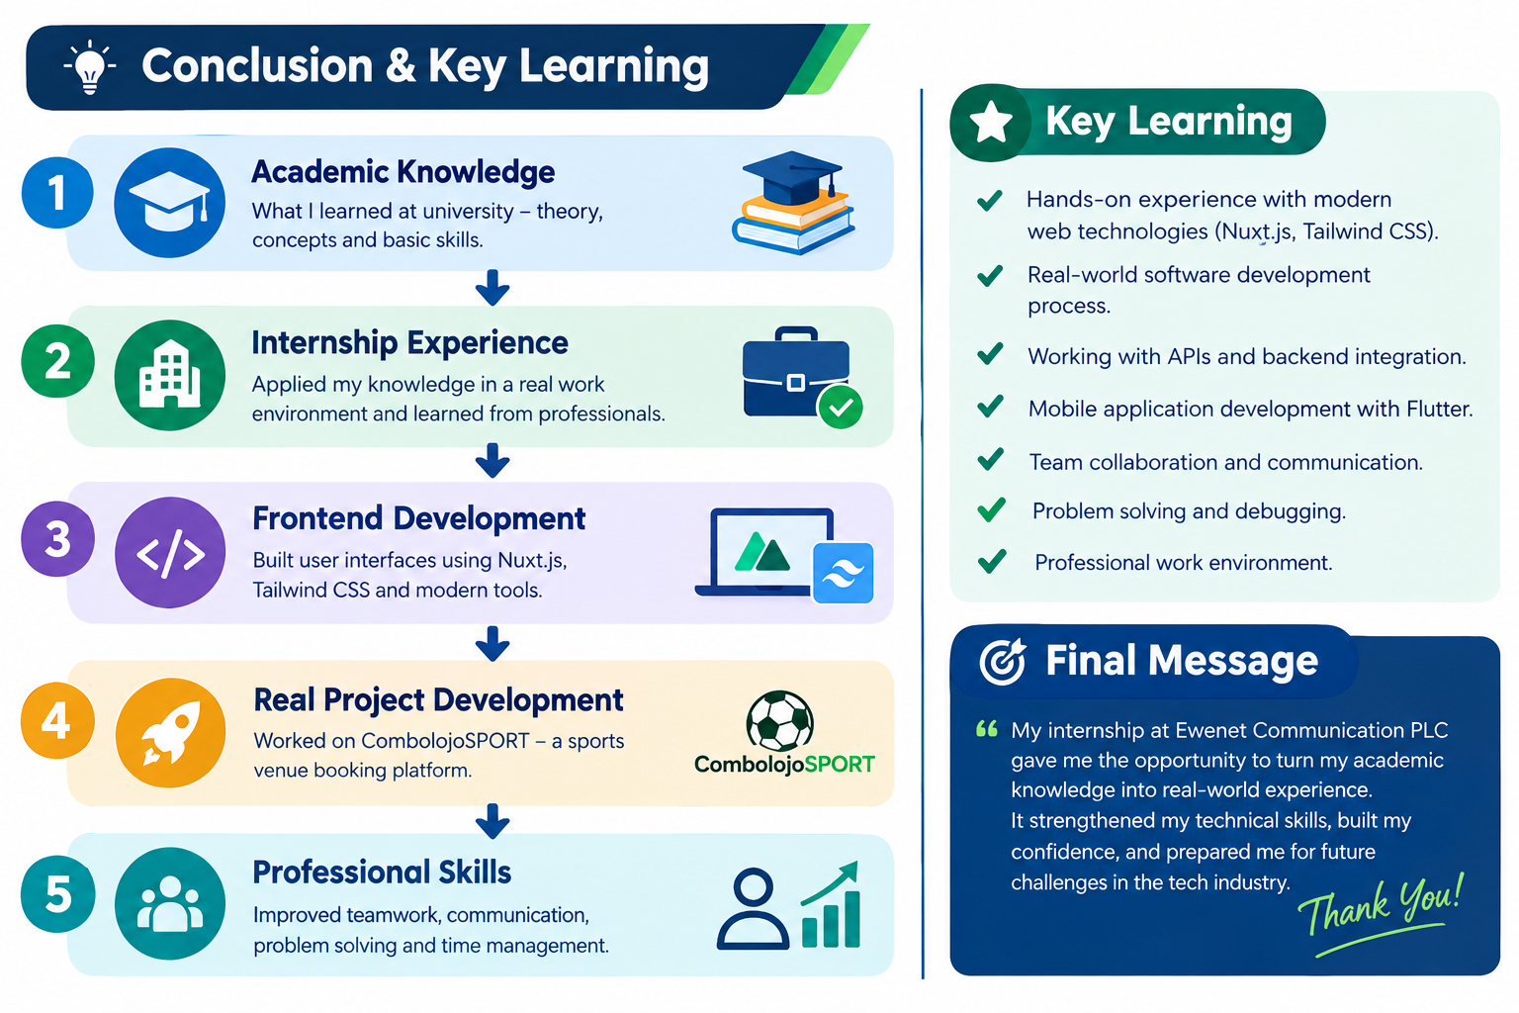
Conclusion
“we two-month internship at Ewenet Communication PLC gave me an opportunity to transform my academic knowledge into practical software development experience.”

Slide 27
Working as a frontend developer on the CombolojoSPORT project helped me understand how a real software project is planned, designed, developed, integrated, tested, and improved.”

Slide 28
THANK YOU!
Questions & Answers

