Slide 1

Implementation Discussion
Micah Projects
March 2026

Slide 2











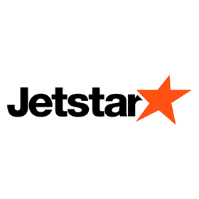
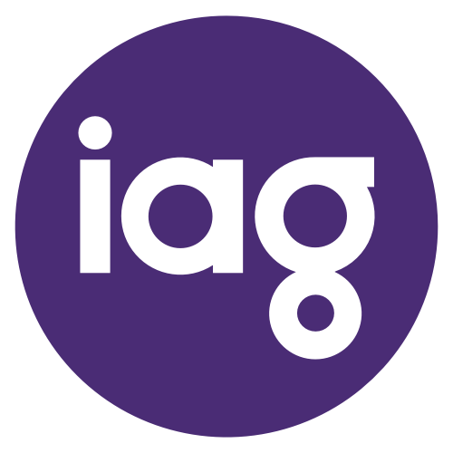


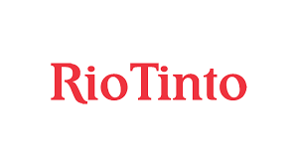


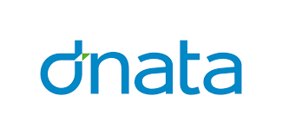

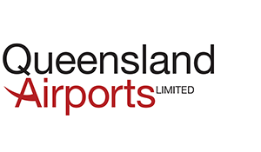








Why Mivada Your Long-Term Partner in Workday Implementations and Managed Services, we grew out of a customer and hence we understand your challenges…
Australian Owned Business creating Australian jobs
We work with notable brands such as…
Dedicated Offshore Capability
We Are Not a Big 4
Dedicated Local Engagement Manager
Direct Access to Our CEO
(Reduced Escalation Matrix)
People Systems and Transformation
Business Process Management and Automation
Data, Analytics and Business Intelligence

Slide 3
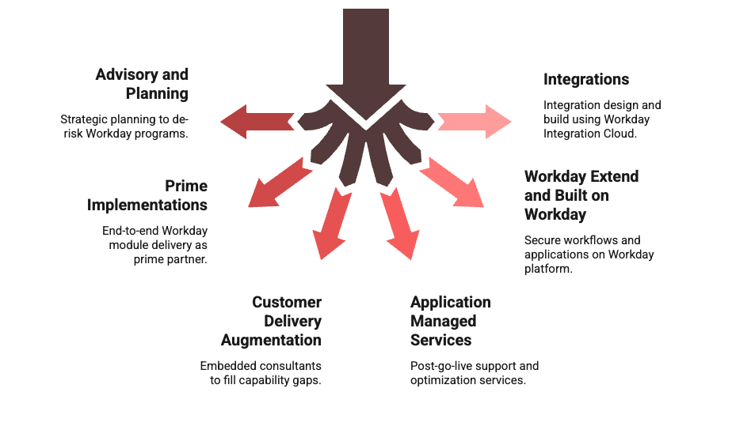
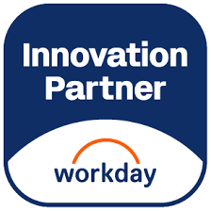
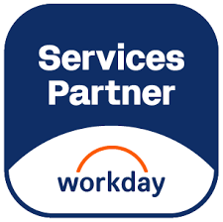
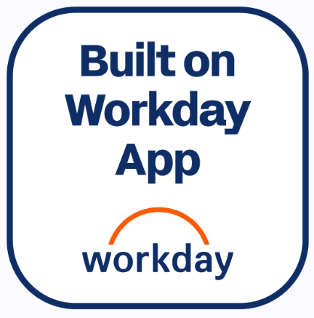
Mivada’s Workday Services
Notes:
Daniel & what we are doing with 9

Slide 4
Mivada’s Capability in Workday Empowering Innovation and Capability through Workday Partnership and Local Expertise
3⁺
10⁺
^{YEARS}
200+ Mivada Employees across Australia, US and India
Our consultants have an average of 3 years of experience with Workday
People Systems ecosystem experience with enterprise global clients (Payroll, T&A, HRIS)
100⁺
3000⁺
2000⁺
Workday Consultants with average of 3+ certifications per consultant.
Workday Custom Reports
Workday Integrations
30⁺
Successfully completed Workday implementations and support project engagements
Notes:
Daniel

Slide 5
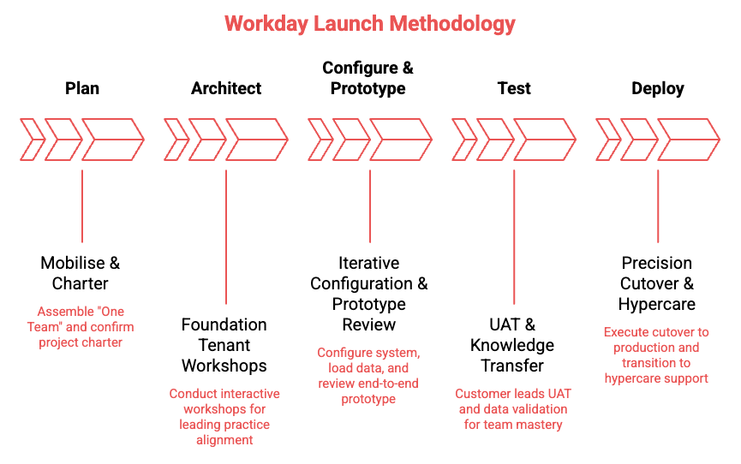
Methodology

Slide 6
Draft Implementation Plan

Slide 7
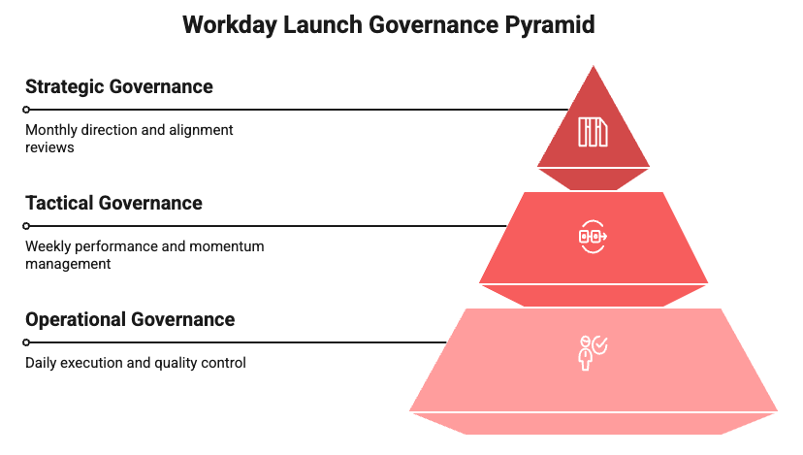
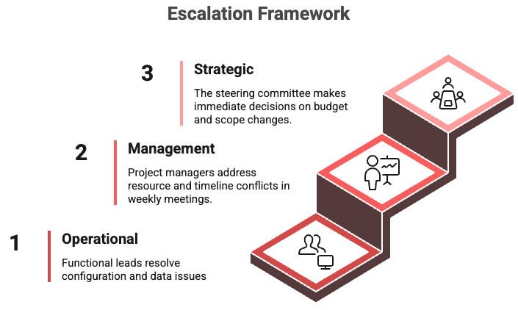
Governance

Slide 8
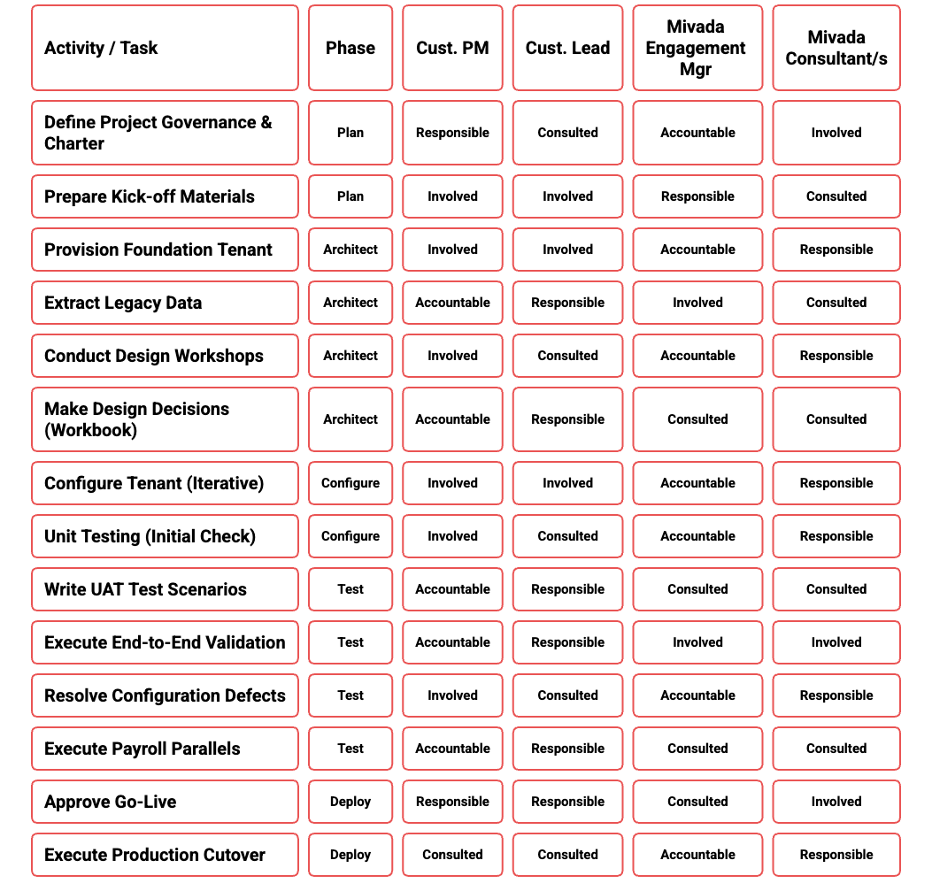
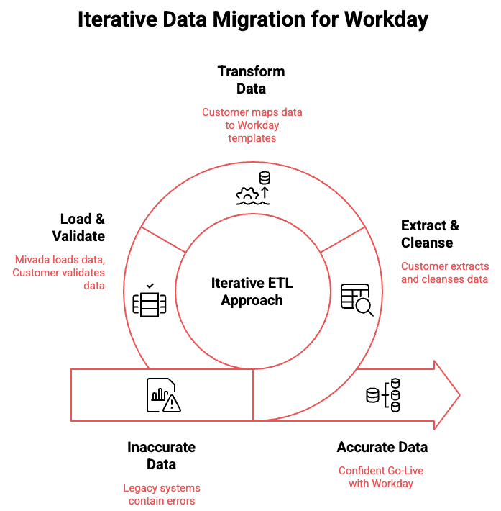
RACI & Data Migration

Slide 9

Understanding of your needs
Payroll Compliance Confidence
Connected HR & Payroll
Rostering That Enforces Rules
A Single, Reliable User Experience
Frontline Manager Visibility
Funding & Cost Visibility

Slide 10
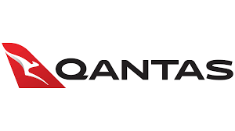
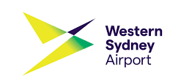
Real-World Success Stories: How Mivada Enables High-Performance Workday Operations
Mivada partnered with Guzman y Gomez (GYG) to stabilise and optimise their Workday platform post–go-live across functional modules, reporting, security, and compliance. Through Agile delivery, helped them onboard 150+ franchisees into Workday deliver new reporting, and a redesigned security model, Mivada strengthened audit readiness, improved performance across HCM, Absence, Learning and enabled GYG’s scalable, compliant global operations.
Mivada has supported Qantas since 2014, taking over Workday support in 2017 and rapidly becoming a strategic partner across HR, Payroll, Digital, Automation, Data, and Analytics. By scaling Workday integrations, modernising architectures, and embedding automation and analytics, Mivada evolved from post–go-live support to Qantas’ long-term enterprise partner.
Mivada partnered with Western Sydney International Airport (WSI) to deliver a card management system, then expanded into a strategic role supporting WSI’s Workday program. By resolving functional and integration issues and assuming full AMS ownership, Mivada stabilised HR, Payroll, Finance, and Procurement, becoming WSI’s trusted long-term partner.
Notes:
Rama

Slide 11
Questions?

