Slide 1

MICAH PROJECTS · MARCH 2026
Implementation discussion.
Mivada — Workday implementation & managed services
mivada.com

Slide 2

WHY MIVADA
WHY MIVADA
Your long-term Workday partner.
— We grew out of a customer — so we understand your challenges first-hand.
— Australian-owned business, creating Australian jobs
— Not a Big 4 — direct access to our CEO, with a reduced escalation matrix
— Dedicated local engagement manager
— People Systems & Transformation
— Data, Analytics & Business Intelligence
— Business Process Management & Automation
— Dedicated offshore capability
— We work with notable brands such as Qantas, Guzman y Gomez and Western Sydney International Airport

Slide 3

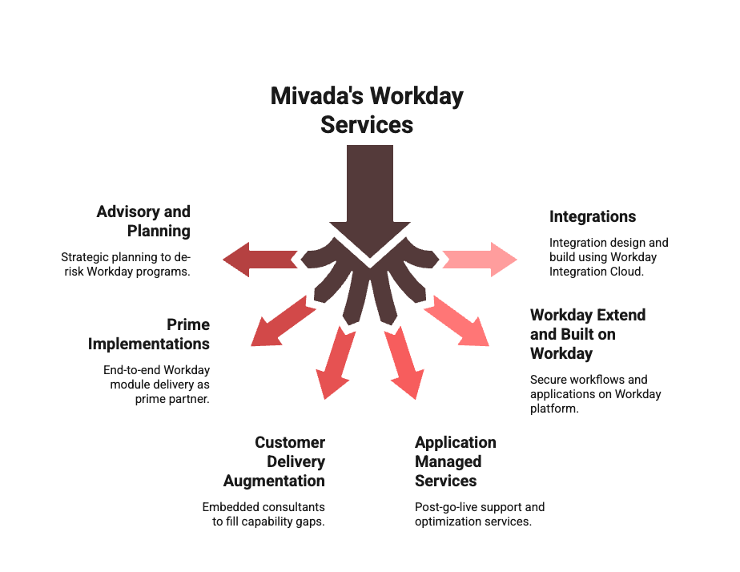
MIVADA'S WORKDAY SERVICES
MIVADA'S WORKDAY SERVICES
Mivada's Workday services.
Notes:
Daniel & what we are doing with 9

Slide 4
MIVADA'S CAPABILITY IN WORKDAY
MIVADA'S CAPABILITY IN WORKDAY
Capability in Workday.
Empowering innovation through a Workday partnership and local expertise — our consultants average 3+ years' Workday experience, across successfully completed implementations and support engagements.
3+
2000+
3000+
30+
CERTIFICATIONS / CONSULTANT
WORKDAY INTEGRATIONS
WORKDAY CUSTOM REPORTS
IMPLEMENTATIONS & SUPPORT
200+
100+
10+
EMPLOYEES · AU, US & INDIA
PEOPLE-SYSTEMS CLIENTS · PAYROLL, T&A, HRIS
YEARS
Notes:
Daniel

Slide 5
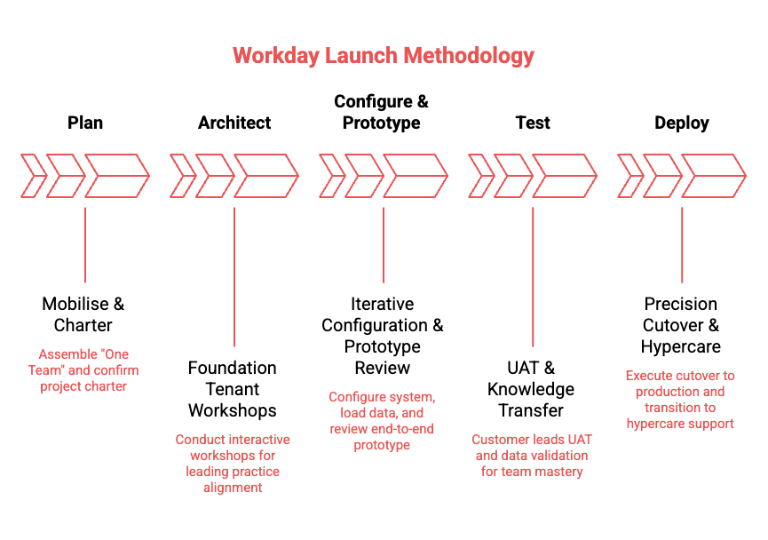
HOW WE DELIVER
HOW WE DELIVER
Our methodology.

Slide 6
INDICATIVE TIMELINE
INDICATIVE TIMELINE
Draft implementation plan.

Slide 7
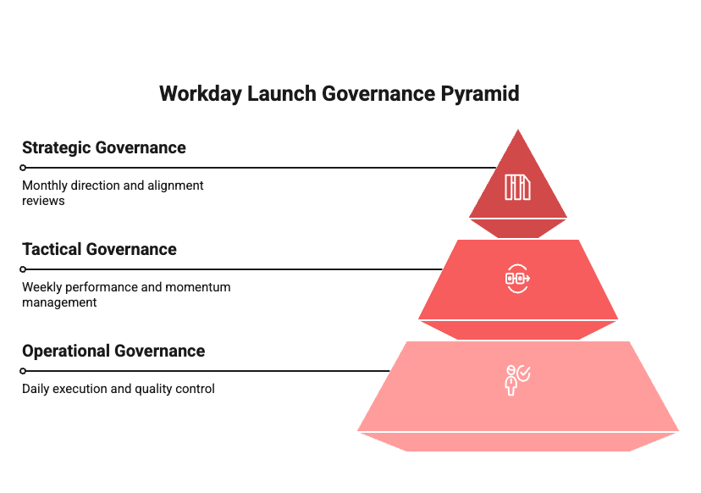
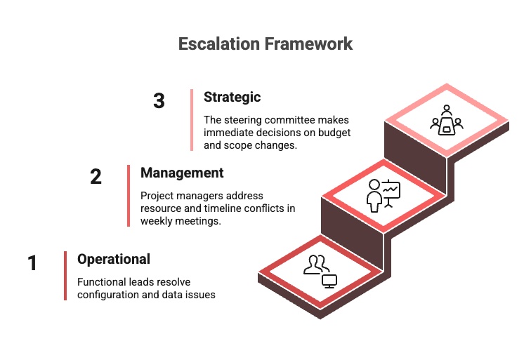
HOW WE RUN IT
HOW WE RUN IT
Governance.

Slide 8
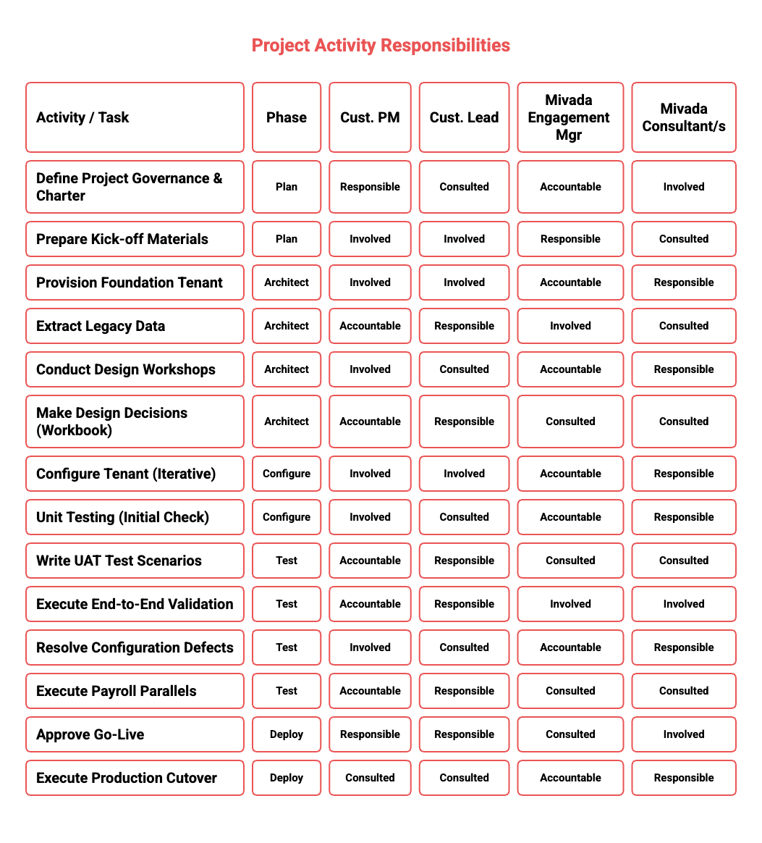
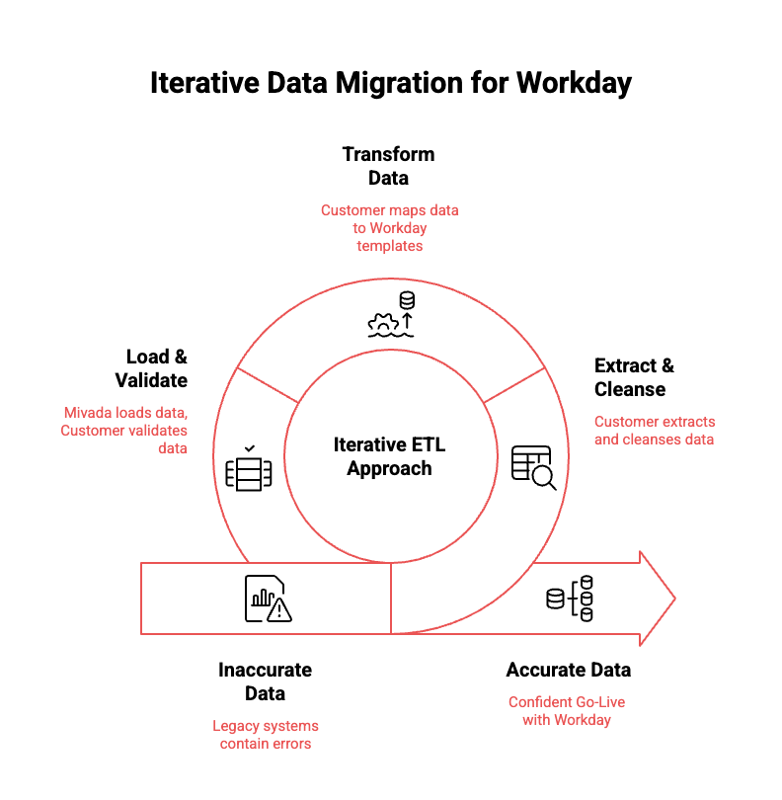
ROLES & DATA
ROLES & DATA
RACI & data migration.

Slide 9
UNDERSTANDING YOUR NEEDS
UNDERSTANDING YOUR NEEDS
What you need this to do.
— Payroll compliance confidence
— Connected HR & payroll
— Rostering that enforces rules
— A single, reliable user experience
— Frontline manager visibility
— Funding & cost visibility

Slide 10
REAL-WORLD SUCCESS STORIES
REAL-WORLD SUCCESS STORIES
Proven Workday outcomes.
How Mivada enables high-performance Workday operations.
GUZMAN Y GOMEZ
QANTAS
WESTERN SYDNEY INTL AIRPORT
Mivada partnered with GYG to stabilise and optimise their Workday platform post–go-live across modules, reporting, security and compliance. Through Agile delivery we onboarded 150+ franchisees, delivered new reporting and a redesigned security model, strengthened audit readiness and improved performance across HCM, Absence and Learning — enabling scalable, compliant global operations.
Mivada has supported Qantas since 2014, taking over Workday support in 2017 and rapidly becoming a strategic partner across HR, Payroll, Digital, Automation, Data and Analytics. By scaling integrations, modernising architectures and embedding automation and analytics, Mivada evolved from post–go-live support to Qantas' long-term enterprise partner.
Mivada partnered with WSI to deliver a card-management system, then expanded into a strategic role supporting WSI's Workday program. By resolving functional and integration issues and assuming full AMS ownership, Mivada stabilised HR, Payroll, Finance and Procurement — becoming WSI's trusted long-term partner.
Notes:
Rama

Slide 11
OVER TO YOU
Questions?
hello@mivada.com · mivada.com
Sydney · Melbourne · AU & India

