Slide 1

MARCH 2026
Implementation Discussion

Slide 2


WHY MIVADA_x000B_YOUR LONG-TERM PART
WHY MIVADA_x000B_YOUR LONG-TERM PART
Why Mivada Your Long-Term Partner in Workday Implementations and Managed Services, we grew out of a customer and hence we understand your challenges…
— Australian Owned Business creating Australian jobs
— We Are Not a Big 4
— Dedicated Local Engagement Manager
— Direct Access to Our CEO
— (Reduced Escalation Matrix)
— People Systems and Transformation
— Data, Analytics and Business Intelligence
— Business Process Management and Automation
— We work with notable brands such as…
— Dedicated Offshore Capability
Notes:
[25 more source image(s) to place]

Slide 3

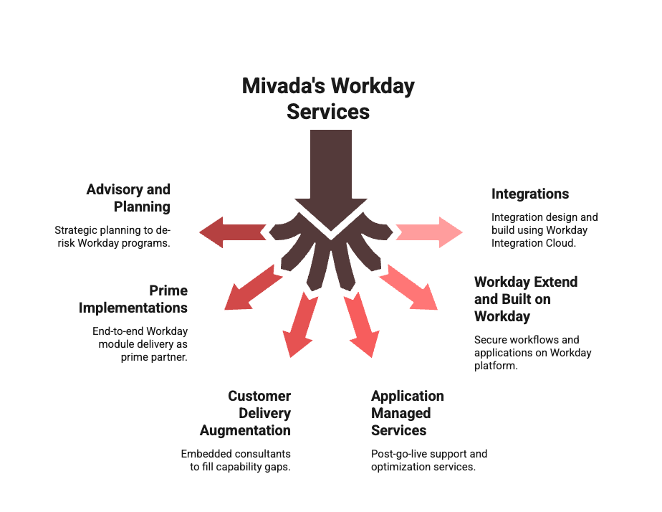
MIVADA’S WORKDAY SERVICES
MIVADA’S WORKDAY SERVICES
Mivada’s Workday Services
Notes:
Daniel & what we are doing with 9

Slide 4
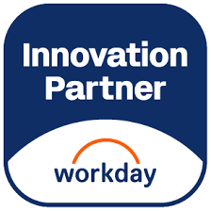
MIVADA’S CAPABILITY IN WORKDAY
MIVADA’S CAPABILITY IN WORKDAY
Mivada’s Capability in Workday Empowering Innovation and Capability through Workday Partnership and Local Expertise
— Our consultants have an average of 3 years of experience with Workday
— 3+
— Workday Consultants with average of 3+ certifications per consultant.
— Workday Integrations
— 2000+
— Workday Custom Reports
— 3000+
— 200+ Mivada Employees across Australia, US and India
— 100+
— People Systems ecosystem experience with enterprise global clients (Payroll, T&A, HRIS)
— 10+
— YEARS
— Successfully completed Workday implementations and support project engagements
— 30+
Notes:
Daniel
[2 more source image(s) to place]

Slide 5
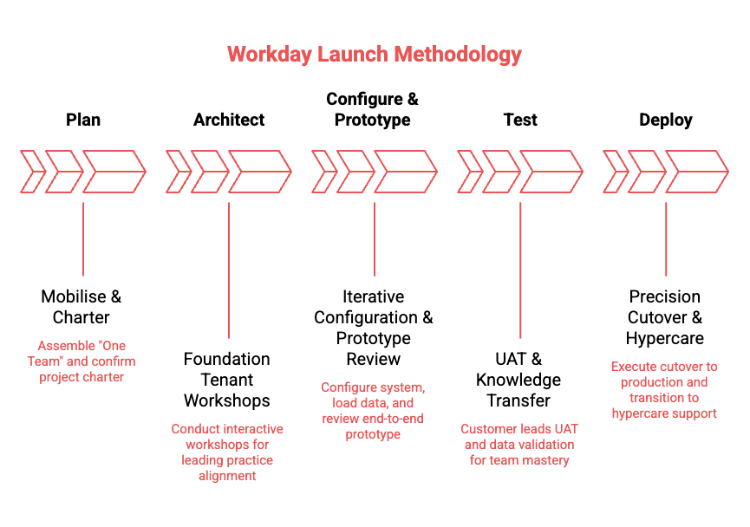
METHODOLOGY
METHODOLOGY
Methodology

Slide 6
DRAFT IMPLEMENTATION PLAN
DRAFT IMPLEMENTATION PLAN
Draft Implementation Plan

Slide 7
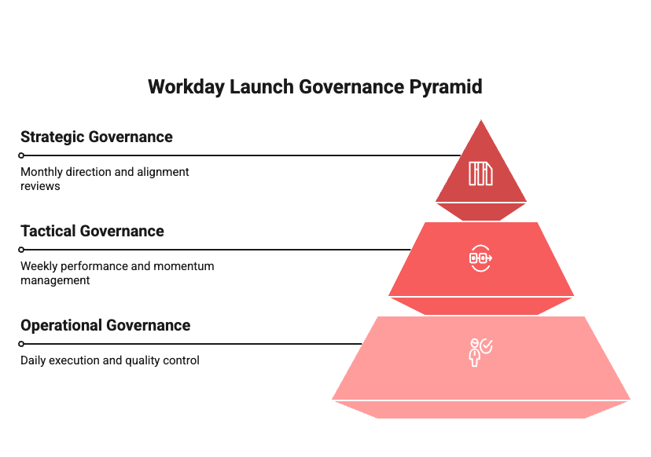
GOVERNANCE
GOVERNANCE
Governance
Notes:
[1 more source image(s) to place]

Slide 8
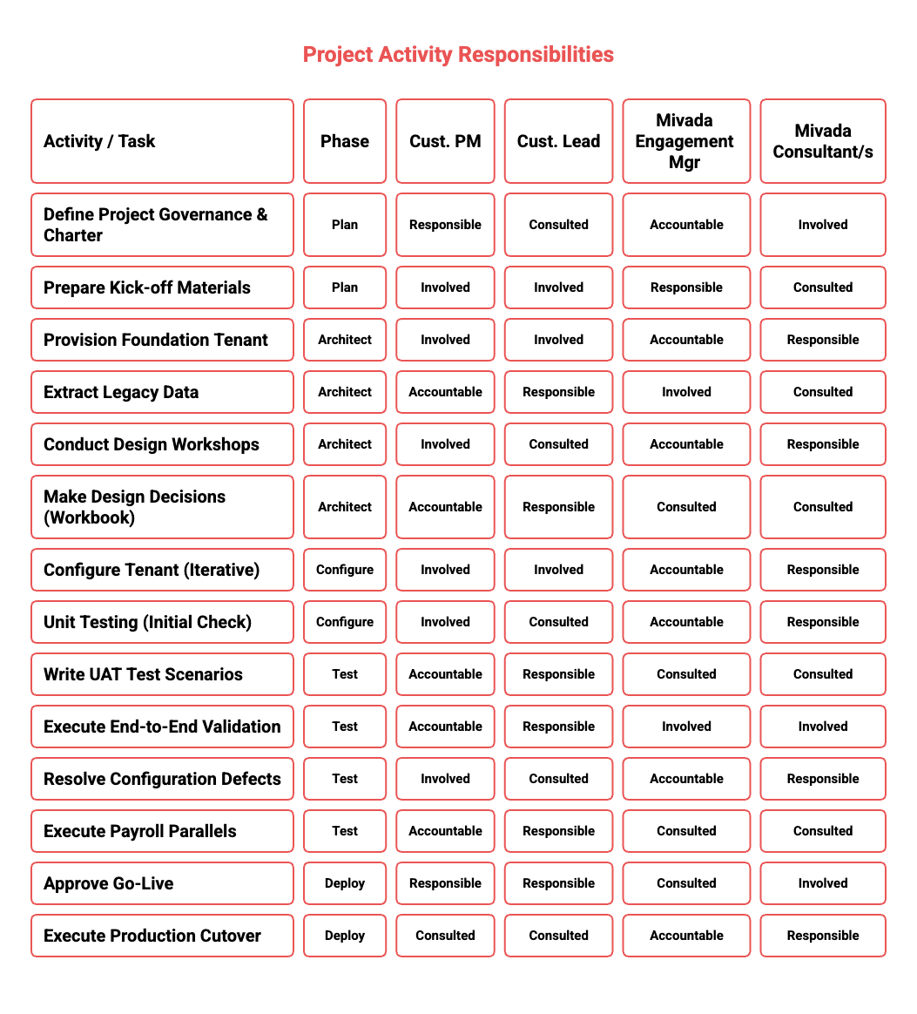
RACI & DATA MIGRATION
RACI & DATA MIGRATION
RACI & Data Migration
Notes:
[1 more source image(s) to place]

Slide 9
UNDERSTANDING OF YOUR NEEDS
UNDERSTANDING OF YOUR NEEDS
Understanding of your needs
— Payroll Compliance Confidence
— Connected HR & Payroll
— Rostering That Enforces Rules
— A Single, Reliable User Experience
— Frontline Manager Visibility
— Funding & Cost Visibility

Slide 10

REAL-WORLD SUCCESS STORIES: HO
REAL-WORLD SUCCESS STORIES: HO
Real-World Success Stories: How Mivada Enables High-Performance Workday Operations
— Mivada partnered with Guzman y Gomez (GYG) to stabilise and optimise their Workday platform post–go-live across functional modules, reporting, security, and compliance. Through Agile delivery, helped them onboard 150+ franchisees into Workday deliver new reporting, and a redesigned security model, Mivada strengthened audit readiness, improved performance across HCM, Absence, Learning and enabled GYG’s scalable, compliant global operations.
— Mivada has supported Qantas since 2014, taking over Workday support in 2017 and rapidly becoming a strategic partner across HR, Payroll, Digital, Automation, Data, and Analytics. By scaling Workday integrations, modernising architectures, and embedding automation and analytics, Mivada evolved from post–go-live support to Qantas’ long-term enterprise partner.
— Mivada partnered with Western Sydney International Airport (WSI) to deliver a card management system, then expanded into a strategic role supporting WSI’s Workday program. By resolving functional and integration issues and assuming full AMS ownership, Mivada stabilised HR, Payroll, Finance, and Procurement, becoming WSI’s trusted long-term partner.
Notes:
Rama
[2 more source image(s) to place]

Slide 11
QUESTIONS?
QUESTIONS?
Questions?

