Slide 1

MICAH PROJECTS · MARCH 2026
Implementation discussion.
Mivada — Workday implementation & managed services
mivada.com

Slide 2

WHY MIVADA · V1
WHY MIVADA
Your long-term Workday partner.
We grew out of a customer — so we understand your challenges from the inside.
01
02
03
04
Australian-owned
Not a Big 4
Direct access to our CEO
Dedicated engagement manager
Creating Australian jobs, accountable locally.
Senior practitioners on the tools — no pyramid.
A reduced escalation matrix — decisions in hours.
One local owner across your engagement.
05
06
07
08
People Systems & Transformation
Data, Analytics & BI
Process & Automation
Dedicated offshore capability
HCM, Payroll, Time & Attendance and HRIS.
From reporting to governed analytics.
Remove the manual, error-prone work.
Scale without losing local accountability.
TRUSTED BY Qantas · Guzman y Gomez · Western Sydney International Airport

Slide 3

WHY MIVADA · V2
WHY MIVADA
We grew out of a customer.
So we get it.
Your long-term partner in Workday implementations & managed services.
01
Australian-owned
05
People Systems & Transformation
02
Not a Big 4
06
Data, Analytics & BI
03
Direct access to our CEO
07
Process & Automation
04
Dedicated engagement manager
08
Dedicated offshore capability
TRUSTED BY Qantas · Guzman y Gomez · Western Sydney International Airport

Slide 4
WHY MIVADA · V3
WHY MIVADA
Built by people who ran it.
People Systems & Transformation
HCM · Payroll · T&A · HRIS
Data, Analytics & BI
Reporting · dashboards · governed analytics
We grew out of a customer, so we understand your challenges first-hand. Australian-owned and senior-led — not a Big 4 — with direct access to our CEO and a dedicated local engagement manager who owns your outcome.
Process & Automation
Redesign · integrations · automation
Dedicated offshore capability
Scale with local accountability
TRUSTED BY Qantas · Guzman y Gomez · Western Sydney International Airport

Slide 5
WORKDAY SERVICES · V1
WHAT WE DO
Workday, end to end.
One partner across the whole platform — from first roadmap to long-term managed services.
01
02
03
Advisory & roadmap
Implementation & deployment
Optimisation & phase 2
04
05
06
Managed services (AMS)
Integrations
Data, analytics & BI
07
08
09
Reporting & dashboards
Security & compliance
Automation

Slide 6
WORKDAY SERVICES · V2
WORKDAY SERVICES
Across the whole Workday lifecycle.
STAGE 01
STAGE 02
STAGE 03
STAGE 04
Advise
Implement
Optimise
Manage
Roadmap, business case, design
Deploy HCM, Payroll, Finance & more
Phase 2, integrations, reporting
AMS, automation, continuous value
Wrapped in managed services & support at every stage.

Slide 7
WORKDAY SERVICES · V3
SERVICES
Three practices, one platform.
People Systems & Transformation
Data, Analytics & BI
Business Process & Automation
— HCM & core HR
— Reporting & dashboards
— Process redesign
— Payroll & compliance
— Prism & data lakehouse
— Integrations
— Time & Attendance
— Governed analytics
— Automation
— HRIS implementation & optimisation
— Insight at scale
— Controls & assurance
All wrapped in managed services & support.

Slide 8
CAPABILITY · V1
CAPABILITY
Capability in Workday.
Empowering innovation through a Workday partnership and local expertise — consultants average 3+ years' Workday experience.
3+
2000+
3000+
30+
CERTIFICATIONS / CONSULTANT
WORKDAY INTEGRATIONS
WORKDAY CUSTOM REPORTS
IMPLEMENTATIONS & SUPPORT
200+
100+
10+
EMPLOYEES · AU, US & INDIA
PEOPLE-SYSTEMS CLIENTS
YEARS DELIVERING WORKDAY

Slide 9
CAPABILITY · V2
PROVEN CAPABILITY
10+
30+
IMPLEMENTATIONS & SUPPORT
200+
EMPLOYEES · AU, US & INDIA
YEARS DELIVERING WORKDAY
2000+
Empowering innovation through a true Workday partnership and deep local expertise.
WORKDAY INTEGRATIONS
3000+
CUSTOM REPORTS

Slide 10
CAPABILITY · V3
CAPABILITY
The numbers behind the partnership.
3+
2000+
3000+
CERTIFICATIONS / CONSULTANT
WORKDAY INTEGRATIONS
CUSTOM REPORTS
30+
200+
100+
IMPLEMENTATIONS & SUPPORT
EMPLOYEES · AU, US & INDIA
PEOPLE-SYSTEMS CLIENTS
10+ years delivering Workday · consultants average 3+ years' experience.

Slide 11
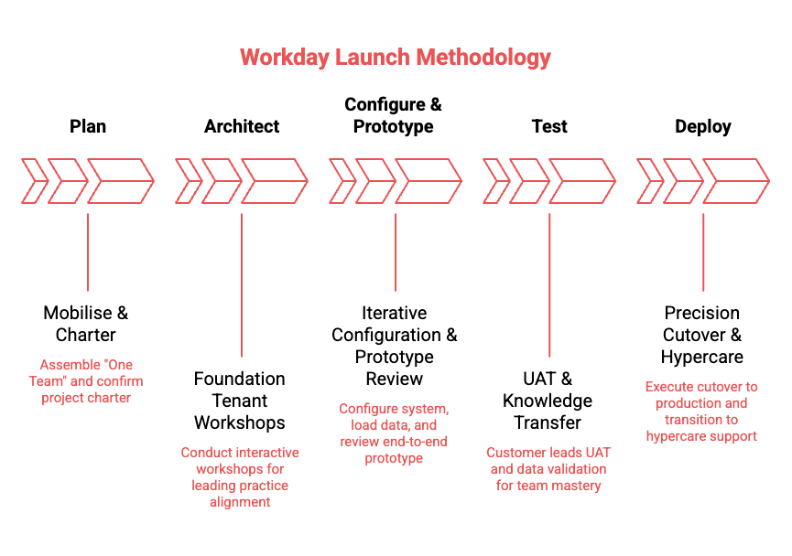
METHODOLOGY
HOW WE DELIVER
Our methodology.

Slide 12
IMPLEMENTATION PLAN
INDICATIVE TIMELINE
Draft implementation plan.

Slide 13
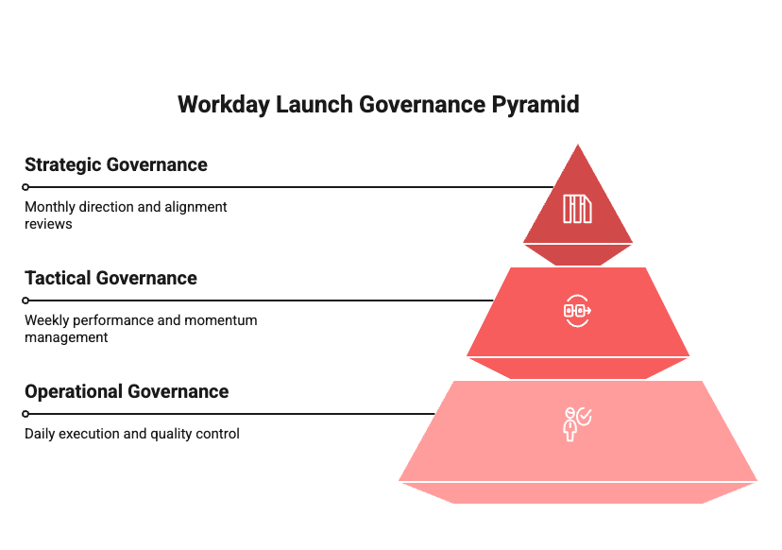
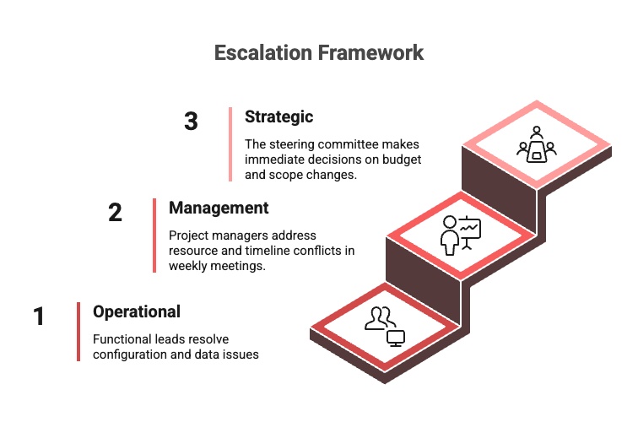
GOVERNANCE
HOW WE RUN IT
Governance.

Slide 14
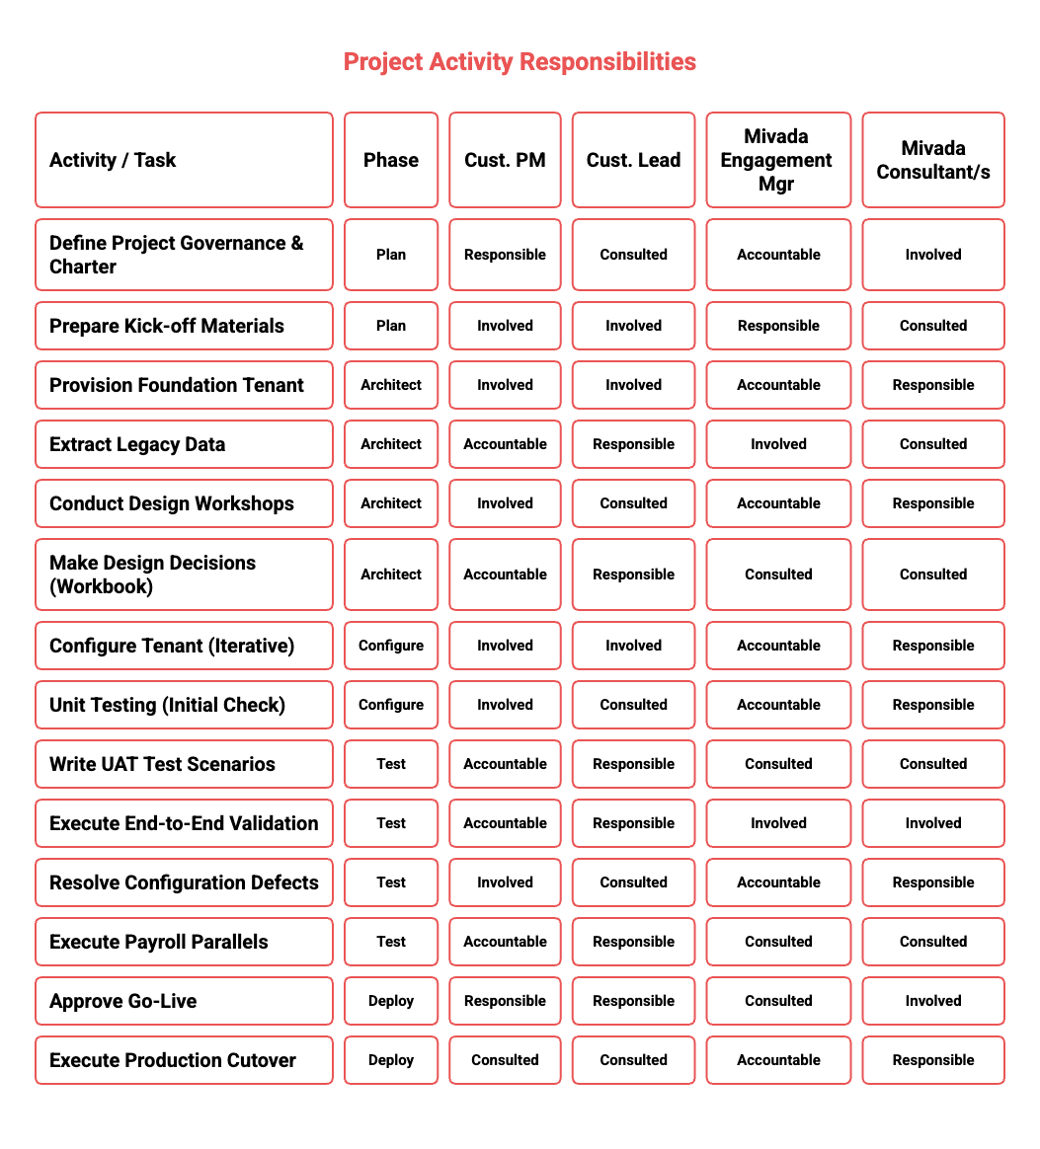
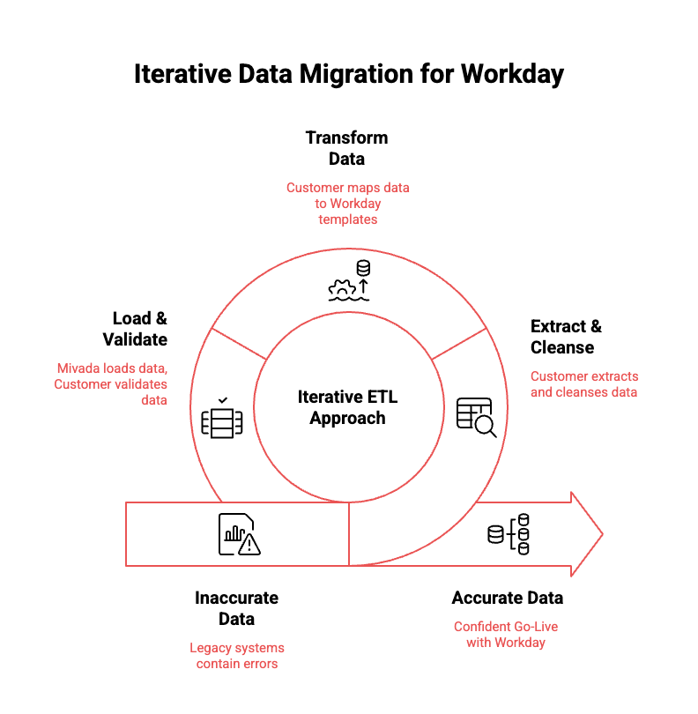
RACI & DATA MIGRATION
ROLES & DATA
RACI & data migration.

Slide 15
UNDERSTANDING YOUR NEEDS
UNDERSTANDING YOUR NEEDS
What you need this to do.
— Payroll compliance confidence
— Connected HR & payroll
— Rostering that enforces rules
— A single, reliable user experience
— Frontline manager visibility
— Funding & cost visibility

Slide 16
SUCCESS STORIES
REAL-WORLD SUCCESS STORIES
Proven Workday outcomes.
How Mivada enables high-performance Workday operations.
GUZMAN Y GOMEZ
QANTAS
WESTERN SYDNEY INTL AIRPORT
Mivada partnered with GYG to stabilise and optimise their Workday platform post–go-live across modules, reporting, security and compliance. Through Agile delivery we onboarded 150+ franchisees, delivered new reporting and a redesigned security model, and improved performance across HCM, Absence and Learning — enabling scalable, compliant global operations.
Mivada has supported Qantas since 2014, taking over Workday support in 2017 and rapidly becoming a strategic partner across HR, Payroll, Digital, Automation, Data and Analytics. By scaling integrations, modernising architectures and embedding automation, Mivada evolved from post–go-live support to Qantas' long-term enterprise partner.
Mivada partnered with WSI to deliver a card-management system, then expanded into a strategic role supporting WSI's Workday program. By resolving functional and integration issues and assuming full AMS ownership, Mivada stabilised HR, Payroll, Finance and Procurement — becoming WSI's trusted long-term partner.

Slide 17
OVER TO YOU
Questions?
hello@mivada.com · mivada.com
Sydney · Melbourne · AU & India

