Slide 1

Technology, human first.

Slide 2

MICAH PROJECTS · FIRST MEETING · MARCH 2026
A partner for your
Workday journey.
Mivada — Workday implementation & managed services
mivada.com

Slide 3

AGENDA
AGENDA
What we'll cover today.
01
Why Mivada
04
Proven capability & outcomes
02
What we understand you need
05
How we deliver
03
Workday — end to end
06
Where to from here

Slide 4

WHY MIVADA
WHY MIVADA
We grew out of a customer.
So we speak your language.
Your long-term partner in Workday implementations & managed services.
— Australian-owned, senior-led Not a Big 4 — practitioners on the tools
— Direct access to our CEO A reduced escalation matrix
— A dedicated local engagement manager One owner across your whole engagement
— Onshore + dedicated offshore Scale without losing local accountability
— 10+ years, exclusively Workday Deep platform expertise, locally delivered
TRUSTED BY Qantas · Guzman y Gomez · Western Sydney International Airport

Slide 5
YOUR NEEDS
YOUR NEEDS
What we understand you need.
The outcomes this Workday programme has to deliver for Micah Projects.
01
02
03
Payroll compliance confidence
Connected HR & payroll
Rostering that enforces rules
04
05
06
A single, reliable user experience
Frontline manager visibility
Funding & cost visibility

Slide 6
WORKDAY SERVICES
WHAT WE DO
Workday, end to end.
People Systems & Transformation
Data, Analytics & BI
Business Process & Automation
— HCM & core HR
— Reporting & dashboards
— Process redesign
— Payroll & compliance
— Prism & data lakehouse
— Integrations
— Time & Attendance
— Governed analytics
— Automation
— HRIS implementation & optimisation
— Insight at scale
— Controls & assurance
All wrapped in managed services & support.

Slide 7
CAPABILITY
PROVEN CAPABILITY
10+
30+
IMPLEMENTATIONS & SUPPORT
2000+
WORKDAY INTEGRATIONS
3000+
YEARS DELIVERING WORKDAY
CUSTOM REPORTS
Empowering innovation through a true Workday partnership and deep local expertise — consultants average 3+ years on the platform.
200+
EMPLOYEES · AU, US & INDIA
100+
PEOPLE-SYSTEMS CLIENTS

Slide 8
SUCCESS STORIES
REAL-WORLD SUCCESS STORIES
Proven Workday outcomes.
How Mivada enables high-performance Workday operations.
GUZMAN Y GOMEZ
QANTAS
WESTERN SYDNEY INTL AIRPORT
Stabilised and optimised Workday post–go-live across modules, reporting, security and compliance. Agile delivery onboarded 150+ franchisees, shipped new reporting and a redesigned security model, and lifted performance across HCM, Absence and Learning — enabling scalable, compliant global operations.
A partner since 2014, taking over Workday support in 2017 and becoming strategic across HR, Payroll, Digital, Automation, Data and Analytics. By scaling integrations, modernising architectures and embedding automation, Mivada grew from post–go-live support into Qantas' long-term enterprise partner.
Delivered a card-management system, then expanded into a strategic role on WSI's Workday program. By resolving functional and integration issues and assuming full AMS ownership, Mivada stabilised HR, Payroll, Finance and Procurement — becoming WSI's trusted long-term partner.

Slide 9
HOW WE DELIVER
HOW WE DELIVER
Delivery you can see and trust.
A proven methodology, a clear plan, and governance that keeps everyone aligned.

Slide 10
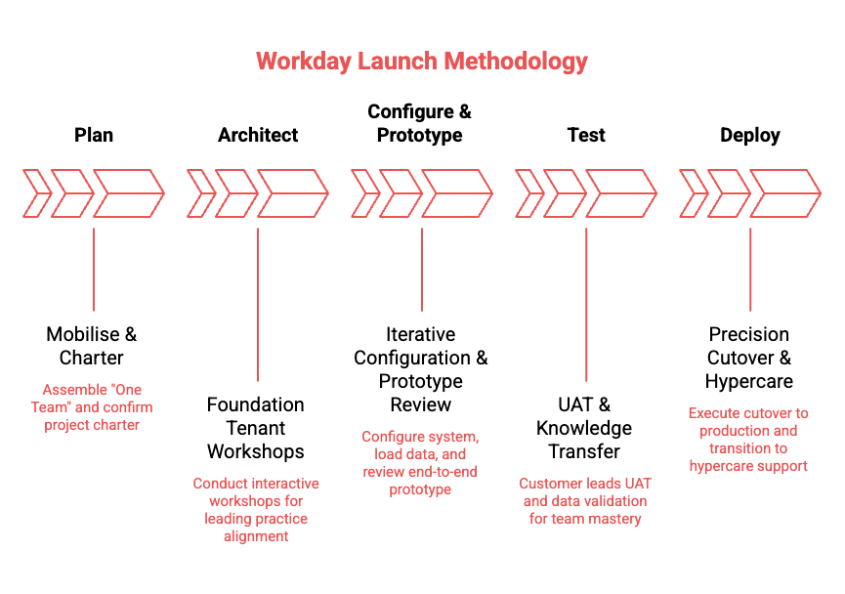
METHODOLOGY
METHODOLOGY
How we deliver.

Slide 11
IMPLEMENTATION PLAN
INDICATIVE TIMELINE
Draft implementation plan.

Slide 12
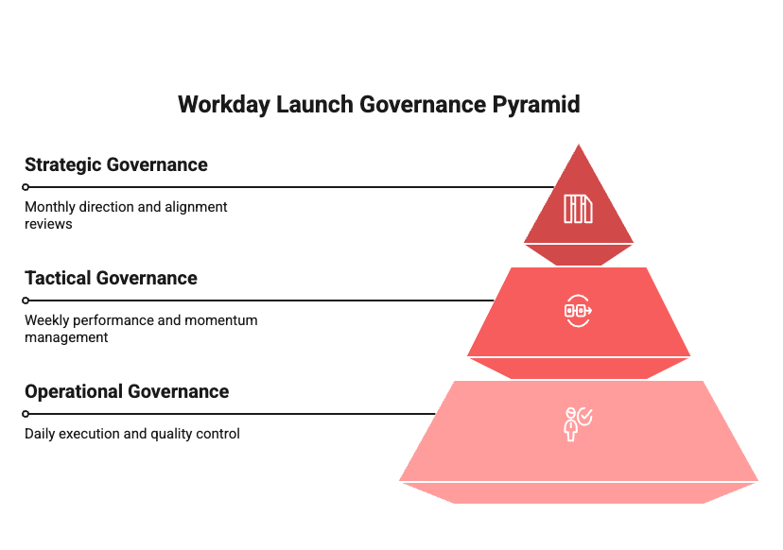
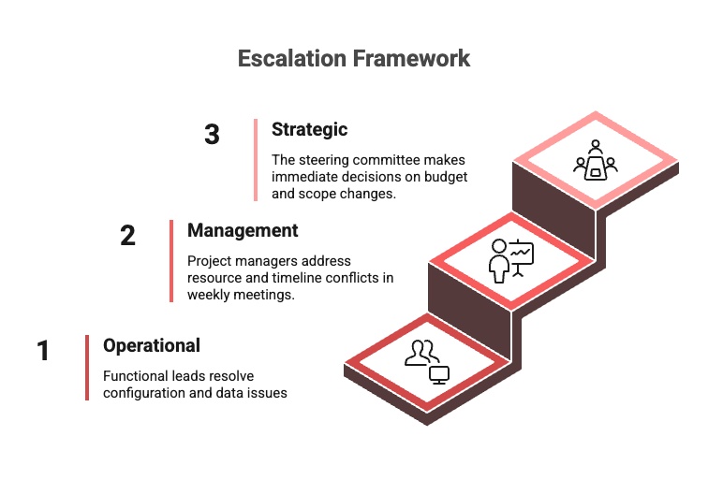
GOVERNANCE
GOVERNANCE
How we run it.

Slide 13
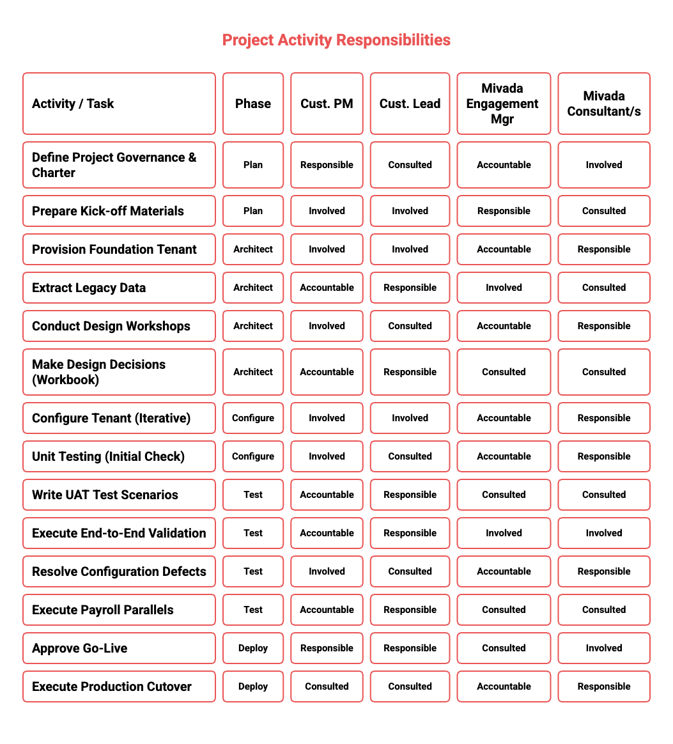
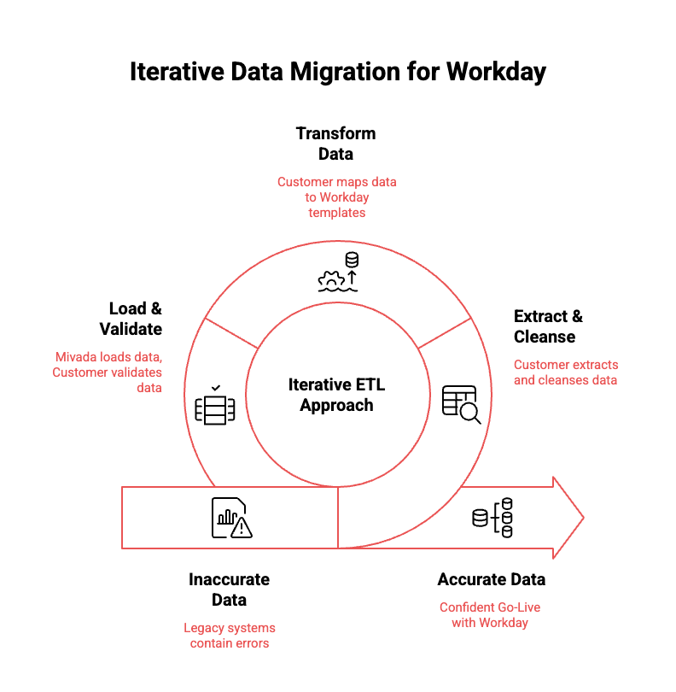
RACI & DATA MIGRATION
ROLES & DATA
RACI & data migration.

Slide 14
NEXT STEPS
Where to from here?
01
Share your priorities and constraints
02
We shape a tailored Workday plan
03
Kick off with a focused discovery workshop
hello@mivada.com · mivada.com
Sydney · Melbourne · AU & India

