Slide 1

Team 5 Buildfest Presentation
By Danieshia Maragh, Kevin Ugbaja

Slide 2


Our team
Kevin Ugbaja
Danieshia Maragh
Junior Computer Science major
Junior Information Science Major; minor in Business Analytics

Slide 3
Content overview
EveryMind’s Mission & Our fit
AI Integration
Technical Solution
Recommendations
Key Findings
Thank you!

Slide 4
EveryMind’s Mission
How we fit in
EveryMind's 988 awareness training focuses on helping participants recognize mental health challenges and crises, understand how the 988 Suicide & Crisis Lifeline works, and know when to seek support for themselves or others. The training aims to strengthen awareness and confidence in accessing mental health resources.
We’re helping EveryMind turn this feedback into actionable insights. By identifying strengths, differences across participant groups, and opportunities for improvement, our analysis guides decisions about training content, delivery, and accessibility. These insights are also used to support grant applications, funding decisions, and program reporting.

Slide 5
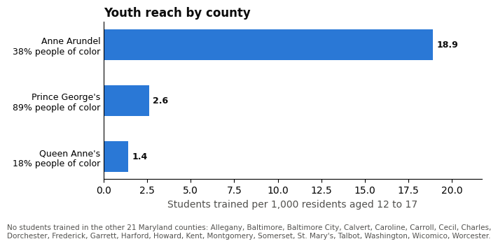
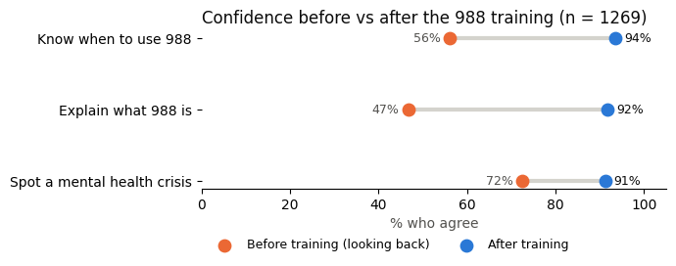

Technical Solution

Slide 6
Key Findings
Spanish speakers are undercounted.
Only 19 people (1.5%) used the Spanish survey.
But 66 (5.1%) wrote their comments in Spanish, and 53 of them were on the English form.
Counting both groups, 72 respondents (5.6%) are Spanish speakers.
The likely cause is access, such as a default English link or no visible language option.
The training itself worked: Spanish speakers gained about as much as everyone else.
People leave with unanswered questions.
222 of 647 (34%) answered “How can we improve this training?” with a question instead of a suggestion.
The top three questions:
  How many people use 988, and does it work? (45)
  What happens when you call? (21)
  Can I contact 988 if I’m not in crisis or if I’m worried about someone else? (18)
Our fix: add a short Q&A segment, and track the share of question-style comments each quarter.

Slide 7
AI Integration
Tools
Prompts
Refining
Errors and Limitations
Verification
An early table showed Spanish speakers less confident after training (78% vs. 85%). Most of that gap came from answers that likely read the scale backwards; after flagging them, it was about 83% vs 86%.
Python (Pandas)
Claude
Jupyter Lab
“Is this accurate to the survey data?”
“According to the case brief and the analysis, does the analysis actually follow it?”
We merged the separate cleaning and analysis notebooks into one notebook that runs from the raw export to every number in the memo.
Every chart is shown beside the table it comes from; the memo quotes the tables, since AI-made charts can be wrong.

Slide 8
Recommendations
Repeat as needed!
Repeat as many times as you need to in order to get the results you desire.
Q&A Box
Leave time for questions in every session, add an optional survey question (“What questions do you still have about 988?”) for a follow-up FAQ, and turn the three most common questions into short quiz questions to show what people learned, not just how confident they feel.
Fix the language gap
Many Spanish speakers take the survey in English, so we recommend letting people choose their language at the start, recording the language of each training, and using Census data on languages spoken at home to decide which languages to add beyond Spanish.
Automate the Review
Staff load new survey results into Python each quarter, and it automatically shows how much confidence grew for each skill and group, along with how many people answered.
01
02
03
04

Slide 9
Thank you!

