Slide 1
MIT 807
Artwork

Slide 2
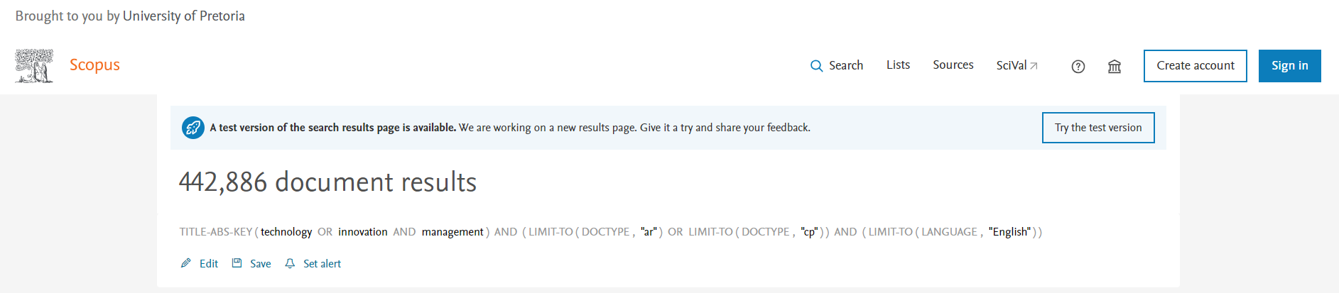
Selection and retrieval of documents in BibTeX format from Scopus
Search Protocol – technology OR innovation AND management
Search Elements – title, abstract or keyword
Subject Area – include all
Document Type – Conference Paper + Article (final publication stage)
Time Duration – 1938 - 2022
Language – English
Undefined Exclusions – Country, Subject Area, Source Title,
Source Type
Results = 145 289 documents
Descriptive Analysis
Bibliometric Analysis
Topic modelling based on Structural Topic Modelling (STM)

Slide 3

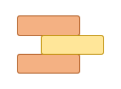

www.scimagojr.com
Journal Rankings
Subject Category:
Management of Technology and Innovation
1999 – 2021
Ranking Data Downloads
Union
SJR
Scimago Journal & Country Rank
Results = 903 TIM Journal Titles
BibTeX Downloads
SJR
Scimago Journal & Country Rank
Results = 372 666 documents
Results = 343 documents

