Slide 1
Expressive Vocabulary Data
DANCE project - DIBRIS, Casa Paganini
Author: Lorenzo Fiaschi

Slide 2
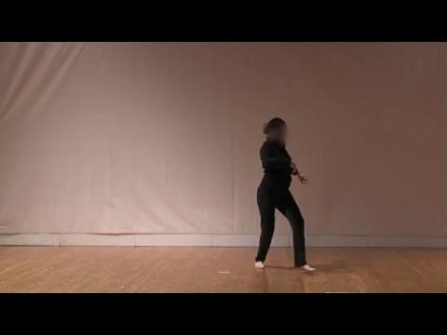
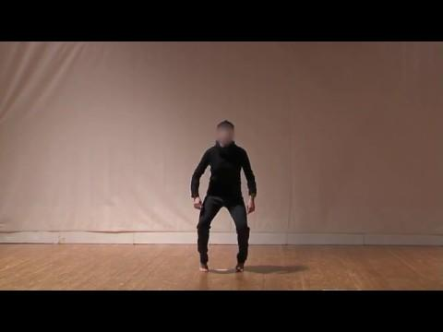
THE PROBLEM
LIGHTNESS
FRAGILITY

Slide 3
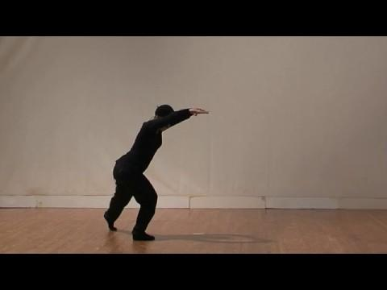
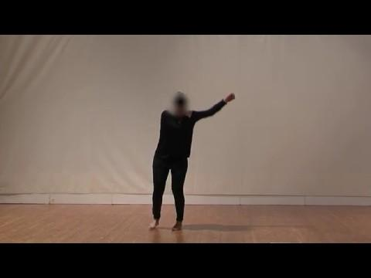
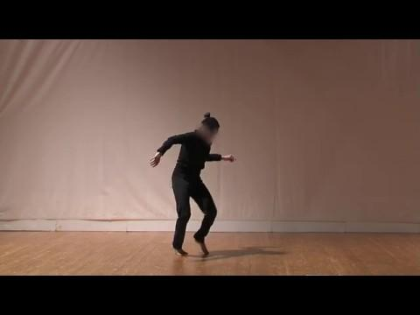
How much a performance is light or fragile?
Lightness: 3.6
Fragility: 0.2
Lightness: 0.6
Fragility: 0.6
Lightness: 1.8
Fragility: 3.4

Slide 4
What we know
According to [1], a movement expressing Lightness should either:
exhibit a low amount of downward vertical acceleration following gravity (in particular on forearms and knees)
have each possible downward acceleration counterbalanced by an opposite “harmonic” upward movement (simultaneous or consequent)
have vertical downward acceleration movements finalized on the horizontal plane

Slide 5
A movement expressing Fragility is:
a sequence of non-rhythmical upper body cracks and leg releases
a non-predictable, interrupted and uncertain movement
Moreover, speaking with an expert [2] we got that Lighthess and Fragility are quasi-orthogonal features, i.e., a movement can be either Light or Fragile or neither.

Slide 6
What we have
Two representative videos
150 evaluated videos, one measure of lightness and one measure of fragility
each mark is the mean of the scores assigned by five competent raters
each rater could assign a discrete score in {0, 1, 2, 3 ,4}

Slide 7
The problem from a computer scientist’s point of view
Two supervised regression problems, one for Lightness and one for Fragility measurement
150 marked samples in the form of short videos (from 7 to 13 seconds)
The quality of the videos is 50fps
The regression algorithms we have at hand are:
SVM
RidgeKernel
Random Forest
Lasso
Orthogonal Group Lasso

Slide 8

Data preprocessing
Grayscale conversion
Thresholding
2.1 All pixels under 60 are set to 255 otherwise to 0
Image blurring
3.1 Convolution of the image with a low-pass filter kernel 10x10
Thresholding
4.1 All over 200 are set to 255 otherwise to 0
Result of a preprocessed frame

Slide 9
Approaches
Density frame approach:
Stratified density estimation
Dictionary learning
Gradient analysis:
Fourier decomposition
Average of squared differences

Slide 10
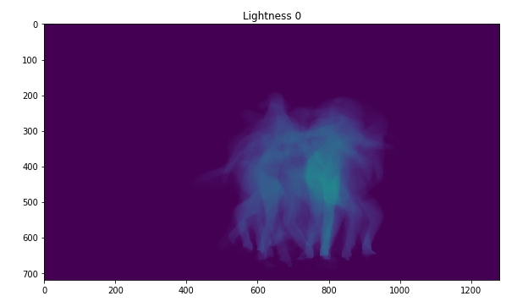

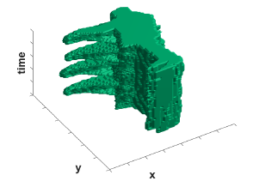
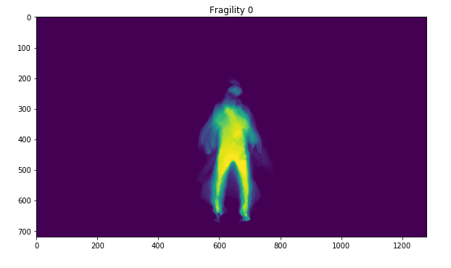
Density Frame approach
what is a density frame?
Sum and normalization over the time
Sum and normalization over the time

Slide 11
Density Frame approach
Stratified density estimation: main idea
To create a global descriptor of the image
Such descriptor should be able to provide an estimation of how much movement has been produced during the whole performance
Anyway the problem is not treated as two classes problem (see later)

Slide 12


Density Frame approach
density computation
R = # of rows of the Density Frame (DF)
C = # of columns of the DF
= # of rows of the density frame with at least a pixel 0
d = estimated density of the DF

Slide 13
Density Frame approach
stratification
Each video can be analyzed at different granularity levels
A granularity level G is defined as the triplet {B, O, S}, where
B = Batch Size: specifies how many consecutive frames must be considered together to compute a DF
O = Overlap: specifies how many consecutive frames of the previous batch must be considered during the collection of the current one
S = Skip: specifies how many consecutive frames must be discarded before keeping the next to create the current batch

Slide 14

Density Frame approach
stratified density estimation
= granularity level of video analysis
H = # of DFs (layers) generated from
= density of the DF h, with h = 1 . . . H
d = density of the (temporal) layers generated by

Slide 15
Density Frame approach
Final dataset and results
In our experiments:
K different granularity levels
 | Lightness K:10 | Fragility K:10 | Lightness K:16 | Fragility K:16
RidgeKernel | e: 0.7903 v: 0.2754 | e: 0.9113 v: 0.4230 | e: 0.8416 v: 0.2683 | e: 1.0383 v: 0.5200
SVM | e: 0.7316 v: 0.2285 | e: 0.8421 v: 0.3477 | e: 0.8741 v: 0.2976 | e: 0.8130 v: 0.1937
Lasso | e: 0.7516 v: 0.2258 | e: 0.9084 v: 0.4145 | e: 0.8129 v: 0.2132 | e: 1.0120 v: 0.4323
Rand. Forest | e: 0.9789 v: 0.5301 | e: 0.9053 v: 0.7258 | e: 0.8649 v: 0.4109 | e: 1.1297 v: 0.9497
K
X
Alg
150 videos

Slide 16
Density Frame approach
Dictionary learning: main idea
Learning a dictionary for Lightness and Fragility
Representing each image in the dataset as the encoding of the atoms
Learning the contribution of each atom to the total Lightness or Fragility of the image
Such contribution is weighted by the image encoding itself

Slide 17
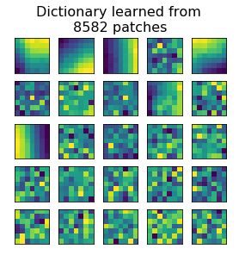
Density Frame approach
Dictionary Learning
Two dictionaries of 25 atoms each and are learned, one for Lightness and one for Fragility estimation
and are learned from the DF of their respective representative videos

Slide 18
Density Frame approach
Image encoding
We extracted patches 7x7 from every image of the dataset
Each patch is then reproduced as the linear combination of (at most) 6 different atoms
Finally each image is reconstructed combining the new patches exactly as they were extracted

Slide 19
Density Frame approach
Final dataset and results
25 atoms weights x 49 patch pixels x 8582 patches
In our experiments:
X
Type
 | Lightness | Fragility
RidgeKernel
SVM
Lasso
Rand. Forest
Group Lasso
Alg
150 videos
?
N.B. The columns of the training matrix full of zeros are deleted before the learning in order to avoid arbitrariness in the vector result

Slide 20
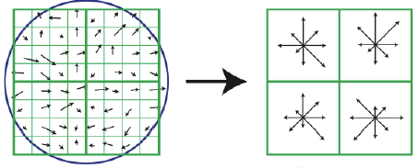
Gradient Analysis approach
Data preprocessing
Extraction of patches 40x40 from each binary frame of a given video
Computation of the gradient of the patch (sort of edge detection)
Projection of the resulting vectors along the 8 fundamental directions (0°, 45°, 90°, 135°, 180°, 225°, 270°, 335°) keeping only the one with maximum value
Pooling of the patches summing up direction-wise the projections (15 overlapping)
Binary Frame
Gradient per patch
Pooling

Slide 21
Gradient Analysis approach
main idea
Compute the variation of the gradient pool-angle-wise along the frames (i.e., the time) of each video
Use the variations inter and intra pools as indicator of the dancer’s movement and its velocity
Signal coming from 15 macro-channels, each divided in 8 micro-channels (total of 120 channels)
Use these parameters as discriminants to quantify the Lightness and the Fragility of a video

Slide 22
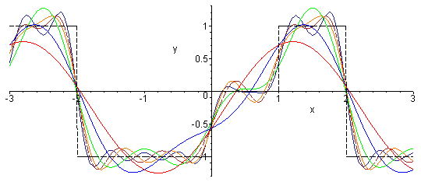
Gradient Analysis approach
Fourier Decomposition
Every difference signal from each channel is encoded with the coefficients of its Fourier Serie
Being the coefficients complex, the algorithm used is Group Lasso, componing each group the real and imaginary parts of such coefficients
The sparsity let us to introduce the prior that not every frequence is important and that the smoothness of the signal is the real key point

Slide 23
Gradient Analysis approach
Final dataset and results
250 coefficients x 2 parts x 15 pools x 8 fundamental angles
In our experiments:
X
 | Lightness | Fragility
Group Lasso | e: 1.4583 v: 0.7183 | e: 1.2500 v: 0.7449
Type
150 videos
Alg

Slide 24
Gradient Analysis approach
Average of squared differences
Every difference signal from each channel is encoded with the average of its squared values
The squaring is introduced to keep track of the difference between signals with the same mean

Slide 25
Gradient Analysis approach
Final dataset and results
In our experiments:
 | Lightness | Fragility
RidgeKernel | e: 1.6736 v: 0.6598 | e: 1.6000 v: 1.0421
SVM | e: 0.6553 v: 0.2486 | e: 0.9651 v: 0.2544
Lasso | e: 0.6309 v: 0.2268 | e: 0.9079 v: 0.2084
Rand. Forest | e: 0.8105 v: 0.3515 | e: 0.9368 v: 0.4928
15 pools x 8 fundamental angles
Alg
Type
X
150 videos

Slide 26
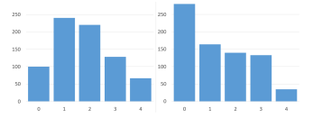
Not working hypotheses and feasible further works
Some ideas
Not working hypotheses
Feasible further works
Datasets we created are not enough meaningful by themselves
Source data quality is not high (too few good and clean examples of Lightness and Fragility, see below)
Superpixels usage
Data integration
Add some prior
Non-Orthogonal Group Lasso
Stratified Group Lasso
Contiguity
Limbs tracking
Segmenting with HMM [3]
Segmented with CNN

Slide 27
REFERENCES
[1] R. Niewiadomski et al., Low-Intrusive Recognition of Expressive Movement Qualities, Proceedings of the 19th ACM International Conference on Multimodal Interaction, 230-237
[2] Radoslaw Niewiadomski, CasaPaganini - InfoMus, DIBRIS, University of Genoa Viale Causa 13, 16145 Genoa, Italy radoslaw.niewiadomski@dibris. unige.it
[3] M. Barnard, M. Matilainen and J. Heikkila, Body part segmentation of noisy human silhouette images, ICME 2008 (2008), 1189-1192

