Slide 1


THE SELF-AVATAR FOLLOWER EFFECT IN VIRTUAL REALITY
MAR GONZALEZ-FRANCO, BRIAN COHN, EYAL OFEK , DALILA BURIN, ANTONELLA MASELLI
Pedro Sobral – 98491
Daniel Figueiredo – 98498
IHC
23-06-20201

Slide 2
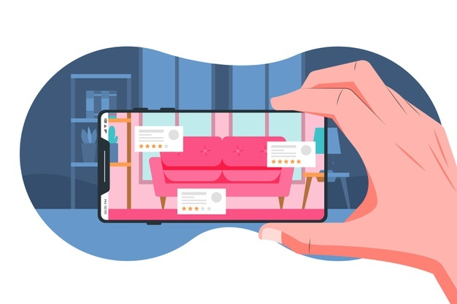
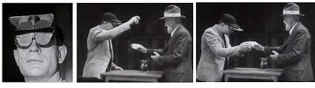
WHY DID WE CHOOSE THIS PAPER?

Slide 3
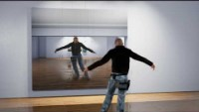
BACKGROUND
Embodiment Ilusion
In case, we have direct control of the avatar we experience embodiment: “A 1 to 1 substitution of our body”.
Research show that embodiment can alter motor behavior in diferente ways
Is there any mechanism that underlies some of these motor compensations?

Slide 4
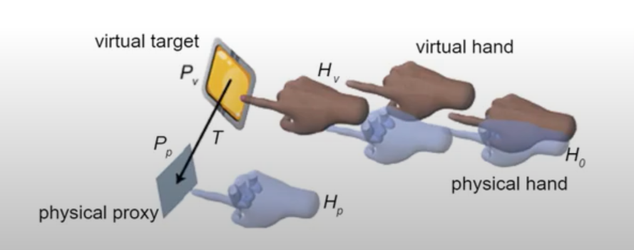
BACKGROUND
Motion Retargeting
The visual feedback componente during a motor action is so strong to guide motor actions that in some cases the avatar can be drifted towards a particular target and that will change the motions of the person.

Slide 5
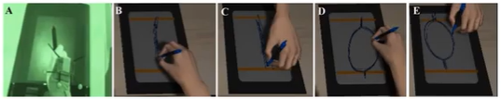
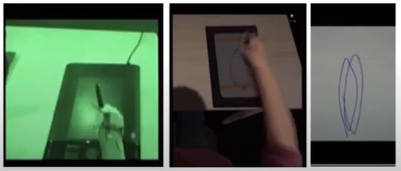
BACKGROUND
Motion Contagion
The avatar motions can also influence our own actions.
Contagion is mostly an involuntary behaviour, for example, when someone yawns, sometimes you yawn as well.

Slide 6
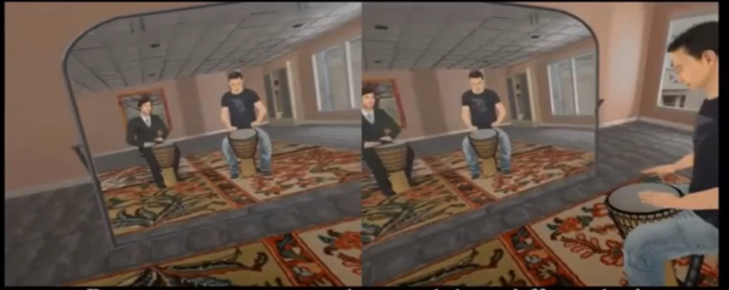
BACKGROUND
Mimicry Effect
Although motor contagion and mimicry result in a similar outcome mimicry seems to have a stronger social and cultural meaning, for example, my movements and behaviour are affected completely or partially by someone else’s actions.

Slide 7
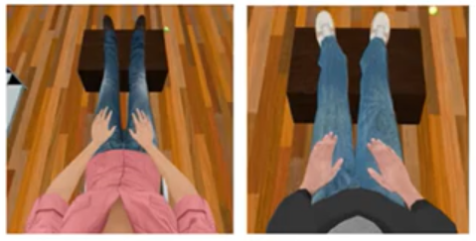
MOTIVATION
Fit-into-the-avatar behavior is consistent with a trend of VR experiments setups.
When participants are fitted with a static avatar from a first-person perspective, they tend to quickly adapt to the avatar posture moving their limbs and body so to be aligned with the virtual body.

Slide 8
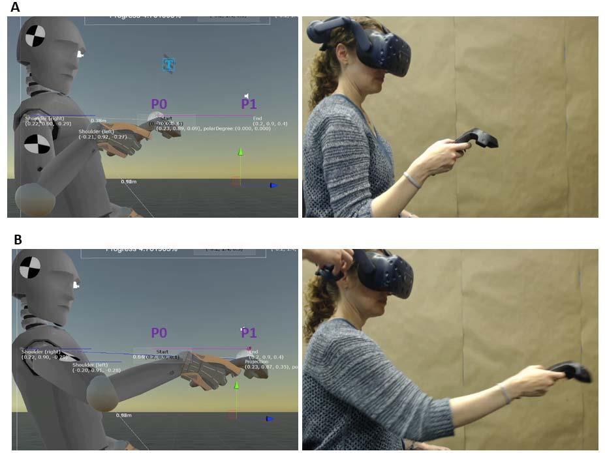
EXPERIMENT
If we drift the avatar , will the participant try to compensate that drift?
21 participants (8F, 13M) between the ages of 18-65 (μ = 29) participated in the experiment.
Task: Ask participants to reach forward while experiencing avatar embodiment with inverse kinematics. In each trial participants reach from a point near the body (P0) and a point away from the body (P1) (Figures XXX).

Slide 9
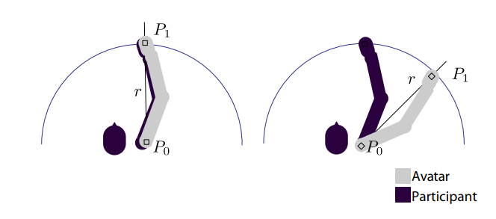
EXPERIMENT
Remap one-to-one movements to a restricted degree of freedom.
Three conditions:
  Instantaneous drift;
  Gradual drift;
  No-drift.

Slide 10
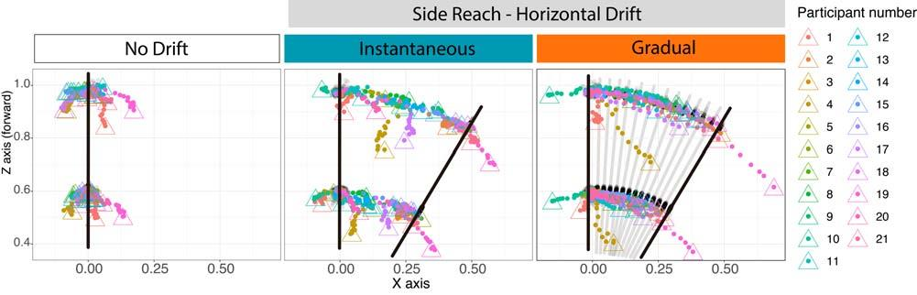
RESULTS
If we drift the avatar , will the participant try to compensate that drift? Yes, they will.

Slide 11
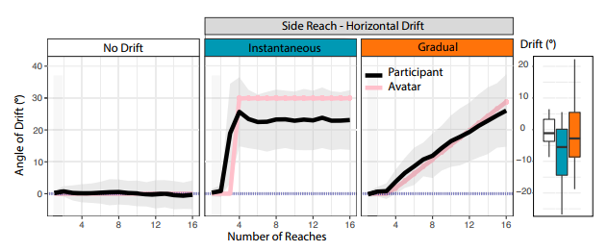
RESULTS
If we drift the avatar , will the participant try to compensate that drift? Yes, but if the drift is too big they might not compensate fully.

Slide 12
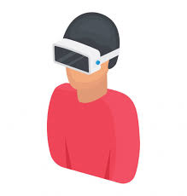
BREAKING THE EFFECT
Self-Avatar Follower Effect
Constant offset;
Drop in embodiment;
Semantic violations.

Slide 13

CONCLUSION
Self-Avatar Follower Effect
Automatic compensations;
Magnitude of the offset matters;
Embodiment strength.

