Slide 1

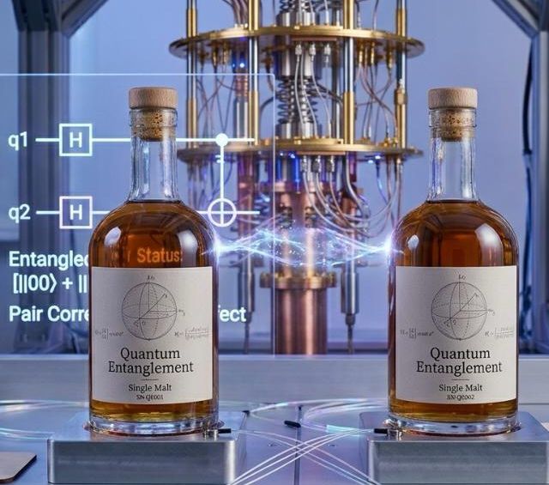
Cat Qubit Stabilization
WhisQu – Alice & Bob Challenge
ETH Quantum Hackathon 2026

Slide 2
Challenge Introduction
As quantum processors grow in complexity, maintaining stable and high-fidelity qubit operations becomes increasingly difficult. Small variations in control parameters, environmental noise, and hardware drift can significantly degrade performance over time.
In this challenge, we explored how optimization techniques can be used to:
Calibrate qubit control pulses efficiently
Track and compensate for hardware drift in real time
Improve the stability of quantum operations
Analyze and preserve logical information in cat qubits under photon loss
Our objective was to develop robust calibration strategies capable of adapting dynamically to changing quantum hardware conditions while maximizing qubit performance and coherence.

Slide 3

Our Approach
We initially tried to work with the complex knobs in the cartesian form (a+ib), but then realized that a polar-form version (mod, arg) could give us better results.
Proxy: Instead of fitting a full curve, we perform a one-time offline calibration to find the baseline lifetime $τ$. During the optimization loop, we measure the qubit at $0.5⋅τ$.
Why? Mathematically, the slope of an exponential decay curve is most sensitive to changes in the decay rate at its half-life point.

Slide 4



Effective knobs
$$α^{2}=\frac{2}{κ_{2}}\left(ε_{d}−{κ_{a}}/4\right)=\frac{g_{2}ε_{d}}{{\left|g_{2}\right|}^{2}}−\frac{k_{a}k_{b}}{8{\left|g_{2}\right|}^{2}}$$
We realized that the expected value of $α^{2}$ depends not on 4 knobs as we initially supposed, but of 3:
This allowed to sweep 3 parameters instead of 4, reducing the time of the simulation
$\left|g_{2}\right|$, $\left|ε_{d}\right|$, φ (a phase)

Slide 5



Reward function
$r_{1}=\log{S_{x}\left(T_{x,ref}\right)}+\log{S_{z}\left(T_{z,ref}\right)}$
$r_{2}=\log{S_{x}\left(T_{x,ref}\right)}−\log{S_{z}\left(T_{z,ref}\right)}$
$r_{0}=\log{S_{x}\left(T_{x_{0},ref}\right)}−\log{S_{z}\left(T_{z_{0_{,}}ref}\right)}$
$$r=ω_{1}r_{1}−ω_{2}{\left(r_{2}+r_{0}\right)}^{2}$$
The value of the reward increases when the expected lifetime increases.
The negative term penalizes the value when the target bias is further
The $r_{0}$ term allows us to compare with our reference values
We used $ω_{1}=1,ω_{2}=2$

Slide 6
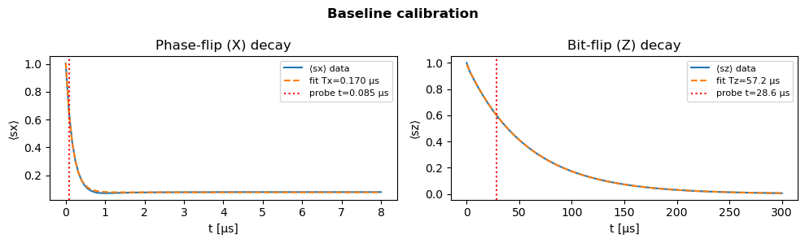
Measuring lifetimes
Problem: Measuring the lifetime requires measuring too many point along a decay curve to perform an exponential fit. This is makes our optimizer too slow, since it needs to evaluate hundreds of parameter sets.
Solution: Instead of the Exponential Fit, we transition to a Single-Point Proxy Measurement. Instead of finding the exact lifetime value, we measure the strength of the signal at a specific time point

Slide 7
Optimization Methods used
CMA-ES
BAYESIAN OPTIMIZATION
SA-ES
Evolutionary algorithm that adapts the search distribution over time
Strong global search capabilities, robust to noisy landscapes
Higher computational cost
Probabilistic surrogate model used to guide parameter exploration
Very sample-efficient, effective for expensive evaluations
Showed strong oscillations and unstable convergence in our experiments
Self-adaptive evolution strategy with dynamic mutation parameters
Flexible, computationally efficient, adapts well to changing conditions
Risk of premature convergence to a local solution

Slide 8
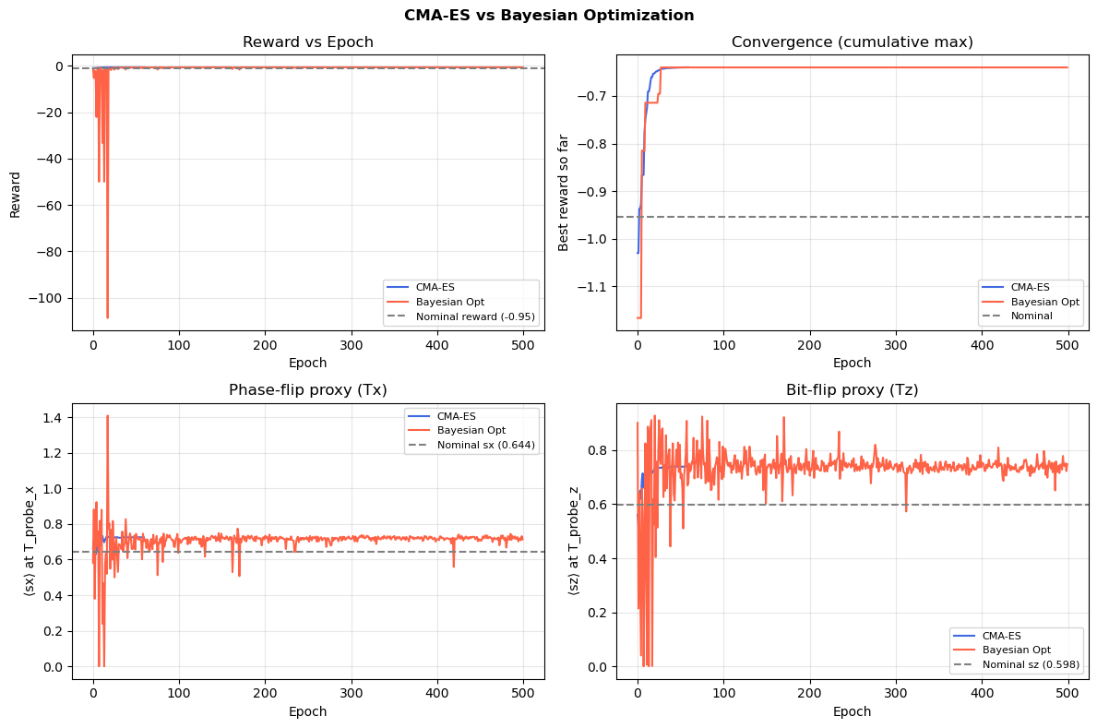
Parameter convergence

Slide 9
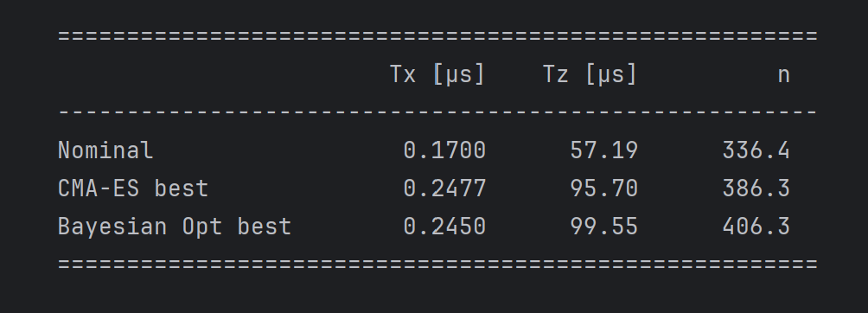
Decay Lifetimes Comparison

Slide 10
Visualization of the cats state
Reference
Optimal - CMA
Optimal - BO

Slide 11
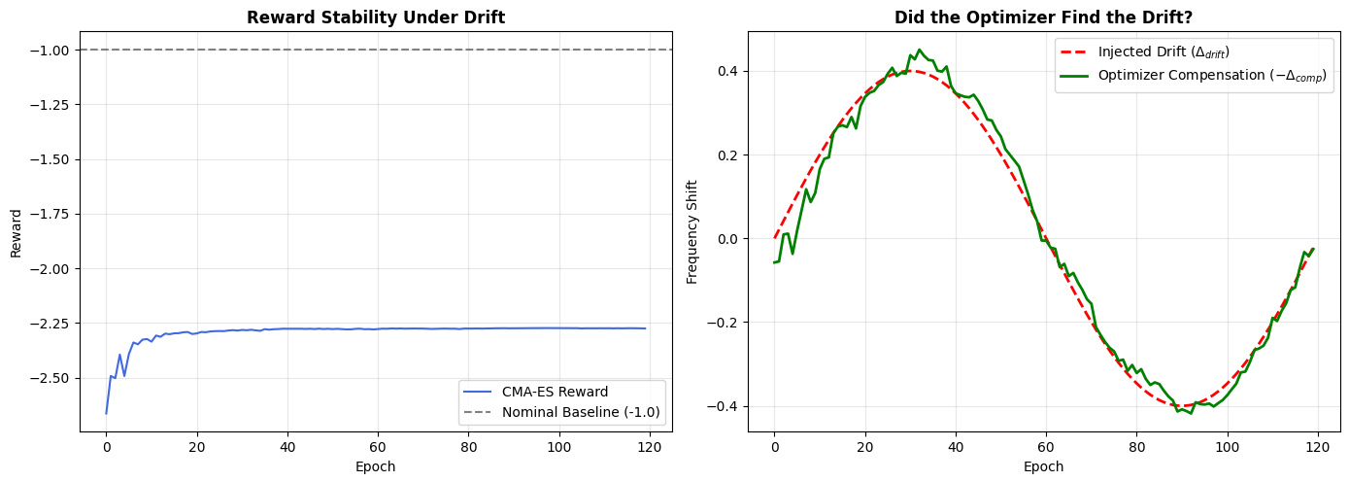

Drift Implementation
Frequency shift of the storage resonator
We introduce a synthetic drift into the Hamiltonian – apply slow, sinusoidal oscillation to the storage frequency across training epochs
Introduce new parameter to search space: frequency compensation knob
Also implement Variance Bounding: $σ$ doesn’t go to 0, forced to keep minimum level of exploration; less chance of premature conversion
Physically: mechanical vibrations of cryocooler, temperature cycling, main power harmonics

Slide 12
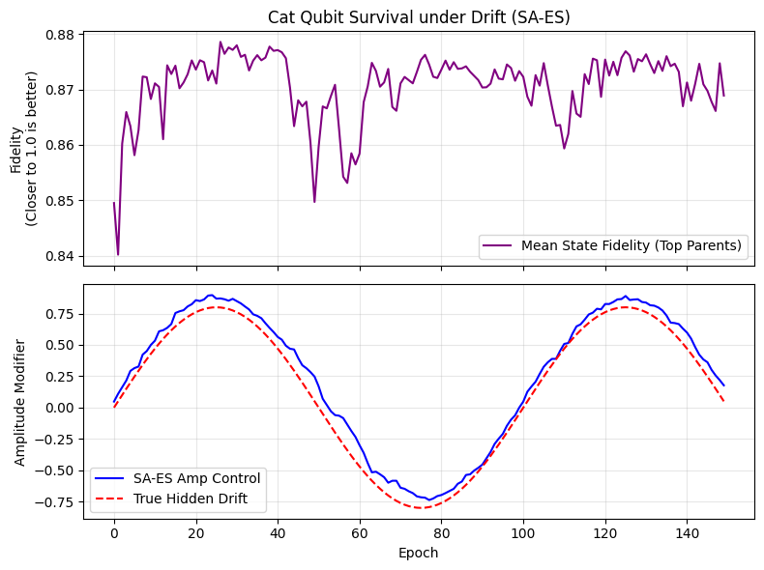
Drift Implementation

Slide 13
Thank you for your time

