Slide 1
EGATE Talent Center
Cybersecurity Learning Platform
Project Presentation

Slide 2
The Objective
The Need for Practical Cybersecurity Education
  Theoretical knowledge is not enough to stop modern cyber threats.
  EGATE Talent Center provides a hands-on, gamified environment.
  Users learn by doing: solving real-world Capture The Flag (CTF) challenges.

Slide 3
Platform Features
Interactive CTF Challenges across multiple domains (Web, Crypto, Binary, etc.)
Live Global Leaderboard to drive competition.
Structured Learning Paths to guide beginners.
Instant flag verification & scoring system.

Slide 4
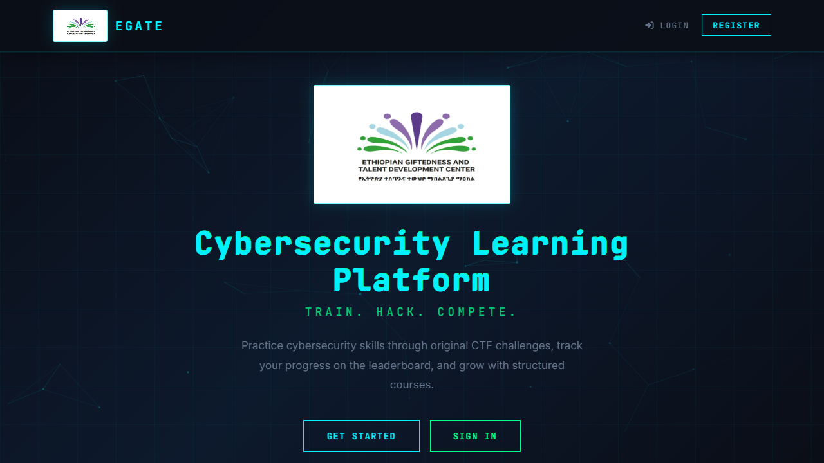
Landing Page

Slide 5
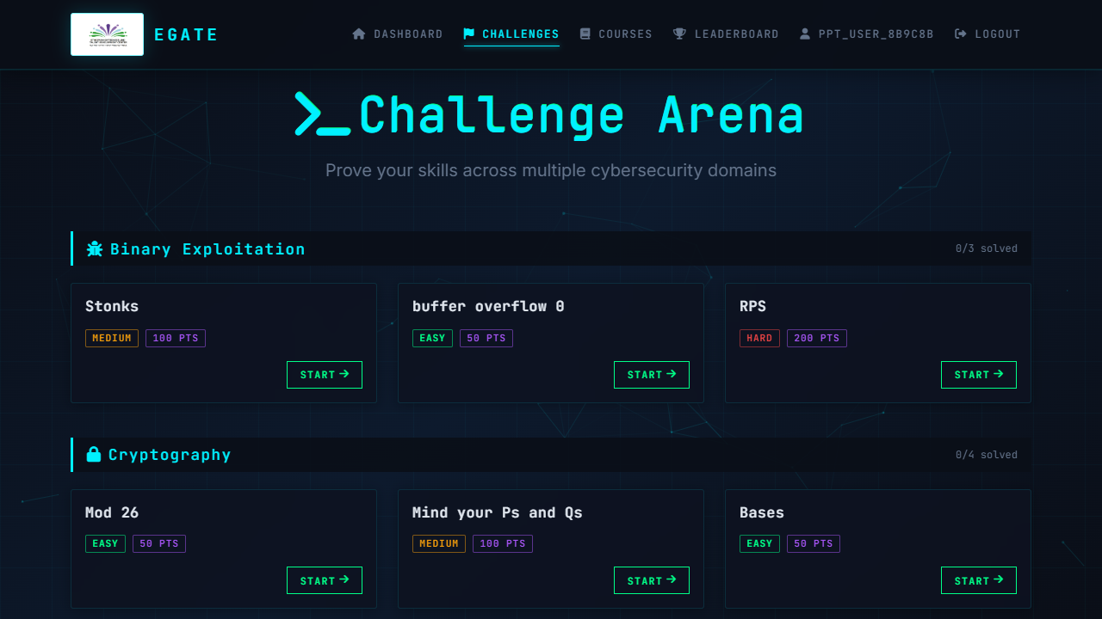
Challenges Dashboard

Slide 6
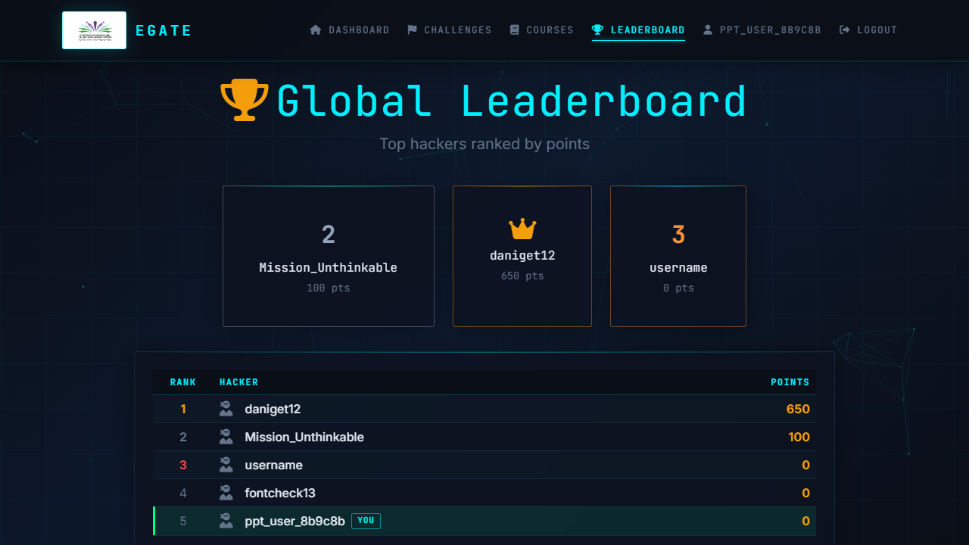
Live Leaderboard

Slide 7
Technology Stack
Backend: Python, Flask, SQLAlchemy
Frontend: HTML5, CSS3, Bootstrap 5, Javascript
Database: PostgreSQL (Neon Serverless)
Deployment: Ready for Vercel

Slide 8
Thank You
Questions & Answers

