Slide 1
EGATE Talent Center
Cybersecurity Learning Platform
Project Presentation

Slide 2
The Objective
The Need for Practical Cybersecurity Education
  Theoretical knowledge is not enough to stop modern cyber threats.
  EGATE Talent Center provides a hands-on, gamified environment.
  Users learn by doing: solving real-world Capture The Flag (CTF) challenges.

Slide 3
Platform Features
Intelligent AI Helper for personalized student assistance.
Interactive CTF Challenges across multiple domains (Web, Crypto, Binary, etc.)
Live Global Leaderboard to drive competition.
Structured Learning Paths across multiple departments.
Instant flag verification & scoring system.

Slide 4
Upcoming Departments & Courses
We are expanding beyond Cybersecurity! Releasing soon:
  Digital & Emerging Technologies
  Robotics & Electronics
  Astronomy & Space Technology
  Biotechnology
  STEM (Science, Technology, Engineering & Mathematics)

Slide 5
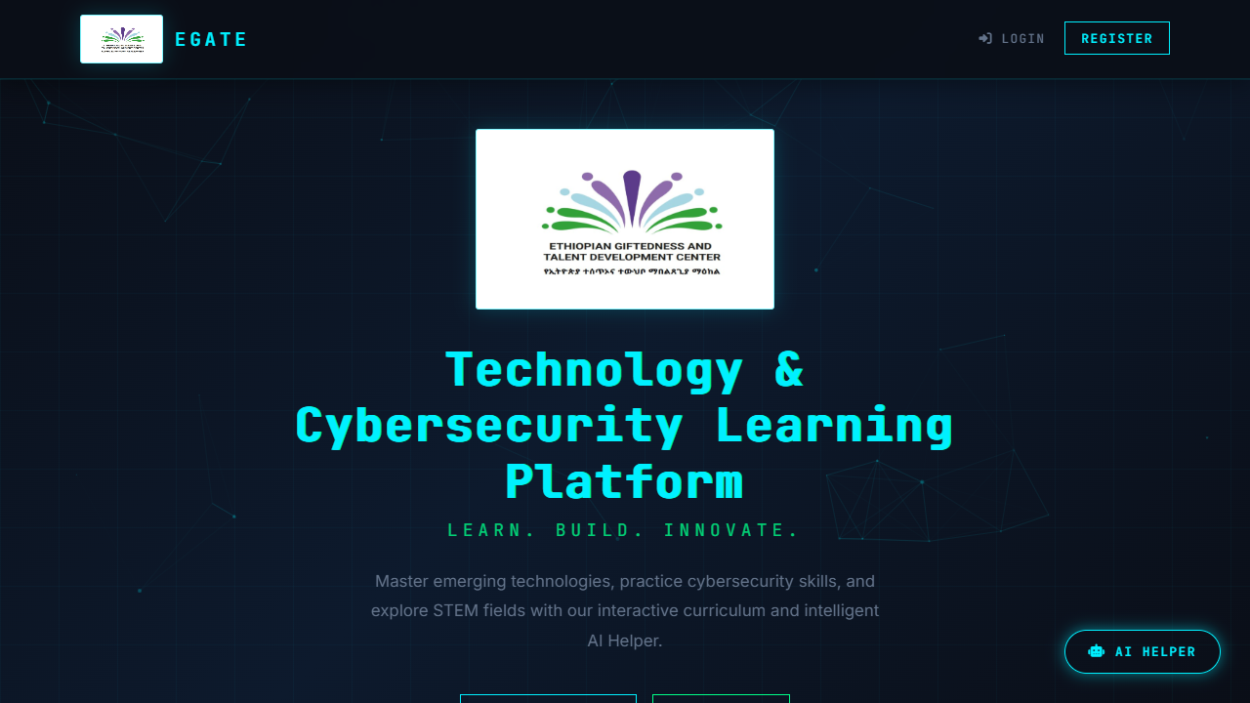
Landing Page

Slide 6
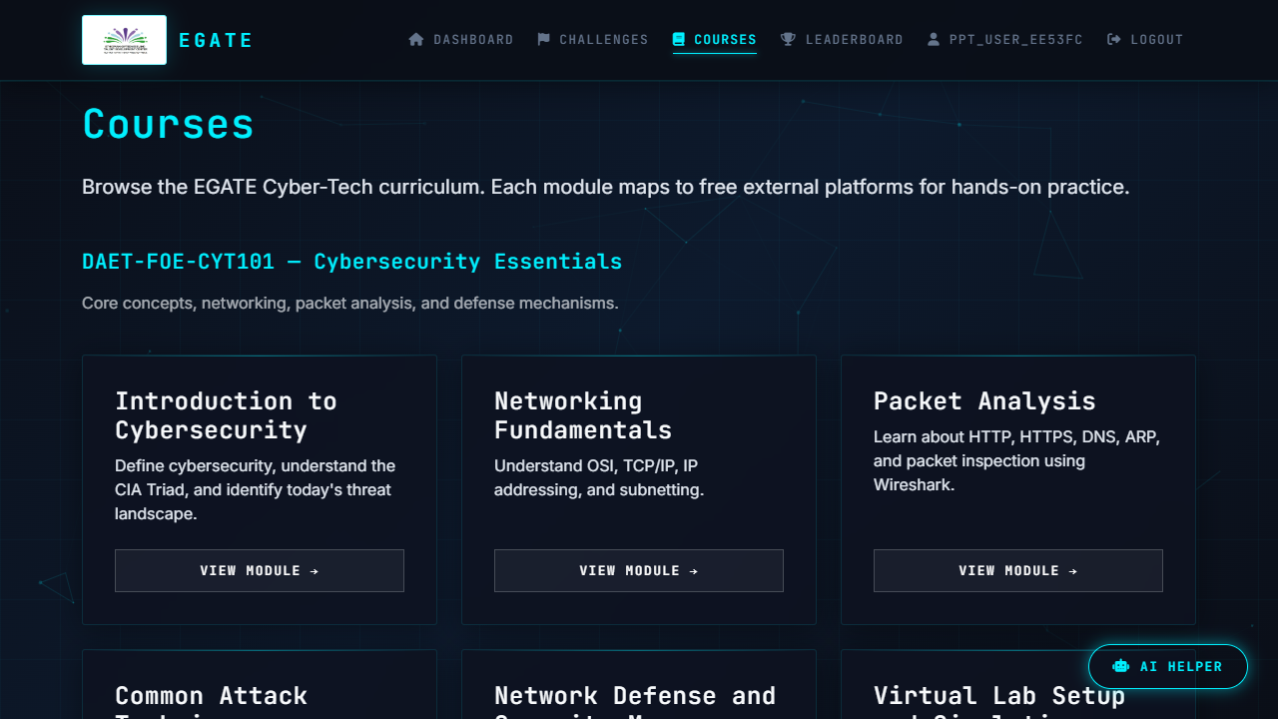
Courses & Departments

Slide 7
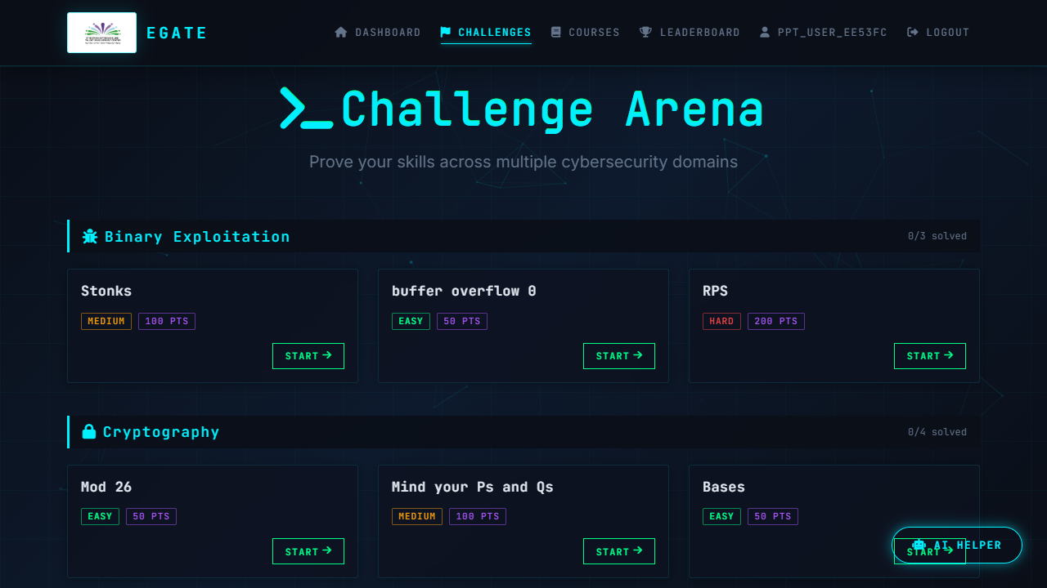
Challenges Dashboard

Slide 8
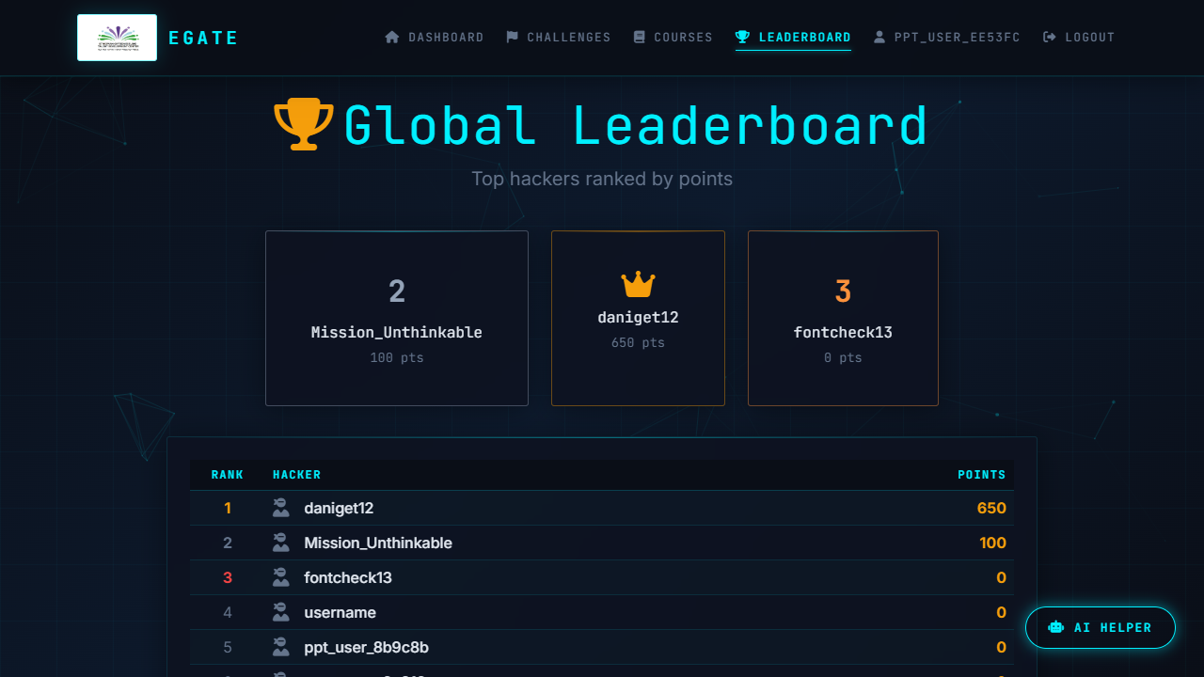
Live Leaderboard

Slide 9
Technology Stack
Backend: Python, Flask, SQLAlchemy
Frontend: HTML5, CSS3, Bootstrap 5, Javascript
Database: PostgreSQL (Neon Serverless)
Deployment: Ready for Vercel

Slide 10
Thank You
Questions & Answers

