Slide 1
Cisco-cyber API-security-challenge
Hillel Ohayon
Daniel Gilkarov

Slide 2
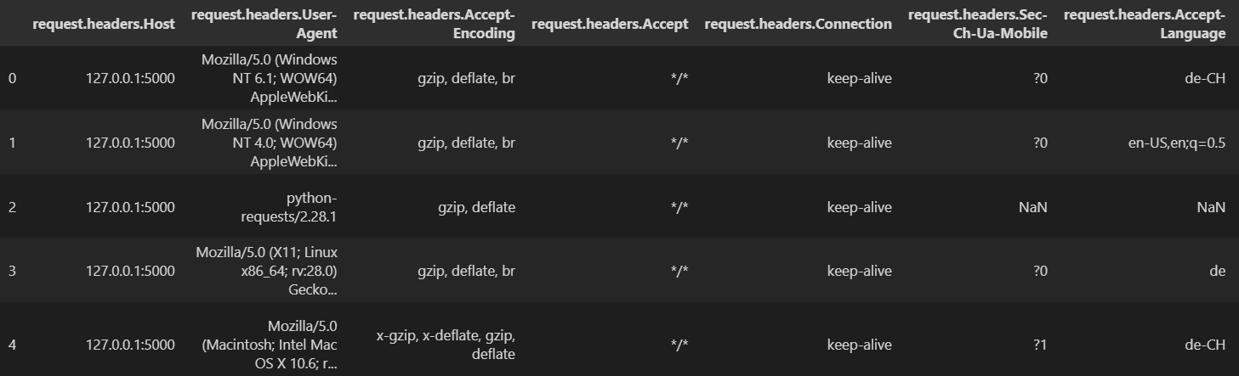
Data encoding
One problem we faced when we first looked into the datasets was that we are dealing with categorical features, meaning they are not continuous numerical values, they are strings, and most machine learning models implemented in sklearn do not know to how to deal with these kinds of values

Slide 3
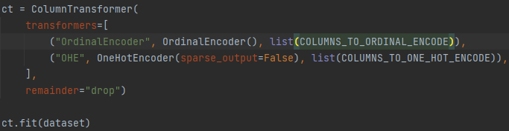
Data encoding
To solve the problem we mentioned earlier, we decide to encode our data, meaning we assign each unique value with respect to the column its in a numeric value that corresponds to it. Differing from the baseline model we chose to use Label Encoding (basic enumeration) for columns with more than a threshold value of 200 unique values, and One Hot Encoding for the rest.
We use pandas.Series.value_counts to split columns into COLUMNS_TO_ORDINAL_ENCODE and COLUMNS_TO_ONE_HOT_ENCODE,
Remainder=“drop” means the columns ‘label’ and ‘attack_type’ are dropped and this is fine since this is our X data without the labels.

Slide 4
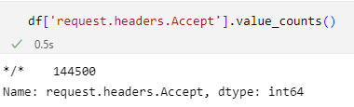
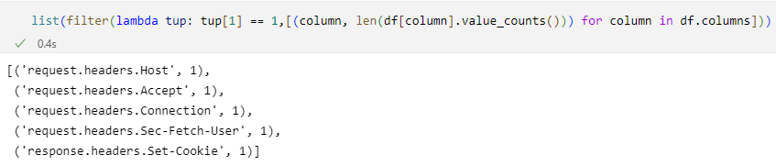
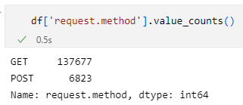
FEATURE selection
For feature selection, we first came to the conclusion that columns in our dataset that only have one unique value are redundant, so in our preprocessing phase we automatically cast these columns out.
Example:
Here all values are “*/*”
Here we have 2 unique values:
GET and POST

Slide 5
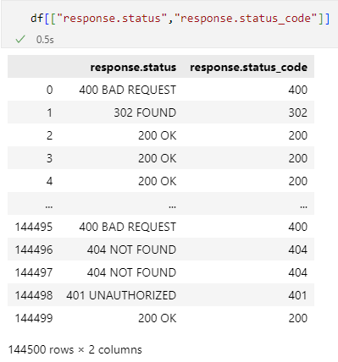
FEATURE selection
In addition to the columns with only one unique value we thought it may be a good idea to look for columns with repeated data
We can see both these columns have the exact same data, so we decide to throw away “response.status_code” so that we will only have string data.

Slide 6
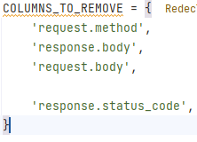








FEATURE selection
We decided against using the body columns from the datasets since we think it won’t help us distinct bad from good, it’s free content, with no context.
We also discard the method column, it is also data that’s sort of tied with the body
columns as GET requests don’t send a body and POST requests do.
In conclusion: we removed these features:

Slide 7
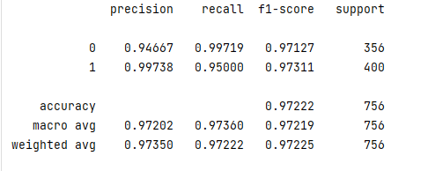
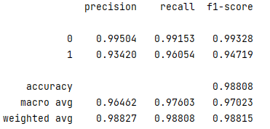
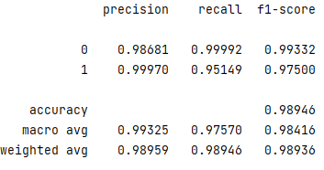
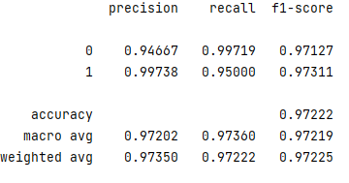
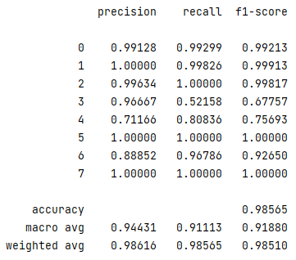
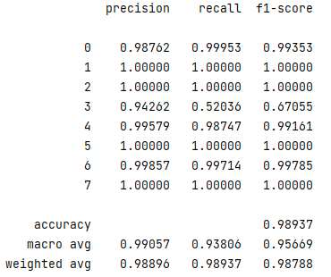
Scores
Dataset 1 (label)
Dataset 3 (label)
Dataset 4 (label)
Dataset 2 (label)
Dataset 3 (attack type)
Dataset 4 (attack type)

