Slide 1
Hidden Markov Models
1
1
1
1
…
1
2
2
2
2
2
…
2
…
…
…
…
K
K
K
K
…
K
x₁
x₂
x₃
x_{K}

Slide 2
Probabilistic Reasoning over Time
States and observation
  Each snapshot (time slice) contains a set of random variables, some are observable.
  π _{t} denote the set of unobservable state variables at time t.
  X _{t} denote the set of observable evidence variable at time t.
Markov assumption
  The current state depends on only a finite history of previous states
Markov processes (Markov chains)
  First-order Markov process
    The current state depends only on the previous state and not on any earlier states
    P(x _{t}| x _{0:t-1})=P(x _{t}| x _{t-1})

Slide 3
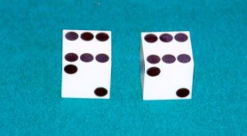
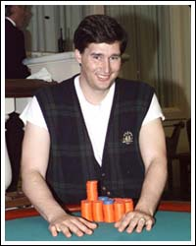
Example: The Dishonest Casino
A casino has two dice:
Fair die
P(1) = P(2) = P(3) = P(5) = P(6) = 1/6
Loaded die
P(1) = P(2) = P(3) = P(5) = 1/10
P(6) = 1/2
Casino player switches back-&-forth between fair and loaded die once every 20 turns
Game:
You bet $1
You roll (always with a fair die)
Casino player rolls (maybe with fair die, maybe with loaded die)
Highest number wins $2

Slide 4
Question # 1 – Evaluation
GIVEN
A sequence of rolls by the casino player
1245526462146146136136661664661636616366163616515615115146123562344
QUESTION
How likely is this sequence, given our model of how the casino works?
This is the EVALUATION problem in HMMs
Prob = 1.3 x 10⁻³⁵

Slide 5
Question # 2 – Decoding
GIVEN
A sequence of rolls by the casino player
1245526462146146136136661664661636616366163616515615115146123562344
QUESTION
What portion of the sequence was generated with the fair die, and what portion with the loaded die?
This is the DECODING question in HMMs
FAIR
LOADED
FAIR

Slide 6
Question # 3 – Learning
GIVEN
A sequence of rolls by the casino player
1245526462146146136136661664661636616366163616515615115146123562344
QUESTION
How “loaded” is the loaded die? How “fair” is the fair die? How often does the casino player change from fair to loaded, and back?
This is the LEARNING question in HMMs
Prob(6) = 64%

Slide 7
The dishonest casino model
0.05
0.95
0.95
FAIR
LOADED
P(1|F) = 1/6
P(2|F) = 1/6
P(3|F) = 1/6
P(4|F) = 1/6
P(5|F) = 1/6
P(6|F) = 1/6
P(1|L) = 1/10
P(2|L) = 1/10
P(3|L) = 1/10
P(4|L) = 1/10
P(5|L) = 1/10
P(6|L) = 1/2
0.05

Slide 8
Definition of a hidden Markov model
Definition: A hidden Markov model (HMM)
Alphabet Σ = { b₁, b₂, …, b_{M} }
Set of states Q = { 1, ..., K }
Transition probabilities between any two states
a_{ij} = transition prob from state i to state j
a_{i1} + … + a_{iK} = 1, for all states i = 1…K
Start probabilities a_{0i}
  a₀₁ + … + a_{0K} = 1
Emission probabilities within each state
e_{i}(b) = P( x_{i} = b | π_{i} = k)
e_{i}(b₁) + … + e_{i}(b_{M}) = 1, for all states i = 1…K
1
2
K
…

Slide 9
A HMM is memory-less
At each time step t,
the only thing that affects future states
is the current state π_{t}
P(π_{t+1} = k | “whatever happened so far”) =
P(π_{t+1} = k | π₁, π₂, …, π_{t}, x₁, x₂, …, x_{t}) =
P(π_{t+1} = k | π_{t})
1
2
K
…

Slide 10
A parse of a sequence
Given a sequence x = x₁……x_{N},
A parse of x is a sequence of states π = π₁, ……, π_{N}
1
1
1
1
…
1
2
2
2
2
2
…
2
…
…
…
…
K
K
K
K
…
K
x₁
x₂
x₃
x_{K}

Slide 11
Likelihood of a parse
Given a sequence x = x₁……x_{N}
and a parse π = π₁, ……, π_{N},
To find how likely is the parse:
(given our HMM)
P(x, π) = P(x₁, …, x_{N}, π₁, ……, π_{N})
= P(x_{N} π_{N} |x₁, …, x_{N-1}, π₁, ……, π_{N-1})*P(x₁, …, x_{N-1}, π₁, ……, π_{N-1})
= P(x_{N}, π_{N} | π_{N-1}) P(x_{N-1}, π_{N-1} | π_{N-2})……P(x₂, π₂ | π₁) P(x₁, π₁)
= P(x_{N} | π_{N}) P(π_{N} | π_{N-1}) ……P(x₂ | π₂) P(π₂ | π₁) P(x₁ | π₁) P(π₁)
= a_{0π1} a_{π1π2}……a_{πN-1πN} e_{π1}(x₁)……e_{πN}(x_{N})
1
1
1
1
…
1
2
2
2
2
2
…
2
…
…
…
…
K
K
K
K
…
K
x₁
x₂
x₃
x_{N}

Slide 12
Example: the dishonest casino
Let the sequence of rolls be:
x = 1, 2, 1, 5, 6, 2, 1, 5, 2, 4
Then, what is the likelihood of
π = Fair, Fair, Fair, Fair, Fair, Fair, Fair, Fair, Fair, Fair?
(say initial probs a_{0Fair} = ½, a_{oLoaded} = ½)
½ × P(1 | Fair) P(Fair | Fair) P(2 | Fair) P(Fair | Fair) … P(4 | Fair) =
½ × (1/6)¹⁰ × (0.95)⁹ = .00000000521158647211 ~= 0.5 × 10⁻⁹

Slide 13
Example: the dishonest casino
So, the likelihood the die is fair in this run
is just 0.521 × 10⁻⁹
OK, but what is the likelihood of
π = Loaded, Loaded, Loaded, Loaded, Loaded, Loaded, Loaded, Loaded, Loaded, Loaded?
½ × P(1 | Loaded) P(Loaded, Loaded) … P(4 | Loaded) =
½ × (1/10)⁹ × (1/2)¹ (0.95)⁹ = .00000000015756235243 ~= 0.16 × 10⁻⁹
Therefore, it somewhat more likely that all the rolls are done with the fair die, than that they are all done with the loaded die

Slide 14
Example: the dishonest casino
Let the sequence of rolls be:
x = 1, 6, 6, 5, 6, 2, 6, 6, 3, 6
Now, what is the likelihood π = F, F, …, F?
½ × (1/6)¹⁰ × (0.95)⁹ = 0.5 × 10⁻⁹, same as before
What is the likelihood
π = L, L, …, L?
½ × (1/10)⁴ × (1/2)⁶ (0.95)⁹ = .00000049238235134735 ~= 0.5 × 10⁻⁷
So, it is 100 times more likely the die is loaded

Slide 15
The three main questions on HMMs
Evaluation
  GIVEN a HMM M, and a sequence x,
  FIND Prob[ x | M ]
Decoding
  GIVEN a HMM M, and a sequence x,
  FIND the sequence π of states that maximizes P[ x, π | M ]
Learning
  GIVEN a HMM M, with unspecified transition/emission probs.,
  and a sequence x,
  FIND parameters θ = (e_{i}(.), a_{ij}) that maximize P[ x | θ ]

Slide 16
Problem 1: Evaluation
Efficiently compute the probability of the observation

Slide 17
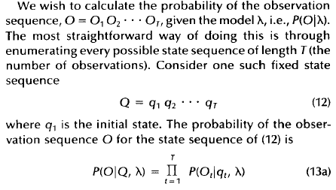
Evaluation

Slide 18
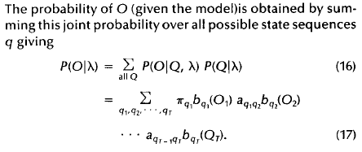
Evaluation
Computation: O(2T.N^{T}) , N: states

Slide 19

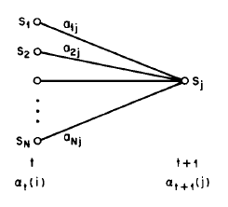
Evaluation (Forward)
A more efficient procedure is required
  Forward-backward procedure

Slide 20
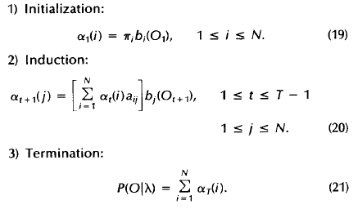
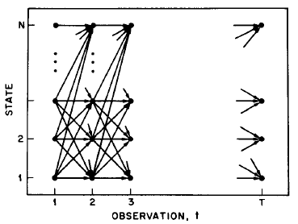
Evaluation
Order: O(N²T)

Slide 21

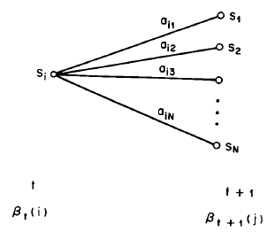
Evaluation (backward)

Slide 22
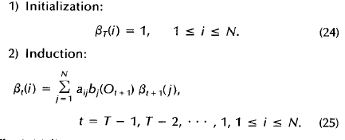
Evaluation (backward)

Slide 23
Problem 2: Decoding
Find the best parse of a sequence

Slide 24
Decoding
1
1
1
1
…
1
GIVEN x = x₁x₂……x_{N}
We want to find π = π₁, ……, π_{N},
such that P[ x, π ] is maximized
π* = argmax_{π} P[ x, π ]
We can use dynamic programming!
Let V_{k}(i) = max_{{π1… πi-1}} P[x₁…x_{i-1}, π₁, …, π_{i-1}, x_{i}, π_{i} = k]
= Probability of most likely sequence of states ending at state π_{i} = k
2
2
2
2
2
…
2
…
…
…
…
K
K
K
K
…
K
x₁
x₂
x₃
x_{K}

Slide 25
Decoding – main idea
Given that for all states k,
and for a fixed position i,
V_{k}(i) = max_{{π1… πi-1}} P[x₁…x_{i-1}, π₁, …, π_{i-1}, x_{i}, π_{i} = k]
What is V_{l}(i+1)?
From definition,
V_{l}(i+1) = max_{{π1… πi}}P[ x₁…x_{i}, π₁, …, π_{i}, x_{i+1}, π_{i+1} = l ]
= max_{{π1… πi}}P(x_{i+1}, π_{i+1} = l | x₁…x_{i},π₁,…, π_{i}) P[x₁…x_{i}, π₁,…, π_{i}]
= max_{{π1… πi}}P(x_{i+1}, π_{i+1} = l | π_{i} ) P[x₁…x_{i-1}, π₁, …, π_{i-1}, x_{i}, π_{i}]
= max_{k} [P(x_{i+1}, π_{i+1} = l | π_{i} = k) max_{{π1… πi-1}}P[x₁…x_{i-1},π₁,…,π_{i-1}, x_{i},π_{i}=k]]
= e_{l}(x_{i+1}) max_{k} a_{kl} V_{k}(i)

Slide 26
The Viterbi Algorithm
Input: x = x₁……x_{N}
Initialization:
V₀(0) = 1 (0 is the imaginary first position)
V_{k}(0) = 0, for all k > 0
Iteration:
V_{j}(i) = e_{j}(x_{i}) × max_{k} a_{kj} V_{k}(i – 1)
Ptr_{j}(i) = argmax_{k} a_{kj} V_{k}(i – 1)
Termination:
P(x, π*) = max_{k} V_{k}(N)
Traceback:
π_{N}* = argmax_{k} V_{k}(N)
π_{i-1}* = Ptr_{πi} (i)

Slide 27
The Viterbi Algorithm
x₁ x₂ x₃ ………………………………………..x_{N}
State 1
2
V_{j}(i)
K
Similar to “aligning” a set of states to a sequence
Time:
O(K²N)
Space:
O(KN)

Slide 28
Viterbi Algorithm – a practical detail
Underflows are a significant problem
P[ x₁,…., x_{i}, π₁, …, π_{i} ] = a_{0π1} a_{π1π2}……a_{πi} e_{π1}(x₁)……e_{πi}(x_{i})
These numbers become extremely small – underflow
Solution: Take the logs of all values
V_{l}(i) = log e_{k}(x_{i}) + max_{k} [ V_{k}(i-1) + log a_{kl} ]

Slide 29
Example
Let x be a long sequence with a portion of ~ 1/6 6’s,
followed by a portion of ~ ½ 6’s…
x = 123456123456…12345 6626364656…1626364656
Then, it is not hard to show that optimal parse is (exercise):
FFF…………………...F LLL………………………...L
6 characters “123456” parsed as F, contribute .95⁶×(1/6)⁶ = 1.6×10⁻⁵
parsed as L, contribute .95⁶×(1/2)¹×(1/10)⁵ = 0.4×10⁻⁵
“162636” parsed as F, contribute .95⁶×(1/6)⁶ = 1.6×10⁻⁵
parsed as L, contribute .95⁶×(1/2)³×(1/10)³ = 9.0×10⁻⁵

Slide 30
Problem 3: Learning
Adjust the model parameters

Slide 31
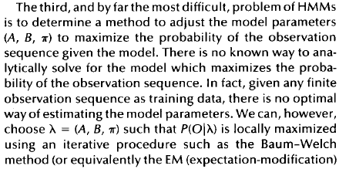
Learning

Slide 32
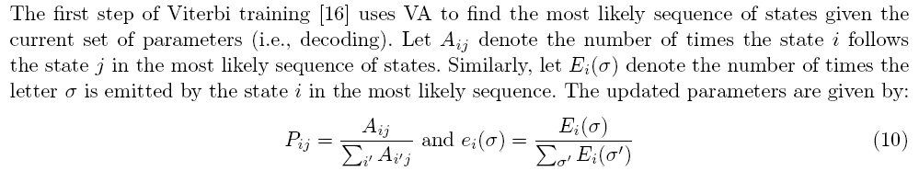
I Viterbi training

Slide 33
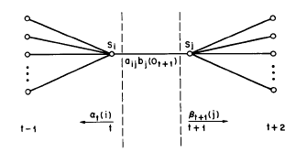

II Baum-Welch training

Slide 34
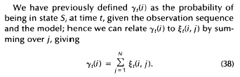
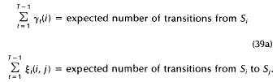
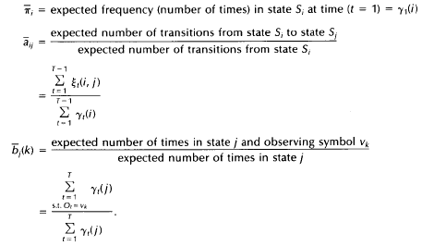
Baum-Welch training

Slide 35
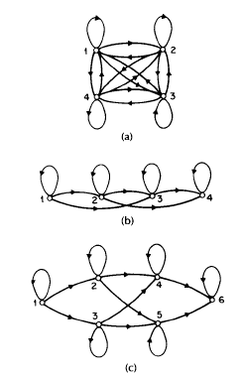
Type of HMM

Slide 36
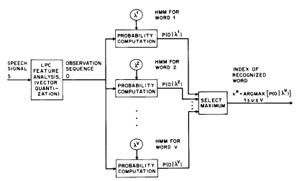
Application of HMM
Isolated word recognition
Bio-information

