Slide 1
Adversarial Search
對抗搜尋

Slide 2
Outline
Optimal decisions
α-β pruning
Imperfect, real-time decisions

Slide 3
Games vs. search problems
"Unpredictable" opponent → specifying a move for every possible opponent reply
Time limits → unlikely to find goal, must approximate

Slide 4

Game tree (2-player, deterministic, turns)

Slide 5

Minimax
Perfect play for deterministic games
Idea: choose move to position with highest minimax value
= best achievable payoff against best play
E.g., 2-ply game:

Slide 6

Minimax algorithm

Slide 7
Properties of minimax
Complete? Yes (if tree is finite)
Optimal? Yes (against an optimal opponent)
Time complexity? O(b^{m})
Space complexity? O(bm) (depth-first exploration)
For chess, b ≈ 35, m ≈100 for "reasonable" games
→ exact solution completely infeasible

Slide 8
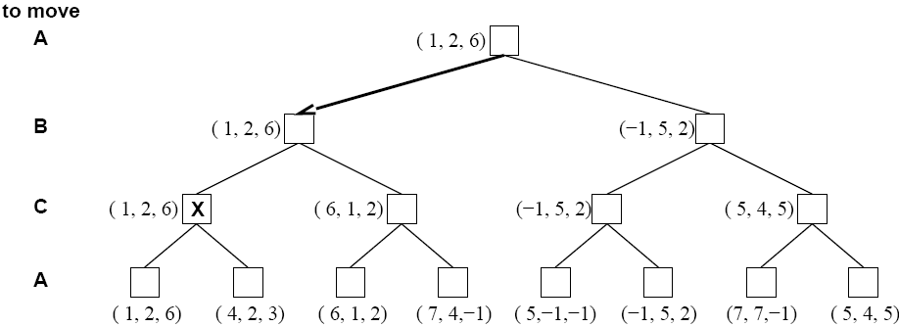
Optimal decisions in multiplayer games

Slide 9

α-β pruning example

Slide 10

α-β pruning example

Slide 11

α-β pruning example

Slide 12

α-β pruning example

Slide 13

α-β pruning example

Slide 14
Properties of α-β
Pruning does not affect final result
Good move ordering improves effectiveness of pruning
With "perfect ordering," time complexity = O(b^{m/2})
  → doubles depth of search

Slide 15

Why is it called α-β?
α is the value of the best (i.e., highest-value) choice found so far at any choice point along the path for max
If v is worse than α, max will avoid it
  → prune that branch
Define β similarly for min

Slide 16

The α-β algorithm

Slide 17

The α-β algorithm

Slide 18
Resource limits
Suppose we have 100 secs, explore 10⁴ nodes/sec
→ 10⁶ nodes per move
Standard approach:
cutoff test:
  e.g., depth limit
evaluation function
  = estimated desirability of position

Slide 19
Evaluation functions
For chess, typically linear weighted sum of features
Eval(s) = w₁ f₁(s) + w₂ f₂(s) + … + w_{n} f_{n}(s)
e.g., w₁ = 9 with
f₁(s) = (number of white chessman) – (number of black chessman), etc.

Slide 20
Cutting off search
MinimaxCutoff is identical to MinimaxValue except
  Terminal? is replaced by Cutoff?
  Utility is replaced by Eval
Does it work in practice?
b^{m} = 10⁶, b=35 → m=4
4-ply lookahead is a hopeless chess player!
  4-ply ≈ human novice
  8-ply ≈ typical PC, human master
  12-ply ≈ Deep Blue, Kasparov

Slide 21
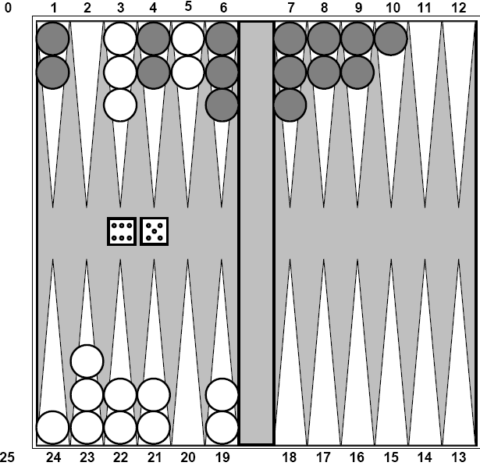
Game that Include an Element of Chance
Backgammon

Slide 22
Expectminmax
Terminal nodes
Max and Min nodes
Exactly the same way as before
Chance nodes
  Evaluated by taking the weighted average of the values resulting from all possible dice rolls

Slide 23
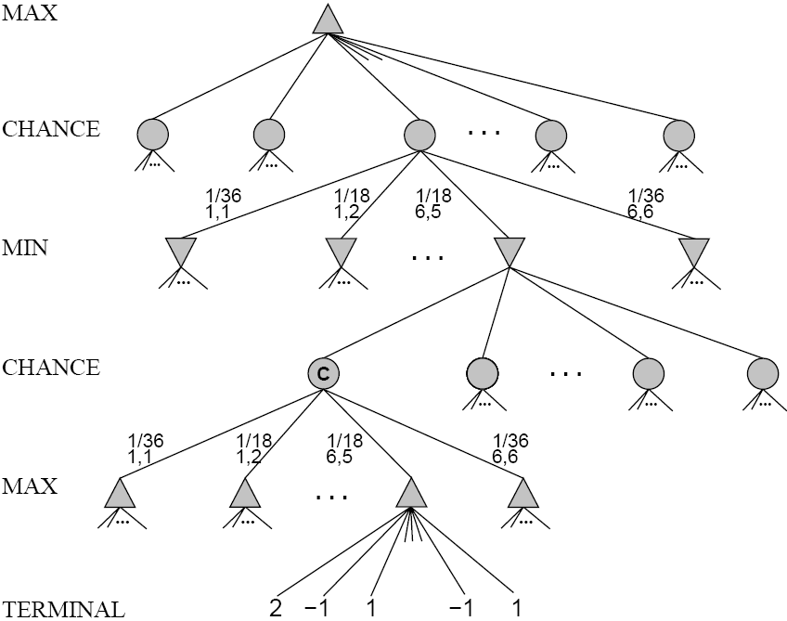
Schematic game tree for a backgammon position

Slide 24
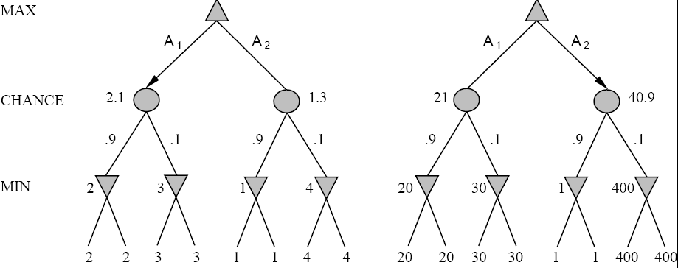
An order-preserving transformation on leaf values changes the best move

Slide 25
Summary
Games are fun to work on!
They illustrate several important points about AI
perfection is unattainable → must approximate

