Slide 1
Hiatus Code Guidebook
Professor Venkatesh
Lauren Toland
Michael Gabriel
Ryan Pittman
Matthew Sirico
Joshua Pam
Daniel De Las Heras

Slide 2
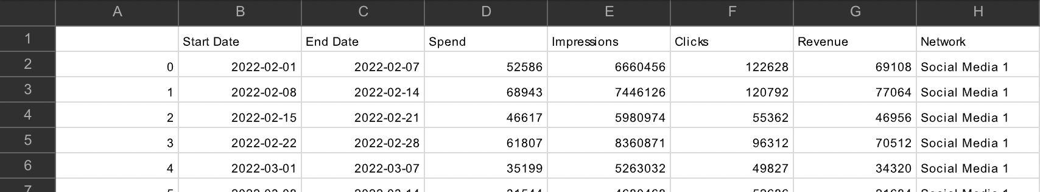
Data Set Format
For the code to work the data set has to take the following format

Slide 3
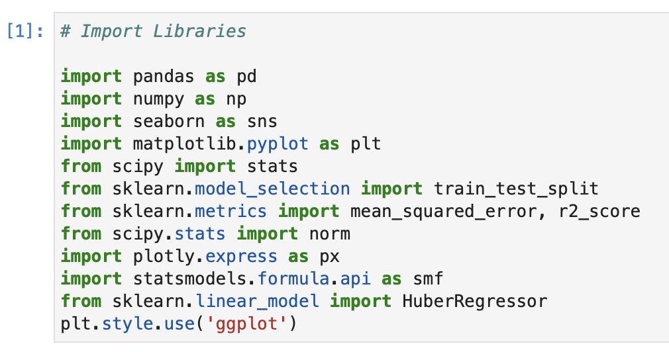
Import Libraries
Prior to running the code, you must import all of the Python Libraries used throughout the code.
Notes:
maybe explain libraries more

Slide 4
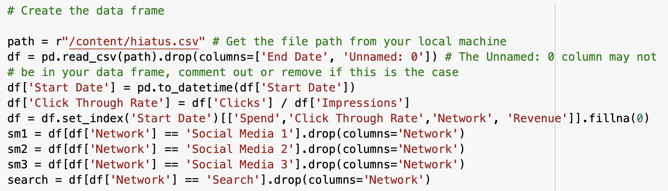
Creating Data Frame
Read the file from your local machine with the “r” command and store it in a variable named “path”. Change the file path to where you saved the csv on your local machine.
Make sure that if you have a column for the end date in your data, you must remove this entire column from your data frame.
Also, there is a column of index values that comes from converting the excel file into a CSV file. This too must be removed. This is done automatically by the code.
Create a column for the Click Through Rate (Clicks/Impressions).
Create separate data frames for each channel.
Notes:
.drop = explain!
needed to replace the string values with 4 binary variables instead
different way to notate which channel we’re using

Slide 5
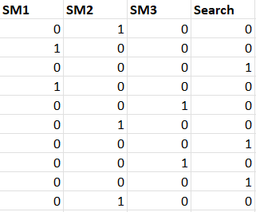
Binary/Categorical Variables Example
Above is an example of how we accounted for categorical variables using binary values.

Slide 6
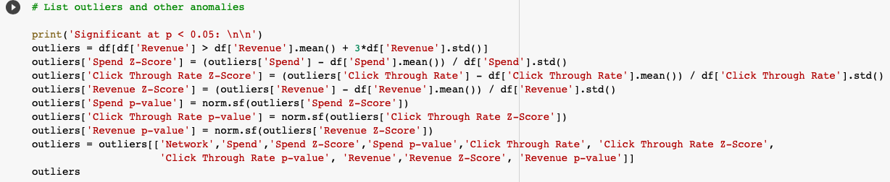
Identifying Outliers
Outliers were determined by considering records where the revenue was more than 3 standard deviations from the mean.
line 2 of the code outlines the 3 standard deviation parameter
Records with a z-score greater than three standard deviation were identified as anomalies and removed.

Slide 7
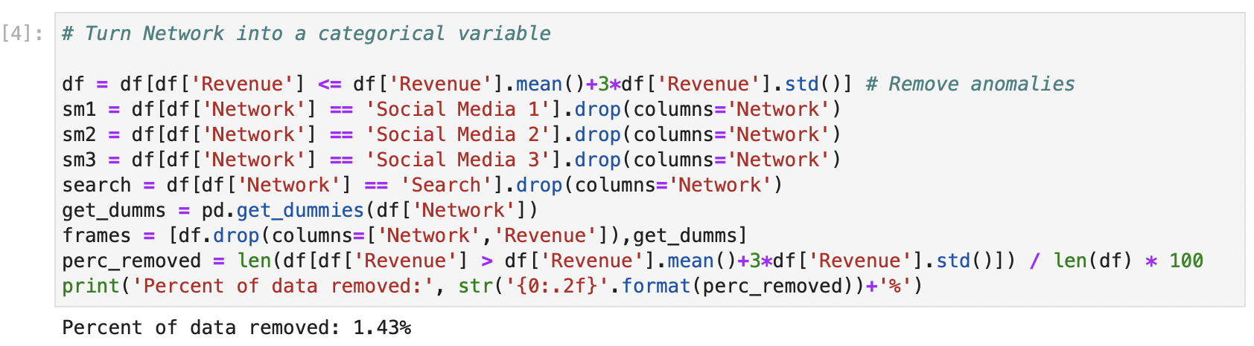
Turn Network Into Categorical Variable
This part of the code breaks the original data frame into sub columns that allow for analysis to be run on independent social media channels.
There are methods within this section to also clean the data and return the amount of data removed.
Note: the number of categories can be expanded upon if Hiatus were to expand marketing onto a new network.

Slide 8
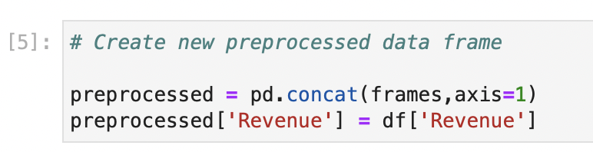
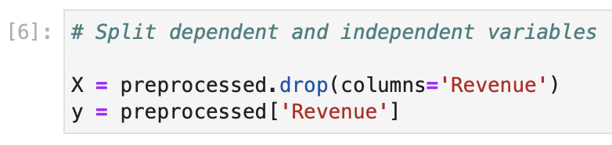
Creating a New Preprocessed Data Frame
The main function of this section regroups the data into a dataframe from the newly cleaned categories.
Split Independent and Dependent Variables
The variables predictor variables (X) and response variable (Y) are assigned their own dataframe feature accordingly.

Slide 9
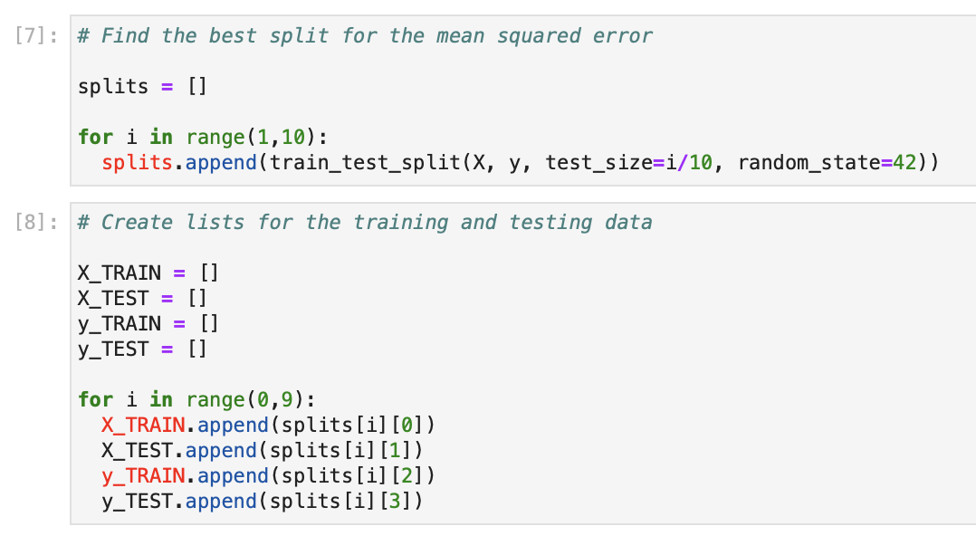
Finding The Best Split for The Mean Squared Error
This step is to determine which proportion of the data is best to use for testing the model.
The minimum MSE is chosen automatically but the code to determine the optimal train/test split for any given dataset.

Slide 10
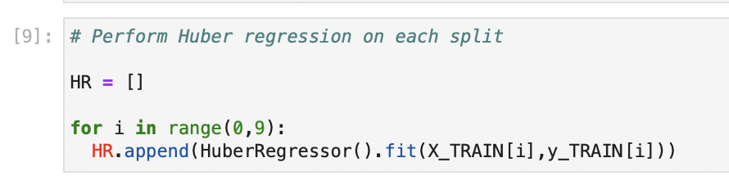
Performing Huber Regression on Each Split
Huber regression appears to be the best regressor for the purposes of this analysis.
This is a regressor that uses L1 and L2 normalization as a piecewise function to minimize the residual terms.
Notes:
What is Huber Regression? What are L1 and L2?

Slide 11
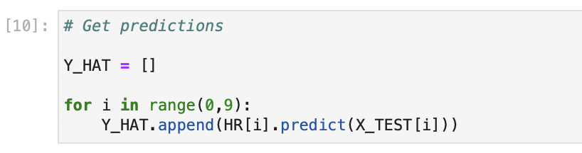
Getting Predictions
Get the predicted values for each testing split.

Slide 12
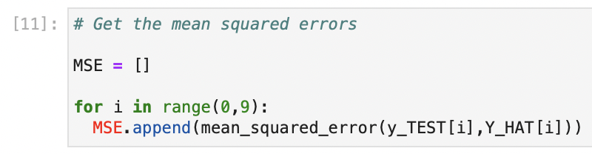
Getting The Mean Squared Errors
Determine which split has the minimum MSE.

Slide 13
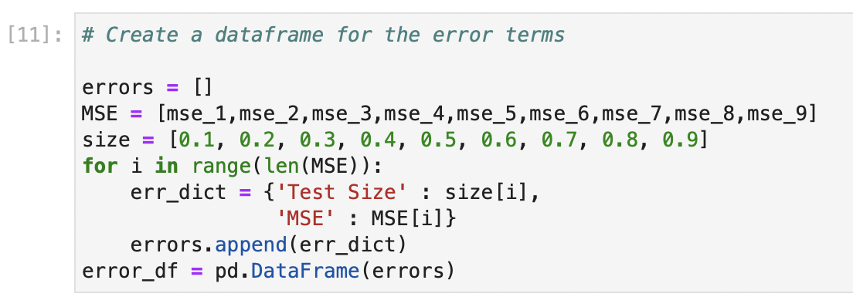
Creating a Dataframe For The Error Terms
Make a dataframe for the error terms used in the plot.

Slide 14
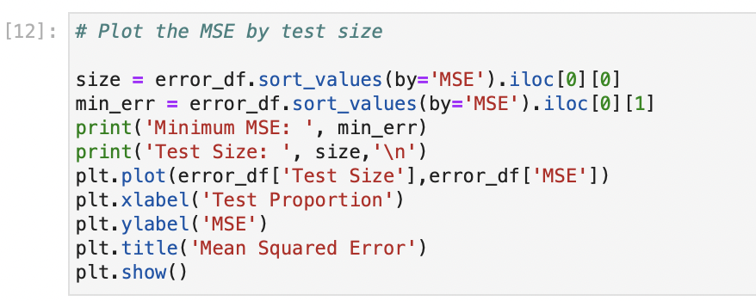
Plotting The Mean Squared Error by Test Size
Plot the error terms by testing size to visualize the ideal train/test split at the given minimum MSE.

Slide 15
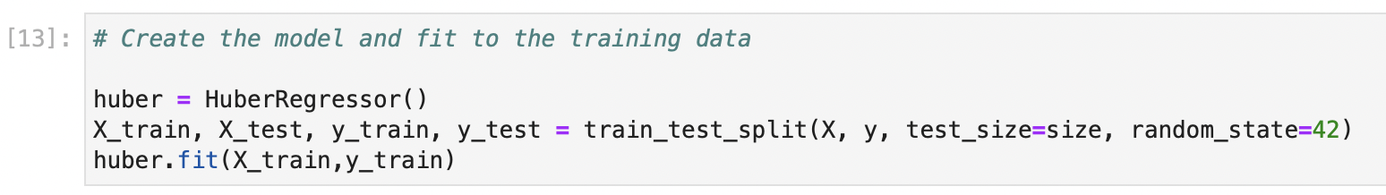
Creating The Model and Fit it to The Training Data
After getting the optimal testing proportion we fit the model to this data.

Slide 16
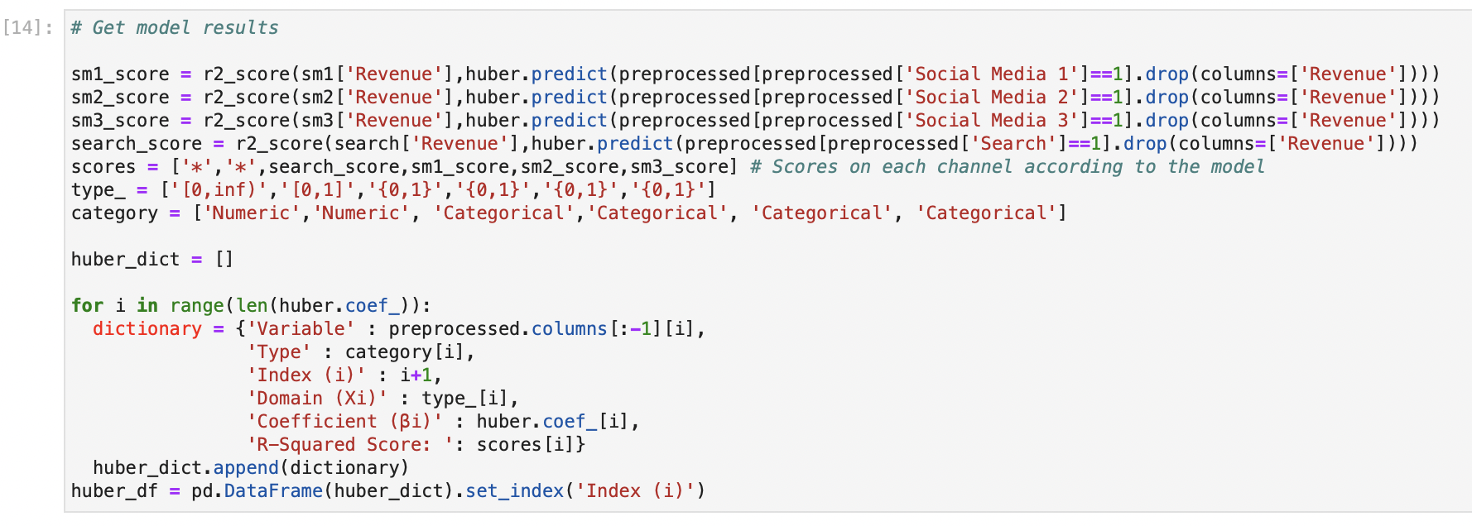
Getting Model Results
Create a dataframe describing the results and parameters for the model.

Slide 17
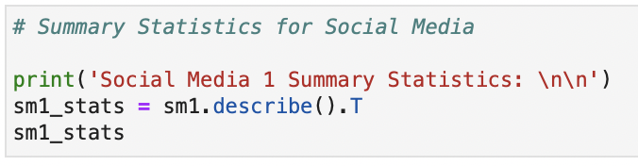
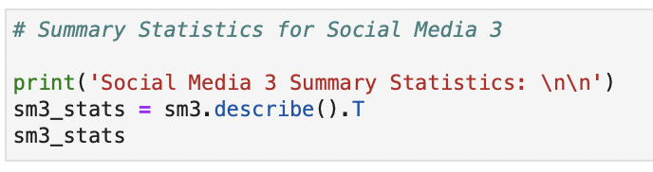
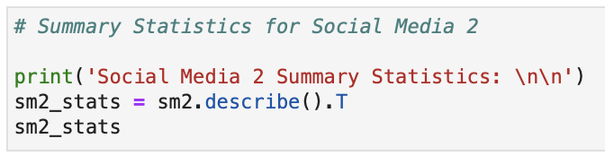
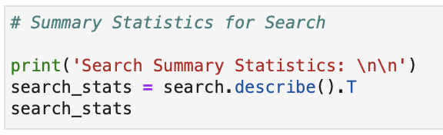
Printing Model Statistics For Social Model 1,2,3 and Search
Use the print function to describe the summary statistics (count, mean, standard deviation, minimum, maximum, interquartile range).
Repeat this individually for each network.

Slide 18
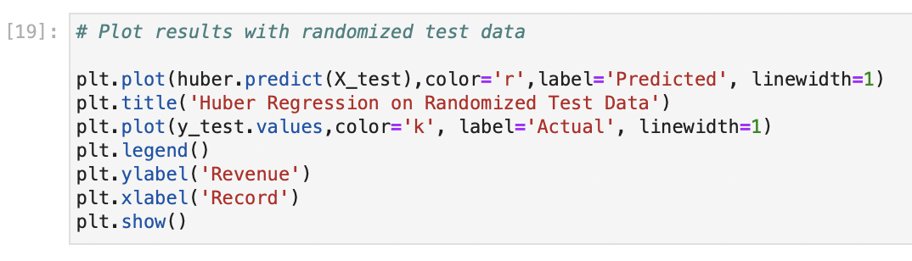
Plotting Results With Randomized Test Data
This step is to visualize how well the model fits the testing data.

Slide 19
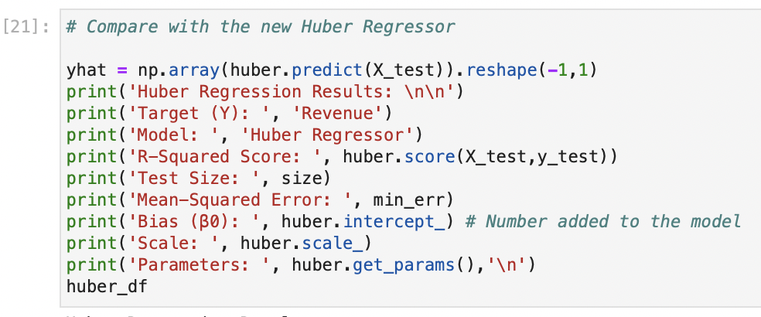
Statistics of The New Huber Regression
The R-squared column describes how much of the variance the model describes for each channel individually.
The domain column describes the range of inputs the model will accept for each dependent variable. The domain will specify what value bounds spend and click through rate can take. The categorical variables associated with the individual channels are binary.
Domain could be 0 to 1 (click through rate-proportion)
Domain could be 0 to infinity (spend)
Domain is range of values that are appropriate, for example spend could not be negative
Notes:
What is domain?
some could be 0 to 1 (click through rate-proportion)
spend could be 0 to infinity
range of values that are appropriate, for example spend could not be negative

Slide 20
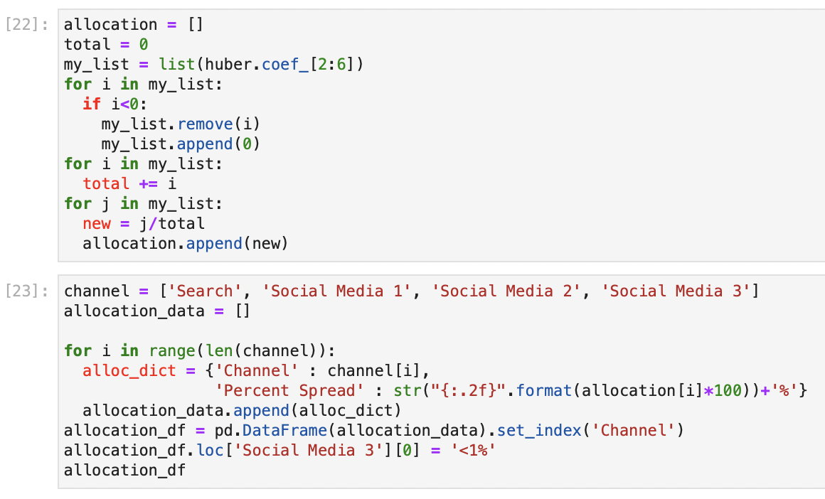
Allocation of The Budget
If we turn the coefficients of the model into a proportion, assuming all other variables remain constant, then this will give the optimal spread for each channel.
These proportions are the percentages of suggested capital allocation for each ad platform.
Notes:
explain the coefficients!
larger coefficients mean more magnitude
bigger is better because it there is a bigger marginal benefit of spending more

Slide 21
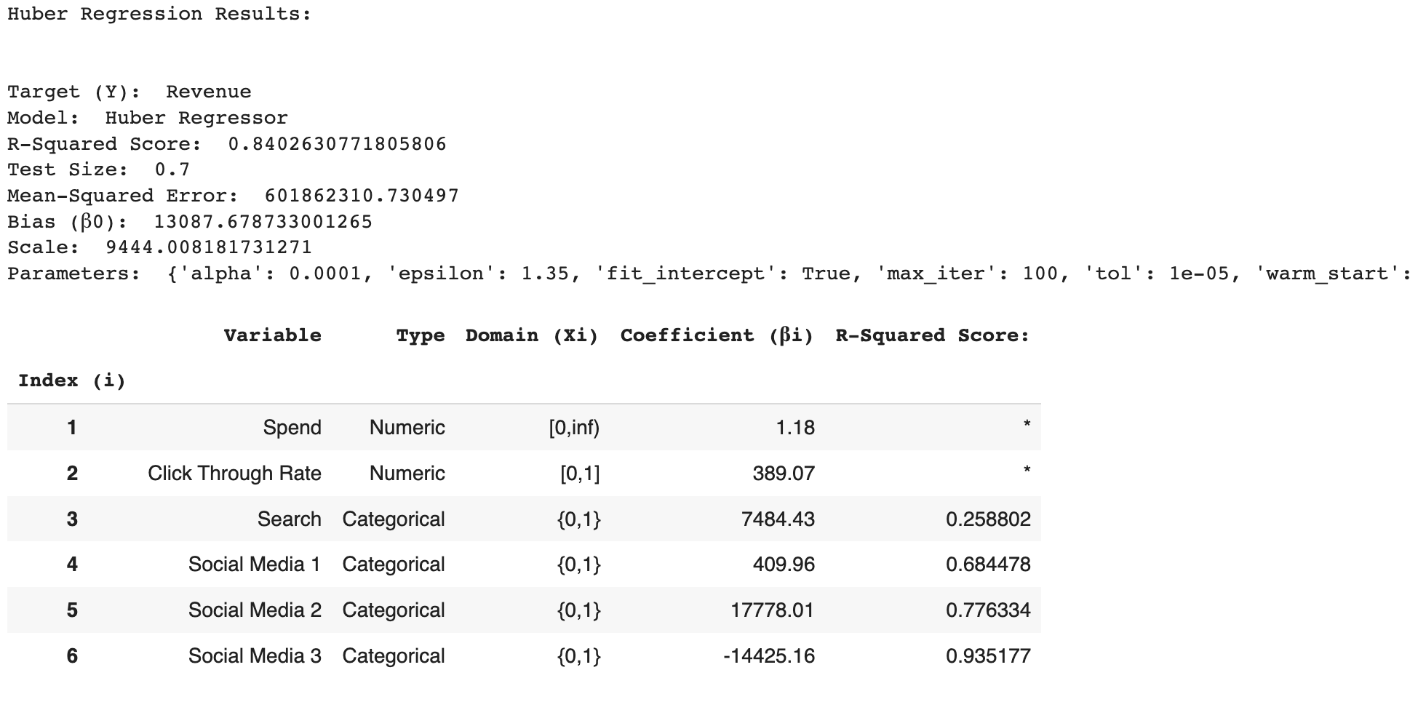
Coefficients
Notes:
explain the coefficients!
larger coefficients mean more magnitude
bigger is better because it there is a bigger marginal benefit of spending more

Slide 22
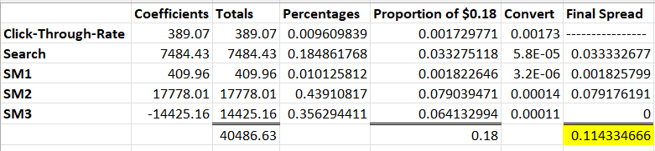
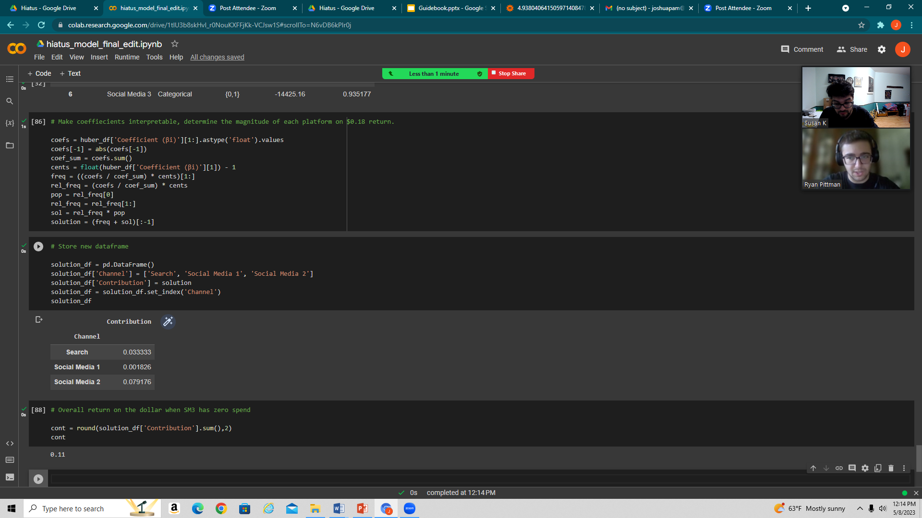
Coefficients
Notes:
Take the coefficients and find their absolute value.
Calculate the sum of all five coefficients and divide each one by this sum to calculate their relative proportions.
Multiply these relative proportions by the return per unit spend to find the magnitude of each platforms’ contribution to the overall return.
Evenly distribute the effect of the click-through rate coefficient among the media platforms by multiplying the click-through rate’s contribution by the relative proportions of the respective platforms.
“Zero out” the contribution of SM3 since its coefficient is negative and calculate the sum of all the contributions.

Slide 23
Coefficients
Notes:
This sum represents the overall return when one or more coefficients are negative since minimal spend will be provided to that platform.

