Slide 1
SMAP & MSL Telemetry Anomaly Detection
An Unsupervised Approach to Spacecraft
Health Monitoring
Daniela Chaves Acuña
Course: Foundation of Intelligent Systems Algorithms
Instructor: Zubia Khan
Date: 10.07.2025

Slide 2
TABLE OF CONTENTS
01
02
03
04
Problem Statement
METHODOLOGY
RESULTS ANALYSIS
CONCLUSIONS

Slide 3
Problem Statement
Spacecraft constantly send vast telemetry data. But manually finding subtle anomalies is impossible. We need to automatically detect deviations from normal behavior to ensure mission success.

Slide 4
Why this problem?
Real-world relevance
Decision-Making
Personal
Critical for preventing costly failures in space missions (e.g., SMAP satellite, MSL Curiosity rover).
Early detection allows engineers to make timely, life-saving decisions for spacecraft.
My passion for space drives me to apply AI to protect these incredible machines.

Slide 5
Dataset Overview: NASA's Vital Signs

Slide 6
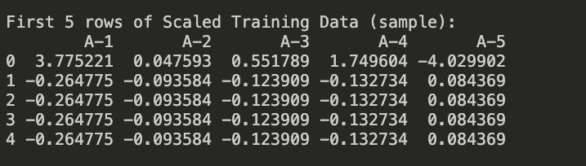
Source:
NASA SMAP & MSL Telemetry Anomaly Detection Dataset: https://www.kaggle.com/datasets/patrickfleith/nasa-anomaly-detection-dataset-smap-msl
Raw telemetry in individual .npy files for 82 sensor channels, downloaded from the telemanom GitHub repository.
Data Structure:
Size: Training data (~7,800 time points), Test data (~36,850 time points). Each has 82 numerical telemetry channels (e.g., A-1, B-2). No missing values.
Channels: Mix of SMAP (55 channels, 429,735 values) and MSL (27 channels, 66,709 values).

Slide 7
METHODOLOGY
Data Processing
Model Building
Loaded all 82 channels, stacked them into time-series arrays.
K-Means Clustering (unsupervised).
Anomaly Detection
Results & Analysis
Distance-based anomaly scoring.
Python, Scikit-learn (KMeans, StandardScaler, PCA), Matplotlib, Seaborn.

Slide 8
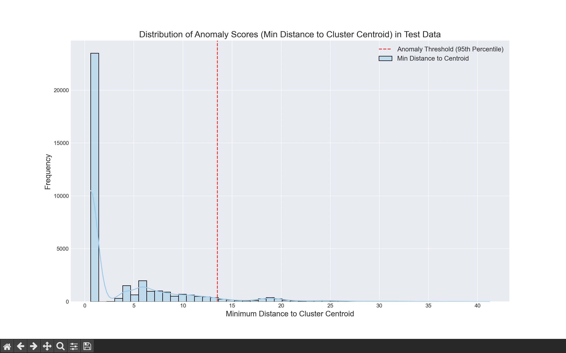
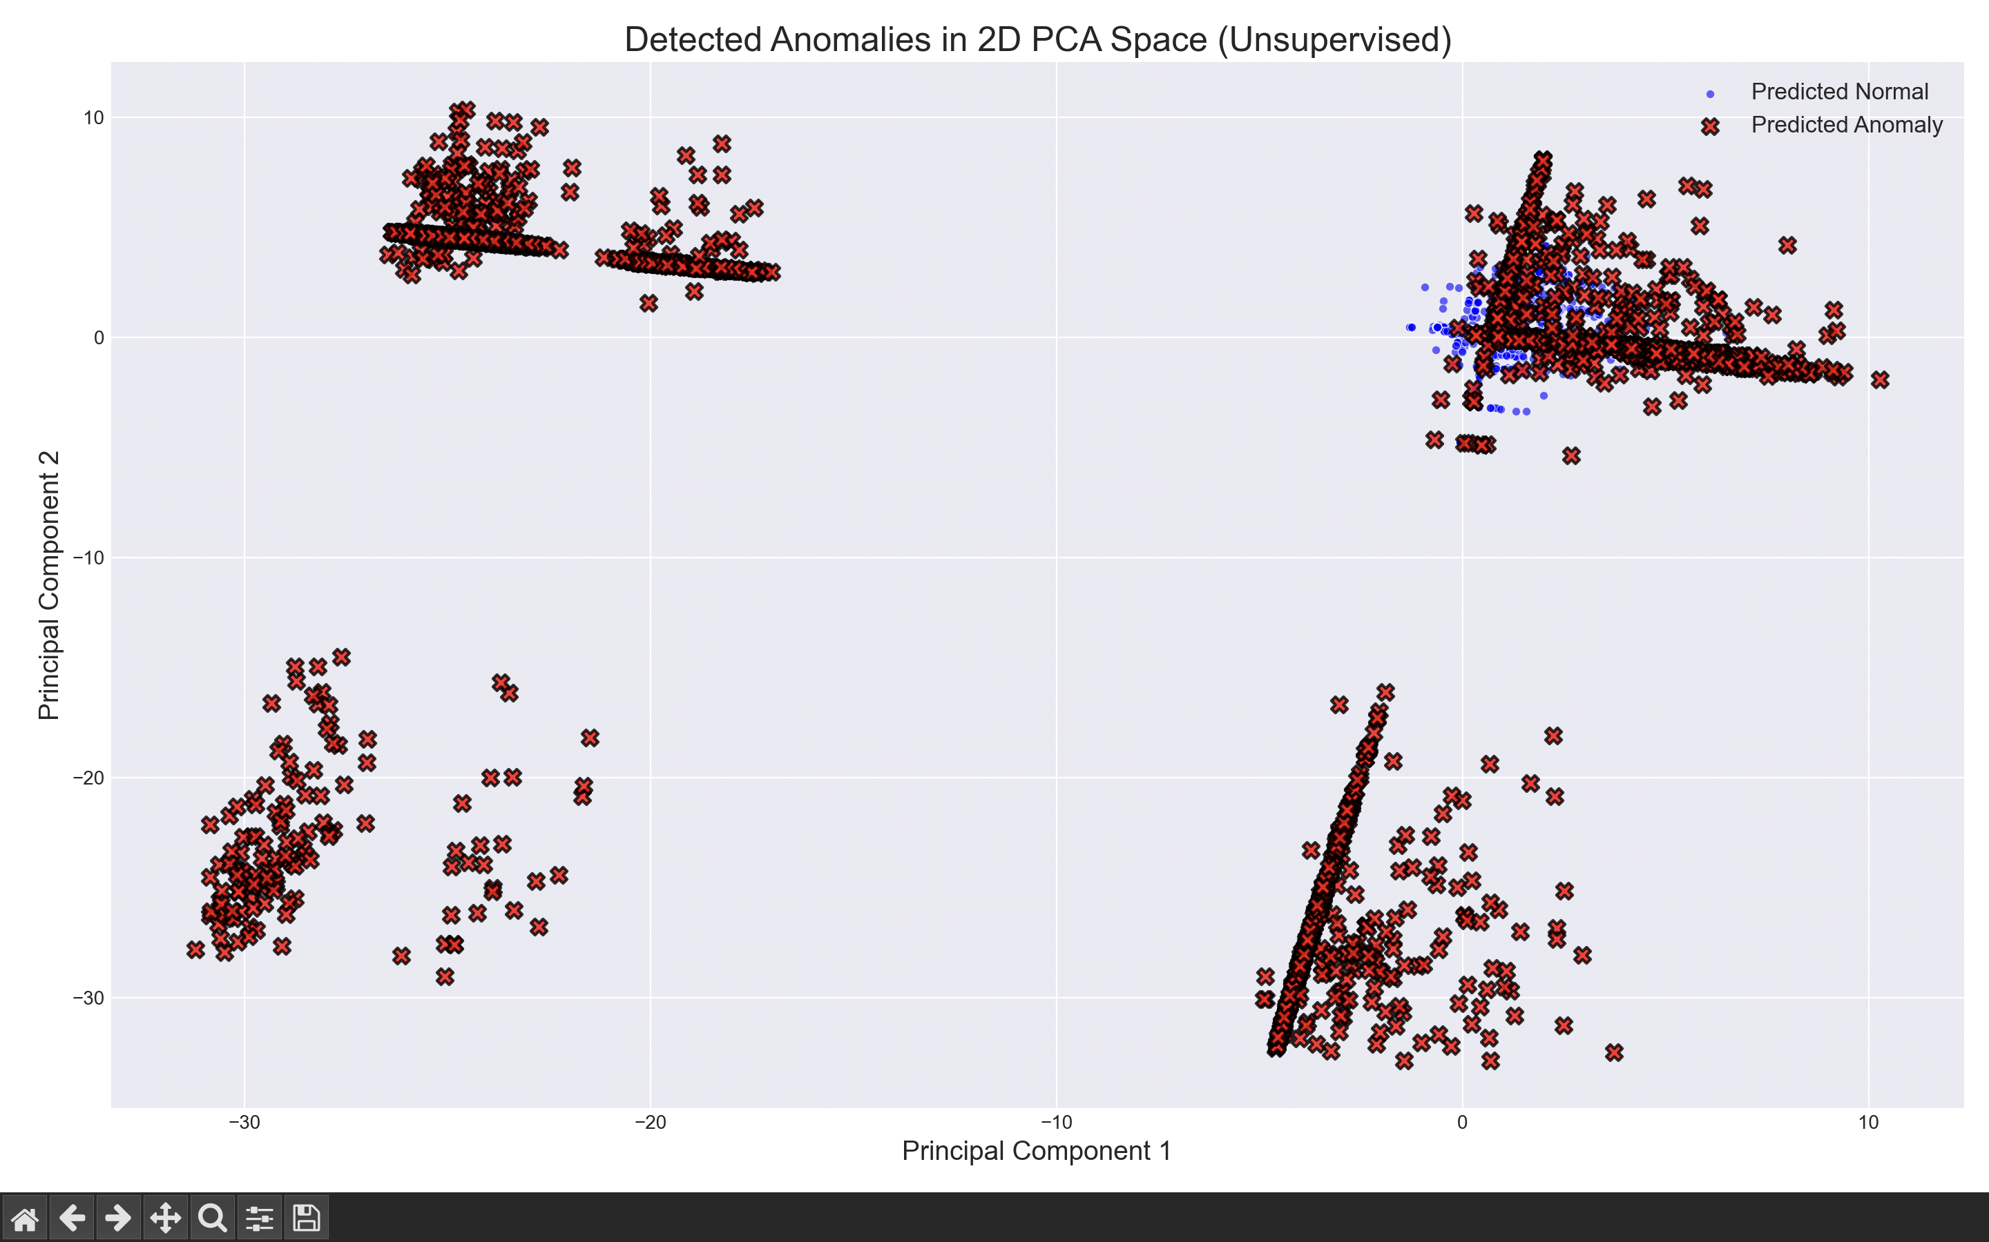
Results & Analysis
Final Output:
Detected 2,774 anomalies in the test set.
This represents 7.53% of the total test data points.
Key Visualizations:
Anomaly Score Distribution:
Detected Anomalies in 2D PCA Space:
Justification for Decision Making:
Actionable Intelligence: This system provides an automated filter, flagging the most statistically unusual telemetry readings. Mission control can then focus their limited expert resources on these ~7.5% of data points, rather than sifting through all data.
Proactive Intervention: Identifying these deviations can lead to early diagnosis of potential issues, enabling proactive adjustments or maintenance to prevent major spacecraft malfunctions. This directly supports critical operational and strategic decisions.

Slide 9
Challenges and Solutions
Challenges
Solutions
Absence of Ground Truth Labels.
High-Dimensional Data (82 channels)
Optimal K Determination
Unsupervised Evaluation
PCA (Dimensionality Reduction)
Elbow Method
Feature Scaling

Slide 10
Conclusion and Future Work
Summary
Successfully demonstrated an unsupervised K-Means anomaly detection system for SMAP & MSL telemetry, effectively flagging unusual spacecraft behavior.
Future Enhancements
Differentiate Anomalies by Spacecraft: Use labeled_anomalies.csv to map channels back to SMAP/MSL.

Slide 11
THANKS!
Do you have any questions?
My GitHub link: https://github.com/danii-07/spacecraft-anomaly-detection.git

