Slide 1
Prepare for the Catboost Workshop
Download the notebooks:
https://github.com/daniiarabdiev/catboost-kaggle
Install the libraries:
pip install catboost ipywidgets sklearn
jupyter nbextension enable --py widgetsnbextension

Slide 2

Gradient Boosting Library for categorical data
Notes:
CatBoost – алгоритм машинного обучения на основе градиентного бустинга

Slide 3
Plan
Intro to Catboost and benchmarks
Coding Sample

Slide 4
Several tree growing strategies
Height > 170
Height > 170
Weight > 65
Weight > 65
Weight > 65
Age > 16

Slide 5
Categorical features support
One-hot encoding
Statistics based on category and category plus label value
Usage of several permutations
Greedy constructed feature combinations
SDE
1
SDE
1
SDE
0
PR
i
SDE
1
PR

Slide 6
Modes
Classification
Regression
Ranking

Slide 7



Neural networks
Images
Sound
Text
Notes:
Нейросети – это действительно очень круто.
Они прекрасно решают определенные задачи – например, те, где нужно работать с однородными данными - к
А еще это, как правило, такие задачи, которые традиционно делает человек – классифицирует картинки, переводит звук в текст, а текст на другой язык.
Когда то же самое делает машина, это впечатляет.

Slide 8
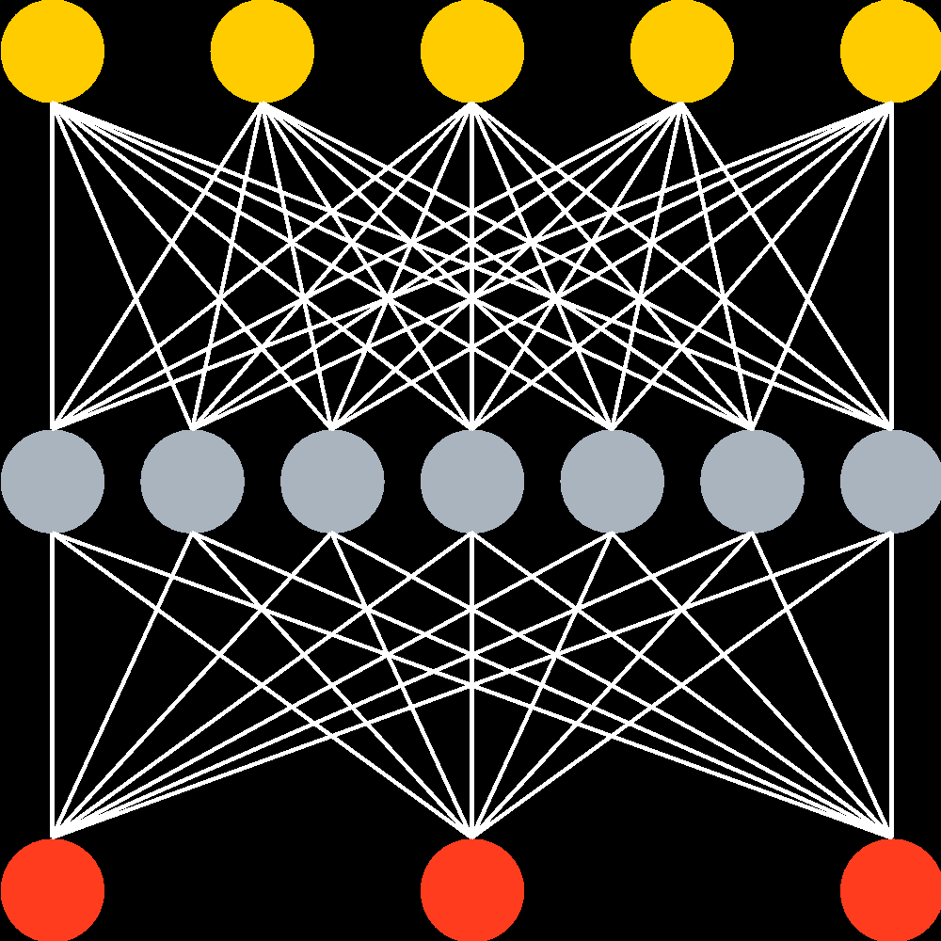
NN + GB
Neural networks
Gradient boosting

Slide 9
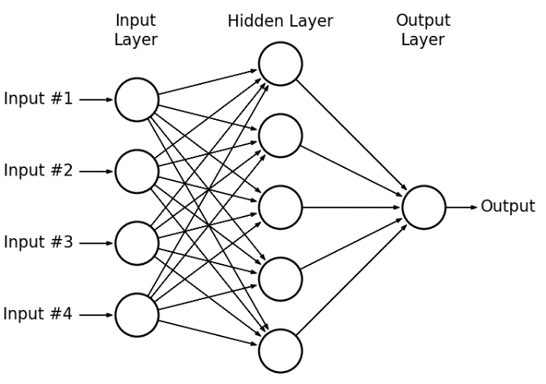
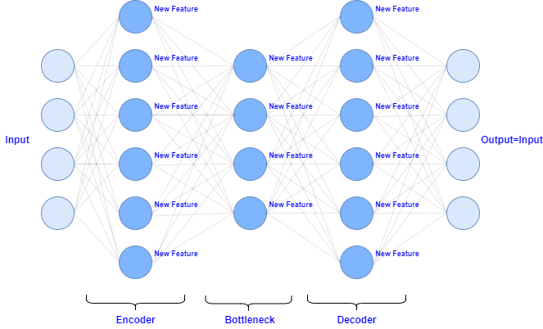
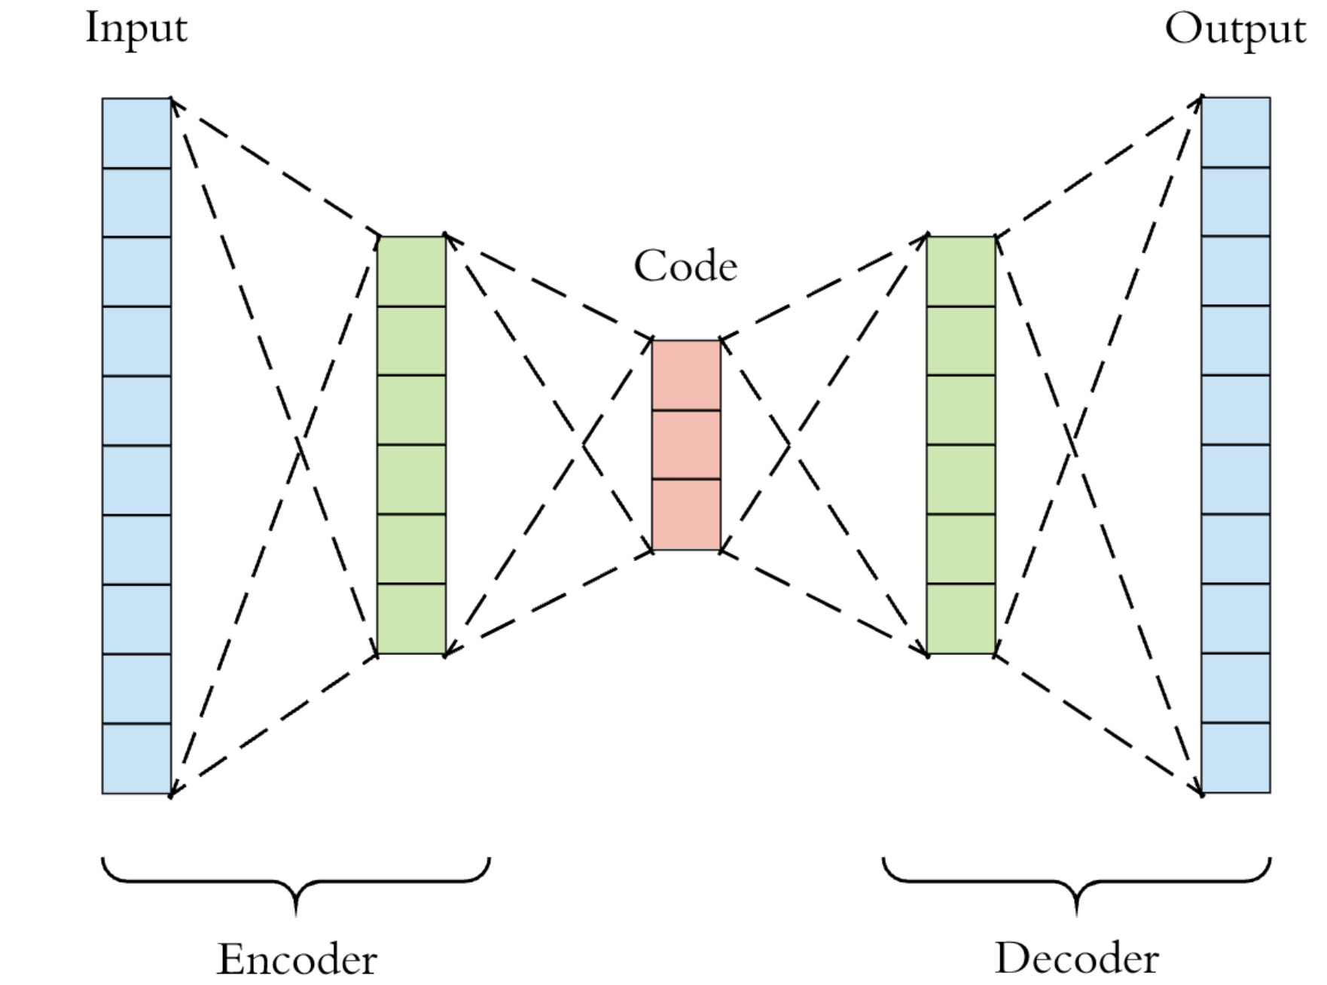
NN + GB

Slide 10
CatBoost advantages
Good quality with default parameters (Default number of trees, automatic best model usage, adaptive learning rate setting)
Sophisticated categorical features support (Similar to target encoding but with solved overfitting issue)
Model analysis tools (SHAP values, Feature Statistics)

Slide 11
Algorithm comparison
 | CatBoost | LightGBM |  | XGBoost |  | H2O
Adult | 0.269741 | 0.276018 | + 2.33 % | 0.275423 | + 2.11% | 0.275104 | + 1.99%
Amazon | 0.137720 | 0.163600 | + 18.79 % | 0.163271 | + 18.55% | 0.162641 | + 18.09%
Appet | 0.071511 | 0.071795 | + 0.40 % | 0.071760 | + 0.35% | 0.072457 | + 1.32%
Click | 0.390902 | 0.396328 | + 1.39 % | 0.396242 | + 1.37% | 0.397595 | + 1.71%
Internet | 0.208748 | 0.223154 | + 6.90 % | 0.225323 | + 7.94% | 0.222091 | + 6.39%
Kdd98 | 0.194668 | 0.195759 | + 0.56 % | 0.195677 | + 0.52% | 0.195395 | + 0.37%
Kddchurn | 0.231289 | 0.232049 | + 0.33 % | 0.233123 | + 0.79% | 0.232752 | + 0.63%
Kick | 0.284793 | 0.295660 | + 3.82 % | 0.294647 | + 3.46% | 0.294814 | + 3.52%
Notes:
www. github.yandex-team.ru/exprmntr/catboost/tree/master/benchmarks
Loglikelihood (логарифм правдоподобия)

Slide 12
Speed
Training on CPU
Training on GPU
Prediction speed

Slide 13
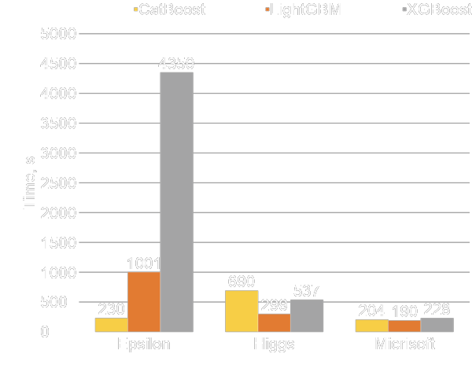
CPU: Comparison with other libraries
Parameters: 1000 iterations
Epsilon: 2k features, 400k objects
Higgs: 28 features, 11kk objects
Microsoft: 136 features, 1kk objects
CPU: Intel® Xeon® E5-2660 v4

Slide 14
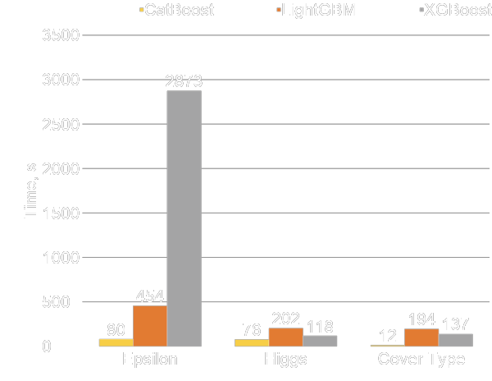
GPU: Comparison with other libraries
Parameters: 1000 iterations
Epsilon: 2k features, 400k objects
Higgs: 28 features, 11kk objects
Cover Type: 54 features, 523k objects
GPU: GTX1080Ti

Slide 15
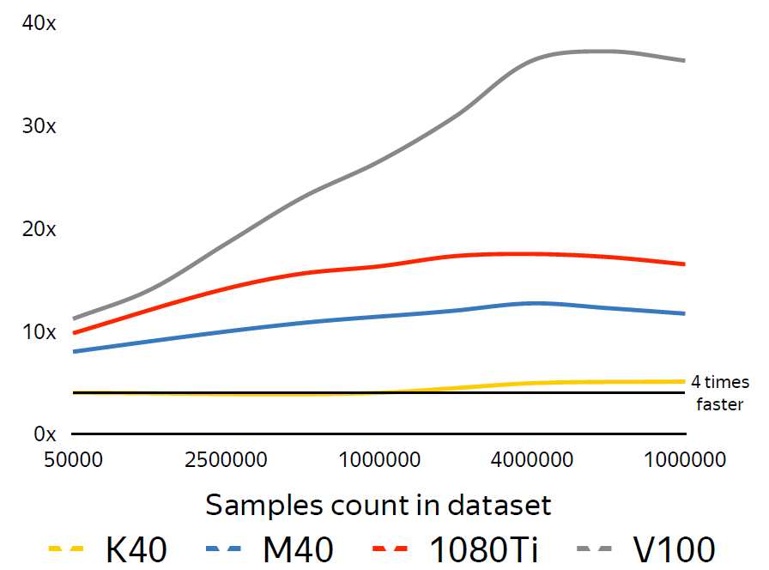
CPU vs GPU
Dual-Socket Intel Xeon E5-2660v4 as baseline
Several modern GPU as competitors
Dataset: 800 features

Slide 16
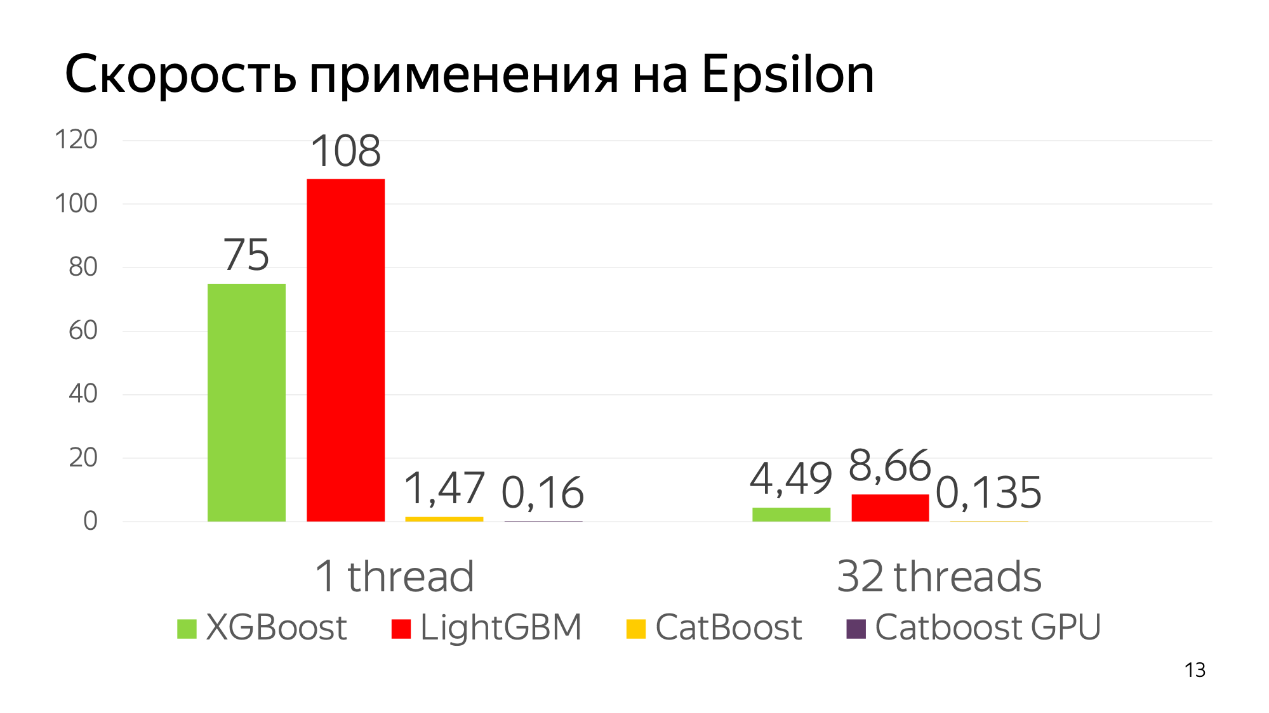
Prediction time

Slide 17
Feature importance
Traditional Feature importance
Feature interaction
Permutation Importance
Per object feature importance (SHAP)

Slide 18
Q&A

