Slide 1

www.CopyCat.com
Luke Doleman
Daniil
Shumko

Slide 2

User Persona 1 – Michael Scott
User – Manager of small paper company
Bio: Middle aged. Single. Childish.
Goal/Needs: Browse through funny pictures to kill time until the next conference room meeting.
Temperament: Short attention span. Limited computer skills. Hopes to view images quickly and easily without having to sign on/up anywhere. Basic sense of humour.

Slide 3
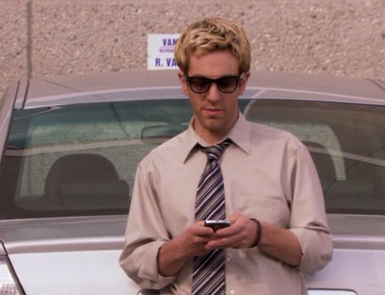
User Persona 2 – Ryan Howard
Developer – Employee of paper company by day. Main developer of WUPHF.com by night.
Bio: Early twenties. In a relationship. Pretentious hipster.
Goal/Needs: Host images to use with his own site (using simple developer API). Requires continual social media integration to be continually updating others and achieve social validation.
Temperament: Angers quickly. Computer skills to some extent. Hopes to host images quickly and easily without having to sign on/up anywhere. Too cool for mainstream sites(imgur.com).

Slide 4
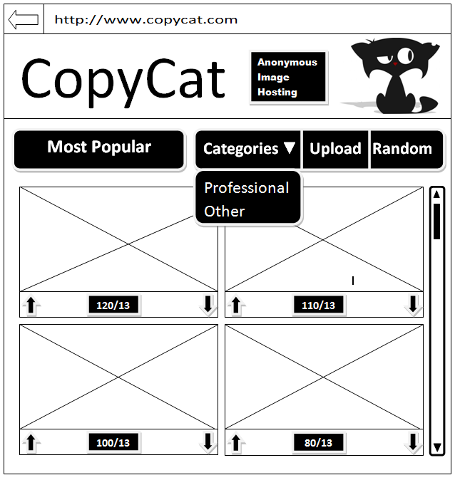
Wireframe – Main Page

Slide 5
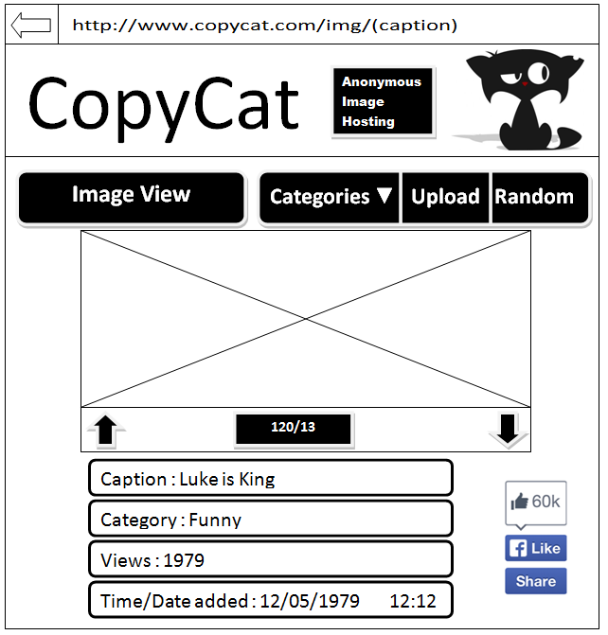
Wireframe – Image view

Slide 6
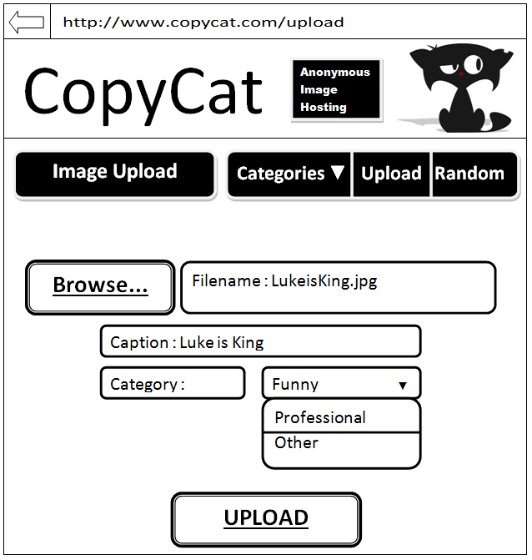
Wireframe – Upload

Slide 7
Main Objectives
Host images
Up Vote and Down Vote images
Categories
View most Up/Down voted images
View most recent images
View most popular images
View random image
Social network integration
Developer API

Slide 8
Main Specification/Functionality
Easily host images on the website
Accept images in .jpg or .png format
10MB max image size
Ability to add caption to the image
Ability to choose a category
Share images on Facebook(and maybe other social network sites)
Ability to share on Facebook any image hosted on the website
Up Vote and Down Vote images
Every image can be Up Voted or Down Voted by the users/viewers

Slide 9
Main Specification/Functionality
Display images by categories
Three categories must be added to the website:
Funny
Professional
Other
Also should include ability to view Most Up Voted, Most Down Voted and Most Recent images
Random image
Image view
Every image can be viewed by clicking on it on the website which will take the user to a different page and show the image in larger size
Show image caption, category, number of views and time/date added
Also should have a button to Like/Share on Facebook
Developers API
An API for developer to easily host images on our website
A JSON response with the status and image information(name, caption, upload date, URL)

Slide 10
Stand out features
Easy and simple image hosting
No registration required
Up Vote and Down Vote images
Social network integration
Random image view
API
NO ADS ☺
yet

Slide 11
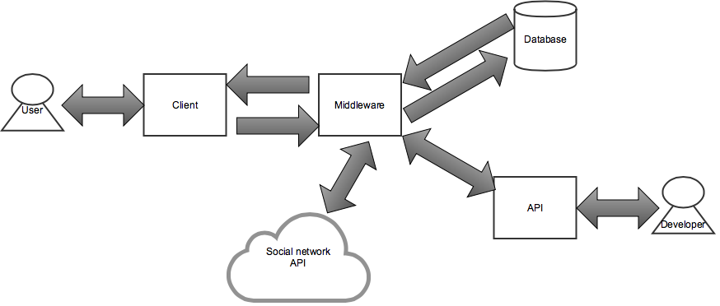
High Level System Architecture

Slide 12
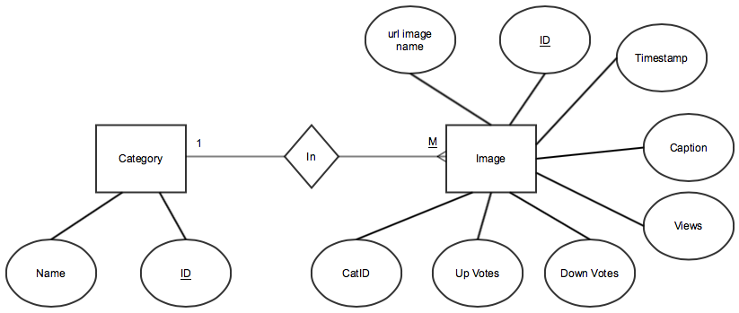
ERD

Slide 13
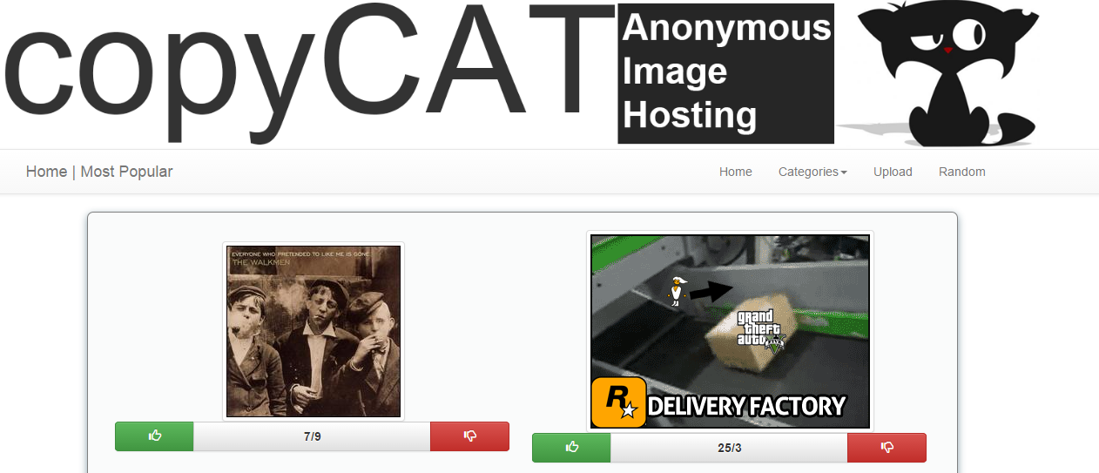
Final Design – Main Page

Slide 14
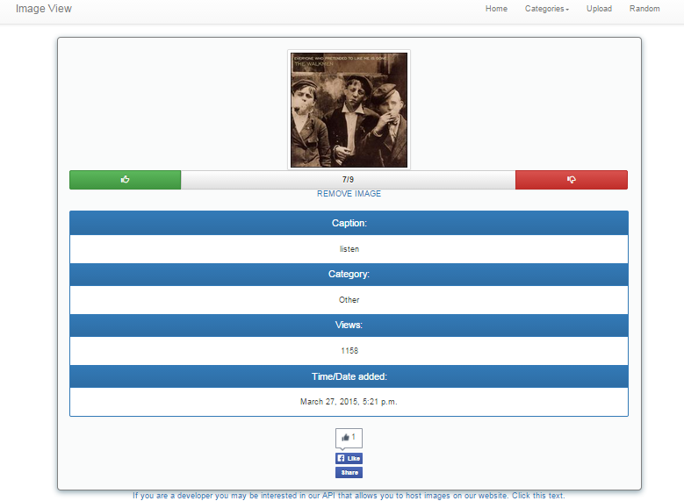
Final Design – Image View (Includes ‘REMOVE IMAGE’ feature as user is logged in as admin)

Slide 15
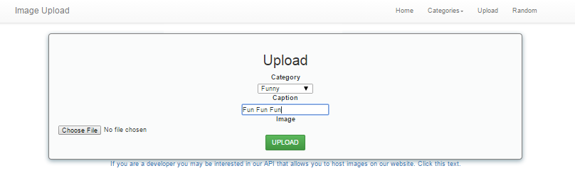
Final Design – Upload View

Slide 16
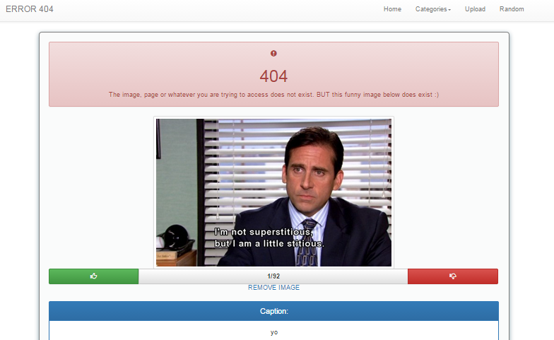
Final Design – 404 Page

Slide 17
Final Design – URL Mapping
http://copycatd7.pythonanywhere.com/image_hosting/ - Main
http://copycatd7.pythonanywhere.com/image_hosting/upload/ - Upload
http://copycatd7.pythonanywhere.com/image_hosting/image_view/images/<your image>.jpg –Image View
http://copycatd7.pythonanywhere.com/image_hosting/professional/ - Category (Professional)
http://copycatd7.pythonanywhere.com/image_hosting/funny/ - Category (Funny)
http://copycatd7.pythonanywhere.com/image_hosting/other/ - Category (Other)
http://copycatd7.pythonanywhere.com/image_hosting/most_recent/ - Category (Most Recent)
http://copycatd7.pythonanywhere.com/image_hosting/most_up_voted/ - Category (Up voted)
http://copycatd7.pythonanywhere.com/image_hosting/most_down_voted/ - Category (Down voted)
http://copycatd7.pythonanywhere.com/image_hosting/random/ - Random
http://copycatd7.pythonanywhere.com/image_hosting/api/ - API Access
http://copycatd7.pythonanywhere.com/image_hosting/test/ - API test

