Slide 1
kmerTaxonomyFF
(private repo)
Link: https://github.com/BiodataAnalysisGroup/kmerTaxonomyFF/tree/main

Slide 2
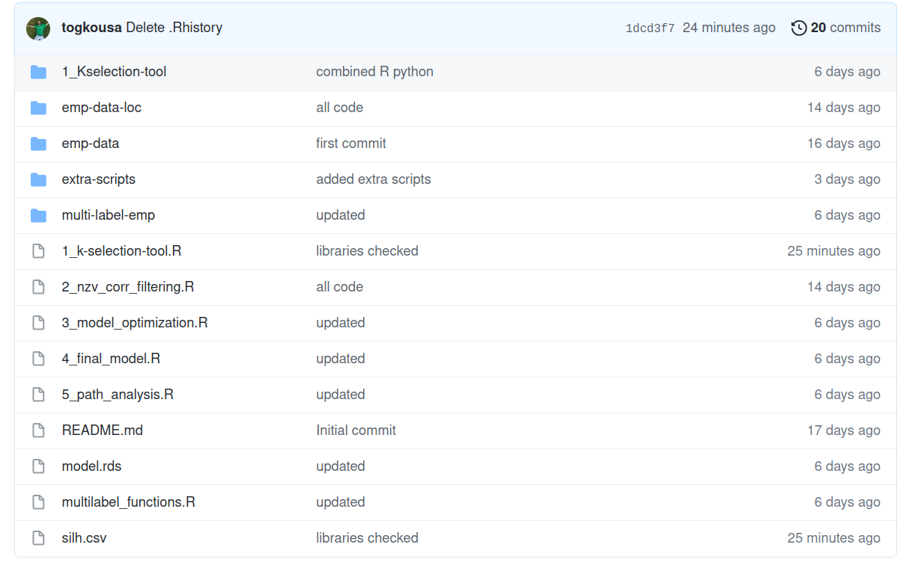
Overview
K-selection-tool: old, python version
data
workflow scripts
model
functions script
stored silhouette scores

Slide 3
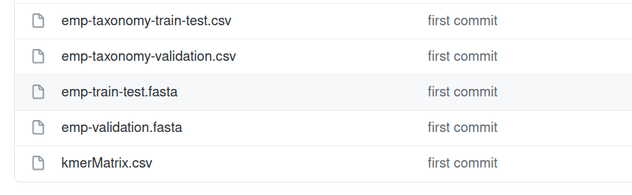
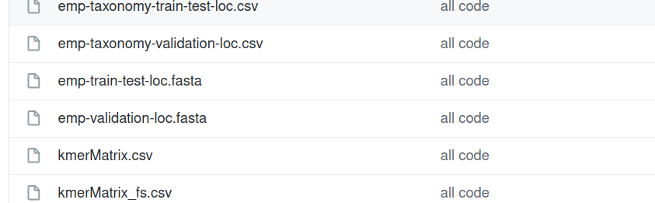
Data
emp-data:
train-test data (30%)
~ 27.000 sequences
validation data (70%)
~ 60.000 sequences
emp-data-loc:
Subsample for local usage
added ‘-loc’ suffix to filenames

Slide 4
Workflow Scripts
1_k-selection-tool.R: calculates the silhouette scores and stores them in ‘silh.csv’ file. The code for the analysis of these scores need to be implemented.
2_nzv_corr_filtering.R: Unsupervised feature selection
3_model_optimization.R: Grid search, finds the optimal parameters
4_final_model.R: Model construction with the optimal parameters, validation, save model to ‘model.rds’ file
5_path_analysis.R: String that maps k-mers to paths, not implemented yet, needs to be discussed
supplamentary material
multilabel_functions.R: includes necessary functions for steps 3 and 4.

Slide 5
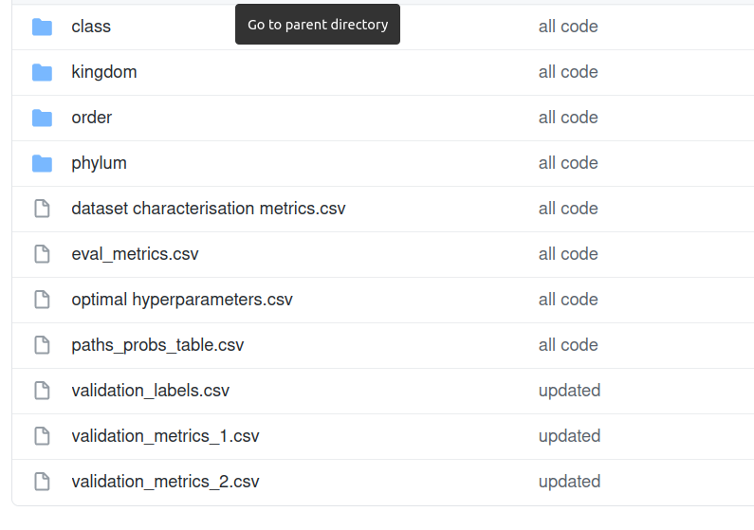
‘Multi-label-emp’ folder
kmer importances for each label
dataset description
metrics (av. acc, avv F1, etc) in train-test
procedure
optimal hyperparameters
metrics in validation phase

Slide 6
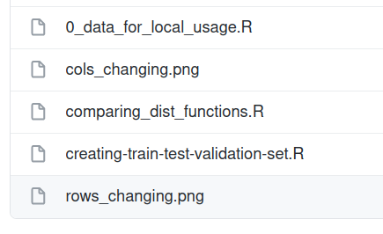
‘extra-scripts’ folder
script that creates the ‘-loc’ suffix data
script that compares various ‘distance’ functions
and creates tha .png files
script that splits data to tain-test and val. set

