Slide 1
annotated data analysis
group 1

Slide 2
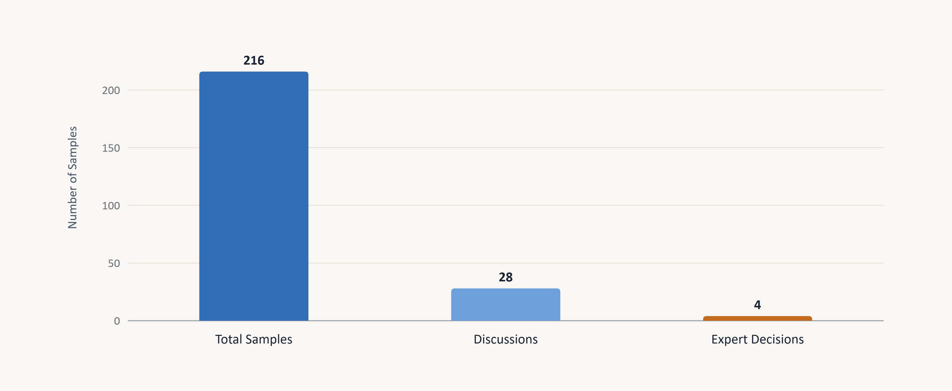
Annotation Workflow Overview

Slide 3
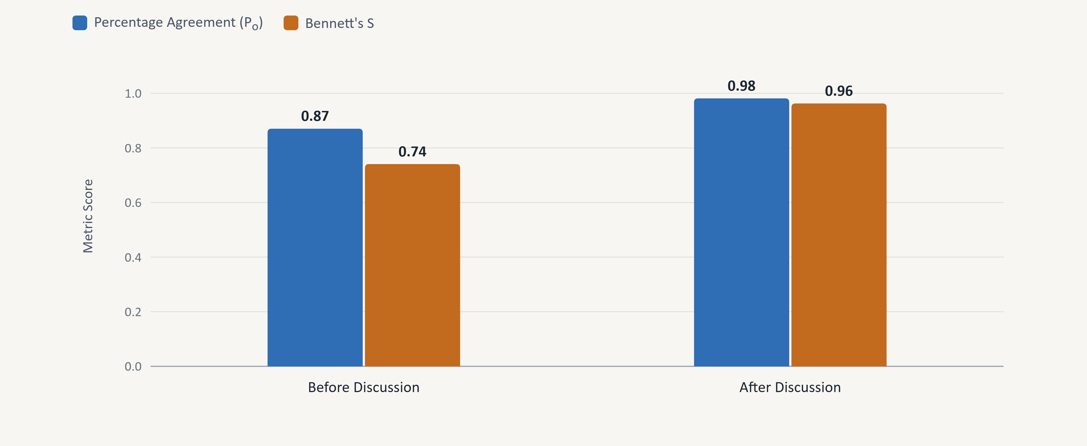
Inter-Annotator Agreement: PA vs. Bennett's S

Slide 4
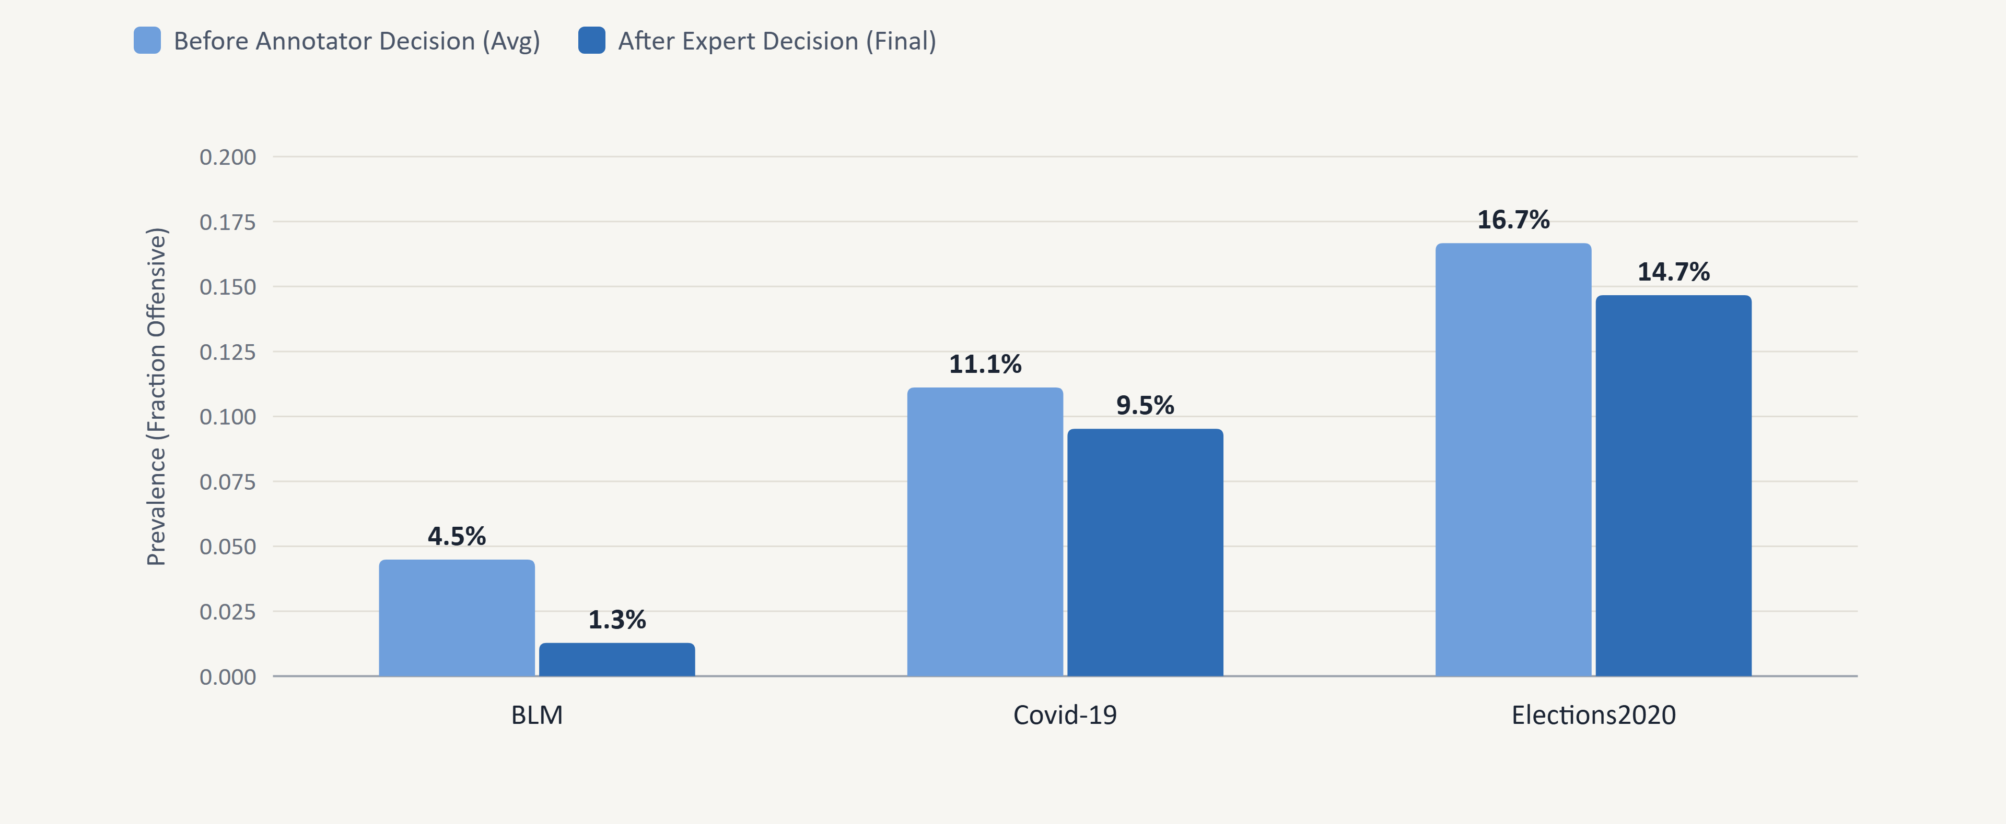
Offensiveness Prevalence by Topic

Slide 5
92% agreement with the original labels
AGREEMENT WITH ORIGINAL ANNOTATION
91.7%
0.90
0.50
Percentage agreement (198 of 216)
Gwet's AC1 (baseline: 0.89)
Cohen's κ, for reference
Ours vs. original (n = 216)
By topic
 | Orig. off. | Orig. not
Ours off. | 11 | 7
Ours not | 11 | 187
Topic | Agree. | AC1 | Off. ours | Off. orig.
Covid-19 | 92.1% | 0.90 | 6 / 63 | 7 / 63
BLM | 93.6% | 0.93 | 1 / 78 | 6 / 78
Elections | 89.3% | 0.86 | 11 / 75 | 9 / 75
We found only 11 of the 22 tweets the original marks as offensive.
Prevalence: ours 8.3%, original 10.2%. We under-label BLM and over-label Elections.

Slide 6
BLM: we found only 1 of the 6 offensive tweets
WHY WE DEVIATE ON BLM
The 5 tweets we missed (original: offensive)
6
1
5
#230 · batch 3
both: not offensive
"The hits just keep coming...what a turd."
offensive in the original
found by us (#549)
missed – all with vulgar language
#239 · batch 3
both: not offensive
"You don't give a fuck about George Floyd bro, stop fucking acting like you care."
1
Shared blind spot
4 of the 5 were "not offensive" for both of us, so they were never discussed. With only two annotators, one shared slip is enough – e.g. #575: I overlooked what "MF" means.
#503 · batch 6
both: not offensive
"THAT MAN KNEW EXACTLY WTF HE WAS DOING! […] FUCK YOUR 'THIRD DEGREE'"
#575 · batch 7
both: not offensive
2
Discussions ended lenient
"[…] this MF will get off because of stupidity. Crap, here comes another riot oh I mean protest."
All 5 BLM discussions ended "not offensive" (Covid-19: 3 of 8, Elections: 6 of 15 ended offensive).
#499 · batch 6
discussed → not offensive
3
The codebook leans lenient on BLM
"Look at this! Scum #londonriots #londonprotests"
4 of its 5 BLM examples are "not offensive" despite insults ("Y'all mfs … stupid asses"). We never revised them, and "speculative offensiveness" rules out unclear targets ("what a turd").
BLM has the highest agreement with the original (93.6%) but the lowest κ (0.27)

Slide 7
Where does political critique end?
REPRESENTATIVE DISCUSSION → CODEBOOK CHANGE
Tweet #488 · Elections2020 · batch 6
NEW RULE IN CODEBOOK
"Corrupt Joe will be impeached immediately if he is elected! America can not have a felon and an American traitor at the helm […] NO PEACEFUL TRANSFER OF POWER EVER HATE BIDEN AT ALL COST!"
Political critique vs. hostile incitement
Not offensive: calling politicians liars, cheats or corrupt without profanity, e.g. #330 "Your an enabler, a liar and a cheat!!"
Offensive: accusations plus incitement to hatred or unrest, e.g. #488
A1: "call for violence"
A2: cites speculative offensiveness: "the only possible offensive words are … a felon and an American traitor"
A1: cites the Offensive definition: "violent […] language expressed with angry, fighting or hurtful words"
But: the original labels #488 as not offensive
Our sharper rule moved us further from the original annotation on this case.
A1: "i think calling out for violence is not allowed. lets move it to expert round"
Expert decision: offensive
Also added in new codebook version: rule on threats and wishing death or harm (from discussions on #140, #256 and tweet #506 "Drop dead...")

