Slide 1
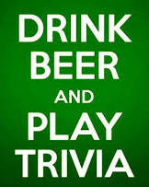
Project IndiGlow
2
+
Our app will…
Bring friends together for beer and trivia via the following:
Find a brewery via location search.
When you arrive at the brewery, start a trivia game.
Compete against your tablemates.
Low score buys the next round!

