Slide 1
Matrix multiplication in numpy
Danilo Pejović

Slide 2
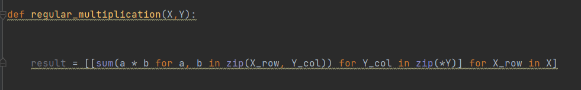
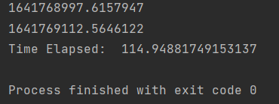
Regular multiplication in Python
Python translates code to processor line by line. For every element it encounters it does basic tests and assigns memory address. Since it is done line by line memory allocation is, in most cases, far from perfect. This slows down algorithms that have a lot of objects of same type.

Slide 3
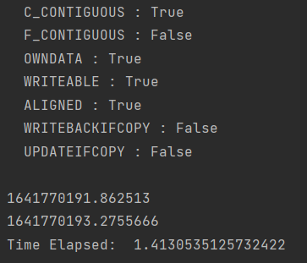
Multiplication numpy
Numpy is largely written in C programming language.
C is lower level programming language and better
for mathematical operations than Python.
Code in C has to be compiled before it is run and
matrices can only have objects of one type that is
defined when we initialize out matrix.

Slide 4
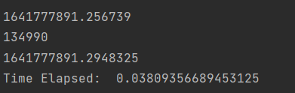
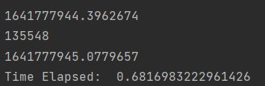
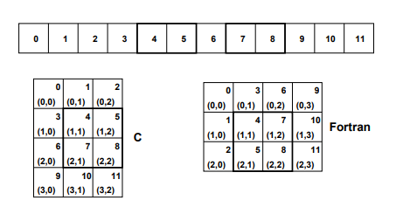
Memory allocation in C
Having matrix size and object type defined before use allows us to more efficiently allocate memory for matrix.
There are 2 ways to allocate memory to matrix. C-style array and Fortran-style array.
When multiplying 2 matrices numpy would initialize first matrix as c-style and second one as fortran-style array.

Slide 5
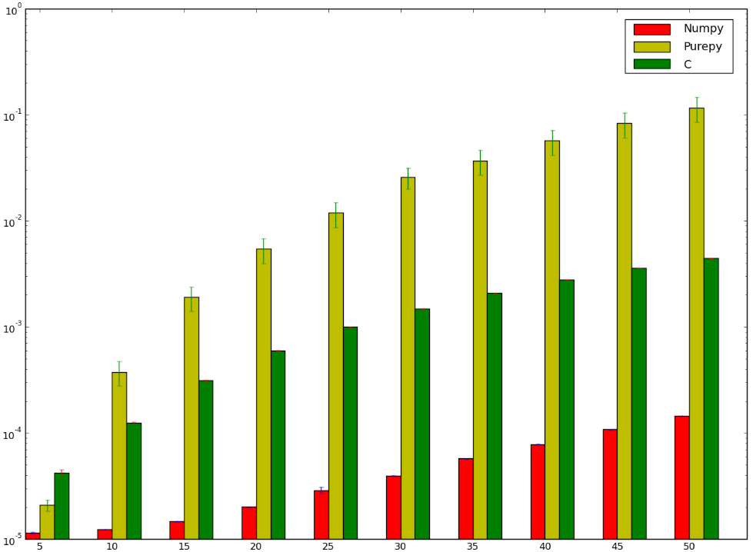
While just memory allocation inherent to matrices in C is decent improvement over Python code, it still lags quite a lot behind numpy level of efficiency.
Reason for that would be inefficient algorithm for our hardware, which forces CPU to make compromises which negatively affect performance

Slide 6
Simplified processor sketch
Register 0
Register 1
Level-2 cache
FPU
Register 2
CPU
Register 3
…
Level-1 cache
Main memory

Slide 7
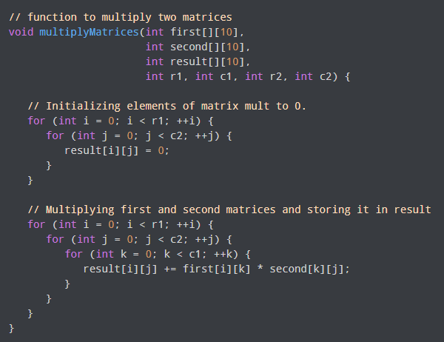
Drawbacks of naive multiplication algorithm
Registers
Level-1 cache
=
x
Level-2 cache
Bringing an element into registers from main memory costs ~100 times more than performing floating point operation on it.
We have to read every matrix (blue one twice since we are returning a result) – meaning we have 4n² memory operations. Seeing 3 nested loops in the code we can determine that we have n³ order of floating point operations.
You can fit roughly 3 40x40 matrices into Level-1 cache that is 32 kB big.
Main Memory
=
x

Slide 8
Blocking algorithm for matrix multiplication
Registers
…. += .*….
Greatly decreases amount of memory operation out of main memory to registers.
Blocking doesn’t bring any significant change to process of multiplication; it improves it by monitoring that memory operations are done from L1 or L2 cache
Level-1 cache
Level-2 cache
Main Memory
=
x

Slide 9
