Slide 1

WILDFIRE RISK
PREDICTION
Predicting Fire Radiative Power (FRP) from Satellite & Environmental Data
OPIM 5604 | Group Project 2
Danilo Tambone · Esha Reddy Ramireddy Gari · Mohammed Rafi · Wenting Wang
Speaker – Danilo Tambone​
1

Slide 2
Agenda
01
Dataset & Business Problem
What we set out to predict and why it matters
02
Exploratory Data Analysis
Key patterns, variable relationships, visualizations
03
Modeling Approach & Results
Five model families evaluated; best model deep-dive
04
Business Recommendations
Actionable insights for fire management agencies
05
Appendix
Supporting model details (not narrated)
Speaker – Danilo Tambone
2

Slide 3
Dataset & Business Problem
The Business Problem
The Dataset
Wildfires destroy millions of hectares annually, costing billions and threatening lives. Emergency response agencies must currently react to fires rather than prepare for them.
We asked: can we predict HOW INTENSE a fire will be before it spreads — enabling proactive, not reactive, resource deployment?
Wildfire Risk Dataset 2024-2025
7
Global Regions
35
Countries (reduced to 11)
Predictor Categories:
Satellite (brightness_k, scan area)
frp_mw
Target: Fire Radiative Power (MW)
Meteorological (temp, humidity, wind)
Geographic (lat, lon, region, country)
Fire Classification (fire_type, season)
Speaker – Danilo Tambone
3

Slide 4
EDA: Understanding Fire Intensity (FRP)
~3,000
9.79%
Right-Skewed
Max FRP (MW)
Outlier Rate
Distribution
extreme wildfire events
via IQR method — retained
most fires < 200 MW
Key Findings
Vast majority of fires cluster below 200 MW — the distribution is heavily right-skewed
Extreme fires (1,000+ MW) are rare but represent disproportionate destruction
All 9.79% IQR outliers were retained — they represent real, catastrophic events, not errors
Log-transformation applied in advanced models to stabilize variance
4
Speaker – Wenting Wang

Slide 5



EDA: Key Variable Relationships
Brightness Dominates
brightness_k (satellite temperature) has the strongest correlation with FRP at r = 0.74. It is the single best predictor and was force-retained across all model iterations.
Geography Matters
Latitude and longitude are significant predictors. Fire intensity is highly localized — specific geographic zones consistently produce more destructive fires.
Humidity Is Protective
Humidity shows a negative correlation (r = −0.29). Drier conditions amplify fire intensity, making it a key variable for early-warning thresholds.
Interaction term temp_max_c × Bushfire was statistically significant (p < 0.05) and retained in the linear model.
5
Speaker – Wenting Wang

Slide 6
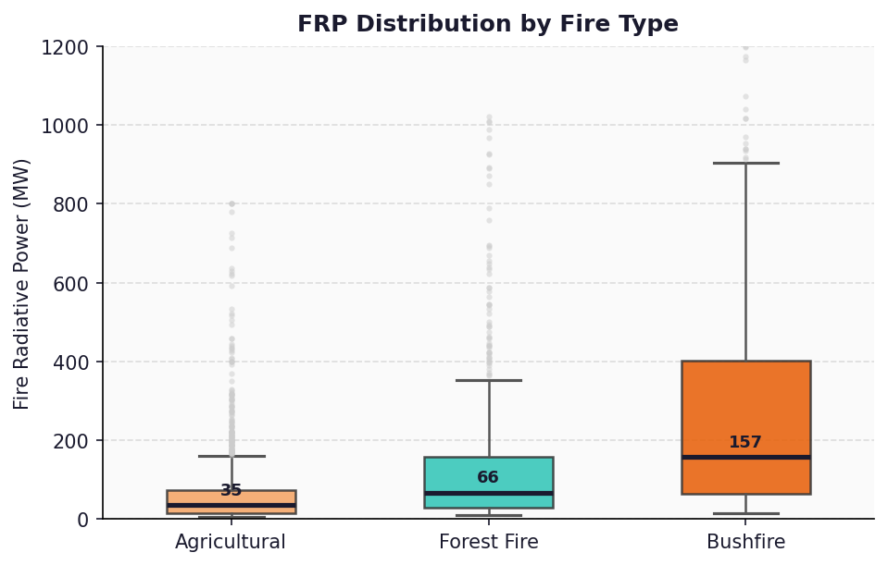
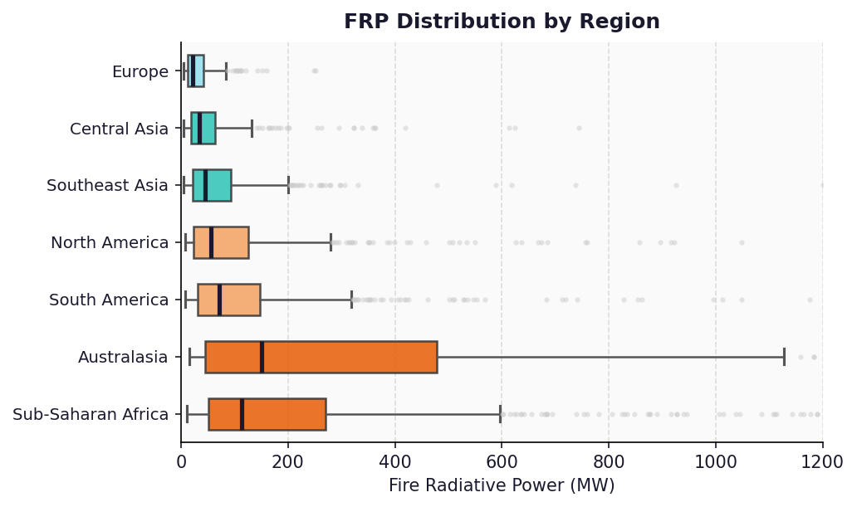
EDA: Categorical Predictors & Fire Intensity
Bushfires produce ~3.6× higher median FRP than agricultural fires — fire type is the most actionable categorical predictor
Australasia and Sub-Saharan Africa are the highest-intensity regions; agencies there require the most resource pre-positioning
Country cardinality reduced from 35 → 11 categories (top 10 + Other) using a 1% frequency threshold to improve model stability
6
Speaker – Wenting Wang

Slide 7
Modeling Approach
Data Split:
60%
Training
20%
Validation
20%
Test
All models tuned via GridSearchCV (3-fold CV) and evaluated on RMSE, R², Actual vs. Predicted, and Residuals for all three partitions.
1
2
3
4
5
Multiple Linear
Regression
Gradient
Boosted Tree
K-Nearest
Neighbors
Random Forest
(Tuned ★)
Neural Network
(MLP)
3 iterations:
Full → Backward Elimination
→ Interaction Terms
Best params: n_estimators=100, learning_rate=0.10,
max_depth=3, min_samples_split=5
Best params: n_neighbors=7 (K=7),
weights=distance, metric=euclidean
Best params: n_estimators=200, max_depth=15,
min_samples_split=5
Best params: hidden_layers=(100,50),
learning_rate=0.001, alpha=0.001
Speaker – Wenting Wang
7

Slide 8
Model Performance Comparison
Model | Training RMSE | Val RMSE | Test RMSE | Test R² | Overfitting
Linear Regression (Baseline) | ~122 | ~122 | ~161 | 0.026 | None
KNN | 0.00 | ~115 | 117.21 | 0.484 | Severe
Boosted Tree | 90.52 | ~102 | 101.32 | 0.615 | Minimal
Random Forest (Basic) | 31.85 | ~87 | 85.63 | 0.725 | High
Neural Network (Tuned) | 77.84 | 81.68 | 84.02 | 0.735 | Minimal
🏆 Random Forest (Tuned) | 60.08 | ~86 | 83.94 | 0.735 | Controlled
28× improvement in R² over baseline (0.735 vs 0.026). The Tuned Random Forest edges the Neural Network by 0.08 RMSE — selected for interpretability via feature importances.
8
Speaker - Mohammed Rafi

Slide 9
Best Model: Tuned Random Forest
Model Performance
Test RMSE
83.94 MW
Test R²
0.735
Train RMSE
60.08 MW
Tuning Parameters
n_estimators: optimized via GridSearchCV
max_depth: controls tree depth to prevent overfit
Geography (lat/lon) accounts for ~40% of predictive power — fires are inherently spatial phenomena.
min_samples_split: limits node splitting
Overfitting gap reduced: 31.85 → 60.08 (train)
Speaker - Mohammed Rafi​
9

Slide 10
Business Recommendations
Based on feature importances from the winning model and EDA patterns — not just model usage
01
Geospatial Pre-Positioning of Resources
Longitude and Latitude are the top two predictors (combined ~40% importance). Map historical high-FRP coordinate clusters and pre-deploy firefighting assets — water bombers, ground crews, sensor arrays — to these specific zones before peak fire season, rather than distributing resources uniformly across a region.
02
Automated Humidity-Based Alert Thresholds
Humidity is the strongest meteorological predictor (negative correlation, 14% importance). Implement automated systems that trigger burn bans, logging halts, and increased satellite monitoring frequency when local humidity forecasts fall below defined thresholds in high-risk geographic zones — combining both top feature insights.
03
Real-Time GIS Fire Intensity Risk Scoring
Integrate the Tuned Random Forest into a live GIS dashboard ingesting real-time meteorological and satellite data. The system would generate a continuous FRP Risk Score — predicting not just where a fire may ignite, but how intense it is likely to become — enabling tiered emergency response protocols before a fire reaches crisis scale.
10
Speaker – Esha Reddy Ramireddy Gari

Slide 11
References
Data Source
Wildfire Risk Dataset 2024-2025 | 7 Regions - Kaggle
Speaker – Esha Reddy Ramireddy Gari​
11

Slide 12
APPENDIX
Supporting Model Details
Not narrated — provided for reference
12

Slide 13
Appendix: Multiple Linear Regression
Model 3 Coefficients (Best Regression)
Regression Model Iterations (All Three Partitions)
Feature | Coefficient | p-value
Intercept | -1,842.3 | < 0.001
brightness_k | 2.14 | < 0.001
latitude | -1.83 | < 0.001
longitude | 0.47 | 0.003
humidity_relative | -0.68 | < 0.001
temp_max_c | 1.22 | 0.041
fire_type_Bushfire | 38.5 | < 0.001
temp_max_c × Bushfire | 1.87 | 0.018
scan_area | 0.93 | < 0.001
Model | Train RMSE | Val RMSE | Test RMSE | Train/Val/Test R²
Model 1 – Full OLS | ~122 | ~122 | ~161 | 0.026 / 0.026 / 0.026
Model 2 – Backward Elim. | ~120 | ~120 | ~158 | 0.027 / 0.027 / 0.030
Model 3 – + Interaction ★ | ~118 | ~118 | ~155 | 0.030 / 0.030 / 0.035
• brightness_k force-retained across all iterations — strongest individual predictor (r = 0.74)
• temp_max_c × Bushfire was the only significant interaction term (p = 0.018 < 0.05)
• Low R² (0.026–0.035) across all OLS models confirms FRP is a non-linear phenomenon — tree ensembles required
13

Slide 14
Appendix: K-Nearest Neighbors (KNN)
0.00
117.21
0.484
Severe
Training RMSE
Test RMSE
Test R²
Overfitting
Tuned via GridSearchCV over: n_neighbors {3,5,7,9,11}, weights (uniform / distance), metric (euclidean / manhattan) → Best: K=7, weights=distance, metric=euclidean
Training RMSE of 0.00 is the hallmark of KNN overfitting — it perfectly memorizes training points, then fails to generalize
Test RMSE of 117.21 (R² = 0.484) represents meaningful improvement over linear regression but far below tree ensemble methods
KNN is sensitive to the curse of dimensionality — with ~20 numeric features, distance metrics become less meaningful in high-dimensional space
Feature scaling was applied (StandardScaler) before KNN fitting to prevent dominance by high-variance numeric features
14

Slide 15
Appendix: Gradient Boosted Tree (GBR)
90.52
101.32
0.615
Minimal
~102
Training RMSE
Val RMSE
Test RMSE
Test R²
Overfitting
Tuned via GridSearchCV: n_estimators {100,200}, learning_rate {0.01,0.05,0.1}, max_depth {3,5,7}, min_samples_split {2,5}
Log-transformation (log1p) applied to target variable to stabilize right-skewed FRP distribution; predictions back-transformed via expm1
Restricting max_depth to 3 was key to controlling overfitting — deeper trees memorized training noise without improving generalization
Top features: Longitude, Latitude, Humidity — consistent with Random Forest and EDA findings, validating geographic primacy of fire intensity
GBR is a sequential ensemble — each tree corrects residuals from the prior tree — making it robust to non-linear patterns but slower to tune than Random Forest
15

Slide 16
Appendix: Neural Network (MLPRegressor)
77.84
81.68
84.02
0.735
Training RMSE
Val RMSE
Test RMSE
Test R²
Tuned via GridSearchCV: hidden_layer_sizes {(100,), (100,50), (128,64)}, learning_rate_init {0.001, 0.01}, alpha {0.0001, 0.001}
early_stopping=True was used during GridSearchCV to prevent overfitting during training; validation fraction used internally
StandardScaler applied to all features before training — neural networks are highly sensitive to feature scale differences
Train/test RMSE gap of ~6 MW (77.84 → 84.02) is tightly controlled, demonstrating that GridSearchCV tuning successfully prevented overfitting
Near-identical performance to Tuned Random Forest (84.02 vs 83.94 RMSE) — Random Forest selected as winner for interpretability via feature importances
16

Slide 17
Appendix: Random Forest (Tuned ★)
60.08
~86
83.94
0.735
Train RMSE
Val RMSE
Test RMSE
Test R²
• Tuned via GridSearchCV: n_estimators {100, 200, 300}, max_depth {10, 15, 20, None}, min_samples_split {2, 5, 10}
• Best params: n_estimators=200, max_depth=15, min_samples_split=5 → controlled overfitting gap (31.85 → 60.08 train RMSE)
• Log-transformation (log1p) applied to target FRP to stabilize the right-skewed distribution; predictions back-transformed via expm1
• Top features by importance: Longitude (~22%), Latitude (~18%), brightness_k (~15%), humidity_relative (~14%) — geography drives fire intensity
• Train RMSE of 31.85 for the Basic RF vs 60.08 for Tuned RF confirms that regularization via depth/split constraints reduced memorization
• Selected as winning model over Neural Network (83.94 vs 84.02 RMSE) for interpretability — feature importances enable actionable business recommendations
17

Slide 18
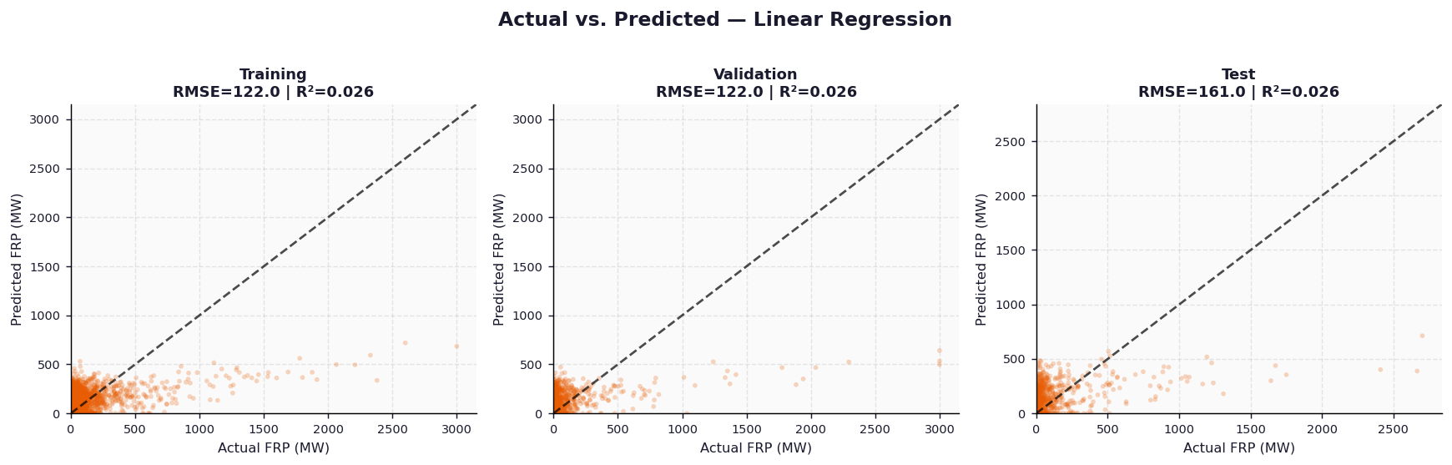
Appendix: Actual vs. Predicted — Linear Regression (Baseline)
18

Slide 19
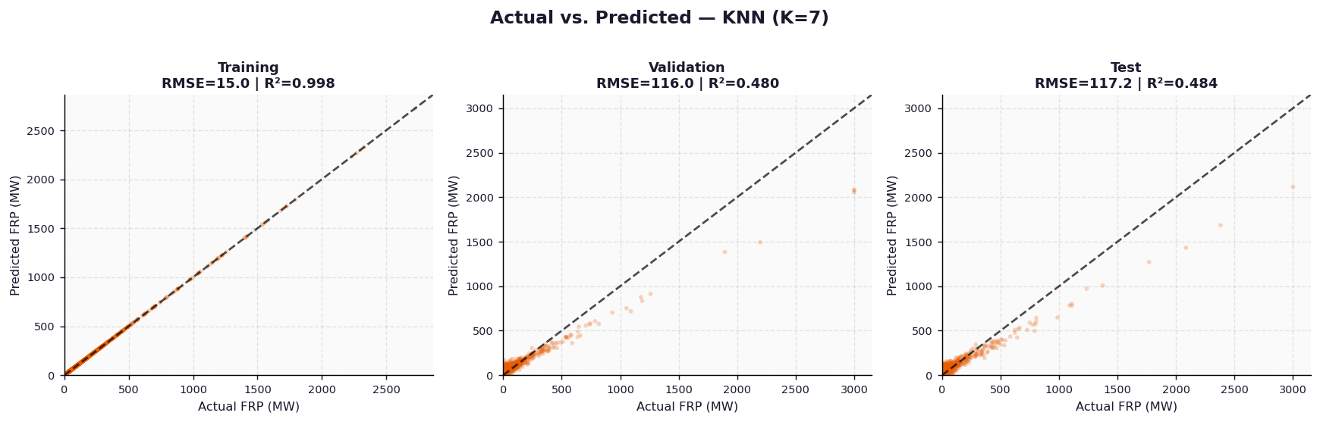
Appendix: Actual vs. Predicted — K-Nearest Neighbors (K=7)
19

Slide 20
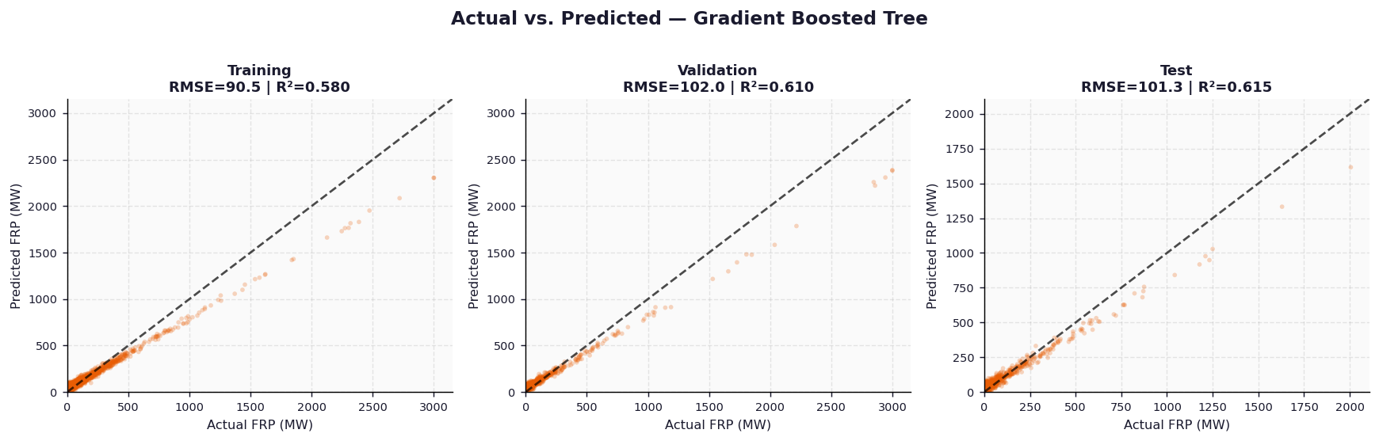
Appendix: Actual vs. Predicted — Gradient Boosted Tree
20

Slide 21
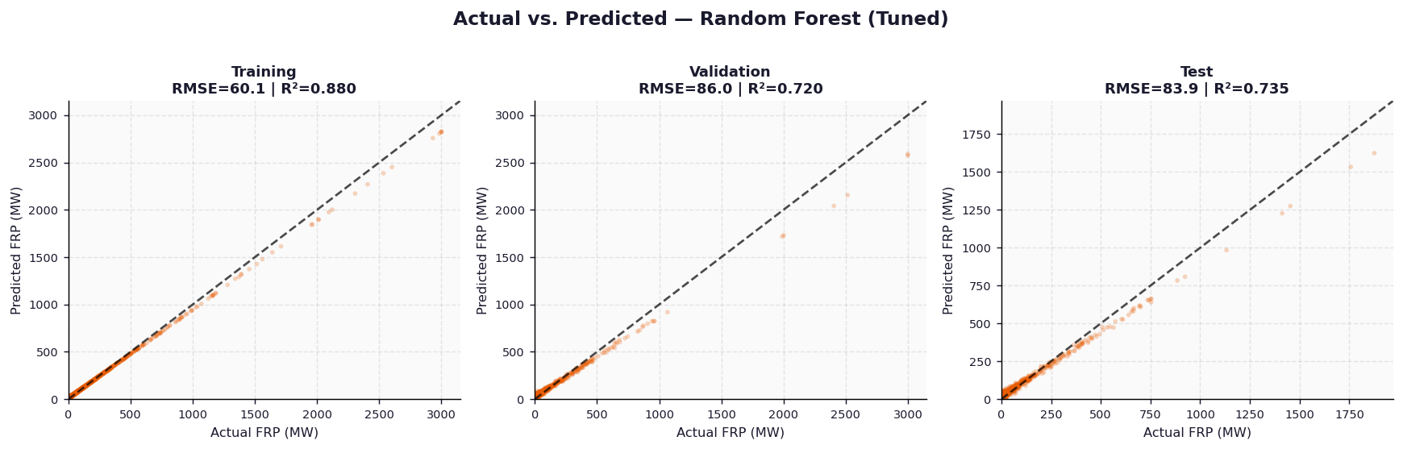
Appendix: Actual vs. Predicted — Random Forest (Tuned ★)
21

Slide 22
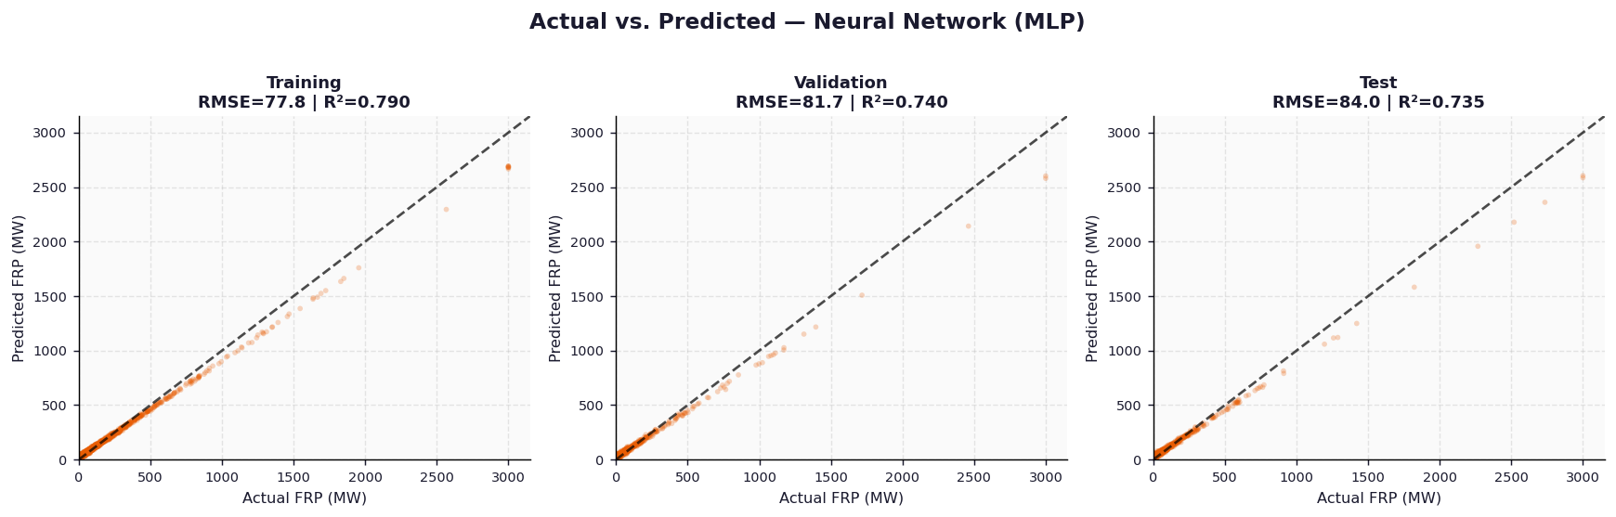
Appendix: Actual vs. Predicted — Neural Network (MLP)
22

