Slide 1
Mean_zonal_circulation

Slide 2
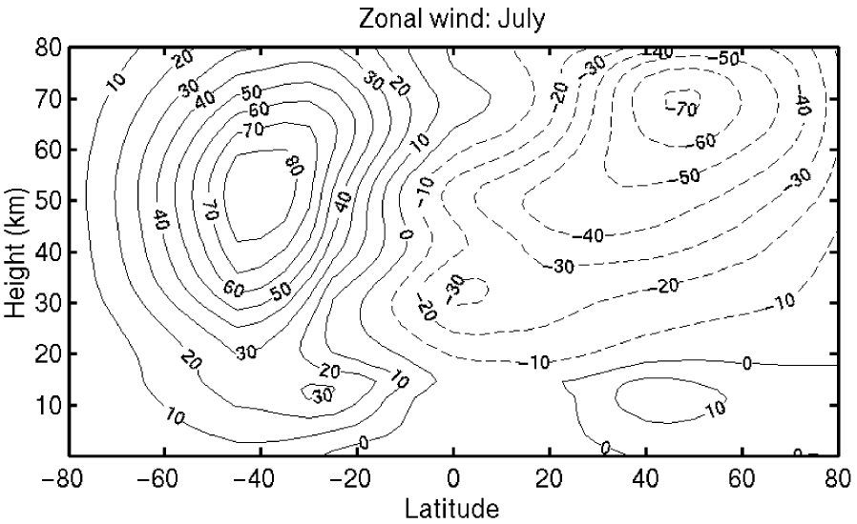

Slide 3
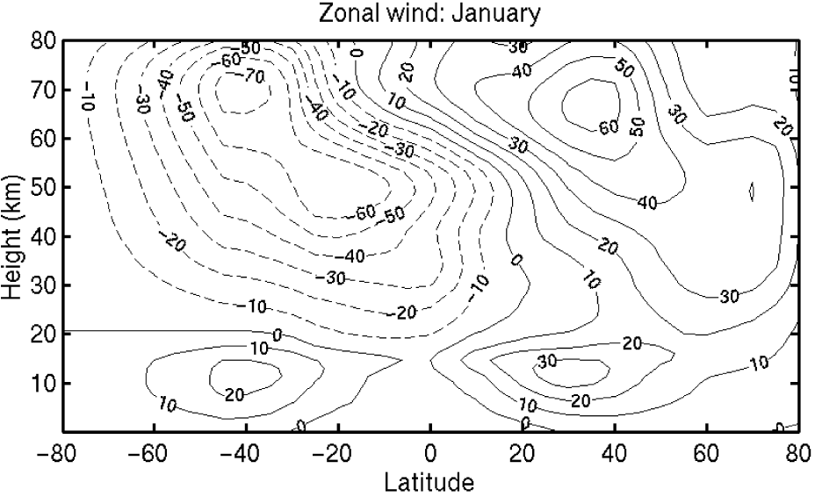

Slide 4
