Slide 1

Optimized matrix multiplication and inversion
Advanced Computer Architecture project
A.Y. 2020/2021
Docenti:
Prof. Marco Ferretti
Prof. Mirto Musci
Membri del team:
Domenico Ragusa
Danilo Modica

Slide 2
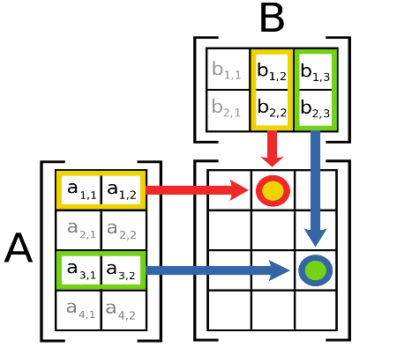
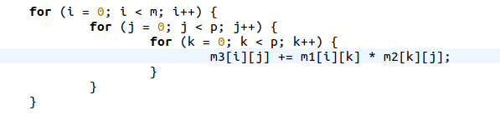
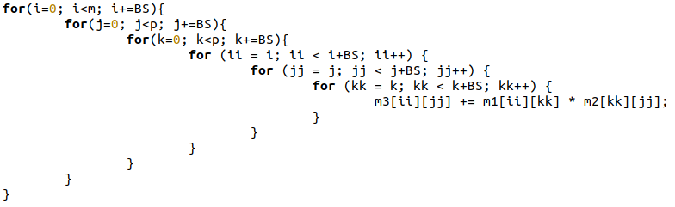
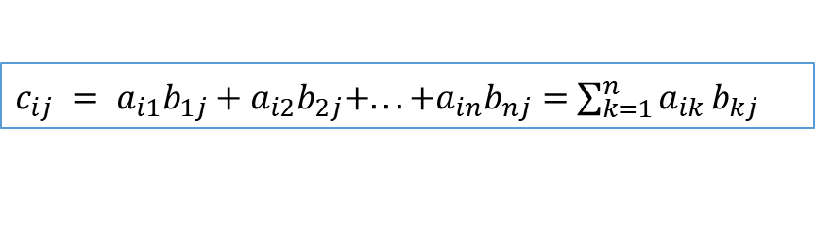
Serial algorithms - Multiplication
n x m n x p
A x B = C
m x p
$c_{ij} = a_{i1}b_{1j}+a_{i2}b_{2j}+...+a_{in}b_{nj}=$ $\sum_{k=1}^{n}{a_{ik}}b_{kj}$
Simplest Algorithm
Program structure
Initialization with memory allocation
Reading of two matrices
Multiplication
Writing the resulting matrix
Matrices subdivision in tiles

Slide 3
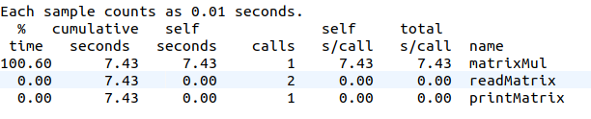
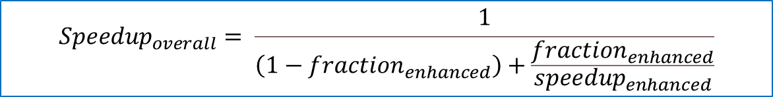
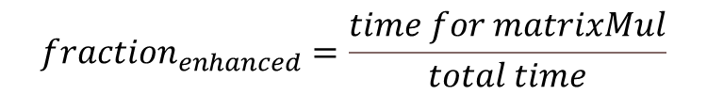
A-priori parallelism study - Multiplication
Gprof profiling
Amdahl’s law
$${Speedup}_{overall}= \frac{1}{\left(1−{fraction}_{enhanced}\right)+\frac{{fraction}_{enhanced}}{{speedup}_{enhanced}}}$$
$${fraction}_{enhanced}=\frac{time for matrixMul}{total time}$$
Theoretical speedups
OpenMP (max 24 thread) -> theoretical speedup = 24
CUDA (640 CUDA cores) -> theoretical speedup = 640

Slide 4
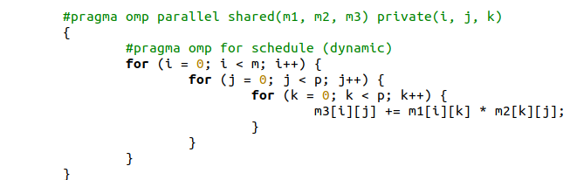
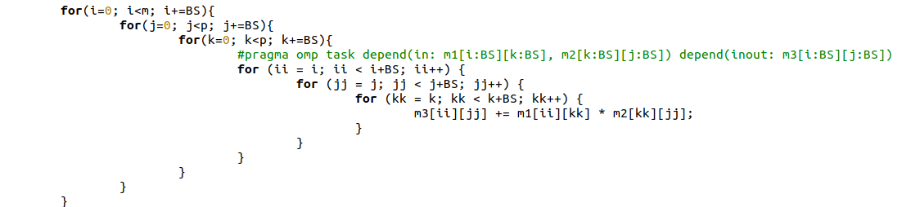
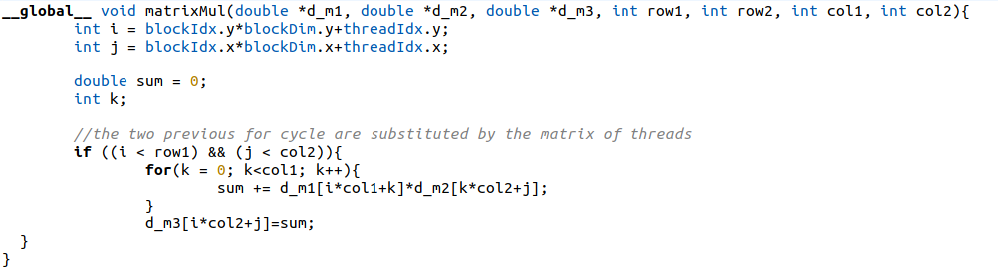
Parallelization - Multiplication
Parallelization by rows
Parallelization per tiles
Parallelization per elements

Slide 5
Performance analysis - Multiplication
Comparison between execution times
 | Serial - rows | Serial - tiles | OpenMP - rows | OpenMP - tiles
2048 | 73.47 s | 10.59 s | 5.80 s | 0.69 s
3072 | 263.58 s | 35.89 s | 20.78 s | 2.29 s
Virtual machine configuration
Ubuntu 20.04
N1 Platform
24 vCPU
22 GB RAM

Slide 6
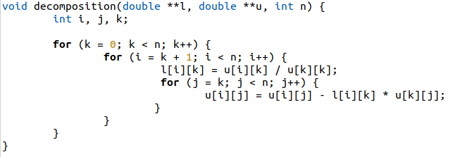
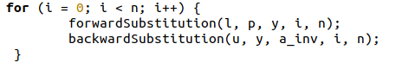



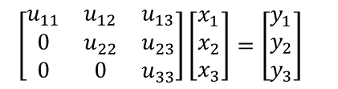
Serial algorithm - Inversion
1. $AA^{−1}=I$
$$\left[\begin{matrix}A_{11} & A_{12} & A_{13} \\ A_{21} & A_{22} & A_{23} \\ A_{31} & A_{32} & A_{33}\end{matrix}\right]\left[\begin{matrix}a_{11}′ & a_{12}′ & a_{13}′ \\ a_{21}′ & a_{22}′ & a_{23}′ \\ a_{31}′ & a_{32}′ & a_{33}′\end{matrix}\right]=\left[\begin{matrix}1 & 0 & 0 \\ 0 & 1 & 0 \\ 0 & 0 & 1\end{matrix}\right]$$
Program structure
Memory allocations with malloc
Reading matrix
Computing inversion
Pivoting
LU decomposition
Computing determinant and checks
Forward and Backward substitutions
Writing the resulting matrix
2. LU decomposition
$$\left[\begin{matrix}l_{11} & 0 & 0 \\ l_{21} & l_{22} & 0 \\ l_{31} & l_{32} & l_{33}\end{matrix}\right]\left[\begin{matrix}y_{1} \\ y_{2} \\ y_{3}\end{matrix}\right]=\left[\begin{matrix}b_{1} \\ b_{2} \\ b_{3}\end{matrix}\right]$$
$\left[\begin{matrix}u_{11} & u_{12} & u_{13} \\ 0 & u_{22} & u_{23} \\ 0 & 0 & u_{33}\end{matrix}\right]\left[\begin{matrix}x_{1} \\ x_{2} \\ x_{3}\end{matrix}\right]=\left[\begin{matrix}y_{1} \\ y_{2} \\ y_{3}\end{matrix}\right]$
3. Forward substitution
4. Backward substitution

Slide 7
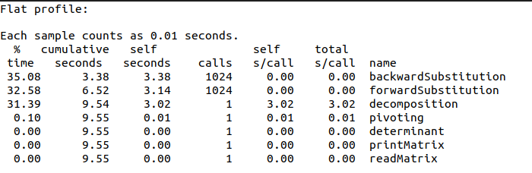
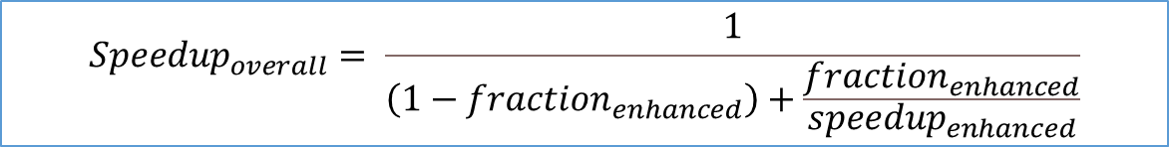
A-priori parallelism study - Inversion
Gprof profiling
Amdahl’s law
$${Speedup}_{overall}= \frac{1}{\left(1−{fraction}_{enhanced}\right)+\frac{{fraction}_{enhanced}}{{speedup}_{enhanced}}}$$
$${fraction}_{enhanced}= \frac{backward time + forward time +decomposition time + determinant time}{total time}$$
Theoretical speedups
OpenMP (max 24 thread) -> theoretical speedup = 19.51
CUDA (640 CUDA cores) -> theoretical speedup = 86.60

Slide 8
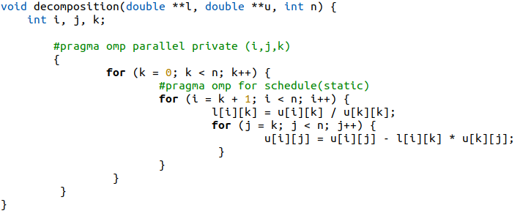
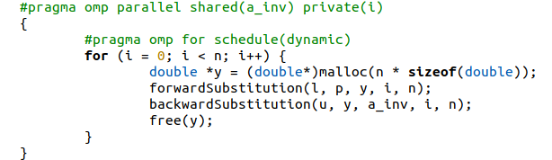
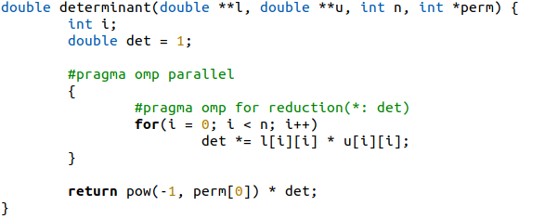
Parallelization - Inversion
Same parallelization reasoning was applied exploiting a GPU through the CUDA framework

Slide 9
Performance analysis - Inversion
Virtual machine configuration
Ubuntu 20.04
N1 Platform
24 vCPU
22 GB RAM

Slide 10
Thank you for your attention
Repository: https://github.com/domenico-rgs/ACA-Project.git

