Slide 2
Inference Is a Black Box
How We Built GPU-Aware Observability with Fluent Bit and OpenTelemetry
Danilo Souza, Senior Delivery Consultant, DevOps, AWS Professional Services
Henrique Santana, Principal Cloud Support Engineer, AWS
Observability Day North America, Salt Lake City, 9 November 2026

Slide 3
The page fires. Every GPU chart is green.
02:14 p99 latency doubles
GPU utilisation: 95%, flat for an hour
GPU memory used: 90%, flat since the pod started
Pods Ready, no throttling, no OOM, no restarts
Nobody knows why.
Meanwhile, industry-wide
~5%
average production GPU utilisation
Same counter. One fleet looks saturated, the other looks idle. Neither number says anything about the inference work.
Industry average production GPU utilisation ~5%: Cast AI, State of GPU utilisation 2026 (cast.ai/blog/fractional-gpu-kubernetes)
Notes:
2 min. Open with the incident, not the architecture. p99 doubled at 02:14. You open three tabs: GPU util 95%, framebuffer 90% used, both flat for an hour. The model is healthy, the pods are Ready, nothing is throttled. Then the hook: across the industry the average production GPU runs at around 5% utilisation. Those two numbers come from the same counter. One says 'saturated', the other says 'idle', and neither tells you anything about the inference work. That is the black box.

Slide 4
vLLM grabs the memory before request one.
The counter everyone watches
DCGM_FI_DEV_FB_USED
Pre-allocated KV cache pool, sized by --gpu-memory-utilization
Jumps to the configured fraction at start-up
Then flat. Idle or saturated, same number.
It measures a config value, not a workload.
pod | gpu-mem-util | FB_USED | moves under load?
vllm-constrained | 0.15 | 3.6 GB | no
vllm-overprov | 0.90 | 20.5 GB | no
Which one is about to fall over?
The smaller one. The memory counter says the opposite.
Live rig: two vLLM pods, facebook/opt-125m, EKS Auto Mode, g5.xlarge (A10G 24 GB), DCGM_FI_DEV_FB_USED
Notes:
Section 2 starts here, 5 min total for 4a-4c. Every serious LLM server pre-allocates its KV cache pool at start-up. vLLM calls it --gpu-memory-utilization. So the framebuffer counter jumps to the configured fraction in the first 30 seconds and never moves again, whether the server is idle or melting. Our constrained pod shows 3.6 GB, the over-provisioned one 20.5 GB, both perfectly flat. The one with less memory is the one that will get into trouble, and this counter cannot tell you that.

Slide 5
GPU util % cannot tell prefill from decode.
Prefill
Whole prompt in one pass. Large matmuls. Compute-bound.
Decode
One token per step, re-reads the entire KV cache. Memory-bandwidth-bound.
vLLM under load, same second | value
GR_ENGINE_ACTIVE ("utilisation") | 99.8%
PIPE_TENSOR_ACTIVE (tensor cores) | 16.6%
DRAM_ACTIVE (memory bus) | 80.4%
DCGM_FI_DEV_GPU_UTIL = "a kernel was running in the sample window"
One busy thread = 100%. It cannot see which phase you are in, or how much of the silicon is working.
Bandwidth-bound, not compute-saturated. "Utilisation" said neither.
The field now talks MFU / MBU: 99% util with 15 to 40% model-FLOPs utilisation is normal for serving.
Measured on vLLM by Elastic Observability Labs (2025): GR_ENGINE_ACTIVE 99.8%, PIPE_TENSOR_ACTIVE 16.6%, DRAM_ACTIVE 80.4%. MFU/MBU framing: Lightbits, The Utilization Illusion.
Notes:
GPU_UTIL means 'at least one kernel was running during the sample window'. A single thread spinning counts as 100%. Inference has two phases with opposite profiles: prefill is compute-bound (big matmuls over the prompt), decode is memory-bandwidth-bound (one token per step, re-reading the whole KV cache). Elastic measured a vLLM server at 99.8% engine-active while the tensor cores were busy 16.6% of the time and the memory bus 80.4%. Bandwidth-bound, not compute-saturated. The training world has moved to MFU and MBU, model FLOPs and bandwidth utilisation; 99% util with 15 to 40% MFU is normal. vLLM 0.30 can even emit MFU itself (--enable-mfu-metrics). The counter on your dashboard is the least informative one the hardware offers.

Slide 6
Counters that mislead, counters that matter.
Misleading on an inference server | Why | Meaningful | What it tells you
DCGM_FI_DEV_GPU_UTIL | any kernel = busy | DCGM_FI_PROF_SM_ACTIVE | share of SMs doing work
DCGM_FI_DEV_FB_USED | pre-allocated, flat | DCGM_FI_PROF_SM_OCCUPANCY | warps resident per SM
DCGM_FI_DEV_MEM_COPY_UTIL | copy engine only | DCGM_FI_PROF_DRAM_ACTIVE | memory-bandwidth-bound?
nvidia-smi "Volatile GPU-Util" | same as GPU_UTIL | DCGM_FI_PROF_PIPE_TENSOR_ACTIVE | tensor cores actually used
 |  | DCGM_FI_DEV_POWER_USAGE vs TDP | cheapest idle detector
And none of them know what a token is.
Queue depth, KV cache pressure, tokens per second: those belong to the serving framework, not the silicon.
DCGM field IDs: docs.nvidia.com/datacenter/dcgm. Profiling (PROF_*) fields need a profiling-capable GPU and DCGM >= 2.x.
Notes:
One slide of vocabulary the room can take home. Left column: what most GPU dashboards show. Right column: what actually describes the work. SM_ACTIVE and SM_OCCUPANCY say how much of the compute is busy, DRAM_ACTIVE says whether you are bandwidth-bound, PIPE_TENSOR_ACTIVE whether the tensor cores are doing the matmuls, POWER vs TDP is the cheapest sanity check. And the punchline at the bottom: none of these counters know what a token is. The GPU cannot tell you about queue depth or KV cache pressure, because those are concepts of the serving framework, not the silicon.

Slide 7
The pod is the join key.
Hardware counters, serving logs and traces each know the pod name. Nothing else is common to all three.
K8s 1.35: Dynamic Resource Allocation is stable; dcgm-exporter 4.8.4 adds pod_uid + ResourceSlice mapping. Same join key, new plumbing.
Notes:
Section 3, 3 min for slides 5 to 6b. If you take one architectural idea home, take this one. DCGM knows which pod holds the GPU (via the kubelet pod-resources socket). Fluent Bit knows which pod wrote the log line. The OTel Collector stamps k8s.pod.name on every span. Nothing else is shared across the three. So you keep the pod name on every signal and you join at query time. Footnote for the people on newer clusters: Kubernetes 1.35 made Dynamic Resource Allocation stable, and dcgm-exporter 4.8.4 added a pod_uid label and ResourceSlice tracking because the old device-plugin mapping breaks under DRA. The idea survives, the plumbing changes.

Slide 8
Signal 1: DCGM, per pod.
args:
- -f /etc/dcgm-exporter/counters.csv
- --kubernetes=true
- --kubernetes-gpu-id-type=uid
env:
DCGM_EXPORTER_KUBERNETES_ENABLE_POD_LABELS: "false"
volumeMounts:
- /var/lib/kubelet/pod-resources (ro)
What it tells you
Which pod holds which GPU
Whether the silicon is busy (SM_ACTIVE, DRAM_ACTIVE)
Power, temperature, memory pool size
What it cannot tell you
Why the GPU is busy
How many requests are queued
Whether the KV cache is full
Anything about tokens
DCGM_FI_DEV_FB_USED{exported_pod="vllm-constrained-7f9f...",
exported_namespace="inference",
gpu="0", modelName="NVIDIA A10G"} 3606
dcgm-exporter --kubernetes reads /var/lib/kubelet/pod-resources. EKS Auto Mode: standalone dcgm-exporter, not the GPU Operator (see slide 15).
Notes:
dcgm-exporter in Kubernetes mode asks the kubelet which pod owns each GPU and stamps exported_pod on every counter. That gives you two things: which pod is on which GPU, and whether that silicon is busy. It does not give you why. On EKS Auto Mode you run the exporter standalone as a DaemonSet with the pod-resources hostPath, because the GPU Operator is not supported there. Seven counters in our counters.csv, and that smallness is deliberate, next slide explains why.

Slide 9
Keep the join key. Drop every other label.
1,000 nodes x 8 GPUs x 60 counters x 3 labels
= 1.4M series
before a single pod or job label. One ECC-per-block metric alone: +320k.
The rule
Identity on logs
Stable dimensions on metrics
Join at query time
Our rig
7 counters in counters.csv
Pod labels off; exported_pod is the only identity
Join on the fixed part of the name, never the hash
Pod names churn on every rollout. Every extra label multiplies by that churn.
ENABLE_POD_LABELS=true is how you find out.
Series math: Last9, 10,000 GPUs, one TSDB (last9.io/blog/10-000-gpus-one-tsdb-cardinality-at-gpu-scale). Rig: 7 counters, pod labels off.
Notes:
The first thing we broke was Prometheus. dcgm-exporter can copy every pod label onto every counter (ENABLE_POD_LABELS). Do the arithmetic at fleet scale: 1,000 nodes, 8 GPUs each, the default 60 or so counters, three label dimensions, and you are at 1.4 million series before a single pod or job label is added. One ECC-per-block metric on MI300X alone adds 320 thousand. Pod names churn on every rollout, so every label you add multiplies by churn. The rule that fixed it: identity on logs, stable dimensions on metrics, join at query time. We ship seven counters and one identity label.

Slide 10
Signal 2: the serving log is the telemetry.
vllm-overprov, steady load
INFO [loggers.py] Engine 000: Avg prompt throughput: 1180.2 tokens/s, Avg generation throughput:
4711.7 tokens/s, Running: 15 reqs, Waiting: 0 reqs, GPU KV cache usage: 0.1%, Prefix cache hit rate: 0.0%
vllm-constrained, saturating load
INFO [loggers.py] Engine 000: Avg prompt throughput: 9810.4 tokens/s, Avg generation throughput:
17227.0 tokens/s, Running: 76 reqs, Waiting: 116 reqs, Preemptions: 41, GPU KV cache usage: 99.6%,
Prefix cache hit rate: 0.0%
tokens/s · running · waiting · KV cache % · prefix hits · preemptions
Six facts about the inference work. Zero of them in any GPU counter.
vLLM V1 engine, vllm/v1/metrics/loggers.py: one stats line every 10 s while the engine is busy (DEBUG level when idle).
Notes:
Section 4 is the centre of the talk, 6 min for 7a to 7c. This is one line of vLLM stdout. Every 10 seconds while it is busy. Read the fields: prompt and generation throughput, running requests, waiting requests, KV cache usage, prefix cache hit rate. And when the scheduler starts evicting work because the cache is full, a Preemptions field appears. Five fields, six under stress, and not one of them exists in any GPU counter. The two lines are the same rig: idle-ish over-provisioned pod, and the constrained pod during the demo load.

Slide 11
Fifteen lines of Lua, per-pod metrics.
function extract_vllm_metrics(tag, ts, record)
local line = record["log"] or ""
local gen = string.match(line, "generation throughput:%s*([%d%.]+)")
if gen == nil then record["vllm_parsed"] = "false"; return 1, ts, record end
record["gen_tokens_per_s"] = tonumber(gen)
record["running_reqs"] = tonumber(string.match(line, "Running:%s*(%d+)")) or 0
record["waiting_reqs"] = tonumber(string.match(line, "Waiting:%s*(%d+)")) or 0
record["kv_cache_usage_pct"] = tonumber(string.match(line, "KV cache usage:%s*([%d%.]+)%%")) or 0
record["preemptions"] = tonumber(string.match(line, "Preemptions:%s*(%d+)")) or 0
record["pod_name"] = record["kubernetes"]["pod_name"] -- the join key
record["vllm_parsed"] = "true"
return 2, ts, record
end
tail -> kubernetes -> lua -> grep
-> log_to_metrics -> prometheus_exporter
vllm_log_kv_cache_usage_pct{pod_name=...}
vllm_log_waiting_reqs{pod_name=...}
vllm_log_preemptions_total{pod_name=...}
Honest caveat
vLLM already exposes these on /metrics. It is our demo vehicle.
This is for everything that does not: custom servers, vendor images, log-only pipelines, the TGI or Triton you inherited. Same 15 lines, different regex.
Fluent Bit 5.1: tail -> kubernetes -> lua -> grep -> log_to_metrics -> prometheus_exporter. vLLM native metrics: docs.vllm.ai/en/latest/design/metrics
Notes:
Fluent Bit tails the container log, the kubernetes filter attaches the pod name (that is the join key arriving), the Lua filter does five string.match calls and promotes pod_name to a top-level field, grep drops everything that is not a stats line, log_to_metrics turns the fields into gauges labelled by pod_name, and prometheus_exporter serves them on :2021 for the same Prometheus that scrapes DCGM. Now the honest caveat, say it before someone asks: vLLM exposes all of this natively on /metrics, kv_cache_usage_perc, num_requests_waiting, request_queue_time_seconds. vLLM is the demo vehicle. This technique is for everything that does not: custom servers, vendor images you cannot touch, log-only pipelines, the TGI or Triton you inherited. Same fifteen lines, different regex.

Slide 12
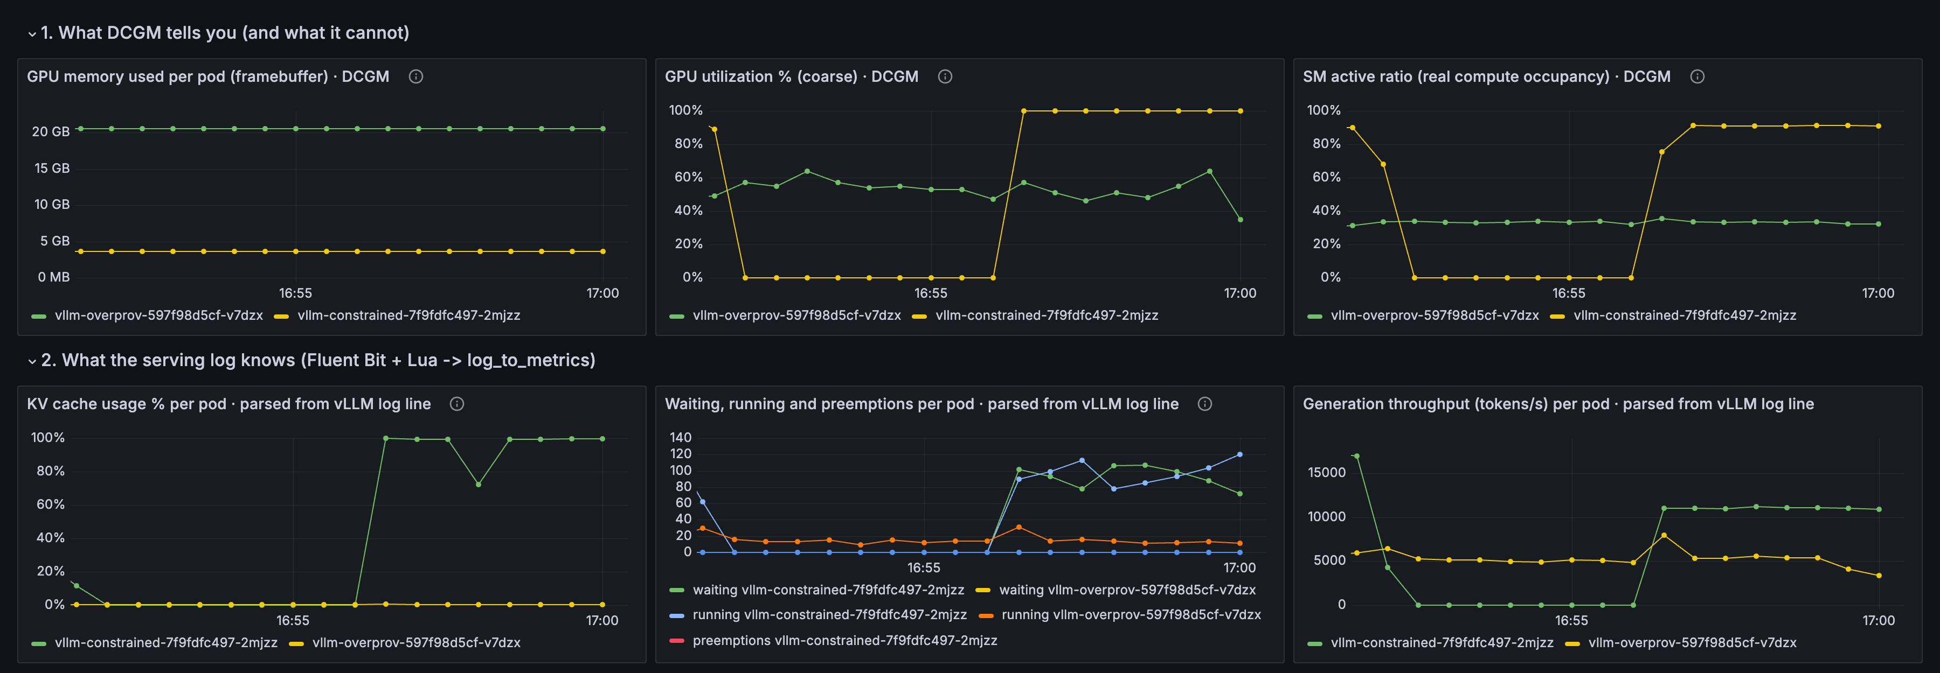
KV cache 100%. Memory counter: unchanged.
Queue time first. Waiting confirms. FB_USED: 3.6 GB before, 3.6 GB after.
GPU_UTIL says "busy" for both pods. It cannot say that one has zero headroom and 100 requests queued, and the other 99% of its cache free.
Queue time rises before 'waiting' is visibly non-zero: Elastic Observability Labs, tuning vLLM Prometheus metrics (2025). Rig numbers from the live demo load.
Notes:
LIVE DEMO. Start the loadgen before this slide (kubectl apply loadgen-job.yaml), it runs 12 minutes. Grafana row 1: FB_USED flat on both pods, GPU_UTIL pegged on both. Row 2: the constrained pod's KV cache goes to 100%, waiting climbs to around 100, p95 queue time jumps from 0.3 s to 4.8 s. Row 3 cross-check agrees with the log-derived numbers. Be precise about row 1: GPU_UTIL did go to 100% and SM_ACTIVE to 90% on the constrained pod, so DCGM does say 'busy'. What it cannot say is why, or how much headroom is left: FB_USED is 3.6 GB before, during and after. The over-provisioned pod shows 55% util and 0.2% KV cache under its own load, so it has 99% of its cache free, and no GPU counter tells you that either. Preemptions stayed at zero in this run (vLLM queues rather than evicts at max-num-seqs 256); if they appear, that is the scheduler evicting running work.

Slide 13
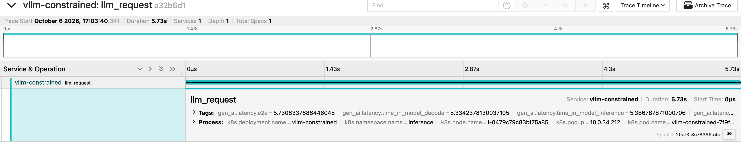
Signal 3: a slow span with a pod name.
# vLLM
--otlp-traces-endpoint=grpc://otel-collector.observability:4317
# OTel Collector
processors:
k8sattributes:
extract: { metadata: [k8s.pod.name, k8s.namespace.name] }
span: llm_request duration: 5.73s
k8s.pod.name = vllm-constrained-7f9fdfc497-2mjzz
gen_ai.usage.prompt_tokens = 582
gen_ai.usage.completion_tokens = 384
gen_ai.latency.time_in_queue = 0.61s
gen_ai.latency.time_in_model_decode = 5.33s
Slow span: a fact. Slow span on the pod whose KV cache was 100% at that second: a diagnosis.
vLLM --otlp-traces-endpoint -> OTel Collector (k8sattributes) -> Jaeger. Tracing was removed in the V1 rewrite and reinstated in vllm PR #20372: needs vLLM >= 0.10.2.
Notes:
Section 5, 3 min. vLLM emits one span per request natively, you point it at the OTel Collector. The k8sattributes processor stamps k8s.pod.name on every span by looking up the source IP. A slow span on its own tells you a request was slow. A slow span on the pod whose KV cache was at 100% at that second, with 116 requests waiting, tells you why. Gotcha worth saying out loud: tracing disappeared in the vLLM V1 engine rewrite and came back in PR 20372, so you need 0.10.2 or later. We run 0.30. If your traces vanished after an upgrade, that is why. Abstract wording: we show traces from the serving path, one span per request; multi-hop waterfalls are a flag away but not the point. Bonus in 0.30: vLLM also emits start-up spans (Load weights, Allocate KV cache, Compile graph), so cold-start time is traceable too.

Slide 14
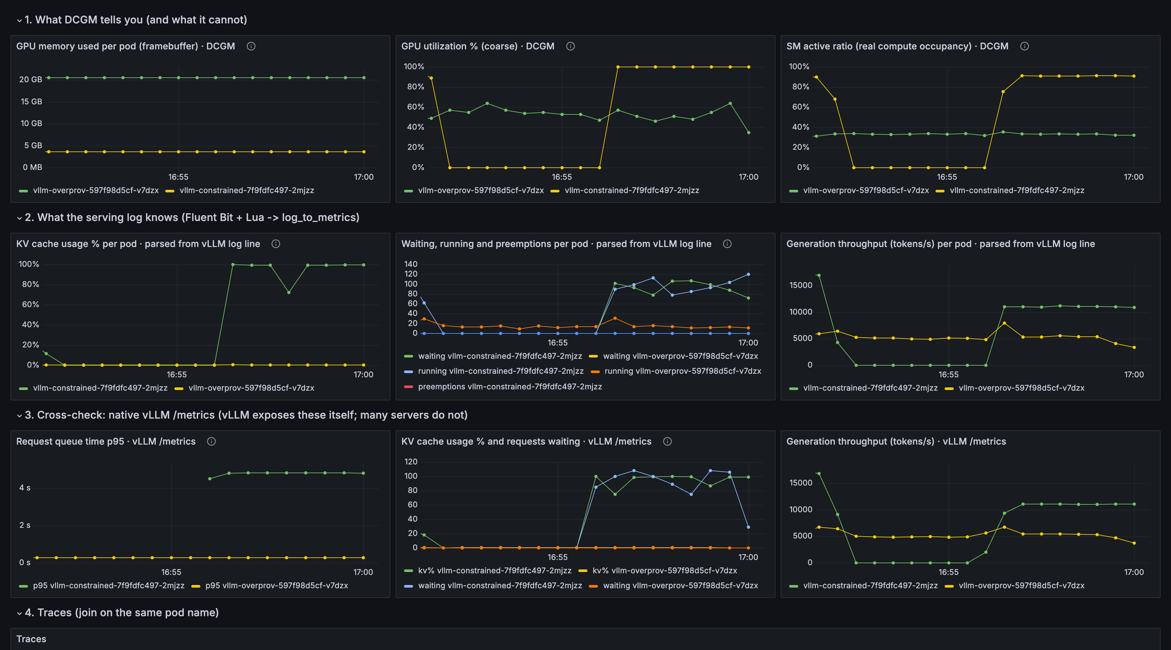
Same pod name. Three sources. One row.
No new agent. No vendor. No eBPF. The pod name on every signal, and the discipline to keep it there.
Grafana dashboard uid gpu-inference-obs, variable $pod matches exported_pod (DCGM), pod_name (Fluent Bit) and pod (vLLM, traces).
Notes:
Section 6, 2 min. This is the slide the whole talk builds to. One Grafana dashboard, one pod variable, three data sources that never heard of each other. Point at the timestamps: KV cache pegs, waiting climbs, span latency jumps, and the DCGM row above is unchanged. That is the black box opened. You did not need a new agent, a new vendor or eBPF. You needed the pod name on every signal and the discipline to keep it there.

Slide 15
What silently broke along the way.
What we expected | What happened | Fix
GPU Operator installs DCGM on EKS Auto Mode | Auto Mode supports neither the GPU Operator nor the NVIDIA DRA driver (drivers + device plugin come with the AMI) | Standalone dcgm-exporter DaemonSet, pod-resources hostPath, SYS_ADMIN
Fluent Bit kubernetes filter adds pod_name | Kube_Tag_Prefix did not match the tail tag; metadata silently missing, join key empty | Kube_Tag_Prefix kube.var.log.containers. (match the tag you actually emit)
Rolling update of a 1-GPU pod | NodePool capped at 2 GPUs: new pod Pending forever, old one never releases | strategy: Recreate on every GPU deployment
EKS Auto Mode GPU support: docs.aws.amazon.com/eks/latest/userguide/device-management-nvidia-dra-device-plugin.html
Notes:
1 min, pick the first one if short on time. EKS Auto Mode ships NVIDIA drivers and the device plugin on its GPU AMIs, but does not support the GPU Operator or the NVIDIA DRA driver. Every DCGM how-to assumes the Operator. So: standalone dcgm-exporter DaemonSet, pod-resources hostPath, SYS_ADMIN cap. Second: Fluent Bit's kubernetes filter needs Kube_Tag_Prefix to match the tail tag exactly, or the pod name silently never arrives and your join key is empty. Third, from this morning: one GPU per pod and a NodePool capped at two GPUs means a RollingUpdate can never surge; the new pod sits Pending forever. strategy: Recreate.

Slide 16
Where this is going.
Disaggregated prefill / decode
llm-d, NVIDIA Dynamo, llm-d-aws: one request, two pods, KV cache shipped over NIXL / EFA. Up to +70% tokens/s at concurrency 128.
Join key becomes request id + pod.
Signals move into the router
Gateway API Inference Extension endpoint picker and Dynamo's KV-aware router route on queue depth and KV cache %. The join leaves Grafana.
Signal 1 is becoming a checkbox
CloudWatch OTel-native Container Insights for EKS (June 2026) wires DCGM into OTel with pod labels and a PromQL endpoint.
Signals 2 and 3 are still yours to wire.
Out of scope today, ask me after
XID / ECC / thermal faults, output quality, eBPF GPU profiling, Dynamo internals.
llm-d on AWS: aws.amazon.com/blogs/machine-learning/introducing-disaggregated-inference-on-aws-powered-by-llm-d. Gateway API Inference Extension: github.com/kubernetes-sigs/gateway-api-inference-extension. CloudWatch OTel Container Insights for EKS (June 2026).
Notes:
1 min. Three things to know before someone asks 'isn't this solved'. One: disaggregated prefill/decode (llm-d, NVIDIA Dynamo, llm-d-aws) splits a request across two pods, with the KV cache shipped between them over NIXL and EFA; AWS reports up to 70% more tokens per second at concurrency 128. The pod is no longer the whole request, so the join key becomes request id plus pod. Two: the Gateway API Inference Extension's endpoint picker and Dynamo's KV-aware router consume exactly these signals, queue depth and KV cache, to route. The join is moving from Grafana into the router. Three: AWS's OTel-native Container Insights, June 2026, packages signal 1 for EKS out of the box. Signals 2 and 3 are still yours to wire.

Slide 17
Steal this for your cluster.
Three counters
DCGM_FI_PROF_SM_ACTIVE, not GPU_UTIL
KV cache % (log or /metrics)
Queue time p95, then waiting
One filter
15 lines of Lua + log_to_metrics. Change the regex, keep the pipeline.
One rule
Pod name on every signal. Identity on logs, stable dimensions on metrics, join at query time.
In the repo
Terraform for EKS Auto Mode + GPU NodePool
dcgm-exporter, Fluent Bit, OTel Collector, Jaeger manifests
Grafana dashboard, loadgen, validate.sh
Original session design: [original author, AWS]. Reproduced clean-room on EKS Auto Mode; all configs in the repo.
Notes:
1 min. Three counters, one filter, one rule. SM_ACTIVE instead of GPU_UTIL. KV cache percent and queue time from the serving framework, by log or by /metrics, whichever you have. Pod name on every signal, nothing else on the metrics. Everything in the repo deploys with one terraform apply on EKS Auto Mode. Attribution: this session was designed by [original author]; I rebuilt it from the abstract and broke different things along the way.

Slide 18
github.com/danilosilvase/gpu-observability-kubecon-na-2026
Danilo Souza, AWS Professional Services · Henrique Santana, AWS
Session feedback: scan the CNCF QR code
[screenshot: cncf-feedback-qr.png]
CNCF feedback QR
Notes:
Thank the room, point at the repo, ask for feedback via the CNCF QR. Q&A. Likely questions: 'why not just scrape vLLM /metrics' (answered on 7b, repeat it), 'what about MIG or time-slicing' (dcgm-exporter 4.5+ has per-process metrics, narrows but does not close the gap), 'SGLang / TGI field names' (same technique, verify the regex against your log line), 'hardware faults' (fourth signal class, out of scope).

