Slide 1
Notes:
[0:00, 0:15] [Danilo] Cover while people settle.
Say nothing yet beyond a hello. Check the clicker, check Grafana is open on the second screen with the loadgen job already running.
Next: title slide.

Slide 2
Inference Is a Black Box
How We Built GPU-Aware Observability with Fluent Bit and OpenTelemetry
Danilo Souza, AWS Professional Services
Henrique Santana, AWS Support
Observability Day North America, Salt Lake City, 9 November 2026
GPU dashboard = ?
One log line = answer
Notes:
[0:15, 1:00] [Danilo] Who we are, one line each, then the thesis.
Danilo: "I'm Danilo, I build platforms for customers at AWS Professional Services, mostly Kubernetes and ML infrastructure." Henrique: "I'm Henrique, Principal in AWS Support, the escalation point when ECS and EKS clusters misbehave at scale, which means I see a lot of GPU incidents after the fact." Point at the two chips: "That is the talk. We tried to explain a slow inference service with the GPU dashboard and got nothing. We got the answer out of a log line."
Next: the incident.

Slide 3

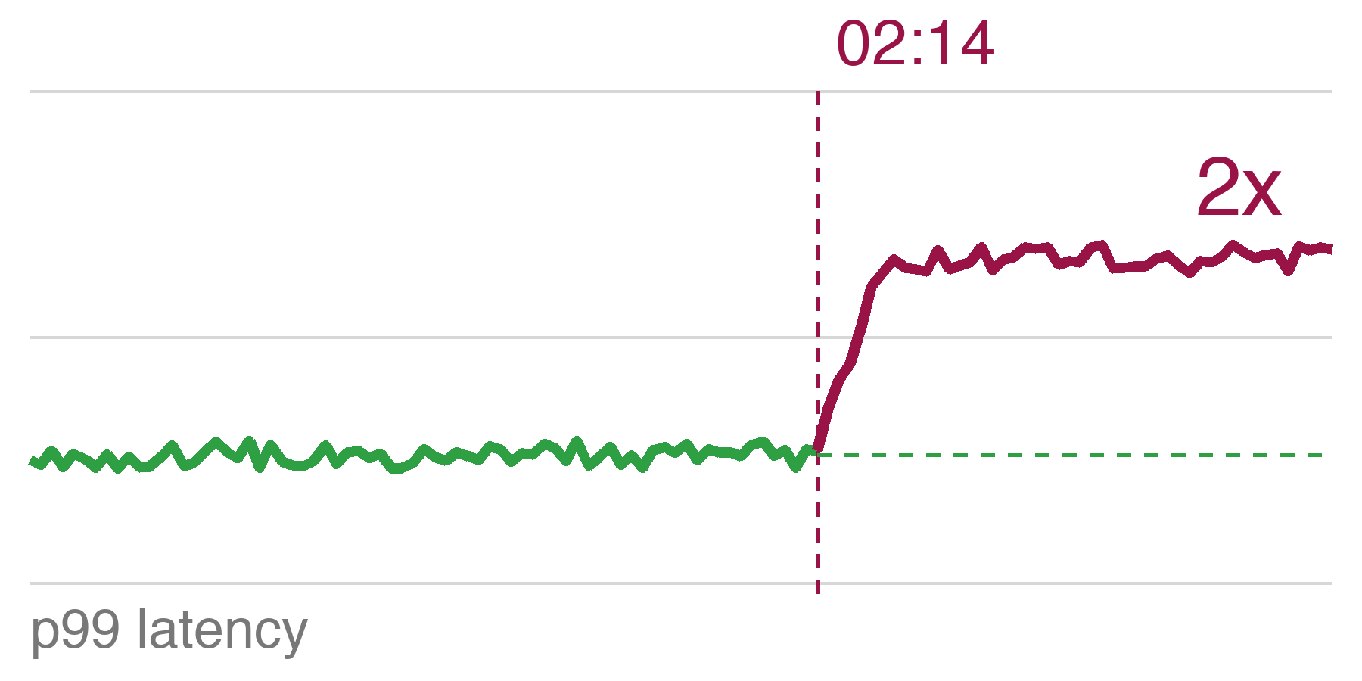
02:14. p99 doubles. Every GPU chart is green.
02:14
The model is healthy.
The pods are Ready.
Nothing is throttled.
Nobody knows why.
Every signal the hardware gives you says: busy and healthy.
Notes:
[1:00, 2:30] [Danilo] The incident. Open with it, not with architecture.
"It's 02:14. The page fires. The dashboard is green. Nobody knows why." Let the sparkline do the rest: flat, then the step change. Pause two seconds. "Utilisation 95%, flat for an hour. Memory 90%, flat since the pod started. Pods Ready, nothing throttled, no OOM, no restarts. Every signal the hardware gives you says busy and healthy. That is the black box we're going to open."
Next: same counter, opposite story.

Slide 4
Utilisation alone tells you nothing.
95%
our fleet at 02:14
looks saturated
~5%
industry average
looks idle
DCGM_FI_DEV_GPU_UTIL
On its own, this number says nothing about the inference work.
Industry average production GPU utilisation ~5%: Cast AI, State of GPU utilisation 2026 (cast.ai/blog/fractional-gpu-kubernetes)
Notes:
[2:30, 3:00] [Danilo] The hook, 30 seconds.
"Here's the thing about that 95%. Across the industry the average production GPU runs at about 5% utilisation. Same counter, DCGM_FI_DEV_GPU_UTIL. One fleet looks saturated, the other looks idle. And neither number tells you anything about the inference work." Point at the counter name. "This talk is about where the signal actually lives, because it isn't here."
Next: section two, why GPU metrics lie for inference. Slides 5 to 8, four minutes. Henrique takes this section.

Slide 5
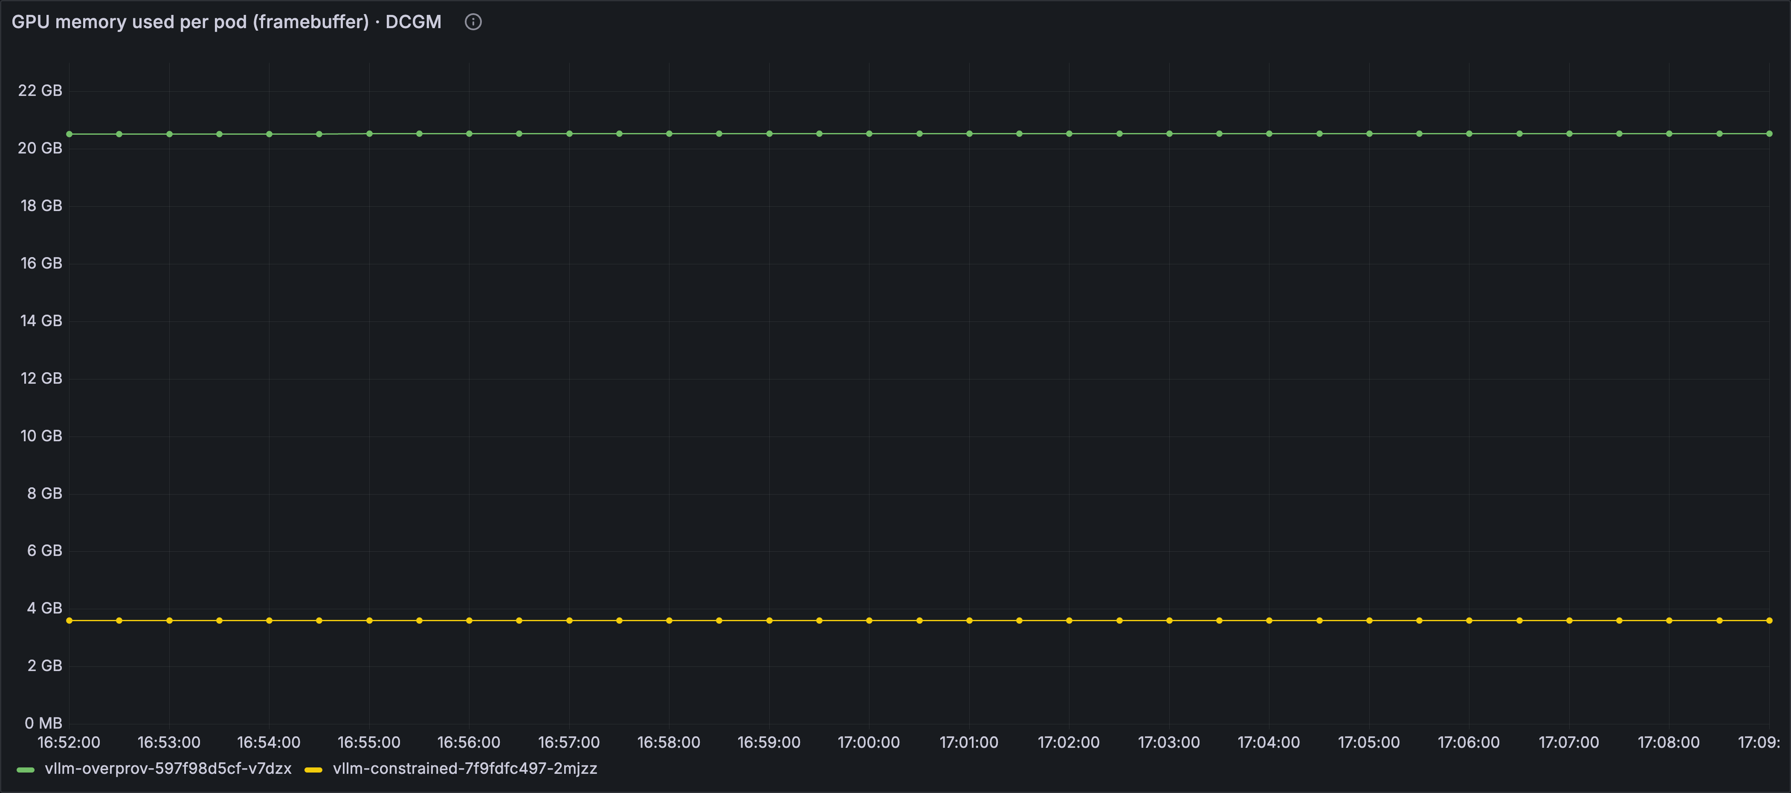
Memory usage is a config value, not a warning.
20.5 GB, flat
gpu-mem-util 0.90
3.6 GB, flat
gpu-mem-util 0.15
DCGM_FI_DEV_FB_USED
Sized once at start-up. Flat forever, including the one about to fall over.
Live rig, Oct 6 2026: two vLLM pods, facebook/opt-125m, EKS Auto Mode, g5.xlarge (A10G 24 GB).
Notes:
[3:00, 4:00] [Henrique] Pre-allocation. The screenshot is from our rig.
"Every serious LLM server grabs its GPU memory before the first request arrives. vLLM calls it gpu-memory-utilization. It's a cap on the whole pool: weights, activation workspace, and the KV cache. On our tiny demo model the weights are small, so this is essentially the KV cache." Point at the two flat lines. "Two vLLM pods, same model. One at 0.90, 20.5 gigabytes. One at 0.15, 3.6 gigabytes. Both lines are perfectly flat, from start-up, through a saturating load, and after." Then the line that is not on the slide: "Which one is about to fall over? The small one. The counter says the opposite."
If asked why 0.90 of 24 is 20.5 and not 21.6: CUDA context and driver overhead.
Next: utilisation.

Slide 6
GPU util % cannot tell prefill from decode.
Prefill
Whole prompt in one pass.
Large matmuls. Compute-bound.
Tensor cores busy, memory bus quiet.
Decode
One token per step.
Re-reads the entire KV cache each step. Memory-bandwidth-bound.
Memory bus busy, tensor cores waiting.
GPU_UTIL 100%
GPU_UTIL 100%
DCGM_FI_DEV_GPU_UTIL
One busy thread reads as 100%. The counter has no idea which phase you are in.
DCGM_FI_DEV_GPU_UTIL (field 203) is NVML-polled: 'a kernel ran during the sample window'. The profiling fields on the next slide come from the GPU's hardware profiler.
Notes:
[4:00, 5:00] [Henrique] Utilisation and the two phases.
"GPU_UTIL has a precise meaning: at least one kernel was running during the sample window. One busy thread reads as 100%." Then the phases. "Inference has two phases with opposite shapes. Prefill: the whole prompt in one pass, big matrix multiplies, compute-bound, tensor cores busy. Decode: one token per step, and every step re-reads the entire KV cache, so it's memory-bandwidth-bound, tensor cores mostly waiting." Point at the two identical stamps. "Same number on both. The counter has no idea which phase you're in or how much of the silicon is doing anything."
Next: what the profiler counters say instead.

Slide 7
Three profiler counters, same second.
99.8%
GR_ENGINE_ACTIVE
the profiler's 'busy'
16.6%
PIPE_TENSOR_ACTIVE
tensor cores doing matmuls
80.4%
DRAM_ACTIVE
memory bus
Bandwidth-bound, not compute-saturated, and "utilisation" never said which.
The counter on your dashboard is the least informative one the hardware offers. Serving teams are borrowing MFU and MBU (model FLOPs and bandwidth utilisation) from the training world to say so.
Measured on vLLM by Elastic Observability Labs (2025): DCGM_FI_PROF_GR_ENGINE_ACTIVE 99.8%, PIPE_TENSOR_ACTIVE 16.6%, DRAM_ACTIVE 80.4%. MFU/MBU vocabulary: Lightbits, The Utilization Illusion.
Notes:
[5:00, 6:00] [Henrique] The Elastic numbers. Be precise about which field.
"These aren't our numbers, they're from Elastic Observability Labs measuring a vLLM server, and they used the DCGM profiling fields, not the NVML utilisation counter." Left to right. "Graphics engine active 99.8%: that's the profiler's version of busy. Tensor cores, the units doing the actual matmuls: 16.6%. Memory bus: 80.4%. The card is not computing. It's waiting on memory." Pause. "Bandwidth-bound, not compute-saturated, and utilisation never said which. If you needed more throughput here you'd quantize before you bought hardware." Last line, lightly: "Serving teams are starting to borrow MFU and MBU from the training world, model FLOPs and bandwidth utilisation, precisely because the dashboard counter is the least informative one the hardware offers."
Next: the vocabulary slide.

Slide 8
Counters that lie, counters you can trust.
Misleading on an inference server
Meaningful
DCGM_FI_DEV_GPU_UTIL
any kernel = busy
DCGM_FI_PROF_SM_ACTIVE
share of SMs doing work
DCGM_FI_PROF_SM_OCCUPANCY
resident warps / SM maximum
DCGM_FI_DEV_FB_USED
pre-allocated, flat
DCGM_FI_PROF_DRAM_ACTIVE
bandwidth-bound?
nvidia-smi Volatile GPU-Util
same as GPU_UTIL
DCGM_FI_PROF_PIPE_TENSOR_ACTIVE
tensor cores in use
And none of them know what a token is.
Queue depth, KV cache pressure, tokens per second. The serving framework owns those, the silicon doesn't.
DCGM field IDs: docs.nvidia.com/datacenter/dcgm. PROF_* fields need a profiling-capable GPU and DCGM >= 2.x. SM_OCCUPANCY is a ratio: resident warps over the SM maximum.
Notes:
[6:00, 7:00] [Henrique] Vocabulary slide, the one people photograph. Don't read every row.
"Left: what most GPU dashboards show. GPU_UTIL, framebuffer used, and nvidia-smi's Volatile GPU-Util which is the same thing. Right: what actually describes the work. SM_ACTIVE, how much of the compute is busy. SM_OCCUPANCY, what share of the warps an SM can hold are actually resident. DRAM_ACTIVE, are you bandwidth-bound. PIPE_TENSOR_ACTIVE, are the tensor cores doing matmuls." Then the punchline, slowly: "And none of them know what a token is. Queue depth, KV cache pressure, tokens per second. The serving framework owns those. The silicon doesn't."
Hand back to Danilo.
Next: section three, the one architectural idea.

Slide 9
The pod is the join key.
DCGM
dcgm-exporter --kubernetes
exported_pod
Serving log
Fluent Bit kubernetes filter
pod_name
Traces
OTel Collector k8sattributes
k8s.pod.name
pod_name
WHERE pod_name = $pod
Stamp it on every metric, log record and span. Join at query time. Nothing else is common to all three.
K8s 1.35: Dynamic Resource Allocation is stable; dcgm-exporter 4.8.4 adds pod_uid and ResourceSlice mapping because the device-plugin mapping breaks under DRA. Same join key, new plumbing.
Notes:
[7:00, 8:00] [Danilo] The join key. If they take one idea home, this is it.
"Three sources that never heard of each other. DCGM knows which pod holds the GPU, because dcgm-exporter asks the kubelet. Fluent Bit knows which pod wrote the log line, because the kubernetes filter tells it. The OTel Collector stamps k8s.pod.name on every span. Nothing else is common to all three." Click: the pill appears. "Same string, three places." Click: the WHERE clause appears. "And that is the join, one predicate at query time. That's the whole architecture."
Footnote only if the room is on new clusters: "Kubernetes 1.35 made Dynamic Resource Allocation stable, and dcgm-exporter 4.8.4 added pod_uid tracking because the old device-plugin mapping breaks under DRA. The idea survives, the plumbing changes."
Next: signal one.

Slide 10
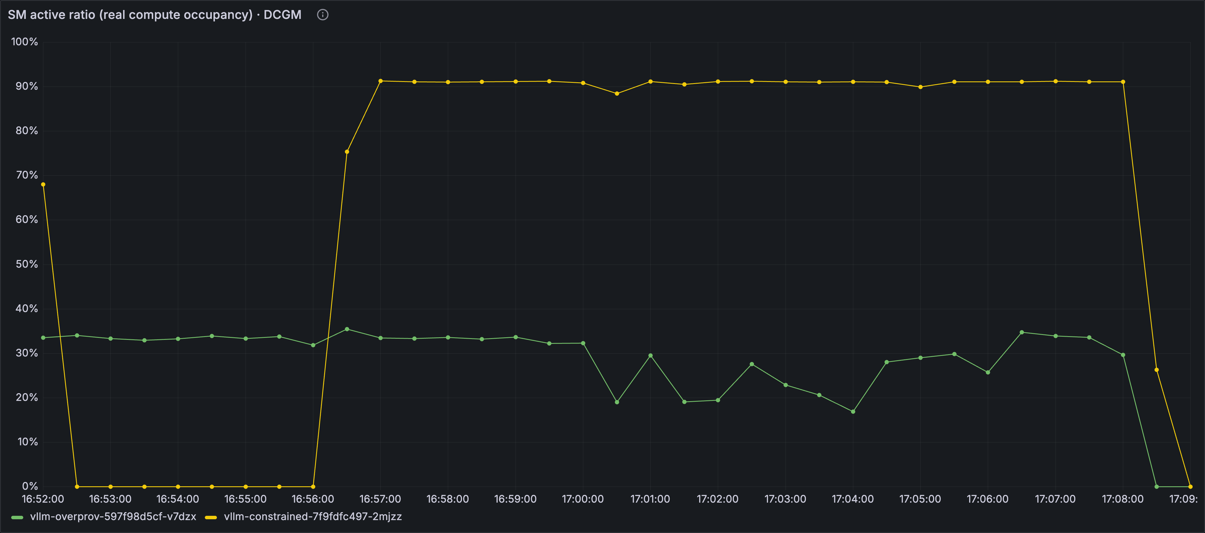
Signal 1: DCGM, per pod.
What it tells you
Which pod holds which GPU
Whether the silicon is busy (SM_ACTIVE, DRAM_ACTIVE)
Power, temperature, pool size
SM active, per pod
What it has no idea about
Why the GPU is busy
How many requests are queued
Whether the KV cache is full
Anything about tokens
--kubernetes=true asks the kubelet who owns each GPU
ENABLE_POD_LABELS=false keep the join key, nothing else (next slide)
dcgm-exporter --kubernetes reads /var/lib/kubelet/pod-resources. EKS Auto Mode: standalone dcgm-exporter, not the GPU Operator (slide 18).
Notes:
[8:00, 8:45] [Danilo] Signal 1, DCGM per pod. Keep it short, the audience knows exporters.
"dcgm-exporter in Kubernetes mode. --kubernetes=true asks the kubelet which pod owns each GPU and stamps exported_pod on every counter. That's the screenshot: SM active, per pod, during our demo." Right side: "It tells you which pod is on which GPU and whether that silicon is busy. It has no idea why, how many requests are queued, whether the KV cache is full, or anything about tokens." Point at the second config line: "ENABLE_POD_LABELS false. That one matters, next slide."
On EKS Auto Mode you run it standalone as a DaemonSet with the pod-resources hostPath; the GPU Operator isn't supported there, we'll come back to that.
Next: cardinality.

Slide 11
Keep the join key. Drop every other label.
1,000 nodes x 8 GPUs x 60 counters x 3 labels
pod_name
= 1.4M series
x every rollout
before a single pod or job label. Every label you add multiplies by pod churn.
series, per label
Identity
on logs
Stable dimensions
on metrics
Join
at query time
ENABLE_POD_LABELS=true is how you find out.
Series math: Last9, 10,000 GPUs, one TSDB (last9.io/blog/10-000-gpus-one-tsdb-cardinality-at-gpu-scale). Our rig: 7 counters, pod labels off, exported_pod is the only identity.
Notes:
[8:45, 9:30] [Danilo] Cardinality. War story one.
"The first thing we broke was Prometheus. dcgm-exporter will happily copy every pod label onto every counter. Do the arithmetic at fleet scale: a thousand nodes, eight GPUs each, the default sixty-odd counters, three label dimensions." Click: the number lands. "1.4 million series, before a single pod or job label." Point at the dot cloud: "And pod names churn on every rollout, so one label becomes a cloud of dead series." The rule: "Identity on logs. Stable dimensions on metrics. Join at query time. We ship seven counters and one identity label, and we join on the fixed part of the pod name, never the hash."
Next: section four, the centre of the talk, 9:30 to 16:30 for slides 12 to 15.

Slide 12
The log says six things the GPU can't.
vllm-overprov, steady load
4,711 tok/s · 0 waiting · 0.1% KV cache
vllm-constrained, saturating load
17,227 tok/s · 116 waiting · 99.6% KV cache
tokens/s · running · waiting · KV cache % · prefix hits · preemptions
Six facts about the inference work, and not one of them shows up in a GPU counter.
vLLM V1 engine, vllm/v1/metrics/loggers.py: one stats line every 10 s while the engine is busy (DEBUG level when idle). Numbers from the live rig.
Notes:
[9:30, 10:45] [Danilo] The log line. Read it aloud, it is not on the slide.
"This is one line of vLLM stdout. It prints every ten seconds while the engine is busy." Read the raw line for the over-provisioned pod from memory, then point at the grey row: "4,700 tokens a second, nothing waiting, cache at 0.1%." Click: the red row appears. "Constrained pod, same model, same second: 17,000 tokens a second, 116 waiting, cache at 99.6%, and a Preemptions field that only shows up once the scheduler starts evicting work." Then: "Six facts about the inference work, and not one of them shows up in a GPU counter."
Next: how five lines of Lua turn that into metrics.

Slide 13
Fifteen lines of Lua. The pod name rides along.
tail
container log
kubernetes
+ pod_name
lua
5 x string.match
grep
stats lines only
log_to_metrics
fields -> gauges
prometheus_exporter
:2021
pod_name rides along from the kubernetes filter onward: the join key
For serving engines without a /metrics endpoint. vLLM exposes most of this natively; same pipeline, different regex.
Fluent Bit 5.1. Full filter and pipeline config in the repo. vLLM native metrics: docs.vllm.ai/en/latest/design/metrics
Notes:
[10:45, 12:15] [Danilo] The Lua pipeline. Diagram only, the code is in the repo.
"Fluent Bit tails the log, the kubernetes filter attaches the pod name, that's the join key arriving. Five Lua matches turn fields into numbers. grep keeps only stats lines. log_to_metrics makes gauges, labelled by pod. prometheus_exporter serves them on port 2021, to the same Prometheus that scrapes DCGM." Point along the dots: "The pod name rides along the whole way."
The caveat, say it before someone asks: "vLLM already exposes most of this on /metrics, kv_cache_usage_perc, num_requests_waiting, request_queue_time_seconds. vLLM is our demo vehicle. This filter is for the servers that don't: custom servers, vendor images you can't touch, log-only pipelines, the TGI or Triton you inherited. Same lines, different regex."
Next: live demo set-up. Henrique drives Grafana, Danilo narrates.

Slide 14
Live: two pods, one is about to run out.
vllm-constrained
gpu-mem-util 0.15, 3.6 GB
gets the saturating load
vllm-overprov
gpu-mem-util 0.90, 20.5 GB
steady load, the control
facebook/opt-125m on both · long prompts, concurrency 128, 12 minutes
Watch two rows.
Row 1, DCGM: GPU memory stays flat. Row 2, the log: KV cache and waiting take off.
Notes:
[12:15, 13:00] [Danilo narrates, Henrique drives] Demo signpost, then live demo 13:00 to 16:00.
Nothing is typed live. The loadgen has been running since before the talk, both port-forwards verified at T-5.
Danilo, on this slide: "Two pods, same model, facebook/opt-125m. vllm-constrained at 0.15, 3.6 gigabytes of pool, gets long prompts at concurrency 128. vllm-overprov at 0.90, 20.5 gigabytes, steady load, that's our control." Then the instruction: "Watch two rows. Row one is DCGM: GPU memory is going to stay flat. Row two is what the log knows: KV cache and waiting are going to take off."
Live demo, 13:00 to 16:00. Henrique drives, Danilo narrates, one tab at a time.
1. Grafana, three rows, the constrained pod selected. Danilo walks them down: GPU memory flat, KV cache climbing to 100%, queue time p95 moving from 0.3 seconds to 4.8 seconds. Be honest out loud: GPU_UTIL and SM_ACTIVE did go up, DCGM does say busy, it just cannot say why.
2. Henrique switches to the pre-opened Jaeger trace, already expanded, no searching on stage. Danilo: one llm_request span, 5.73 seconds, time in queue 0.61, time in decode 5.33, and the pod name on the span.
3. Henrique switches back to Grafana for the aligned spike. Danilo: "Same pod name, same second, three sources."
If the live rig misbehaves: stop, flip to slide 15 and narrate the captured panels. Do not debug on stage. Hard stop 16:30 either way.
Next: back to slides, the result slide.

Slide 15
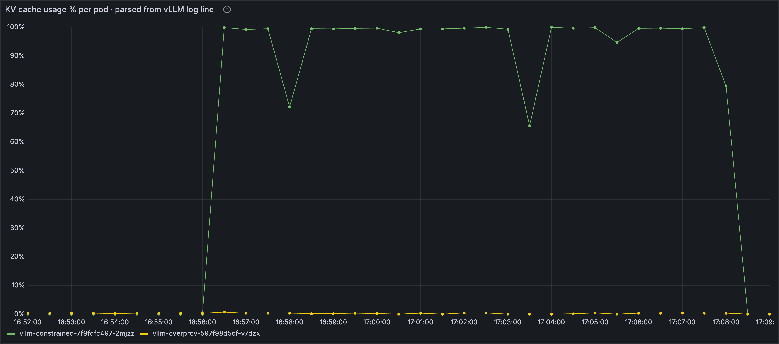
KV cache 100%. Memory counter: unchanged.
100%
KV cache, constrained pod
3.6 GB before, 3.6 GB after
DCGM: GPU memory used
The log: KV cache usage, per pod
4.8 s
p95 queue time, was 0.3 s
~100
requests waiting
0.2%
KV cache, over-prov pod
90%
SM_ACTIVE: busy, but blind
Queue time first. Waiting confirms. GPU memory never moved.
Rig numbers, Oct 6 2026 16:56 to 17:08. Queue time rises before 'waiting' is visibly non-zero: Elastic Observability Labs, tuning vLLM Prometheus metrics (2025).
Notes:
[16:00, 16:30] [Danilo] Demo result. Recap, or fallback if the live demo failed.
"Left, DCGM: GPU memory, 3.6 gigabytes before, during and after. Right, the log: KV cache goes to 100% within a minute of the load and stays there." The four numbers: "p95 queue time 4.8 seconds, was 0.3. About 100 requests waiting. The over-provisioned pod has 99.8% of its cache free the whole time. And SM_ACTIVE at 90%, because DCGM did say busy, it just could not say why." Close: "Queue time moves first. Waiting confirms. GPU memory never moved."
Next: section five, traces. Henrique.

Slide 16
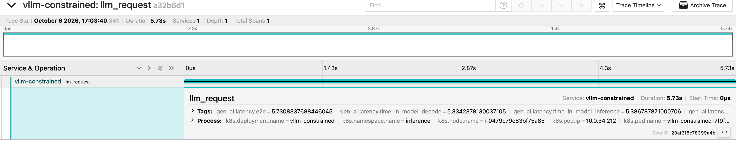
Signal 3: a slow span with a pod name.
llm_request 5.73 s
KV cache this second: 99.6%
k8s.pod.name
vllm-constrained-7f9fdfc497-2mjzz
gen_ai.latency.time_in_queue
0.61 s
gen_ai.latency.time_in_model_decode
5.33 s
--otlp-traces-endpoint=grpc://otel-collector.observability:4317 plus k8sattributes on the Collector. That is the whole wiring.
A slow span by itself is just a fact. The same span on the pod whose KV cache hit 100% that second is a diagnosis.
vLLM --otlp-traces-endpoint -> OTel Collector (k8sattributes) -> Jaeger. Tracing was removed in the V1 rewrite and reinstated in vllm PR #20372: needs vLLM >= 0.10.2 (rig: 0.30). gen_ai.* attributes follow OTel GenAI semconv, status Development, names can still change.
Notes:
[16:30, 17:30] [Henrique] Signal 3, traces.
"vLLM emits one span per request natively. You point it at the OTel Collector with --otlp-traces-endpoint. The k8sattributes processor looks up the source IP and stamps k8s.pod.name on every span. That's the whole wiring." The screenshot: "An llm_request span, 5.73 seconds, on vllm-constrained, during the saturation. Time in queue 0.61 seconds, time in decode 5.33." Point at the red chip: "A slow span by itself is just a fact. The same span, on the pod whose KV cache hit 99.6% that second, is a diagnosis."
Gotcha, say it out loud: "Tracing disappeared in the vLLM V1 engine rewrite and came back in PR 20372, so you need 0.10.2 or later. We run 0.30. If your traces vanished after an upgrade, that's why."
Honesty line: "We show traces from the serving path, one span per request. Multi-hop waterfalls across a gateway are a flag away, but they're not the point today." Footer, only if asked: the gen_ai attributes follow the OTel GenAI semantic conventions, still at Development status, so the names can change.
Next: the join, the slide the whole talk builds to. Danilo.

Slide 17
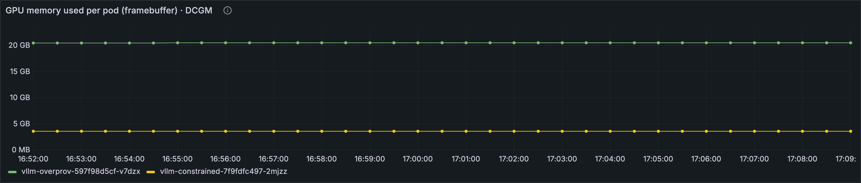
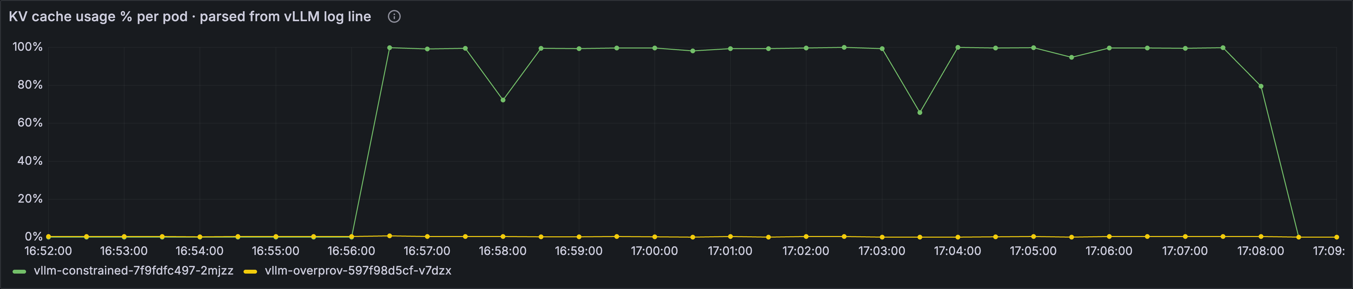
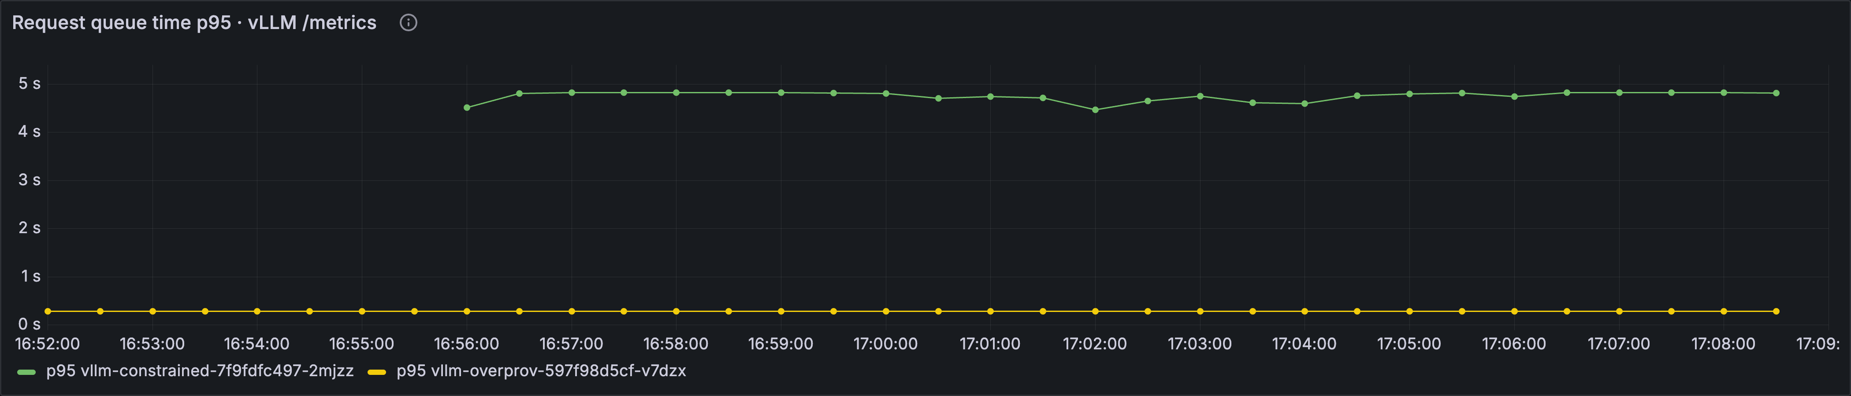
Same pod name. Three sources. One row.
16:56 load hits
flat
DCGM memory
100%
KV cache (log)
0.3 s to 4.8 s
queue time p95 (/metrics)
Opened.
No new agent, no vendor, no eBPF. Just the pod name on every signal.
Grafana dashboard uid gpu-inference-obs, variable $pod matches exported_pod (DCGM), pod_name (Fluent Bit) and pod (vLLM, traces). Constrained pod, 16:52 to 17:09.
Notes:
[17:30, 19:30] [Danilo] The join. Slow down here. Two minutes on one slide is fine.
"One Grafana dashboard. One pod variable. Three data sources that never heard of each other: DCGM through exported_pod, Fluent Bit through pod_name, vLLM and the traces through pod." Point at the red line: "Right there, where the line jumps, the load hits. Top row, DCGM memory: flat. Middle row, KV cache from the log line: pegs at 100%. Bottom row, queue time from vLLM: 0.3 to 4.8 seconds. Same second, same pod name." Pause. "The incident from slide three is this picture." Click: the word appears. "Opened." Close: "No new agent, no vendor, no eBPF. Just the pod name on every signal, and the discipline to keep it there."
Next: one thing that broke. Henrique.

Slide 18
What silently broke along the way.
What we expected
Every DCGM how-to assumes the GPU Operator. Check your platform's driver model before you follow one.
What happened
EKS Auto Mode supports neither the GPU Operator nor the NVIDIA DRA driver. Drivers and device plugin ship with the AMI.
Fix
Standalone dcgm-exporter DaemonSet, pod-resources hostPath, SYS_ADMIN. Seven counters.
GPU Operator
Also in the repo: Fluent Bit Kube_Tag_Prefix must match the tail tag or the join key arrives empty; a 1-GPU pod on a 2-GPU NodePool never finishes a RollingUpdate, use Recreate.
EKS Auto Mode GPU support: docs.aws.amazon.com/eks/latest/userguide/device-management-nvidia-dra-device-plugin.html. Two more gotchas (Fluent Bit Kube_Tag_Prefix, 1-GPU RollingUpdate) in the repo README.
Notes:
[19:30, 19:50] [Henrique] One gotcha, 20 seconds. Cut this slide first if running late.
"Every DCGM how-to assumes the NVIDIA GPU Operator, so check your platform's driver model before you follow one. EKS Auto Mode ships the drivers and the device plugin on its GPU AMIs and supports neither the Operator nor the NVIDIA DRA driver. So: standalone dcgm-exporter DaemonSet, pod-resources hostPath, SYS_ADMIN capability, seven counters." One breath on the grey line: "Two more in the repo README: Fluent Bit's Kube_Tag_Prefix has to match the tail tag exactly or the pod name silently never arrives, and a one-GPU pod on a two-GPU NodePool never finishes a RollingUpdate, use Recreate."
Next: where this is going. Danilo.

Slide 19
The join key is moving into the router.
Today: join in Grafana
one pod, one request
PromQL on pod_name
Next: join key = request id + pod
prefill and decode on different pods
llm-d, NVIDIA Dynamo
Then: router consumes the join
routes on queue depth and KV cache
Gateway API Inference Extension
join key
llm-d on AWS: aws.amazon.com/blogs/machine-learning/introducing-disaggregated-inference-on-aws-powered-by-llm-d. Gateway API Inference Extension: github.com/kubernetes-sigs/gateway-api-inference-extension.
Notes:
[19:50, 20:30] [Danilo] Where this is going, 40 seconds. Pre-empts "isn't this solved".
Left to right, vendor-neutral first: "Today the join happens in Grafana. Next, disaggregated serving splits one request across two pods, llm-d and NVIDIA Dynamo, shipping the KV cache between them over NIXL and EFA, up to 70% more tokens per second at concurrency 128, so the join key becomes request id plus pod. Then the router itself consumes queue depth and KV cache to decide where traffic goes, the Gateway API Inference Extension endpoint picker and Dynamo's KV-aware router, and the join leaves Grafana entirely." Same shape on KServe, if that is your serving layer: the join key is still the pod.
One aside, said once, not shown: CloudWatch's OTel-native Container Insights for EKS, June this year, wires DCGM into OTel with pod labels out of the box, so signal one is becoming a checkbox. Signals two and three are still yours to wire.
If asked after: XID/ECC/thermal faults, output quality, eBPF GPU profiling, Dynamo internals are all out of scope today.
Next: takeaways.

Slide 20
Steal this for your cluster.
3 counters
1 filter
1 rule
DCGM_FI_PROF_SM_ACTIVE
instead of GPU_UTIL
15 lines of Lua
+ log_to_metrics
pod name
on every signal
KV cache %
log or /metrics
change the regex
keep the pipeline
identity on logs
stable dimensions on metrics
queue time p95
then waiting
works for
TGI, Triton, anything that logs
join
at query time
0 new agents
Reproduced clean-room on EKS Auto Mode; all configs in the repo.
Notes:
[20:30, 21:00] [Danilo and Henrique] Steal this, 30 seconds. One column each, read the headers, not every box.
Danilo: "Three counters: SM_ACTIVE instead of GPU_UTIL, KV cache percent, queue time p95 then waiting." Henrique: "One filter: fifteen lines of Lua, change the regex, keep the pipeline." Danilo: "One rule: pod name on every signal, join at query time." Point at the badge: "Zero new agents." Then the payoff: "Everything in this talk is in the repo on the next slide, with the Terraform, the Lua, the dashboard and a validate script."
Next: thank you and Q&A.

Slide 21
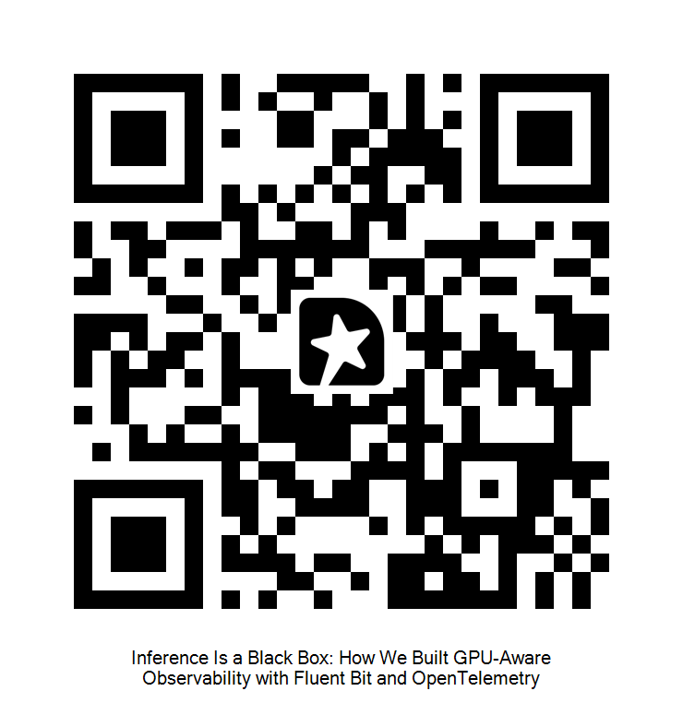
Thank you.
github.com/danilosilvase/
gpu-observability-kubecon-na-2026
Danilo Souza, AWS Professional Services
Henrique Santana, AWS
Scan to rate this session.
Notes:
[21:00, 25:00] [Danilo and Henrique] Close and Q&A, four minutes.
"Thank you. The repo has the Terraform, the manifests, the Lua, the dashboard and the validate script. Please scan the QR to rate the session, the organisers read every one." Leave the QR up for the whole Q&A.
Likely questions and short answers:
- "Why not just scrape vLLM /metrics?" We do, row three of the dashboard. The filter is for servers that don't expose it. Slide 13.
- "MIG or time-slicing?" dcgm-exporter 4.5+ has per-process metrics, which narrows the gap but doesn't close it; the serving log still knows more.
- "SGLang / TGI field names?" Same technique, different regex. Verify against your log line before trusting it.
- "Hardware faults, XID, ECC?" A fourth signal class, real, out of scope today.
- "Cardinality numbers from your own rig?" Seven counters, one identity label; the 1.4M is the Last9 fleet math, cited on slide 11.
- "Disaggregated serving breaks the join?" Yes, slide 19: join key becomes request id plus pod.

